Slide 1


პროგრამული უზრუნველყოფის ინჟინერია
ლექცია 3

Slide 2
Welcome!
Today:
Testing
Java Generics

Slide 3
Validation
Formal reasoning or Verification
Code review
Testing
1 - 10 defects/kloc: Typical industry software.
0.1 - 1 defects/kloc: High-quality validation. Java libraries
0.01 - 0.1 defects/kloc: The very best, safety-critical validation. NASA

Slide 4
Why Testing is Hard?
Exhaustive testing is infeasible.
Sum of two integers has 2^64 test cases!
Haphazard testing Testing does not work
(“just try it and see if it works”)
Random or statistical testing doesn’t work well for software.

Slide 5
Test-First Programming
Test early and often!
Write a specification for the function.
Write tests that exercise the specification.
Write the actual code. Once your code passes the tests you wrote, you’re done.

Slide 6
Test Types
Black-box testing – test only public interfaces
White-box testing – test internals of classes
Boundary-value tests – test extreme situations
Acceptance testing – tests from customer’s viewpoint
Load tests – test tsability
Stress tests – go beyond load tests to know application limits.

Slide 7

Testing Strategy
Choose test cases by partitioning

Slide 8
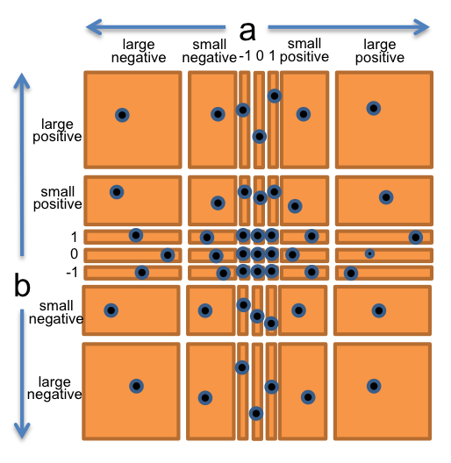
Testing Example
multiply : BigInteger × BigInteger → BigInteger
Black-box testing

Slide 9
Coverage
Statement coverage
is every statement run by some test case?
Branch coverage
for every if or while statement in the program, are both the true and the false direction taken by some test case?
Path coverage
is every possible combination of branches — every path through the program — taken by some test case?
A good code coverage tool for Eclipse is EclEmma

Slide 10
Unit Testing
Unit tests – test single unit of functionality
For each class or interface some unit tests
It’s good to use test-first style
Your code is high quality
You frame problems before work code
With UT it’s easy to make changes and experiment
Cost – 20%-50% more work. Think of it as investment.
UT types
Basic – for small to medium sized inputs
Advanced – complex cases
Edge – empty string, empty list, < instead <=
UT makes you act like a client

Slide 11
Using Generic Class
Before Java SE 5.0 generic programming in Java was always achieved with inheritance.
ArrayList example:
Public class ArrayList {
public Object get(int i) {….}
public void add(Object o) {….}
…
public Object[] elementData;
}
Problems:
A cast is necessary when you get values
No error checking when you add values

Slide 12
Using Generic Class
Generics offer better solution: type parameters
ArrayList<String> files = new ArrayList<String>();
You can not create ArrayList<int>, we use ArrayList<Integer> instead
Boxing/Unboxing
Unboxing does not work with == or !=
List<Integer>a,b;
a.get(0)==b.get(0) – compares pointers!

Slide 13
Our Generic Class
public class notFoo<T> {...
public claas Pair<T, U> {...
private T first;
<T extends Number> - a constraint about T
Pair class example
Generic Method:
public static <T> T getMiddle(T[] a){
return a[a.length/2];
}
double mid = class.getMiddle(3.14, 1234, 0); - error

Slide 14
Our Generic Class
The Virtual Machine does not have objects with generic types
The type variables are erased and replaced by their bounding types(or Object for variables without bounds)
Bridge methods are synthesized to perserve polymorphism
Casts are inserted as necessary to preserve type safety
Differens between C++ and Java generics in Java erasure turns Pair<String> and Pair<Integer> classes into raw Pair type.

Slide 15
Restrictions and Limitations
Pair<int> - can’t store int in Object
instanceof Pair<String> same as instanceof Pair
Pair<String> str;
Pair<Emploee> emp;
if(str.getClass()==emp.getClass()) //they are equal!
Pair<String>[] t = new Pair<String>[10]; - ArrayStoreException! – use ArrayList instead
There is no relationship between Pair<T> and Pair<S>
useful link on Generics

