Slide 1


პროგრამული უზრუნველყოფის ინჟინერია
ლექცია 8

Slide 2
Welcome!
Today:
Inner and Nested Classes
Views
View Tree
Listener Pattern

Slide 3
Inner and Nested Classes
An "inner" class is a class defined inside some other "outer" class
Examples: Iterator, binary tree nodes
The inner class operates like a sub-part of the outer class
The outer and inner classes can access each other's state, even if it is private
Calling "new" just anywhere will not work to create an inner object, because of the need for an outer object

Slide 4
Inner Class

Slide 5
Inner and Nested Classes
Inner Class Like Function Pointer
Collection example
Nested Class is static Inner Class

Slide 6
Anonymous Inner Class
Can implement a superclass or interface, just like a regular inner class
An anonymous inner class cannot have a constructor
An anonymous inner class does not have a name
Can see ivars of their outer object
Does not have access to local stack vars from where it is declared

Slide 7
Anonymous Inner Class

Slide 8
View
GUIs are composed of view objects
The view concept goes by different names
In Java Swing they are JComponent objects;
in HTML, they are elements or nodes;
widgets, controls, interactors…
View Tree
Views are arranged into a hierarchy of containment
child views are nested inside their parent’s bounding box.

Slide 9
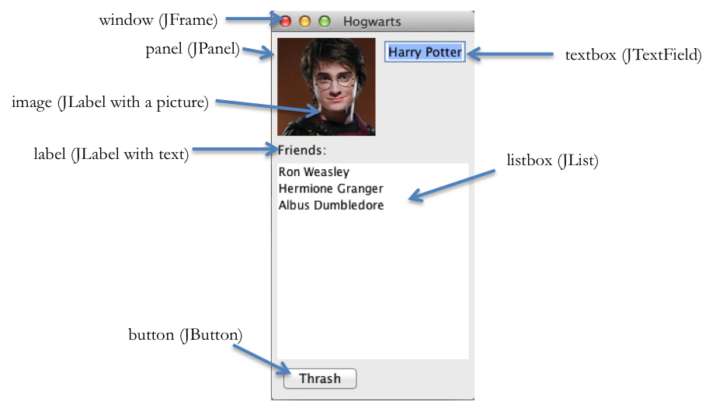
View Tree

Slide 10
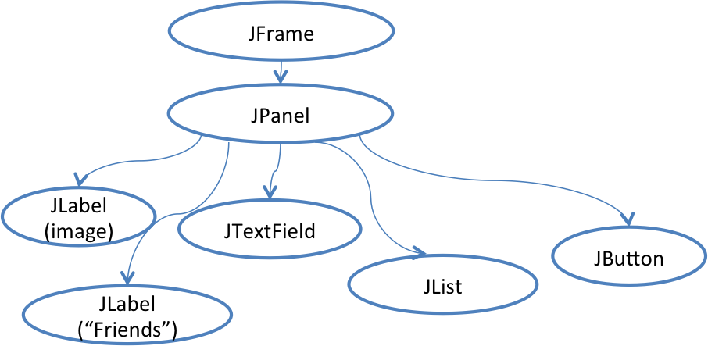
View Tree

Slide 11
View Tree Output
Views are responsible for displaying themselves
GUIs change their output by mutating the view tree.
In Java Swing,
every view in the tree has a paint()
The repaint process is driven by calling paint() on the root of the tree, which recursively calls paint() down through all the descendent nodes of the view tree.

Slide 12
View Tree Input
Views can have input handlers
the view tree controls how mouse and keyboard input is processed

Slide 13
View Tree Layout
The view tree controls how the views are laid out on the screen
An automatic layout algorithm automatically calculates positions and sizes of views.
Specialized containers (like JSplitPane, JScrollPane) do layout themselves.
More generic containers (JPanel, JFrame) delegate layout decisions to a layout manager (e.g. GroupLayout, BorderLayout, BoxLayout…).

Slide 14
View Tree Input Handling
while (true) {
read mouse click
if (clicked on Thrash button)
doThrash();
else if (clicked on textbox)
doPlaceCursor();
else if (clicked on a name in the listbox) doSelectItem();
...
}
not modular code
it mixes up responsibilities for button, listbox, and textbox

Slide 15
Listener Pattern
An event source generates a stream of discrete events, which correspond to state transitions in the source.
One or more listeners register interest (subscribe) to the stream of events, providing a function to be called when a new event occurs.
When an event occurs, the event source distributes it to all subscribed listeners, by calling their callback methods.

Slide 16
Control Flow
A top-level event loop reads input from mouse and keyboard.
In Java Swing this loop is hidden from you.
For each input event, it finds the right view in the tree and sends the event to that view’s listeners.
Each listener does its thing and then returns immediately to the event loop.

Slide 17
Listener Pattern
Many GUI objects generate their own higher-level events,
JButton sends an action event when it is pressed
JList sends a selection event when the selected element changes
JTextField sends change events when the text inside it changes for any reason
A button can be pressed either by the mouse or by the keyboard So you should always listen for these high-level events
Use an ActionListener to respond to a JButton press, not a mouse listener.

