Slide 1
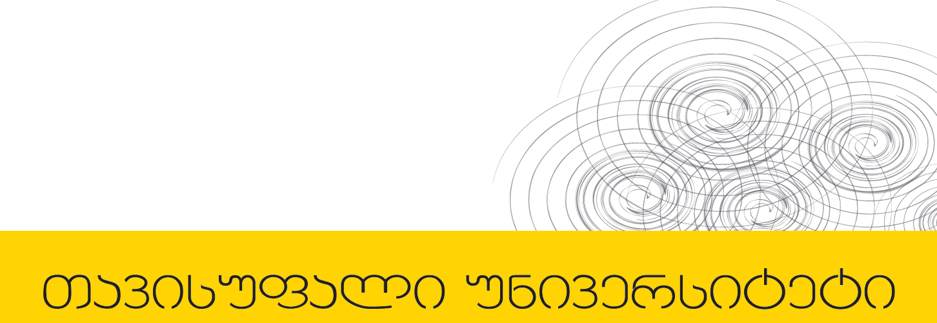

პროგრამული უზრუნველყოფის ინჟინერია
ლექცია 9

Slide 2
Welcome!
Today:
Listener Pattern
Adapter Classes
MVC
Swing Table classes

Slide 3
Event Handling Basics!
Event Object evt
Event Listener
Event Source
Any objects of class that implements an appropriate listener interface
class Listener implements
ActionListener {
…
actionPerformed(Event evt) {…}
}
Has to register its own listeners
Source.addActionListener(Listener)

Slide 4
Example
A button that beeps when clicked

Slide 5
Adapter Classes
Illustrate the concept of Adapter classes using WindowEvents
We can terminate program when a window is closed using setDefaultCloseOperation(JFrame.EXIT_ON_CLOSE);
Let’s try to fix it.
When user tries to close window, FirstFrame object (window) generates a WindowEvent object.
Create a listener object that listens for WindowEvent and terminates the program when user closes the window.
The object must belong to a class (call it Teminator) that implements the WindowListener Interface.

Slide 6
Adapter Classes

Slide 7
Adapter Classes
Keying in code for six do-nothing method is tedious.
Java provides companion adapter class for each AWT listener interface that has more than one method.
The adapter class implements all methods to do nothing.
We can extend the adapter by refining only methods that correspond to interesting events.

Slide 8
Adapter Classes
The adaptor for WindowListener interface is called WindowAdaptor.
Using the adapter, we can rewrite Terminator class as follows:
class Terminator extends WindowAdapter
{
public void windowClosing(WindowEvent e)
{
System.exit(0);
}
}

Slide 9
MVC
User interface logic tends to change more frequently than business logic
In some cases, the application displays the same data in different ways
Designing visually appealing and efficient HTML pages generally requires a different skill set than does developing complex business logic.
User interface code tends to be more device-dependent than business logic
Creating automated tests for user interfaces is generally more difficult than for business logic.

Slide 10
MVC
Model-View-Controller pattern has separation of concerns as its primary goal.
It separates front end from the backend
Separates input from output

Slide 11
MVC Models
provide app data
are often mutable
provide methods for changing state
preserve rep invariants!
notify clients when there is a change
dependent view can update display
dependent controllers can respond
Using listener pattern

Slide 12
MVC Views
responsible for output
occupy some chunk of the screen
query model for data and show data on screen
listen for changes of the model

Slide 13
MVC Controllers
handle the input
receive keyboard and mouse events
instruct model to change accordingly

Slide 14
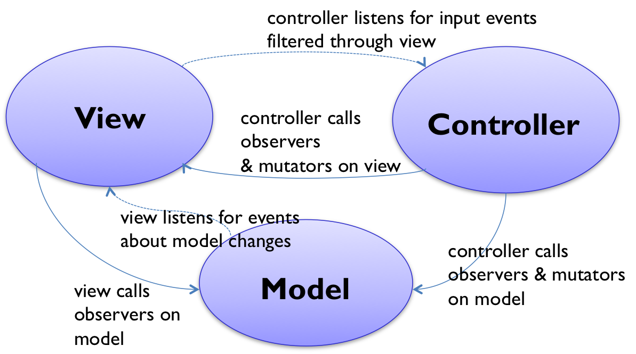
MVC
Notes:
აქტიური და პასიური მოდელი

Slide 15
MVC
Benefits
Supports multiple views. User interface can display multiple views of the same data at the same time.
Accommodates change. Users may prefer different colors, screen layouts, and levels of support for new devices such as cell phones or PDAs.
Liabilities
Complexity. The MVC pattern introduces new levels of indirection and therefore increases the complexity of the solution slightly.
Cost of frequent updates. If the model undergoes frequent changes, it could flood the views with update requests.

Slide 16
Swing Table Classes
Jtable - View Component
Has a pointer to a TableModel that does its storage
Has all sorts of built-in features to display tabular data
TableModel – Interface
The messages that define a table model, the abstraction is a rectangular area of cells.
getValueAt(), setValueAt(), getRowCount(), getColumnCount(), ...
The table model establishes a co-ordinate system: 0..getRowCount()-1, 0..getColumnCount()-1. The model and the view(s) all use this model coordinate system to identify rows and columns.

Slide 17
Swing Table Classes
TableModelListener – Interface
Defines the one method tableChanged(TableModelEvent e)
The TableModelEvent object indicates specifically what sort of change it was -- row add, row delete, cell updated, ...
If you want to listen to a TableModel to hear about its changes, implement this interface.

Slide 18
Swing Table Classes
AbstractTableModel
Implements some TableModel utility behavior.
Provides helper utilities - addTableModelListener(), removeTableModelListener()
fireXXXChanged() convenience methods
These iterate over the listeners and send the appropriate notification like
fireTableCellUpdated(row, col), fireTableRowDeleted(row)
getRowCount(), getColumnCount(), and getValueAt() are abstract -- they must be provided by a subclass table model that actually stores data.

Slide 19
Swing Table Classes
DefaultTableModel
A built-in Swing implementation of TableModel
Extends AbstractTableModel
Uses Vector for its implementation (Vector is what Java had before ArrayList), so it's a little old

Slide 20
Swing Table Classes
BasicTableModel Code Points
A complete implementation of TableModel using ArrayList
getValueAt() pulls data out of the ArrayList of ArrayList implementation
setValueAt() changes the data model and uses fireTableXXX to notify the listeners
AbstractTableModel
Has routine code in it to manage listeners -- add and remove.
Has fireTableXXX() methods that notify the listeners -- BasicTableModel uses these to tell the listeners about changes.

