Slide 1

Environment
Name:V.Vashmitha
Department:AIML

Slide 2
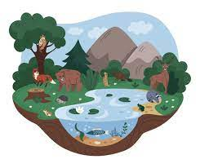
Environment
Environment= Natural +
Living Beings +
Non Living Things

Slide 3


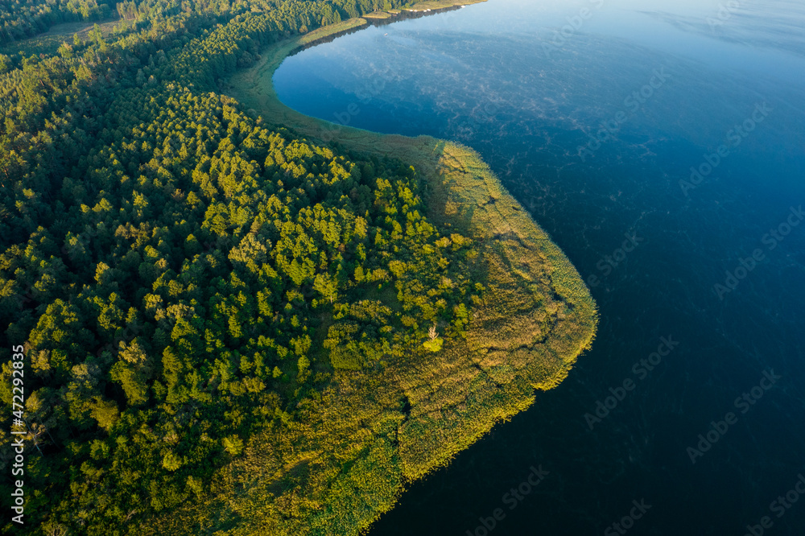

Types of Environment
Natural Environment
Ex: air,water,land,climate.
Human Made Environment
Ex: like buildings,roads,industries.
Social Environment
Ex: like culturals,tradition and institutions.

Slide 4
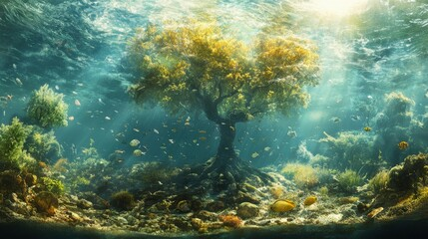
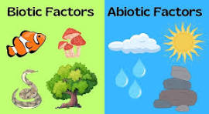
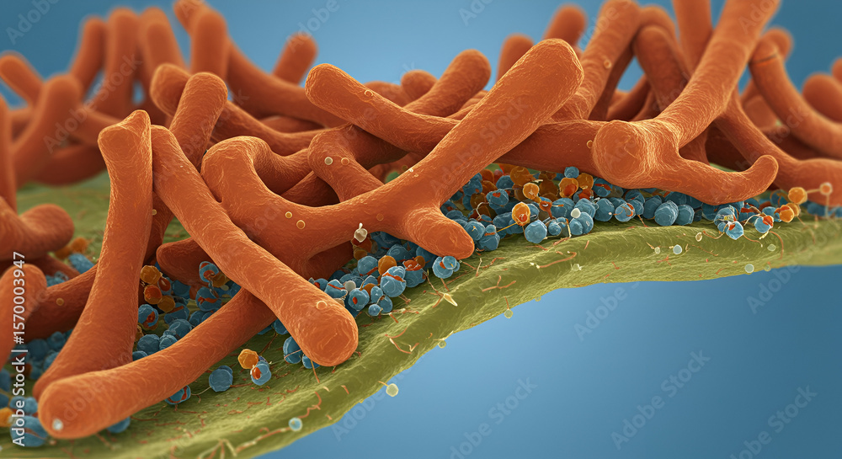
Components Of Environment
Abiotic components
Air,water,soil,sunlight and temperature etc...
Biotic components
plants,animals,human and microorganism etc...

Slide 5
Importance of Environment
Maintain ecological balance.
Supply raw material for industries.
Supports biodiversity and life system.
Plays a important role in climate regulation and natural cycle.

Slide 6

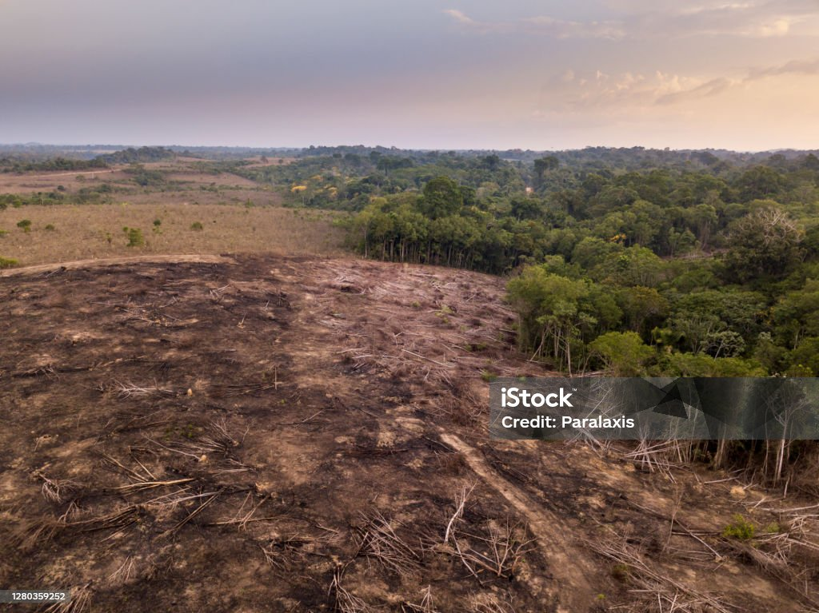
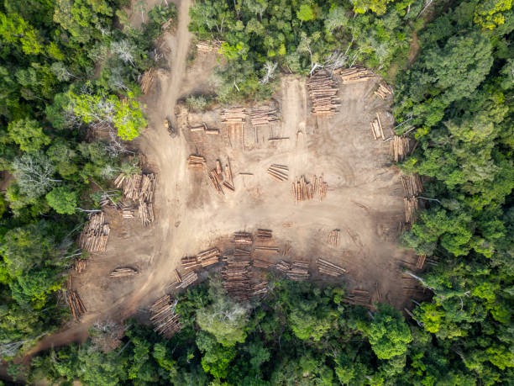

Human Impacts of Environment
Positive Impacts:
Afforestation, renewable energy,conservation.
Negative Impacts:
Defforestatiob,pollution,global warming and over population.

Slide 7

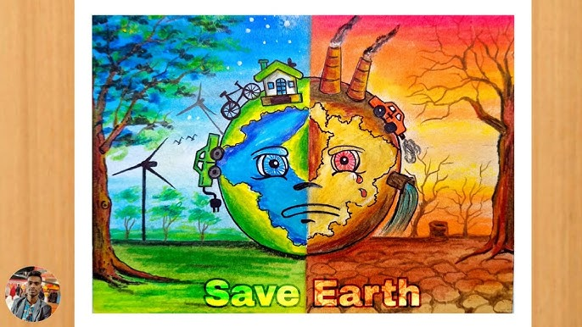
Conclusion:
The environment is the foundation of life on earth. It connects all living and non living things in a delicate balance . Protection and conserving it is essential for present and future generations.

Slide 8
THANK YOU

