Slide 1
AI HACK DAY 2025
Problem Statement : Design a content generator that automatically converts educational books, articles, or research papers into narrated video summaries in local languages.
Domain : Video
Sub-Domain : AI for Content Creation in Local Languages
Team Name : AGI
Team Leader Name : Mohammed Kalam Khan
Member Details :
Rollno : 22261A0565 Name: Abdul Hai Contact : 7386036431
Rollno : 22261A0597 Name : Muhammad Saadullah Contact : 7095042644
Rollno : 22261A05A4 Name : Mohammed Kalam Khan Contact : 8374228026

Slide 2
Content Generator AI
AGI
Proposed Solution – Content Generator AI
A Streamlit-based AI assistant that takes educational content (PDFs or questions) and auto-generates explainer videos in regional languages. It uses Gemini for script generation, gTTS for narration, TranslatePy for localization, and Manim for animation.
Problem Solved: Eliminates manual effort in creating educational videos and makes content accessible in local languages.
Innovation & Uniqueness:
Fully automated end-to-end content-to-video pipeline
AI-generated Manim code for dynamic visual explanation
Regional language narration via real-time TTS
Modular, scalable architecture using LangGraph

Slide 3
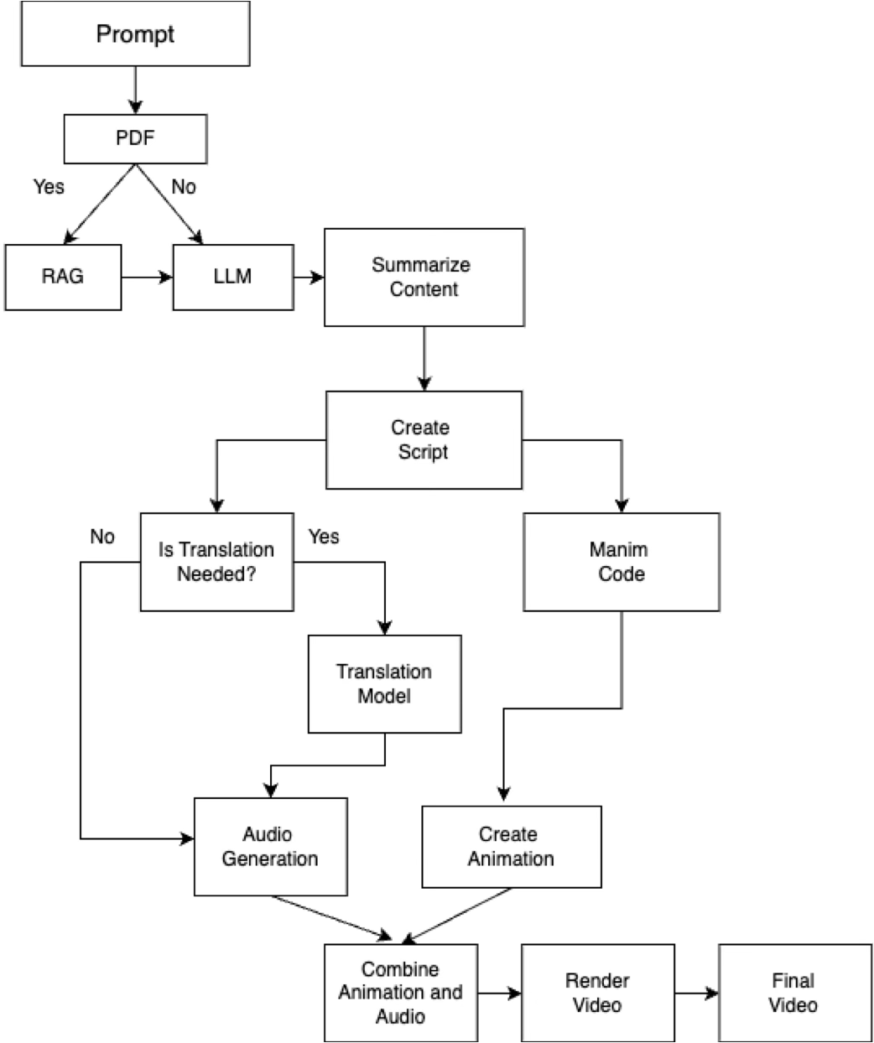
TECHNICAL APPROACH
AGI
Languages: Python
Frameworks & Tools:
LangGraph – tool orchestration
Streamlit – user interface
Manim – animation generation
Gemini API – LLM for script and code
TranslatePy – language translation
gTTS – text-to-speech conversion
MoviePy – video editing/merging

Slide 4
FEASIBILITY AND VIABILITY
AGI
Feasibility Analysis
Built entirely using Python and open-source tools
Requires minimal hardware (works on local machines)
Scalable to multiple use-cases (education, corporate, training)
Supports regional languages, making it inclusive and adaptable
Potential Challenges & Risks
Animation Sync Issues
Translation Accuracy Variations
TTS/API Failures or Latency
LLM Output Inconsistencies (script/Manim code)
Strategies to Overcome
Add retry logic and fallback messages in each tool
Manual script override or review option
Validate Manim code structure with test prompts
Use persistent storage and checkpoints to reduce repeat execution

Slide 5
RESEARCH AND REFERENCES
AGI
Retrieval-Augmented Generation for Knowledge-Intensive NLP Tasks https://arxiv.org/abs/2005.11401
Retrieval-Augmented Generation for Large Language Models: A Survey https://arxiv.org/abs/2312.10997
Corrective Retrieval-Augmented Generation (CRAG) https://arxiv.org/abs/2401.15884
Survey on RAG for AI-Generated Content https://arxiv.org/abs/2402.19473
Improving Domain Adaptation in RAG https://arxiv.org/abs/2309.01431

