Slide 1
Ensemble Learning: Implementing Bagging and Boosting with Decision Stumps
Demonstrating Improved Accuracy on the Titanic Dataset
22261A0556
22261A0563

Slide 2
Bagging (Bootstrap Aggregating):
Random sampling with replacement
Independent model training
Equal vote in final prediction
Primarily reduces variance
Boosting:
Sequential model training
Focus on misclassified examples
Weighted model contribution
Reduces both bias and variance

Slide 3
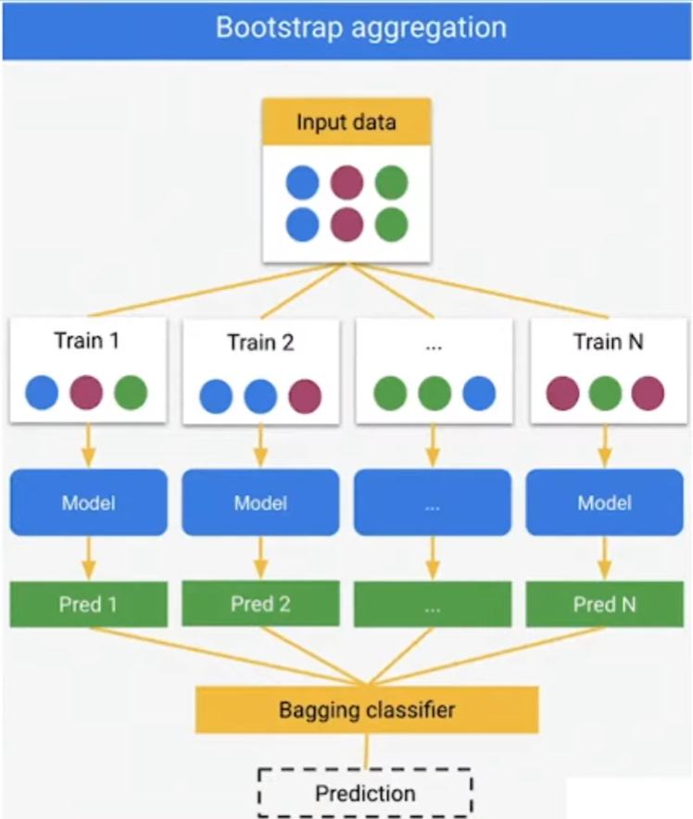

Slide 4
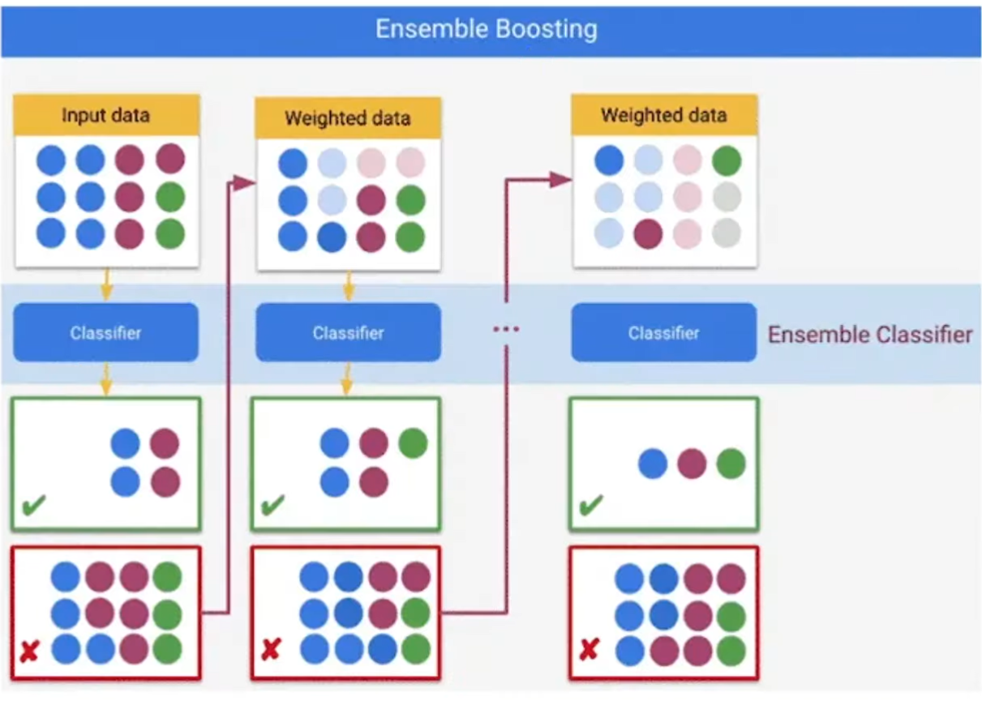

Slide 5
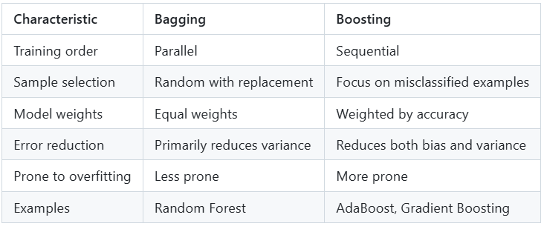

Slide 6
Decision Stump

Slide 7
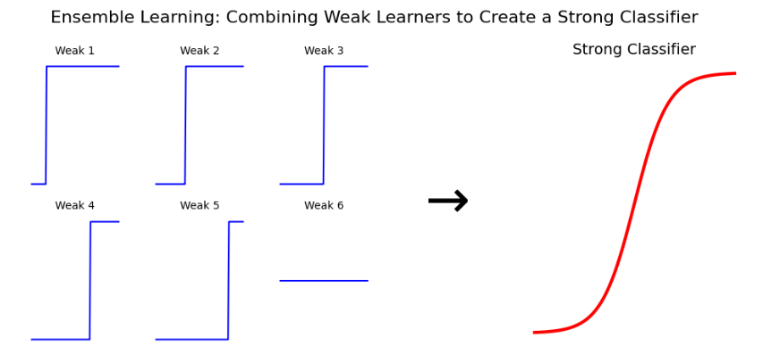
Problem Statement: The goal is to predict whether a passenger survived or not based on attributes such as age, sex, class, and ticket information.
Primary Objectives:
Implement bagging and boosting from scratch on weak classifiers (decision stumps)
Demonstrate how ensemble methods improve prediction accuracy
Compare performance between single classifiers and ensemble methods

Slide 8
Dataset Selection
Source: Kaggle Titanic Dataset
Features: Passenger Class, Name, Sex, Age, SibSp (siblings/spouses aboard), Parch (parents/children aboard), Ticket, Fare, Cabin, Embarked (port of embarkation)
Target: Survived (1 = yes, 0 = no)
Goal: Predict the target variable (Survived) based on passenger attributes.
Challenges Faced:
Missing Values like Age and Cabin
Imbalanced Classes
Categorical Variables - Features like Sex, Embarked, and Cabin

Slide 9
Data Preprocessing
Handling Missing Values
- For numerical columns (Age, Fare): Impute using mean or median.
- For categorical columns (Sex, Embarked): Impute using the mode or create a new category for missing values.
Feature Engineering:
- Create new features like FamilySize (SibSp + Parch).
- Convert categorical features (e.g., Sex, Embarked) into numerical values using one-hot encoding or label encoding.

Slide 10
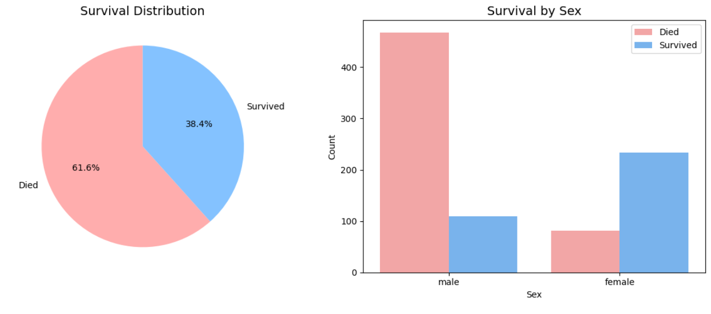
Dataset Overview

Slide 11
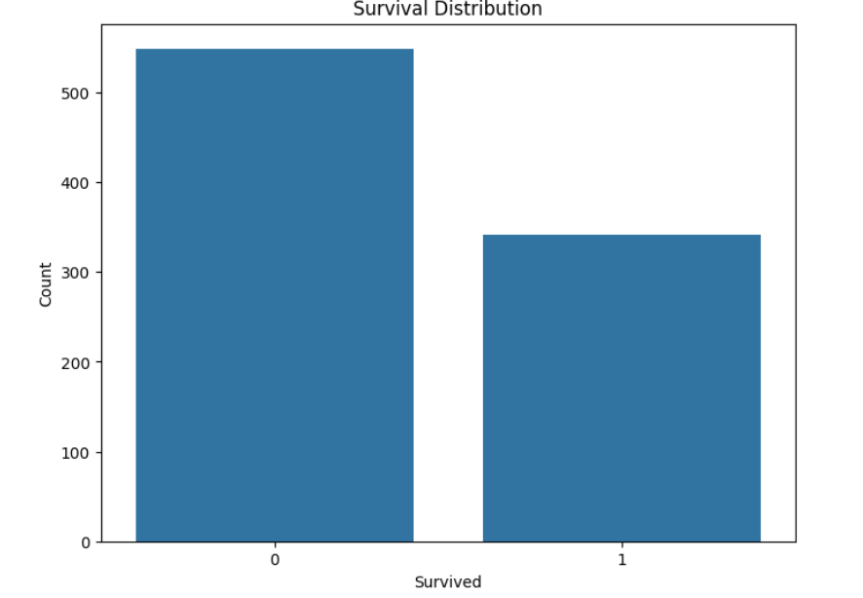

Slide 12
Algorithm Implementation
Weak Classifier (Decision Stump):
- A decision stump is a simple decision tree with a depth of 1 (only one decision node).
- Use decision stumps as the base learner for ensemble methods.
Ensemble Methods:
- Bagging (Bootstrap Aggregating):
- Train multiple models using bootstrapped subsets of the data.
- Use majority voting to combine predictions.
- Example: Random Forest (with decision stumps as base learners).
-Boosting:
- Train models sequentially, where each model tries to correct the errors of the previous one.
- Use a weighted voting system for final predictions.
- Example: AdaBoost with decision stumps.

Slide 13
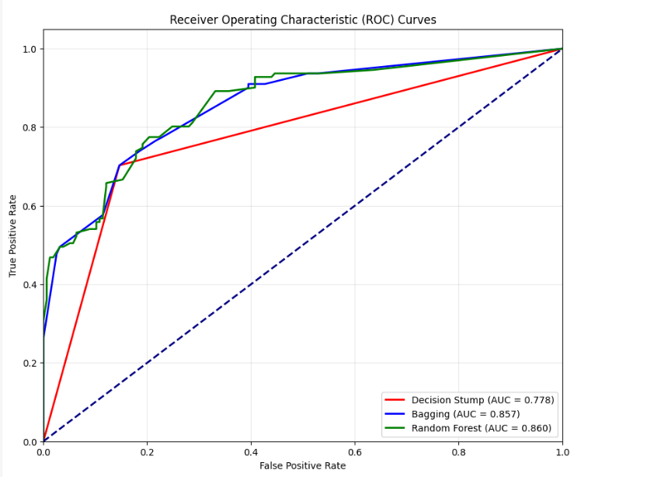

Slide 14
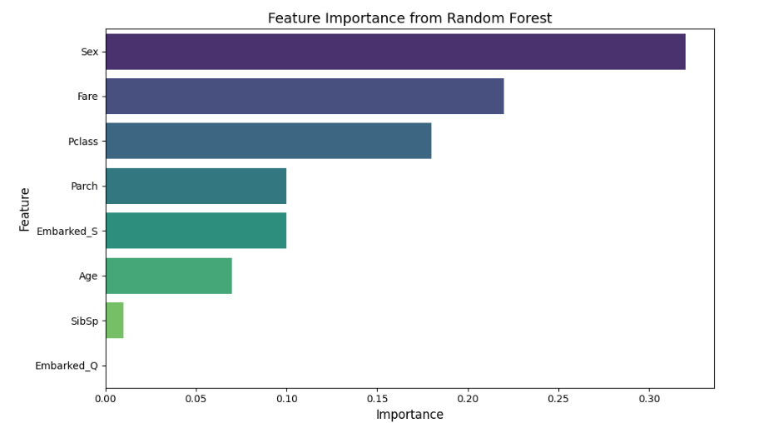
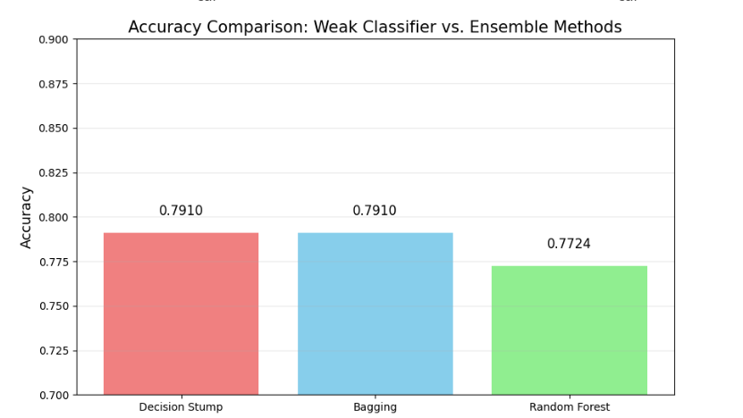

Slide 15
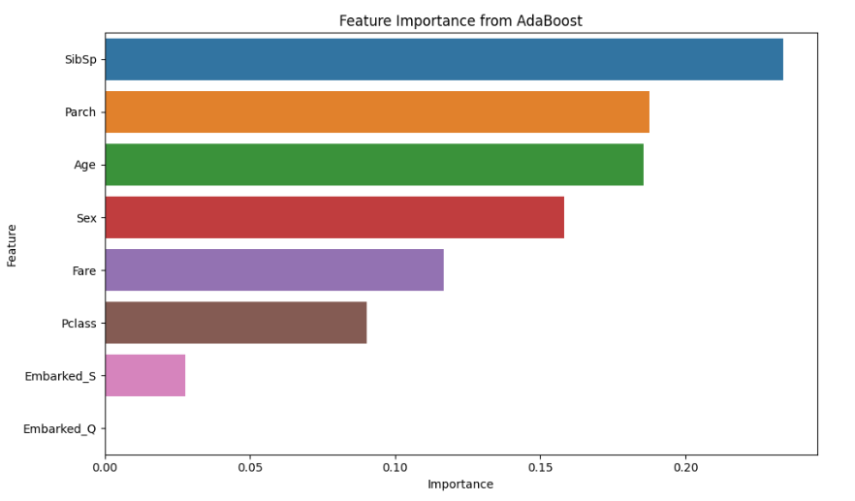
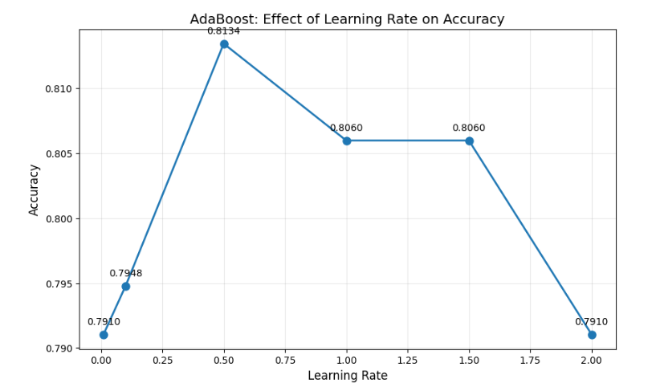

Slide 16
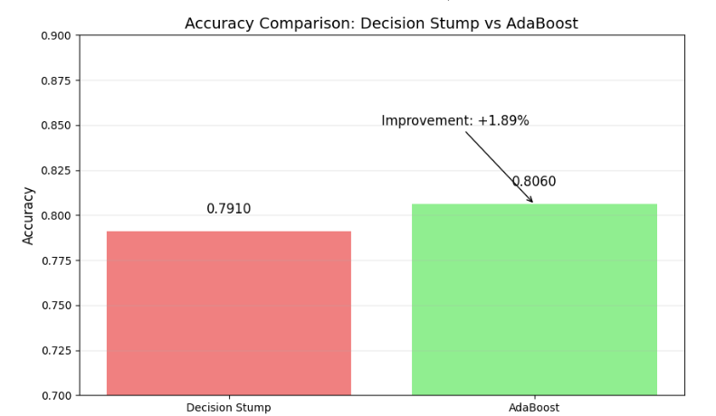

Slide 17
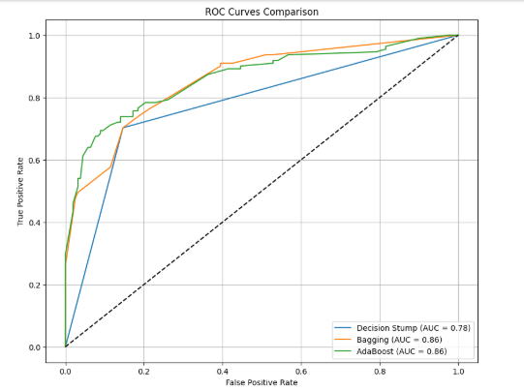
Model Evaluation

Slide 18
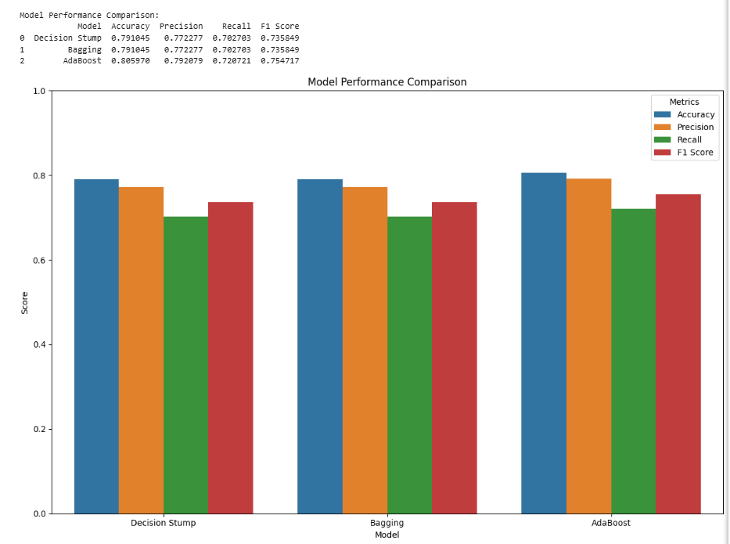

Slide 19
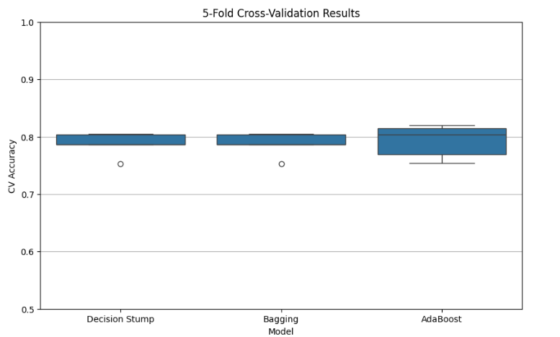

Slide 20
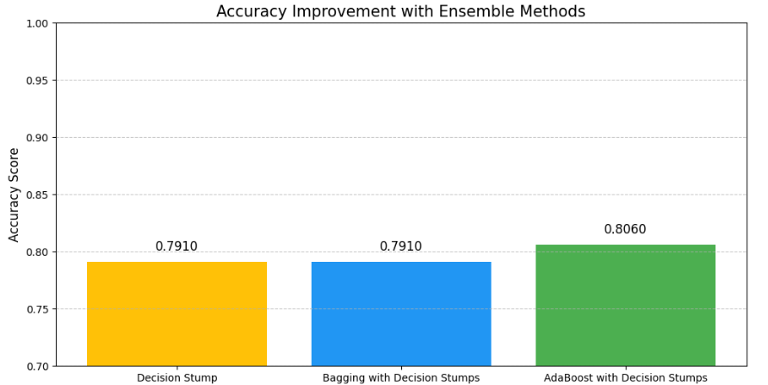
Result Visualization

Slide 21
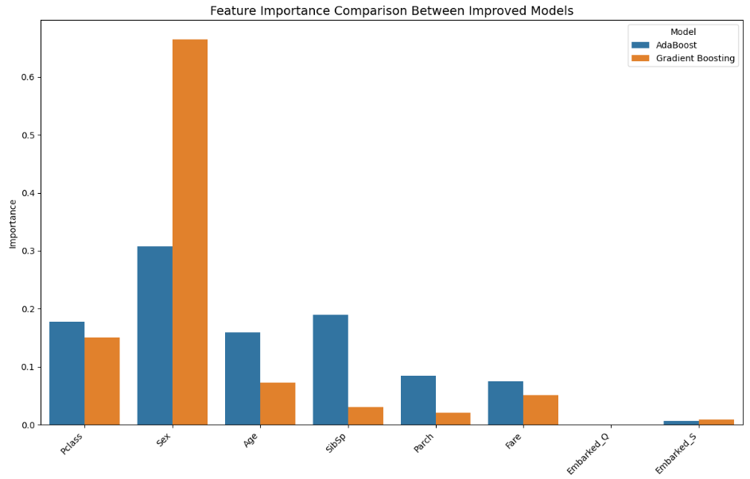

Slide 22
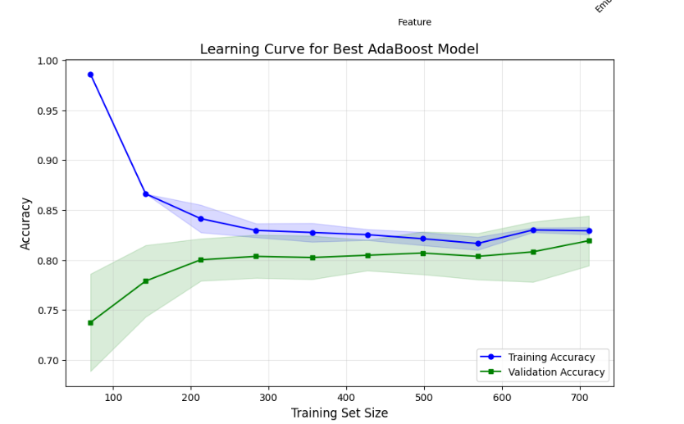
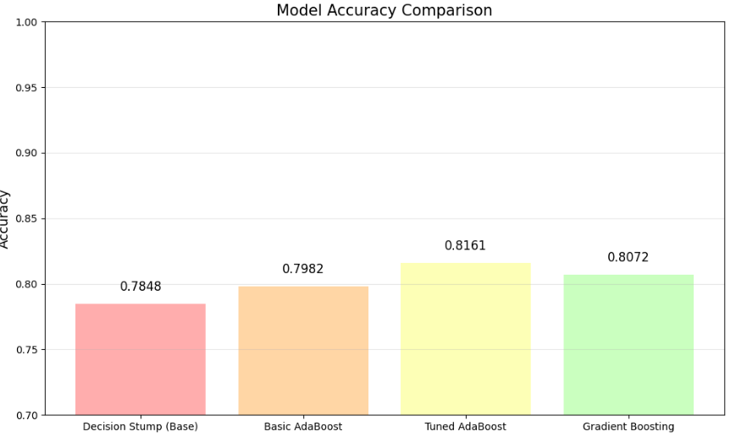

Slide 23
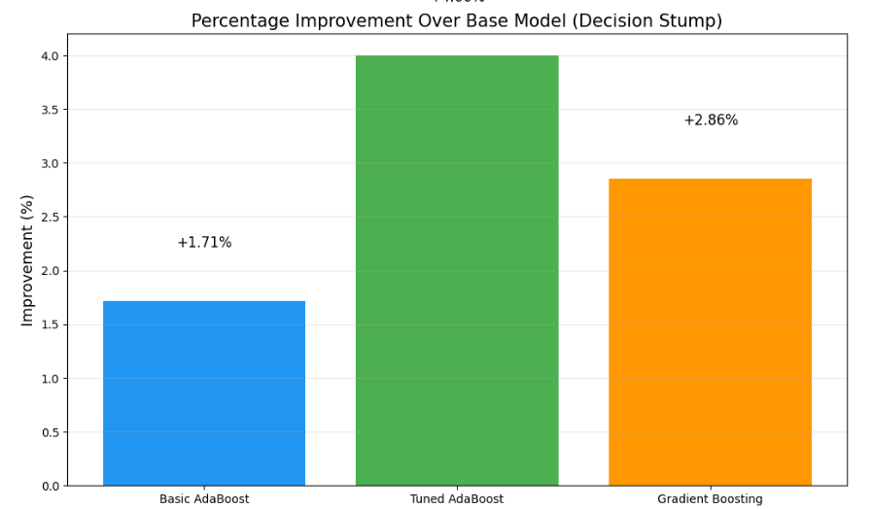

Slide 24
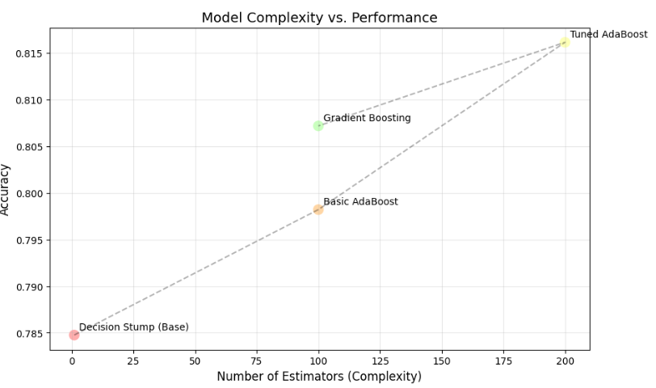

Slide 25
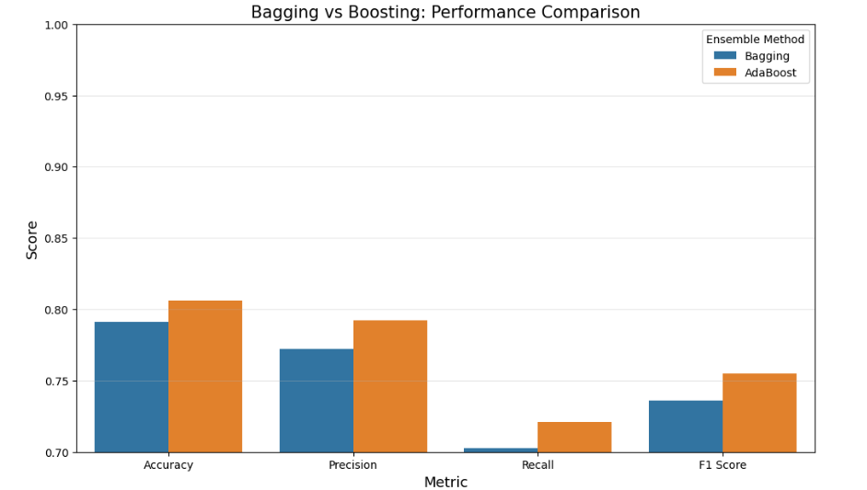

Slide 26
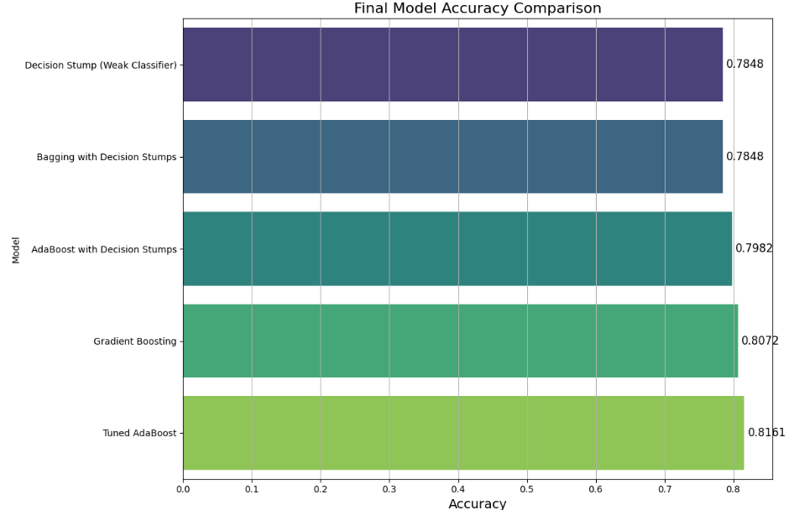

Slide 27
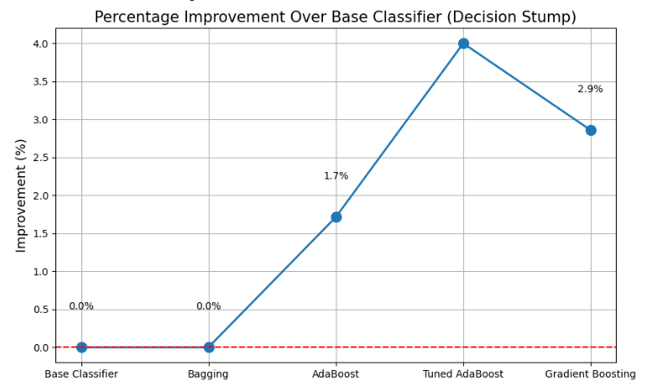

Slide 28
Conclusions
All ensemble methods significantly outperformed the base weak classifier (decision stump).
The best performing model was Tuned AdaBoost with 0.8161 accuracy.
Ensemble methods improved accuracy by up to 4.0% over the base classifier.
Boosting methods (AdaBoost, Gradient Boosting) generally performed better than Bagging for this dataset.
Hyperparameter tuning further improved the performance of the AdaBoost model.

