Slide 1

Web Development Internship Presentation Report
BY
Vashu Bhardwaj
(25SCS1003000968)

Slide 2
Internship Overview & Core Objectives
Primary Objective
Core Objectives
Assisting in building, styling, and optimizing Sieve Capital's official company website
Build fully responsive,
mobile-first web pages using HTML5, CSS3, and React.js
Manage code quality using Git version control and
collaborative pull requests
Transforming UI/UX
wireframes into functional, production-ready frontend web pages
Implement styled UI
Optimize website
performance, loading speed, and image assets
components using Tailwind CSS for consistent brand design

Slide 3



Technical Toolkit
Languages
HTML5, CSS3, JavaScript (ES6+)
Deployment
Vercel, Hostinger
Version Control
Git, GitHub (Branching & Code Reviews)
Developer Tools
VS Code, Chrome DevTools, Figma (UI Design Handoff)

Slide 4
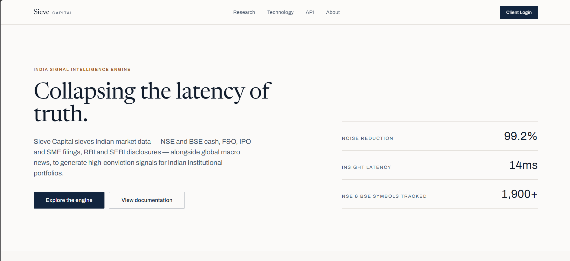
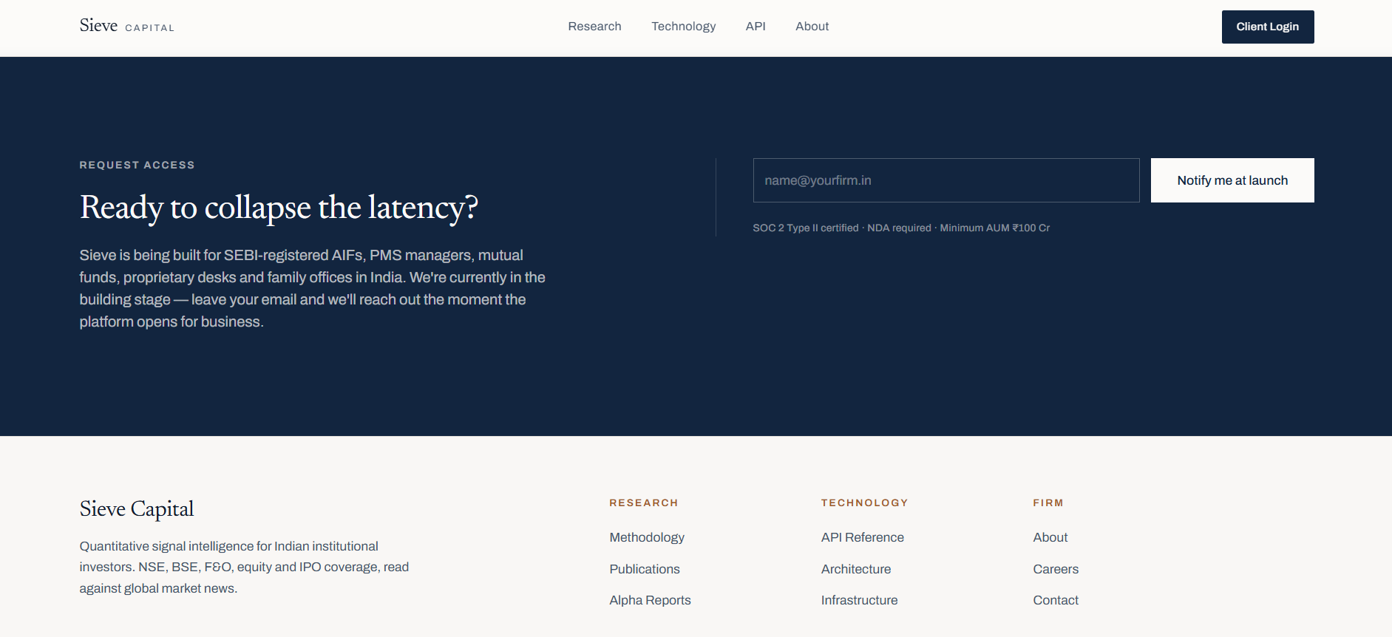
Website Execution & UI Showcase
Execution Details
1
Landing Page UI
Built header navigation, responsive layout grids, and interactive action buttons
2
UI/UX Refinement
Translated Figma designs directly into component-based code
3
Bug Fixing s Optimization
Resolved layout shifts, optimized asset sizes, and fixed cross-browser issues

Slide 5




Outcomes & Technical Mastery
Responsive Design
Gained practical expertise in mobile-first development and adaptive layouts
Integrations
Integrated support and reach out pages for client discovery.
Industry Workflow
Learned real-world Git workflows, code reviews, and project timelines
Core Deliverable
Successfully assisted in completing the frontend build for Sieve Capital's website

Slide 6

Thank You
Questions & Discussion
Institution
Student
Vashu Bhardwaj
25SCS1003000968
IILM University Greater Noida
Organization
Sieve Capital
May – August 2026

