Slide 1
Prognostic signatures for Cancer: A computational biology approach
-VASANTHA KUMAR R
-BS19B032
-ADITYA GUPTA
-BS18B001

Slide 2
introduction
Cancer has become one of the deadliest disease in our world. Also, the rate of cancer is ever increasing.
According to the, Global Cancer Statistics, 2020, there are 19.3 million new cancer cases, out of which almost half, 10 million death cases are reported.
Among, females breast cancer and ovarian cancer have become most common cancer detected.
In this project, our main objective is to find gene markers in a human protein interaction network that would affect the survival of patients.
This is done using the microarray mRNA data of cancer patients.
Then, we would like to validate the found gene module using Kaplan-Meier survival analysis, to understand how the found gene module affects the survival of patients.

Slide 3
Materials and methods protein interaction network
In our step towards the project, we wanted to create a network of gene interactions, which would consist of protein pair relationships among different proteins.
For this we used the functional human protein interaction network proposed by Wu G, Feng X and Stein L, for cancer application.
The downloaded file was consisted of gene names and its UniProt accession numbers.
The main reason we selected this network is that, apart from the curated pathways of genes, this also contains, predicted gene interactions.

Slide 4
Adding weights to network
In the next step, to make this network more specific to cancer, we introduced weights to the edges.
These weights are Pearson Correlation Coefficients(PCC) between the two interacting genes.
To calculate PCC, we used the algorithm developed by Jamil Najafov, Ayaz Najafov called GECO.
From GECO website, we downloaded the R source code for the algorithm and modified it to find PCC values based on CCLE(Cancer Cell Line Encyclopedia) database.
There were some variant proteins in the network for which we cannot correlate, so we assumed the PCC of their interactions to be zero.

Slide 5
Clustering of network
For efficient working on the network, we formed clusters in the network using the MCL or Markov clustering algorithm.
We downloaded the pakage from the author’s website and used it t create clusters.
As it is a large network, to reduce the size of clusters, inflation was set to 20.
To find clusters for efficient usage, we set two thresholds on the clusters:
total genes(n) > 7 and average edge weight > 0.25

Slide 6


Slide 7
Breast cancer dataset
The Breast Cancer dataset we used in the module was downloaded from GEO as soft format files.
The dataset is GSE1456, which contained gene expression data of 159 cancer patients.
Then, the probes with affymetrix ids in dataset were matched to genes using online bioinformatics tool GEO2R and then normalized it.

Slide 8
Finding network module related to cancer data
Using the mRNA cancer data, we calculated the total gene expression for each module.
Then, we also calculated differently expressed genes in the data based on survival of patients.
Now, we went for a linear search for a network module matching with these conditions.

Slide 9
Kaplan-Meier survival analysis
To validate the found network module, we did a Kaplan-Meier survival analysis on the cancer dataset, based on the expression of the found module on each patients.
We downloaded the R package for survival analysis and modified it to analyze the module obtained.

Slide 10
results
The final protein interaction network consists of:
9450 nodes
181691 interactions(edges)
Avg. degree = 38
Then after adding edge weights, and when clustering is done a total of 6711 clusters are formed.
At first threshold of N>7, a total of 95 modules passed.
After the second threshold of avg. weight > 0.25, the final list of modules was 42.

Slide 11
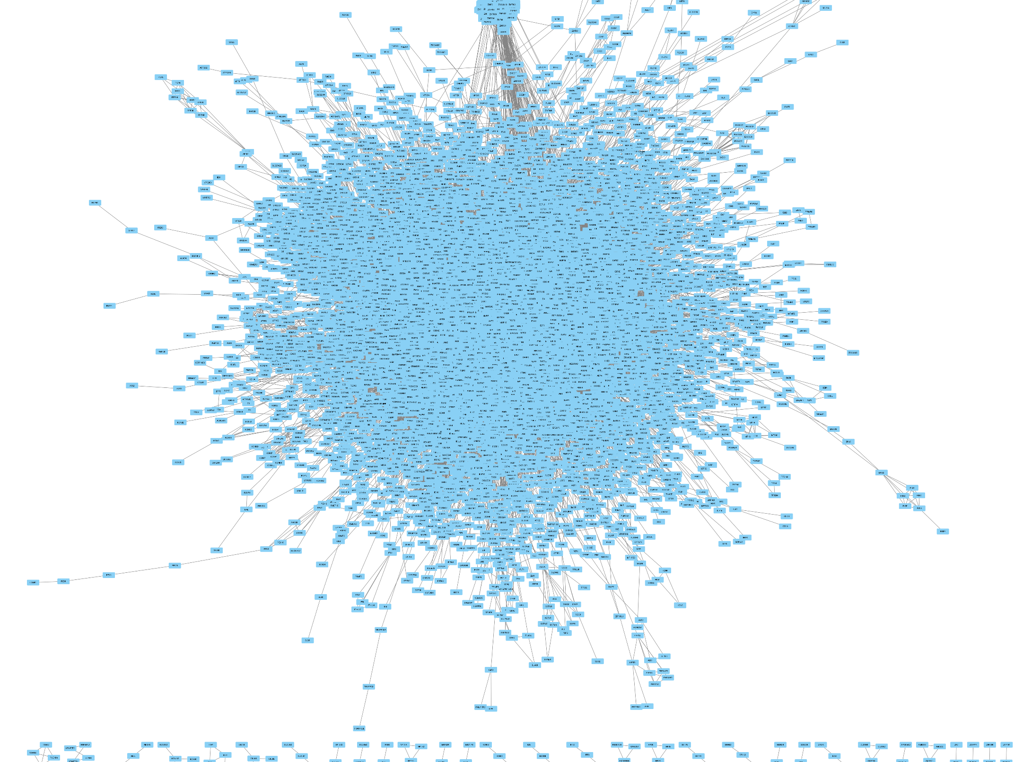

Slide 12
Now, after matching the probes to genes, we found the differentially expressed genes based on survival data.
ID | adj.P.Val | P.Value | t | Gene.symbol
212549_at | 0.00493 | 2.21E-07 | -5.41395 | STAT5B
217957_at | 0.02493 | 2.87E-06 | 4.851867 | CFAP20
209285_s_at | 0.02493 | 4.38E-06 | -4.75519 | FAM208A
212070_at | 0.02493 | 4.48E-06 | 4.750483 | ADGRG1
215011_at | 0.02898 | 6.50E-06 | 4.663706 | SNHG3
203698_s_at | 0.0423 | 1.18E-05 | -4.52374 | FRZB
212228_s_at | 0.0423 | 1.71E-05 | 4.433825 | COQ9
202746_at | 0.0423 | 1.79E-05 | -4.42217 | ITM2A
218039_at | 0.0423 | 1.95E-05 | 4.402034 | NUSAP1

Slide 13
Module X
After, the search the final module we got was module X, which consists of 21 genes.
PIK3R1
STAT5B
TINF2
SNAI1
GNAT2
SPDEF
OR5A2
MLL3
ATP4A
SEC11A
RAD21
C1QTNF5
CELSR1
MARS
DTX4
PRPF3
FUT1
SP110
LRAT
REXO2
SERPINB3

Slide 14
Now, to validate the module X, to find whether it affects the survival of cancer patients, we did Kaplan-Meier survival.
It is a univariate method which is used to predict the survival probability, based on the specified variables.
First, we calculated the gene expression of module X across all patients and ranked them accordingly.
Next, we found the median for this data.
Now, the patients were split into two groups: patients above median value and below.
We then plotted the curve for two sets in same graph for comparison purposes.

Slide 15
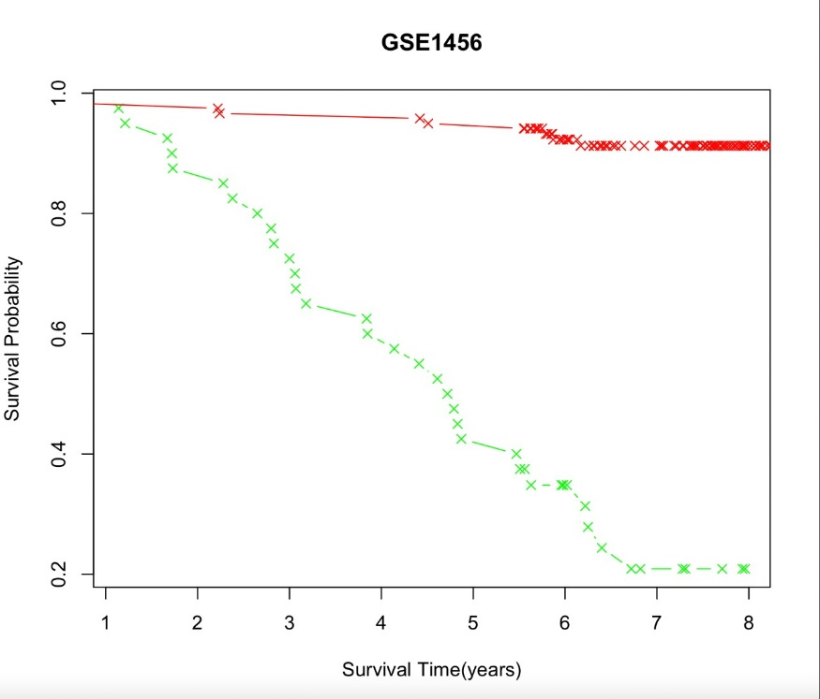
Green – High Expression of module X
Red – Low Expression of Module X

Slide 16
discussion
The highly differentially expressed gene STAT5B plays a significant role as a transcription factor, which gets activated by growth factors.
It acts as a signal transducer and involves in various processes like apoptosis and adult mammary gland development.
So, it is clear that STAT5B is a highly important gene in breast cancer analysis.
Other genes like TINF2, which affects telomeres function, thus directly interpreting cell divisions.
The CELSR1 gene mediates contact communications.
RAD21 gene is significant in M phase of cell cycle.
REXO2 gene provides resistance to cell death.
Therefore, as the module X genes plays a significant role in cell cycle, contact inhibitions, these genes are highly related to survival in breast cancer patients.

Slide 17
In this project, we did a simple and rapid procedure to combine disease specific gene expression data along with a static protein functional interaction network, in order to identify candidate prognostic network modules and genes.
A problem with the module X genes is the not all genes in the cluster directly affects the cancer characteristics of cell, but, still they involve in cell cycle related activities.
Next, drawback is about the diverseness of the dataset used.
The dataset we used GSE1456, contains patient details only from Stockholm, Sweden.
Thus due to the genetic factors, the significance of this result across others countries might be less.

Slide 18
Thank you

