Slide 1
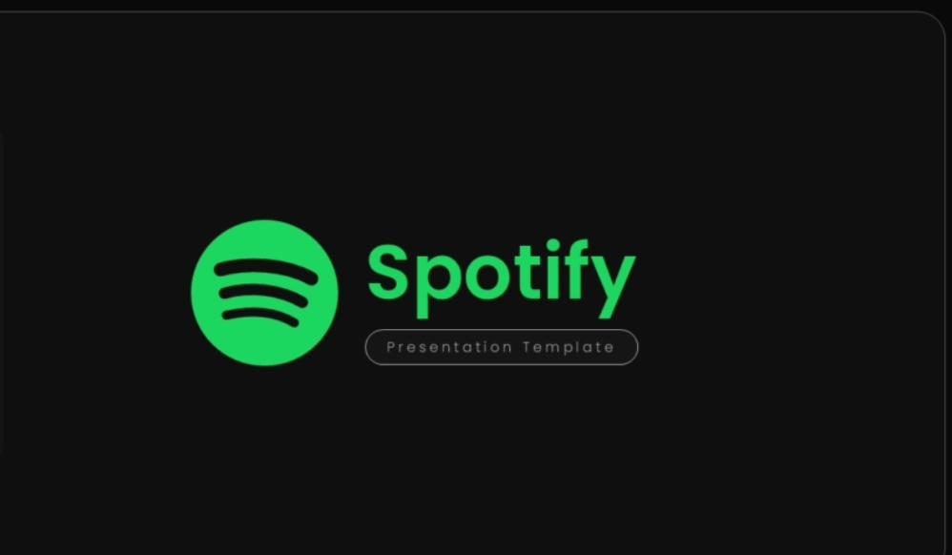
Spotify Analyzing
Data Science Bootcamp

Slide 2





Our Teams
Objective:
Analyze Spotify streaming trends to uncover patterns in music consumption
Vasiliki Nterkou
Vassia Galanopoulou
Angeliki
Triantafyllou
Dataset
114.000 Spotify Songs
Source
Kaggle
Size
114.000 tracks
Τools:
Pandas,Matplotlib,Seaborn

Slide 3


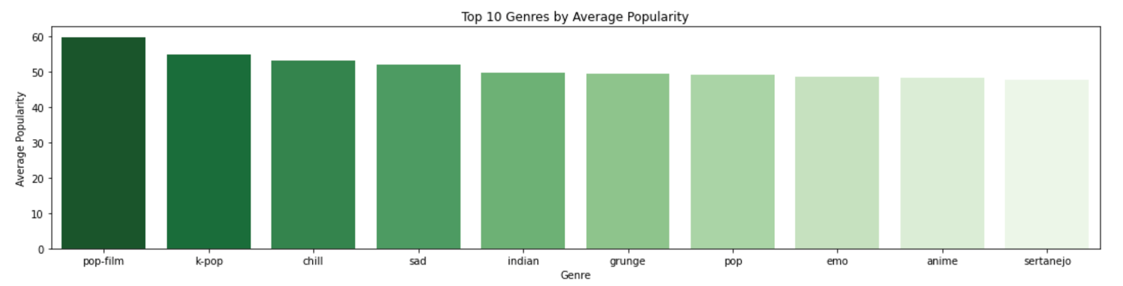

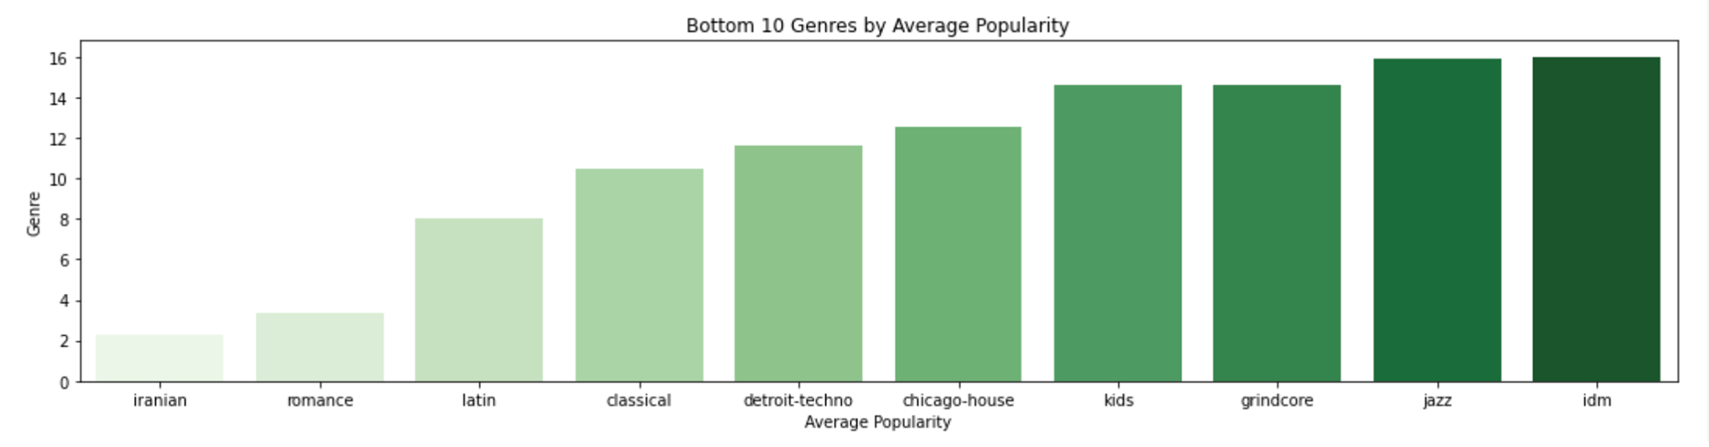

Most and Least Popular Genres
By grouping the data by genre and calculating the average popularity score, we can see which styles perform better and which perform lower on Spotify.

Slide 4
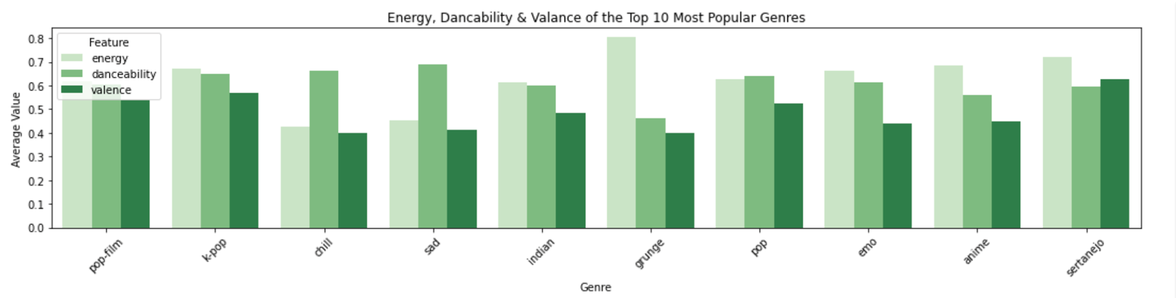
Audio Features of Popular Genres
This grouped bar plot shows the average values of three key audio features — energy, danceability, and valence — for the Top 10 most popular genres in the dataset.

Slide 5
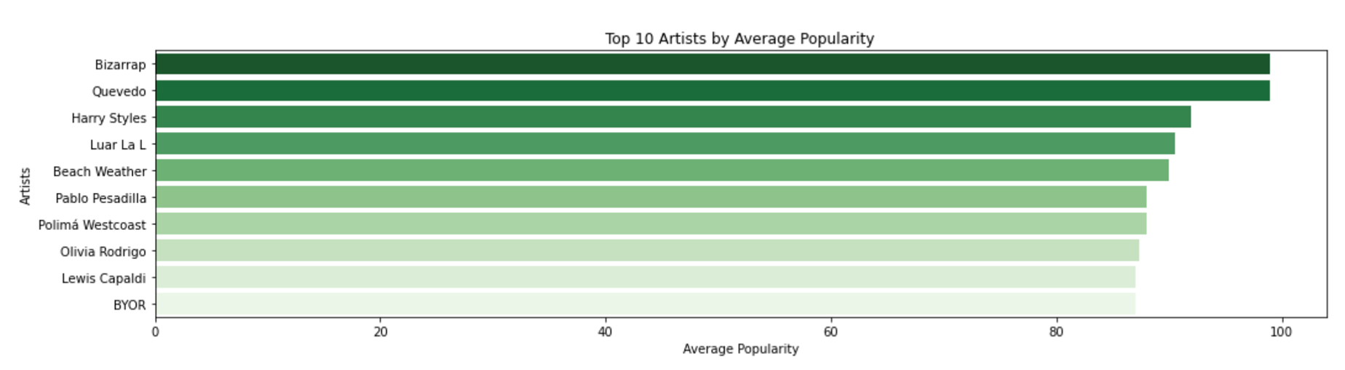
Popular Artists
Artists who consistently achieve high listener engagement.

Slide 6
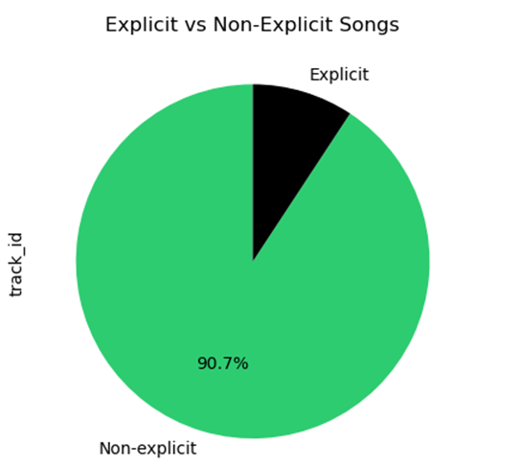
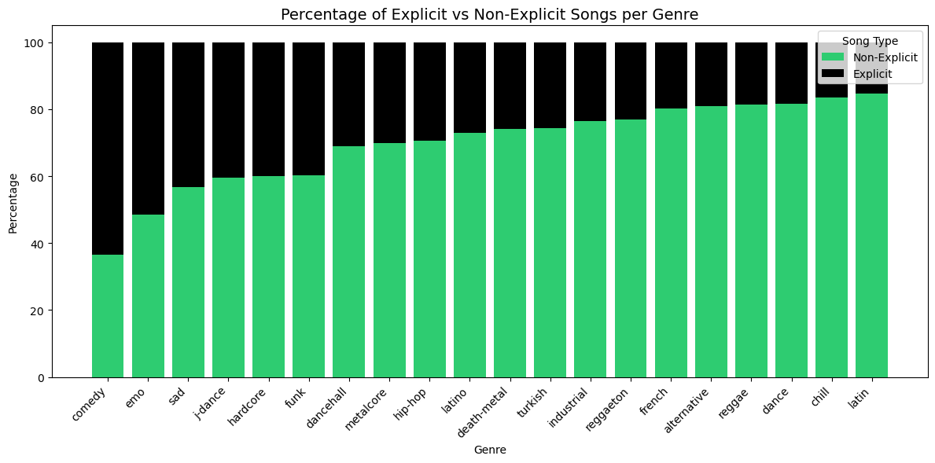
Explicit Content
Shows the percentage of tracks marked as explicit.
Shows which genres have more or less explicit content
9,3%

Slide 7
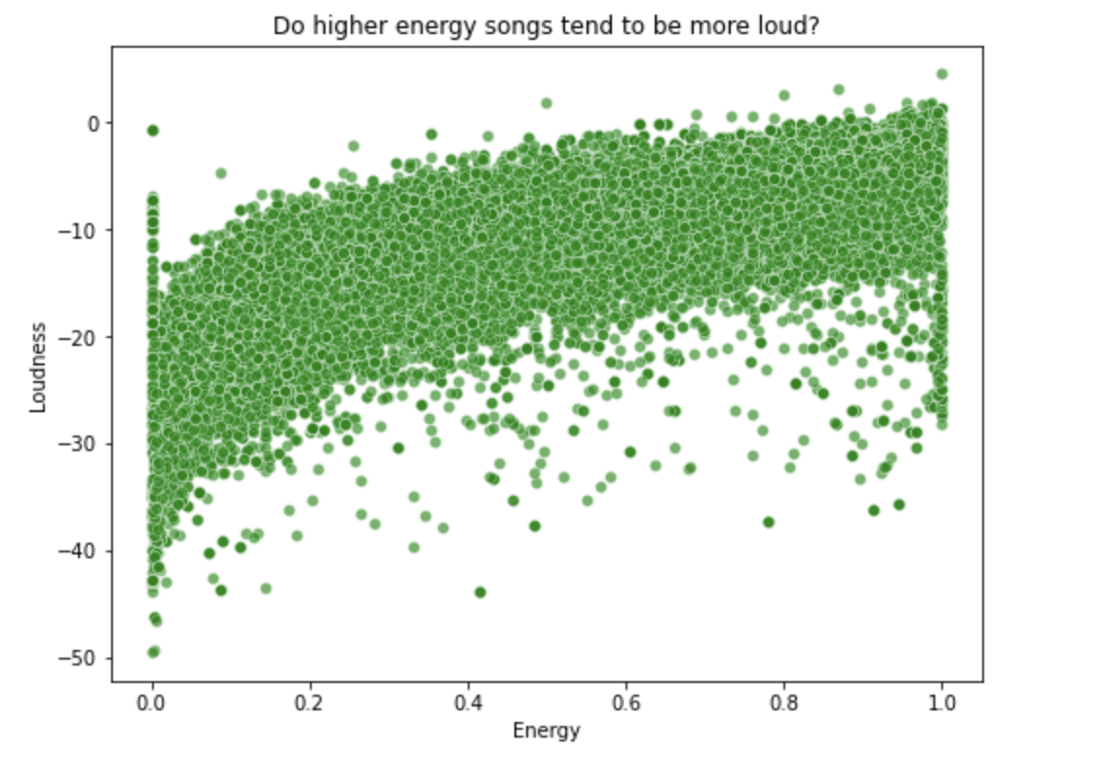
Energy vs Loudness
Correlation between energy and loudness: 0.77

Slide 8
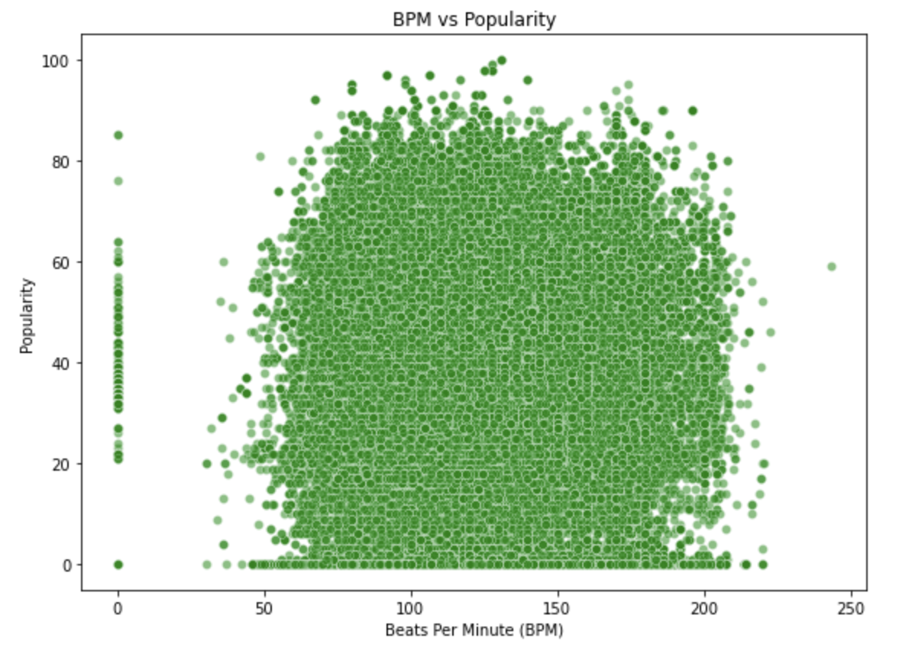
BPM vs Popularity
Correlation between BPM and Popularity: 0.02

Slide 9
Thank You for your attention!

