Slide 1
HACKATHON PROBLEM STATEMENT 3
Reimagining Chhattisgarh Sewa Setu
A clear, step-by-step roadmap to make government services easier, faster, and accessible to every citizen.
By Team Neural Ninjas

Slide 2



ABOUT US & OUR APPROACH
Team Neural Ninjas
Our team conducted a comparative study of leading citizen-service platforms across India to identify proven practices and translate them into a more accessible, efficient, and citizen-centric Sewa Setu for Chhattisgarh.
Studied 6 States
Understood Users
Designed Solutions
Planned the Tech
Compared Sewa Setu with top portals like Goa and Delhi.
Found out exactly where citizens get stuck online.
Created visual mockups of a simpler, faster interface.
Drew a clear map for developers to build the new system.

Slide 3
THE PROBLEM TODAY
Where Citizens Struggle Right Now
Hard to Find Services
Blind Waiting Periods
Citizens must guess which government department handles their needs.
People don't know who is reviewing their file or why it's delayed.
Uploading Same Papers
Poor Pay the Same
Users are forced to upload basic ID and papers every single time.
Low-income citizens get no automatic fee help during application.

Slide 4
From Goa: Live Dashboards
LEARNING FROM THE BEST
Showing everyone exactly how fast offices are working.
Borrowing What Works Best
From Kerala: Smart Fee Waivers
Using ration card data to automatically waive fees for the poor.
We didn't invent these ideas. We found the most successful features from other states and combined them into one perfect plan.
From Karnataka: Automatic Penalties
Alerting senior officials when a citizen's file is delayed.
From Delhi: DigiLocker Magic
Pulling documents automatically so citizens type less.

Slide 5


THE BIG PICTURE
Our Four Main Goals
1. Easy Searching Type what you want in plain words, and the AI finds it instantly.
2. Clear Tracking See your application move step-by-step, just like tracking a package online.
3. For Everyone Voice search in local languages and big text options for seniors.
4. Systems Talking Together Government databases talk to each other so citizens don't have to carry papers.

Slide 6
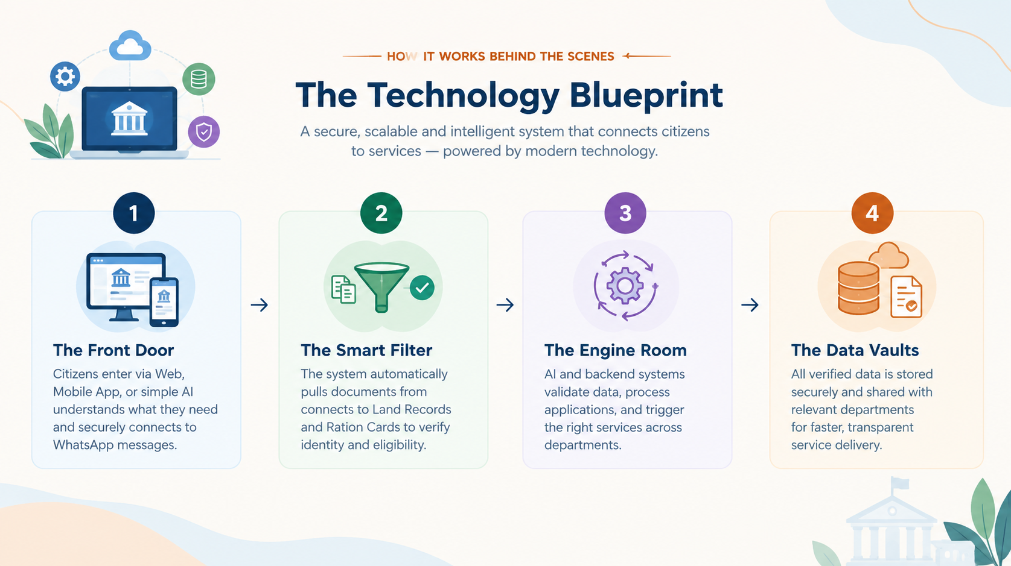

Slide 7
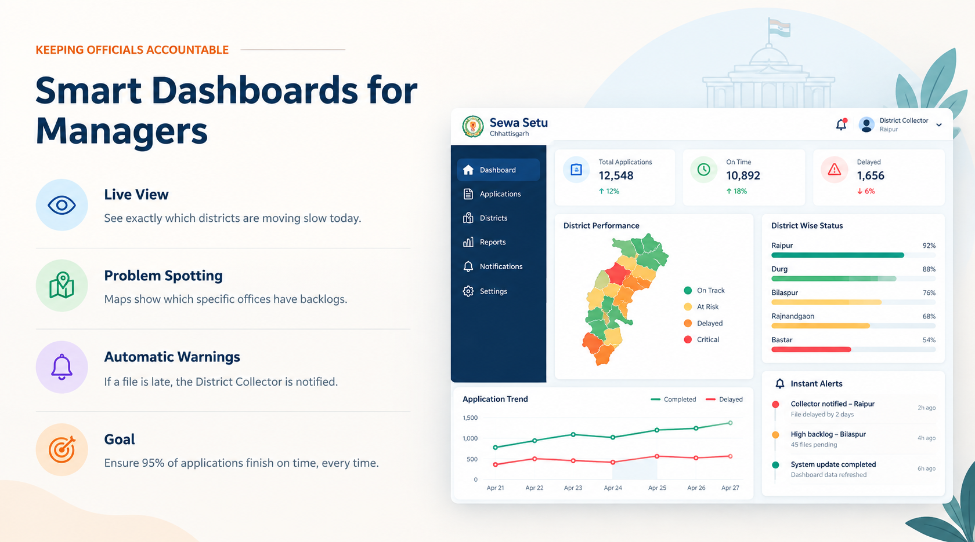

Slide 8


THE CITIZEN EXPERIENCE
Making Life Easier for Everyone
No More Guessing
Citizens just say what they need. The system does the hard work of finding the right form.
No Surprise Rejections
The portal checks if you qualify before you even waste time filling out the whole form.
One Click Filling
Forms fill themselves using safe data from your Aadhaar and DigiLocker.

Slide 9
HOW WE BUILD IT
Step-by-Step Rollout Plan
PHASE 1: Search
PHASE 2: Forms
PHASE 3: Management
PHASE 4: Smart Tech
Better Front Page
Simpler Applying
Public Dashboards
AI Automation
Add the smart search bar and big-text accessibility options first.
Introduce step-by-step easy forms and visual package-style tracking.
Turn on the public speed-tracking graphs and automatic fee waivers for BPL.
Use computers to pre-check uploaded documents to speed up approvals.

Slide 10
CONCLUSION & EXPECTED IMPACT
A Better Governance Experience
We have built a practical plan to make Chhattisgarh Sewa Setu the fastest, easiest, and most transparent portal in India.
Thank You | Neural Ninjas

