Slide 1
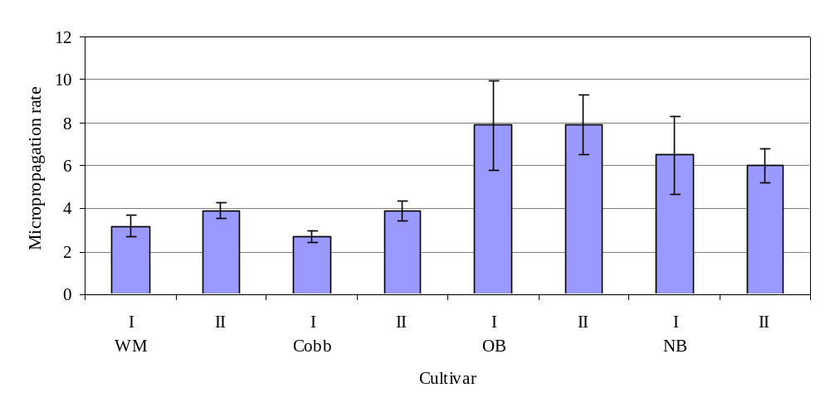
c
c
d
d
a
a
b
b
Figure 3 – The mean micropropagation rates (see M&M) obtained over three culture periods in phase I and II for cultivars: WM='Wiri Mist', Cobb='Cobb', OB='Oratia Beauty' and NB='Nicola's Blush'. Initial phase I was after the establishment of the cultures and the subsequent phase II was for the final three culture periods; i.e. after 12 months (WM & Cobb) and 8 months (OB & NB). Vertical bars denote standard errors (p<0.05); the same letter denotes no statistical difference between culture phase I and II within each cultivar.

