Slide 1
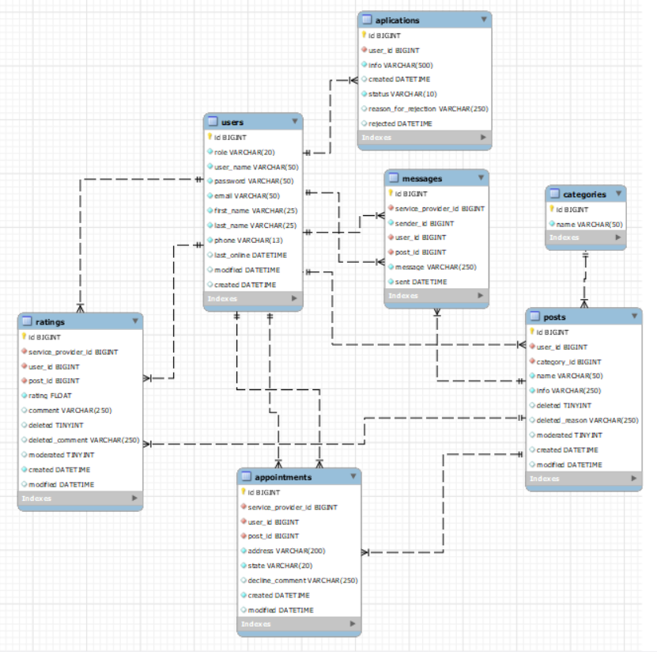
Users:
Unregistered user
Registered basic user
Service Provider
Moderator
Admin

Slide 2
Unregistered users:
Can go trough the posts and its comments, by searching by name or by category
Can create account by registration form

Slide 3
Basic users:
Can go trough posts and its comments, by search or category
Can message provider, or create appointment prom the post
Can have multiple chats with different providers
Can look the progress of appointments
Can menage personal data
Can apply to become provider

Slide 4
Service Provider:
Can browse through the appointments made for you, you can accept and finish or decline.
Browse through the messages sent to you, and respond
Manage your posts – create, update, or delete
Manage your personal data and information.
Switch back to regular user menu, from witch you can behave as regular user

Slide 5
Мoderator
Browse through applications for Service Provider, you can accept or reject.
Browse through un-moderated posts, you can mark as moderated or delete. Can also do the same as moderated.
Browse through comments left by users, you can delete them.
Manage your personal data and information.

Slide 6
Admin
Can do the same things as Moderator, but also can change user’s information.
Can create and update Categories

