Slide 1
Who are we?
Martin Kuyumdjiev
Vasil Vazonov
Cadets in IT Talents Season 14

Slide 2
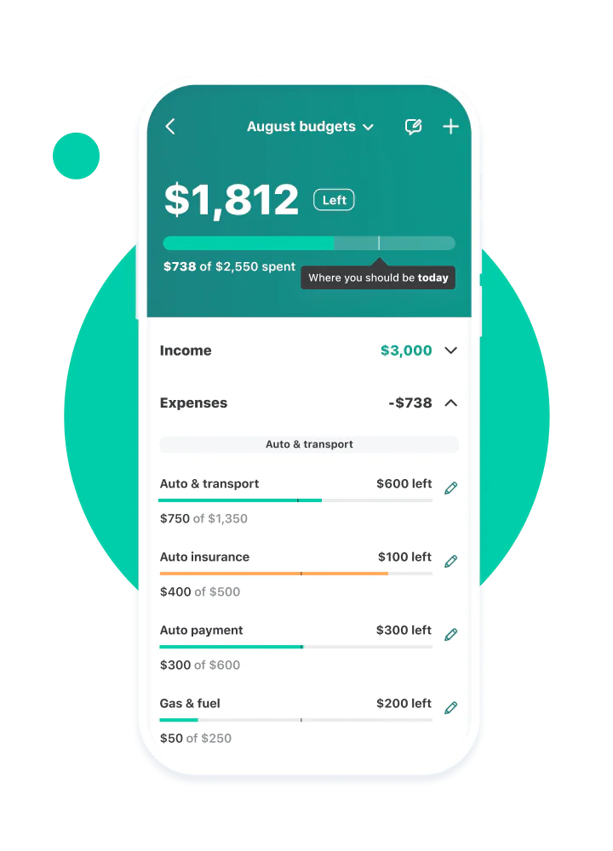
Finance Tracker app

Slide 3
Technologies
Java 17
Hibernate
Maven
Spring Boot
Software
IDE Intelij Idea
MySql Workbench
GIT
Postman
API’s
IText and PdfBox
Lombok
JavaMail through Gmail smtp
exchangeratesapi.io for currency exchange
Spring Data JPA
ModelMapper
Bcrypt

Slide 4
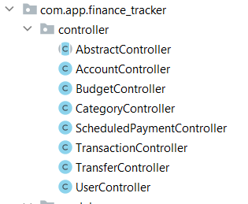
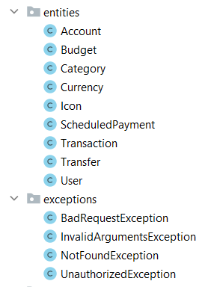
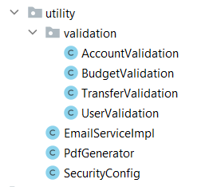
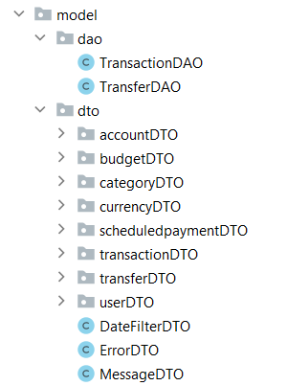
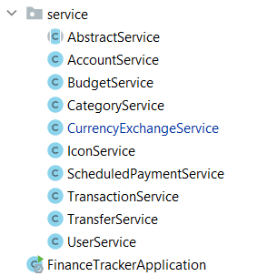
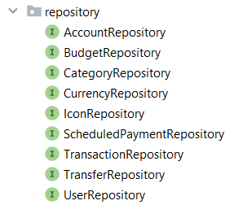

Slide 5
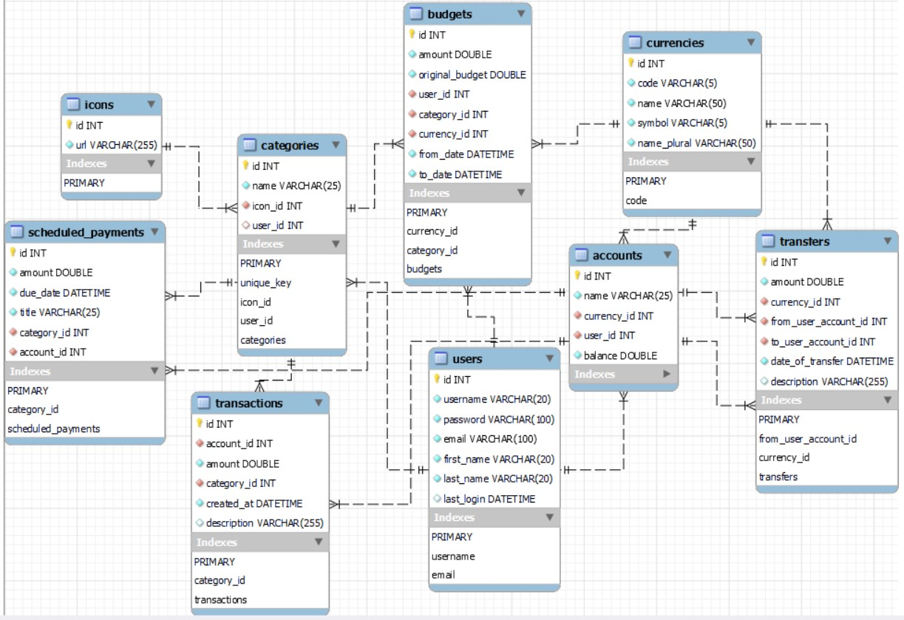

Slide 6
Finance Tracker App
Users
Register
Login – Logout
Forgotten Password
Update profile
Accounts
Create/Update/Delete
Get all own acc
Add money
Budgets
Create/Update/Delete
Get by Id
Get all for user
Categories
Create/Update/Delete
Get All/By Id/By name
Download Image
Transactions
Create
Get All/By Id
Get All filtered
Download reference
Transfers
Create
Get All sent/received
Get By Id
Get All Filtered
Download reference
Scheduled Payments
Create/Update/Delete
Get By Id
Get All

Slide 7

Demo Time?

