Slide 1

Vasile Constantin 16/05/2023

Slide 2
Hello!
I am Vasile Constantin
Today will gain different insight about our customers dataset
You can email me vasile7@hotmail.com

Slide 3

Customer first
1
Why is having a client important?

Slide 4

Customer satisfaction is an essential factor in any business, and analyzing customer data can help identify areas for improvement

Slide 5

166,491 flights
18.8 million passengers
90 aircrafts
Whoa! That’s a big number, aren’t you proud?

Slide 6
Analyzing customers
Average age is 35 years
Most customers are between the ages of 30 and 50 .
Moderate positive correlation between age and amount spent.

Slide 7

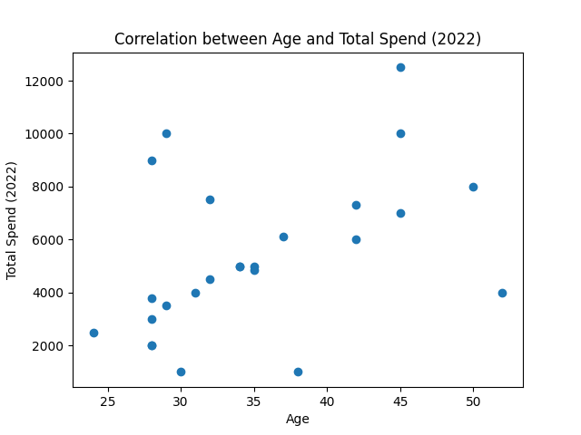
Positive correlation
The older the customer, the higher the spending

Slide 8
Analyzing our customer dataset
Number of flights(2022)
524 flights
Total Spend(2022)
134550 EUR

Slide 9
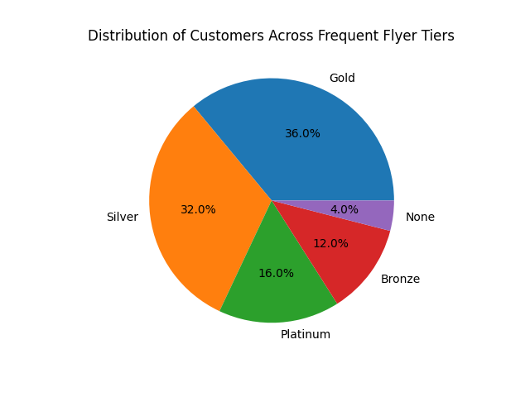
Frequent Flyer Tiers
The most popular frequent flyer tier is Gold, followed by Silver and Platinum

Slide 10
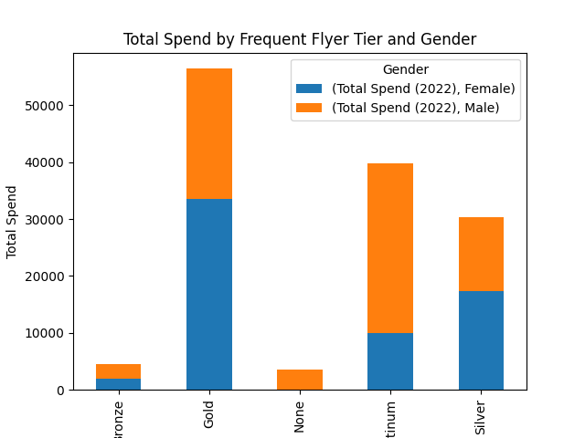
Total spend by frequent flyer tier and gender

Slide 11
Booking source
Airline website
Travel agency
Mobile app
48 %
28 %
24 %
1
2
3

Slide 12
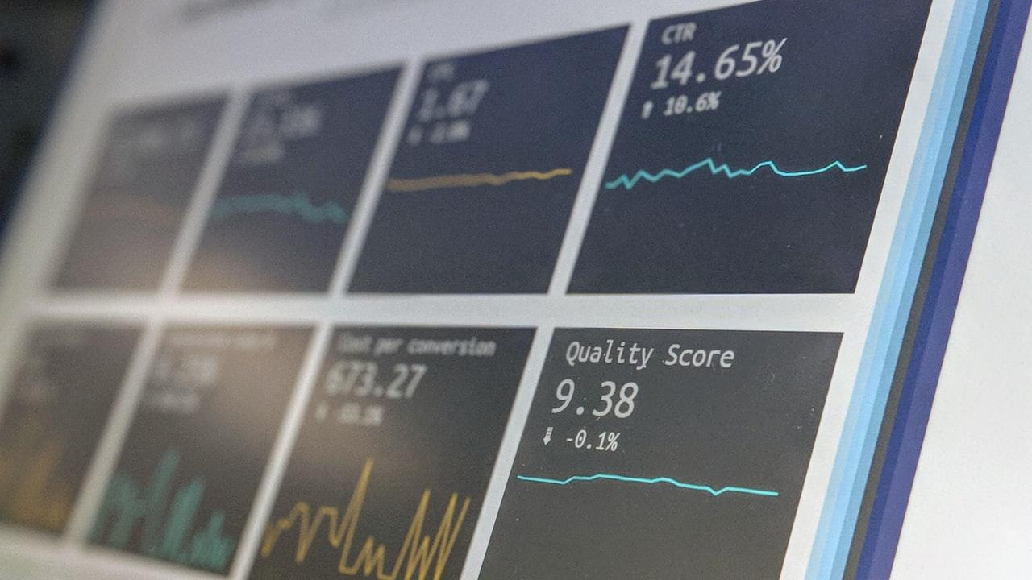
The average spent on flights in 2022 is 5382 EUR
Standart deviation of 2970,85 EUR
52 % Male / 48% Female

Slide 13

Thanks!
You can find me at:
email: vasile7@hotmail.com

