Slide 1
Wireless ECG Monitoring
Sahil Lakhe
Vasileios Bimpikas
Siddharth Shukla
Vasileios Filos

Slide 2
Personal Health Monitoring
“[health, personal..]monitoring devices will grow to more than 36 million units in 2017, up from under 3 million units in 2011” – AIB Research
“ medical devices bought by the consumer to self-monitor their health will account for more than 80 percent of all wireless-enabled consumer medical devices in 2016” – IMS
Enough Inspiration to drive us!

Slide 3
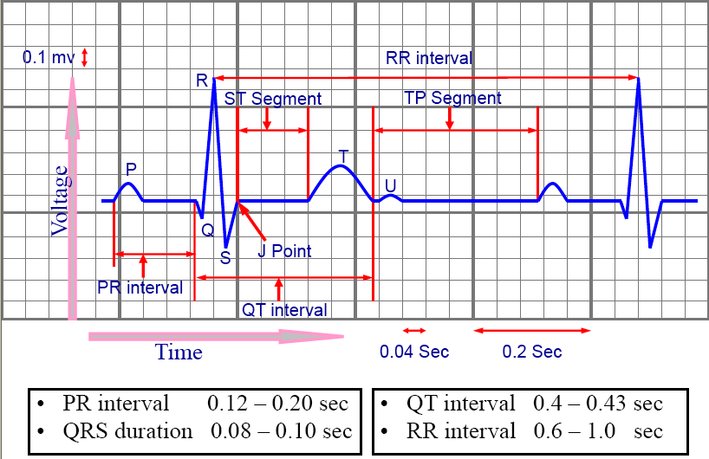
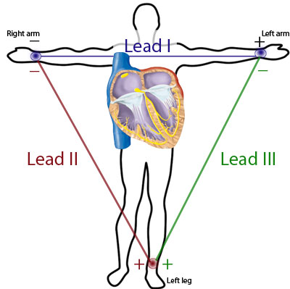
What is ElectroCardioGram?
Biosignal (1D), representing the electrical and muscular functionality of our heart
Collected by at least three surface electrodes, placed in a specific way to follow the Einthoven’s Law => RAV.dLA + LLV.dLA = RAV.dLL

Slide 4
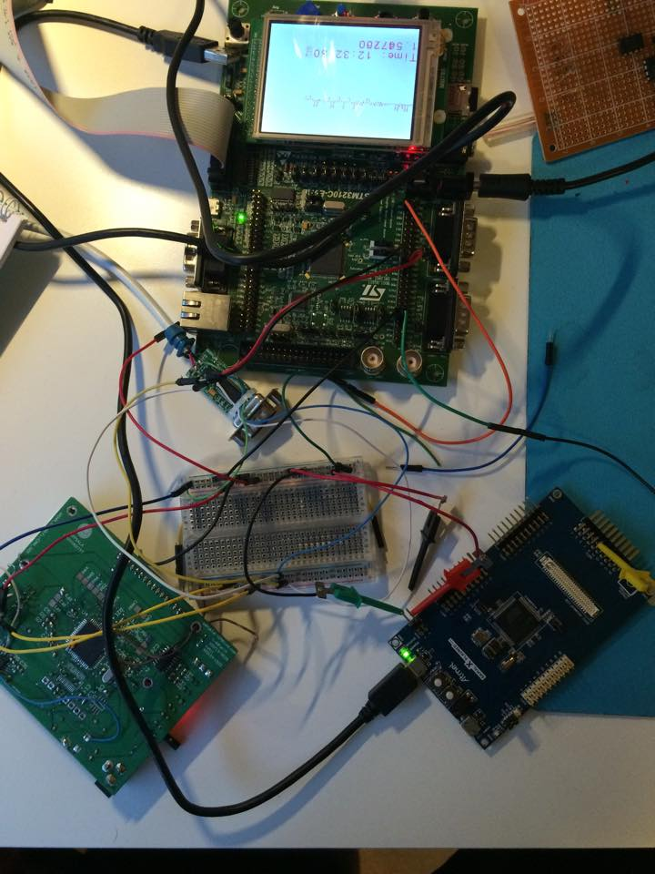
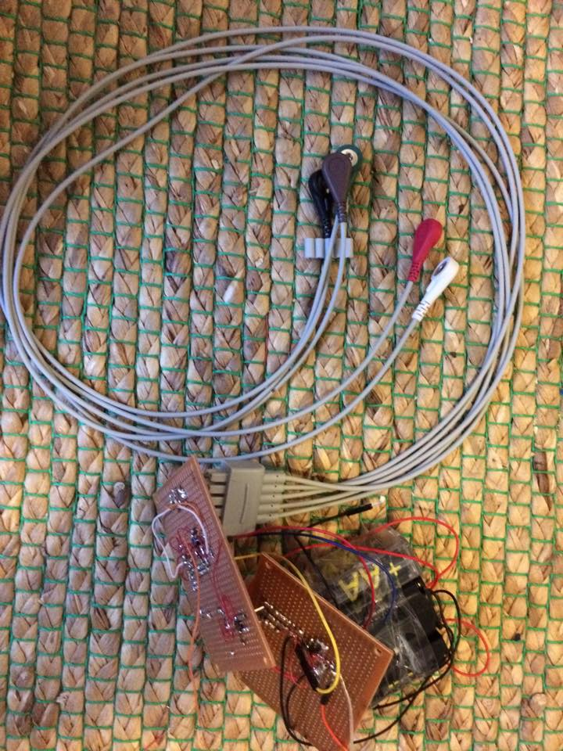
Our Prototype
STM3210C-EVAL board
ATSAM4LC4CL ARM
Board
ESP8266
INA121
OPA227

Slide 5
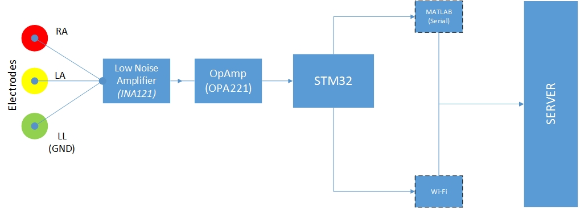
Block Diagram

Slide 6
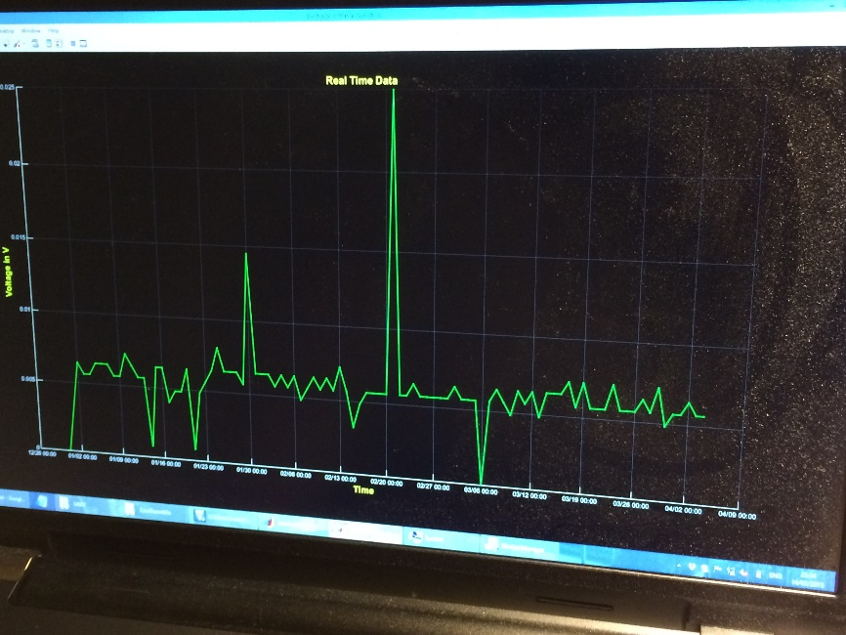
Hardware Challenges
Signal acquisition
  Noise filtering
  Amplification (very low signal level)
  Electrodes

Slide 7
Firmware Challenges
Wi-Fi module communication (ESP8266)
Managing data rates
  Buffer implementation
Priority assignment
  Priority 4: Buffer consume task
  Priority 3: ADC task
  Priority 2: LCD task
  Priority 1: RTC task

Slide 8
Software Challenges
Real-time plotting on the LCD
  Bresenham's line algorithm implementation
MATLAB
  Data acquisition
  Real-time plotting
  Uploading
Setting up the server

Slide 9
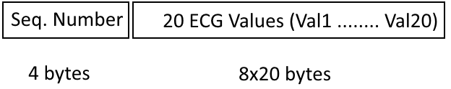
Data frame
Web format
Packet format

Slide 10
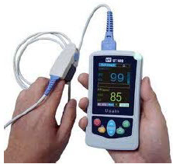
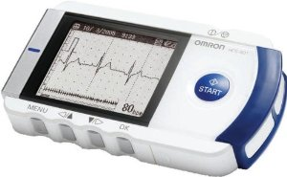
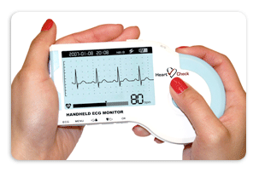
In the Market…Competition!

Slide 11
Conclusion & Experience
Faithful ECG signals representation requires high sampling rates
  Need of more memory to save data
Integrated on-chip wireless solutions would prove more efficient in terms of performance and memory

Slide 12
_{THANK YOU!}
_{Questions?}

