Slide 1
Expedia Hotel
Recommendations
Session-based recommendation with Word2Vec embeddings
Evros Vasileiou
Computer Science
University of Nicosia
Nicosia, Cyprus
vasileiou.e8@live.unic.ac.cy
Best test result
Hits@10 = 0.0592
Previous-item model performed best
Hotel sessions -> embeddings -> next-hotel ranking
Notes:
Good morning. This presentation is about my project on Expedia hotel recommendations using session-based modeling.
The goal is to predict the next hotel a user is likely to click within a browsing session using Word2Vec embeddings learned from click sequences.
The main result is that embedding-based methods clearly outperform a popularity baseline, and the best-performing model is the previous-item approach with a Hits@10 of 0.0592 on the test set.
I will walk through the problem, the data pipeline, the methodology, the implementation, and the key findings.

Slide 2
Problem and objective
WHY THIS MATTERS
Why hotel recommendation is difficult
Session-based framing
•
Users browse many hotels within one session.
•
Intent can change quickly while browsing.
H12
H77
H11
H309
Top-10
recs
•
Popularity ignores order, and the item space is huge.
Project objective
Input: ordered clicks already observed in the session
Predict the next hotel from the clicks already observed in the same session.
Output: ranked candidate hotels for the next interaction
Hypothesis: sequential patterns carry more predictive signal than popularity alone.
Notes:
The main challenge is that users browse many hotels within a session, and their preferences can change quickly.
A simple popularity model is easy to implement, but it ignores the order of interactions.
So I formulate this as a session-based next-item prediction problem.
Given the hotels already clicked in a session, the system must rank the next hotel the user is most likely to select.
My hypothesis is that sequential behavior within a session provides a stronger signal than global popularity.

Slide 3
Dataset and preprocessing
DATA PIPELINE
click sequences
5% sample
80 / 10 / 10
length >= 2
seed = 42
Feasibility
Experimental split
Minimum session
Reproducibility
Raw input
clicks column
session list
filter
sample
split
comma-separated hotel IDs
ordered hotel sequence
remove sessions with < 2 clicks
random 5% subset
train / validation / test
The code creates a session list, computes session_length, filters short sessions, samples 5% of the data, and then uses train_test_split twice to obtain train, validation, and test sets.
Reason for sampling: the original dataset is large and sparse, so a controlled subset makes training feasible while keeping the experiment reproducible.
Notes:
The dataset represents sessions as click sequences, where each row contains comma-separated hotel IDs.
During preprocessing, I convert these into ordered lists to preserve the temporal structure.
I remove sessions with fewer than two interactions, since they are not useful for prediction.
To keep the experiment feasible, I use a random 5% sample with a fixed seed, and split it into 80% training, 10% validation, and 10% test.

Slide 4
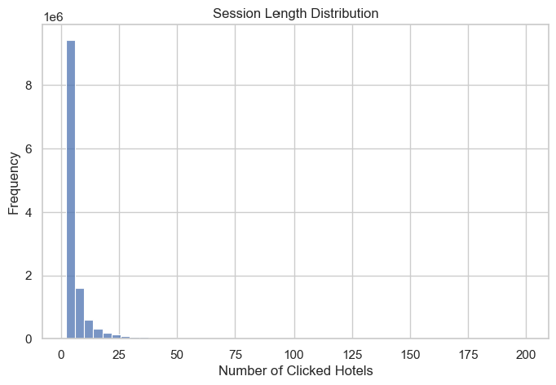
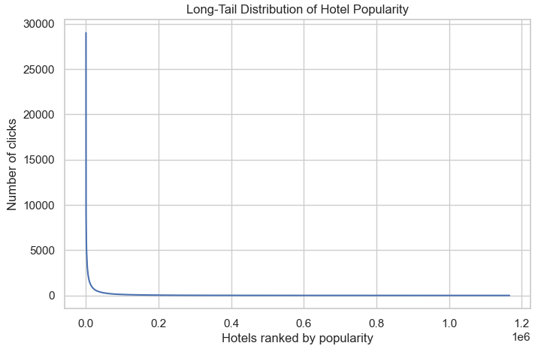
Exploratory findings
EDA
Session lengths are highly skewed
Hotel popularity follows a long tail
Observed pattern from the report and EDA code
Observed pattern from the report and EDA code
Most sessions are short, with a smaller tail of longer browsing behavior.
A few hotels receive many clicks, while most hotels appear infrequently.
•
•
Short sessions suggest local behavior matters most.
This creates sparsity and weak coverage for rare items.
•
•
Longer sessions exist, but they are much less common.
Embedding quality is better for frequently seen hotels.
Notes:
The exploratory analysis shows two key patterns.
First, most sessions are short, meaning user intent is often captured by just a few interactions.
Second, hotel popularity follows a long-tail distribution, where a small number of hotels appear frequently and many are rare.
This makes the problem challenging, because the model must learn from limited signals in a very sparse item space.

Slide 5
Methodology: Word2Vec for hotel sessions
MODEL
Session as sentence, hotel as word
Best configuration
Word2Vec learns dense vectors from co-occurrence inside sessions.
vector_size
64
H12
H77
H11
H309
window
3
Example browsing session
negative
8
alpha
0.01
•
Skip-gram (sg = 1) with negative sampling
•
min_count
5
•
Similarity computed with dot product between vectors
No explicit user profiles or hotel metadata required
epochs
10
Embedding space
Interpretation
Hotels used in similar contexts are placed close together.
A moderate window worked best, which suggests local browsing context is more useful than long-range context in this dataset.
Notes:
The main idea is to treat each session as a sentence and each hotel as a word.
Word2Vec learns embeddings based on co-occurrence patterns, so hotels appearing in similar contexts get similar vector representations.
I use the skip-gram architecture with negative sampling, which is efficient and helps learn better representations for less frequent hotels.
Similarity between hotels is computed using the dot product between their embedding vectors.
After tuning, the best configuration used vector size 64, window 3, negative sampling 8, learning rate 0.01, min_count 5, and 10 epochs.

Slide 6
Three recommendation strategies
COMPARISON
Popularity baseline
Previous-item model
Context-based model
Rank hotels by frequency in training data
Use the last clicked hotel as the query vector
Average all previous hotel vectors in the session
#1 hotel
H12
H77
H11
rec1
H12
H77
H11
#2 hotel
average
rec2
#3 hotel
q
Strengths
Strengths
Strengths
Simple reference point
No learned representation
Captures the strongest local signal
Best test performance
Uses more session information
Still beats the baseline
Main limitation
Main limitation
Main limitation
Ignores sequence and user state
Uses only one interaction
Can dilute relevant signal by averaging
Notes:
I evaluate three recommendation strategies.
The first is a popularity baseline, which ranks hotels by frequency.
The second is the previous-item model, which uses only the last clicked hotel and recommends similar ones.
The third is the context-based model, which averages all previous hotel embeddings in the session.
For filtering, the popularity and context models exclude all previously seen hotels, while the previous-item model excludes only the reference hotel.

Slide 7
How the code implements the experiment
FROM NOTEBOOK TO PIPELINE
Core code blocks in the notebook
Execution flow
model = train_w2v(train_sessions, ...)
W, hotel_to_idx, idx_to_hotel = export_embeddings(model)
popular_test_hit10 = hits_at_k_popular(test_sessions, popular_hotels, k=10)
prev_test_hit10, prev_total, prev_skipped = hits_at_k_prev(
test_sessions, W, hotel_to_idx, idx_to_hotel, k=10)
context_test_hit10, context_total, context_skipped = hits_at_k_context(
test_sessions, W, hotel_to_idx, idx_to_hotel, k=10)
results = pd.DataFrame({
"Model": ["Popular", "W2V Prev", "W2V Context"],
"Hits@10": [popular_test_hit10, prev_test_hit10, context_test_hit10]})
prepare sessions
Validation is used to tune each model separately, and then both models are compared on the test set.
train Word2Vec
tune hyperparameters
Important detail
retrain final model
Skipped sessions are reported when embeddings are missing for the required hotels.
evaluate on test
The implementation mirrors the methodology: train embeddings, export vectors, evaluate the three recommenders, and compare Hits@10.
Notes:
The notebook prepares the sessions, trains Word2Vec, exports embeddings, and evaluates the three recommendation strategies.
Hyperparameter tuning is done separately for each model using the validation set.
After tuning, each model is retrained and evaluated once on the test set.
The implementation also reports skipped sessions when embeddings are missing.

Slide 8
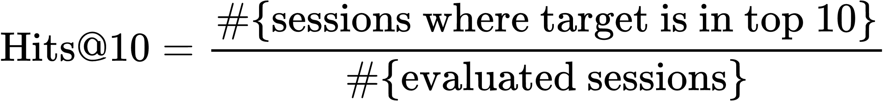
Evaluation strategy
HITS@10
Metric
Fair evaluation protocol
Hits@10 asks whether the true next hotel appears in the top 10 recommendations.
Input: all but the last click in the session
Target: the final hotel in the session
Example ranked list
Filtering: skip sessions with insufficient data or missing embeddings
1 H44
If the actual next hotel is H11, this session counts as a hit because H11 is inside the top 10.
2 H19
Selection: choose the best method on validation
3 H83
4 H11
Final report: evaluate once on the test set
5 H72
...
Why this metric? It matches interfaces that show only a few ranked options.
10 H309
Important limitation: Hits@10 does not reward a better rank position inside the top 10, so it is simple and useful, but not fully detailed.
Notes:
Performance is measured using Hits@10, which checks whether the true next hotel appears in the top 10 recommendations.
For each session, all but the last interaction are used as input, and the final interaction is the target.
Both models are tuned on the validation set, and final results are reported on the test set.
A limitation is that Hits@10 does not distinguish between rank 1 and rank 10.

Slide 9
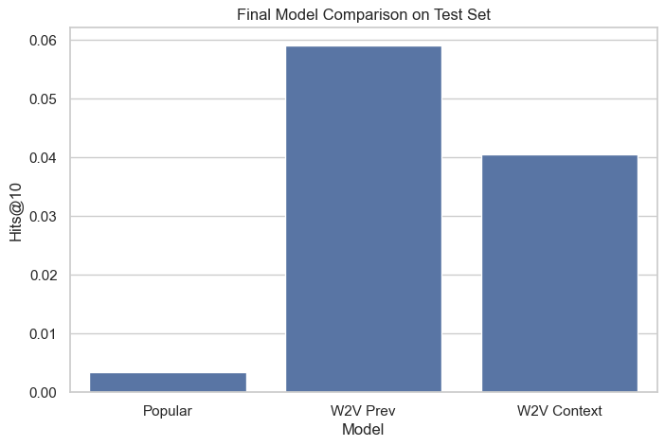
Results
TEST PERFORMANCE
Hits@10 on the test set
Exact scores
Model
Hits@10
Popular baseline
0.0035
Previous-item
0.0592
Context-based
0.0405
16.5x higher than the popularity baseline
Embedding models clearly beat the baseline, and the previous-item model gives the best overall ranking accuracy.
About 42% higher than the context model
Notes:
The results show a clear improvement over the baseline.
The popularity model achieves 0.0035, while the previous-item model reaches 0.0592 and performs best.
The context-based model achieves 0.0405.
This shows that learned embeddings are effective, but the strongest signal comes from the most recent interaction.

Slide 10
Discussion and interpretation
WHAT THE RESULTS MEAN
Why the previous-item model wins
Why the context model is weaker
Recent clicks carry the strongest short-term intent. In this dataset, local sequential patterns are more informative than longer context.
Averaging many embeddings can blur the most relevant signal, especially when users explore several directions in the same session.
Why absolute values stay low
What to be careful about
The hotel space is very large and sparse, so recommendation is inherently difficult. Even small absolute gains matter in this setting.
Some sessions are skipped when embeddings are unavailable, so reported scores reflect an evaluable subset and may be slightly optimistic.
Notes:
The previous-item model performs best because the last interaction carries the strongest short-term intent.
The context-based model uses more information, but averaging can dilute the most relevant signal.
Overall performance remains low because the task is difficult: the item space is large, the data is sparse, and some sessions cannot be evaluated due to missing embeddings.

Slide 11
Limitations and future work
NEXT STEPS
Current limitations
Future improvements
•
Rare hotels receive weak training signal.
Richer metrics
•
Word2Vec cannot model long-range dependencies explicitly.
Add Recall@K, MRR and NDCG
•
A 5% sample improves feasibility but may reduce representativeness.
More context
•
Use attributes such as price or location
Hits@10 alone does not capture detailed ranking quality.
Stronger models
Test GRU-based and transformer models
Operational realism
Explore real-time or incremental updates
Important trade-off: stability improves when rare hotels are filtered, but coverage becomes weaker for those same hotels.
Notes:
There are several limitations.
The data is sparse, so embeddings are stronger for frequent hotels than for rare ones.
Word2Vec also cannot capture long-range dependencies beyond its context window.
For future work, I would include additional metrics such as Recall@K, MRR, and NDCG, incorporate side information like location and price, and compare with stronger sequence models such as GRUs or transformers.
Another extension would be real-time updates to adapt to changing user behavior.

Slide 12
Conclusion
Three takeaways
Final result
1
Session sequences can be modeled effectively without explicit user profiles.
Hits@10
0.0592
2
Word2Vec embeddings clearly outperform a simple popularity baseline.
Best model: Word2Vec previous-item
3
The last interaction is the strongest predictor of the next hotel click.
Thank you
Questions?
Evros Vasileiou
University of Nicosia
Notes:
In conclusion, this project shows that Word2Vec can effectively model session-based recommendations.
The key result is that the previous-item model performs best, highlighting the importance of recent user behavior.
The main takeaway is that even simple models can be effective when they capture the right behavioral signal.
Thank you, and I’m happy to take any questions.

