Slide 1
Why our customers leave
Churn analysis · UK full-fibre broadband · 10,000 customer records · descriptive → predictive → prescriptive
• Most churn is structural, not dissatisfaction: 82% of terminations are customers moving home or leaving the area — where our network may not reach.
• Recorded churn — 6,947 of 10,000 customers (69.5%) terminated; the base is churn-weighted, so treat rates as relative comparisons, not the live-business rate.
• Strongest controllable lever — 24-month contracts churn at 42.5% vs ~75% for monthly/12-month — 78% lower odds of churn after controls.
• Geography — Leeds (82%) and Manchester (77%) churn well above London (63%) and Nottingham (41%).
• Competition is NOT the driver — number of competitors has no significant effect once other factors are controlled — spend on contract terms and movers, not price matching.
• What to do — contract migration at renewal, a mover's programme, and a Manchester/Leeds service-quality review — ( see recommendations on the last slide).

Slide 2
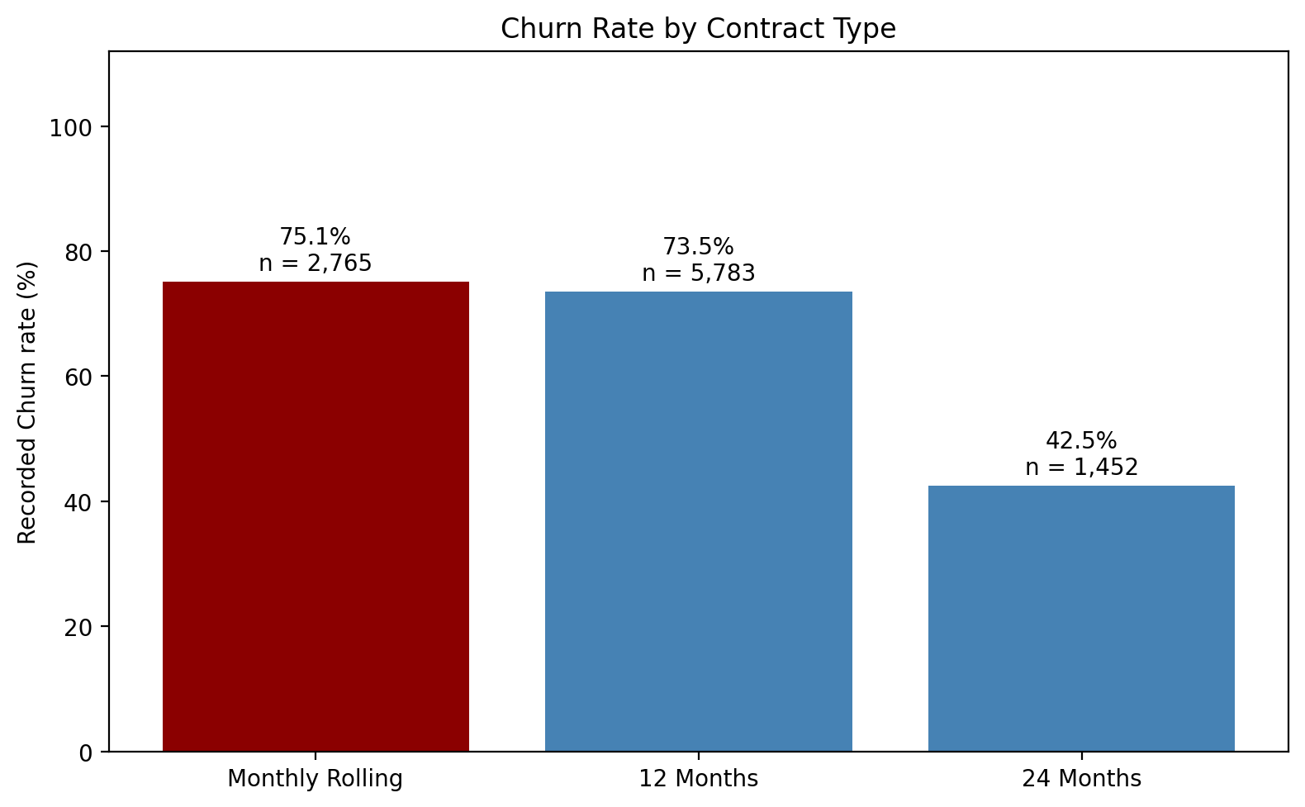
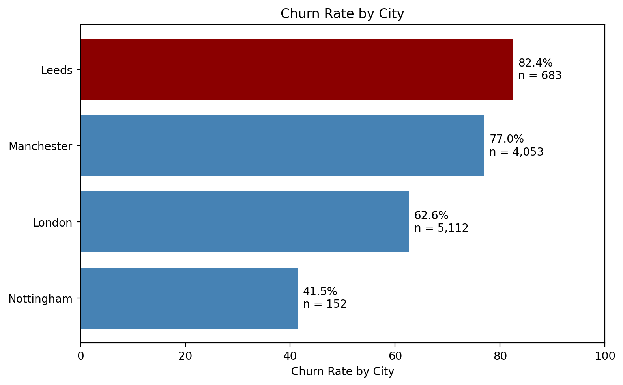
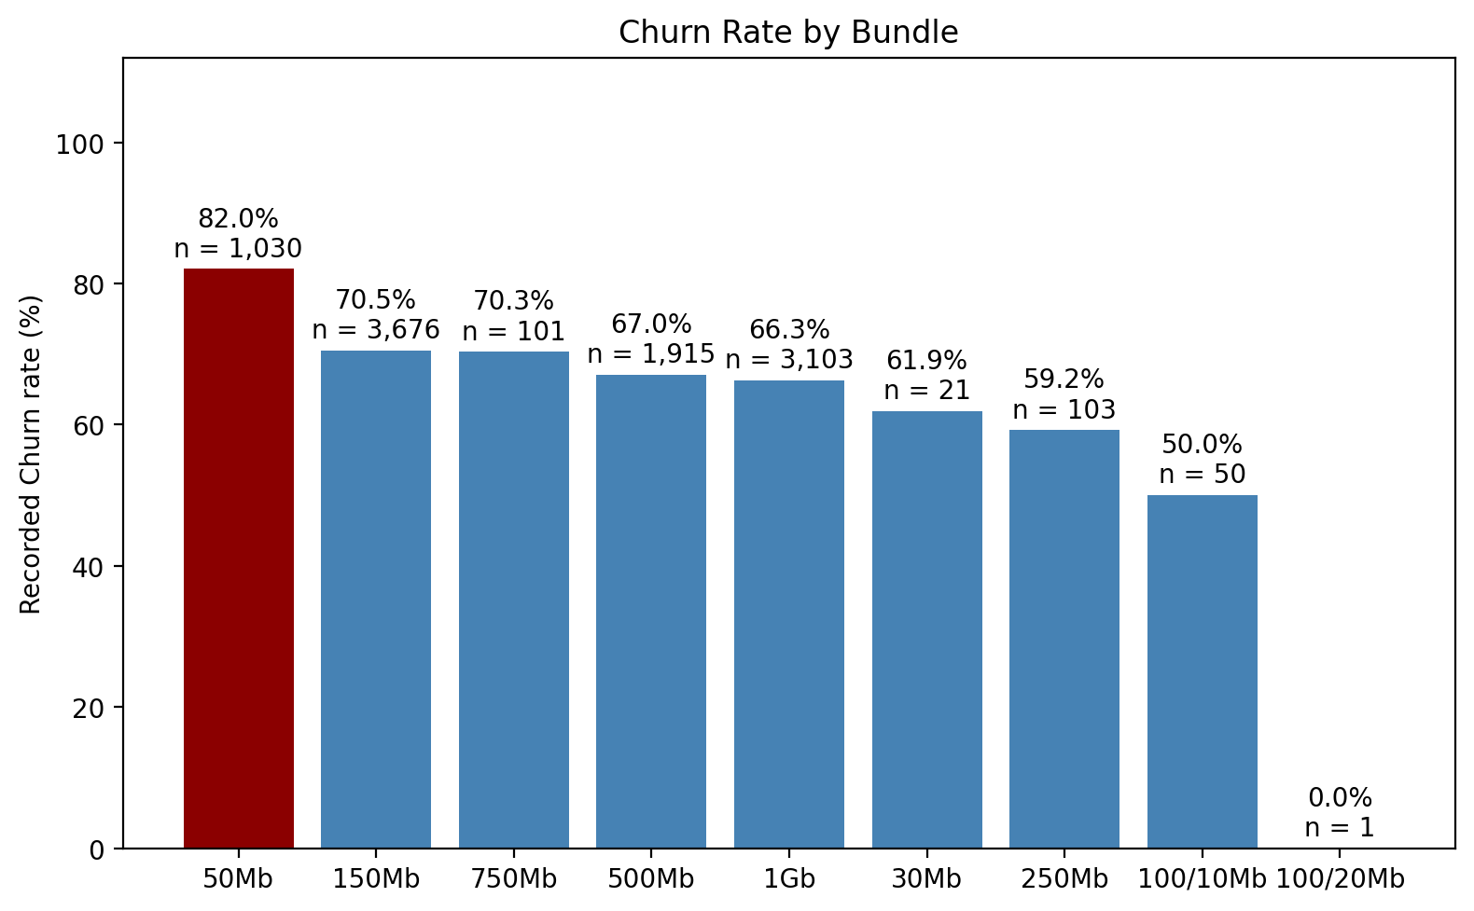
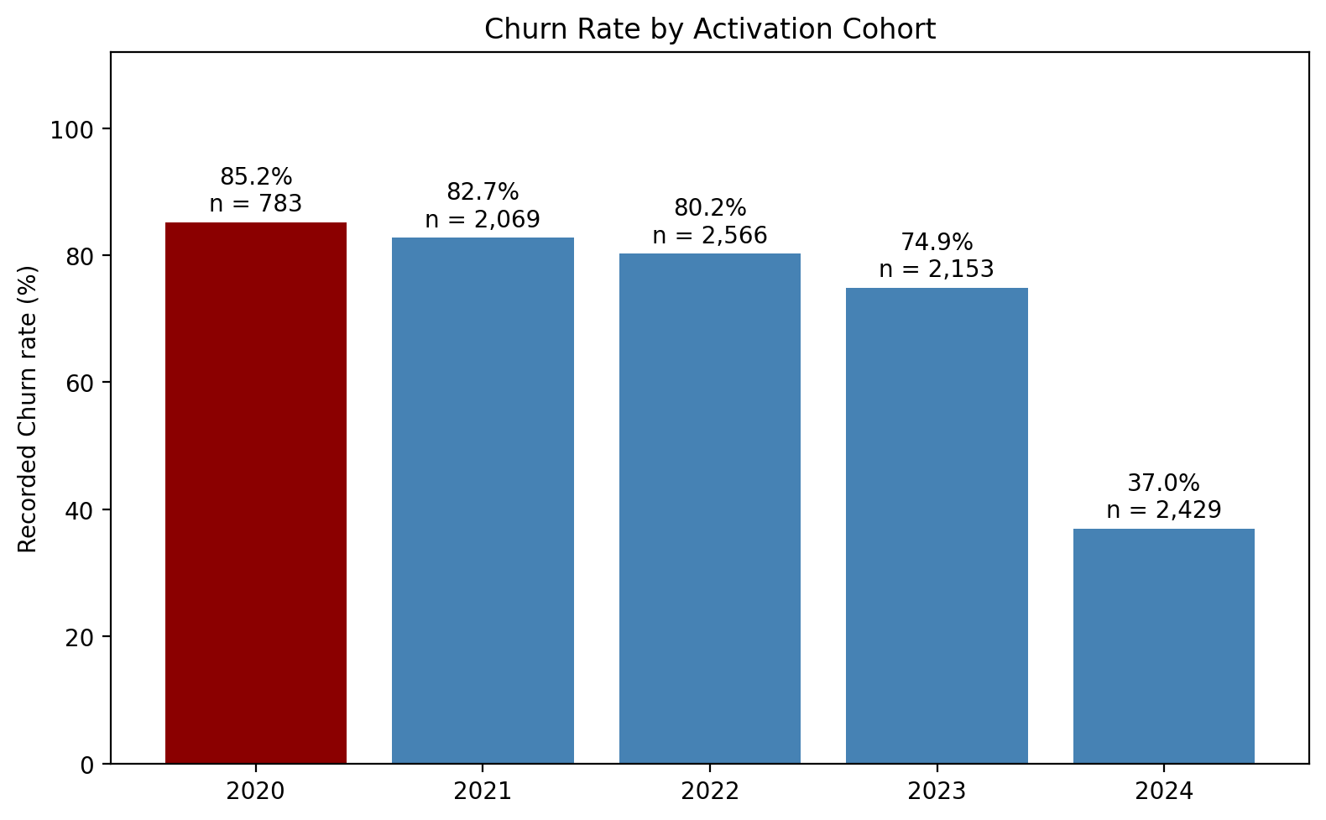
Data, approach & headline findings
• Data — 10,000 customers · activations Jan 2020 – Dec 2024 · terminations to Sep 2025. Cleaning: serial dates parsed, '-' → missing; only termination fields are missing — missing termination = still active.
• Approach — descriptive → statistics (chi-square, Cramér's V, correlations) → logistic regression (interpretable odds ratios; holdout acc 78%, AUC 0.80, recall 89%).

Slide 3
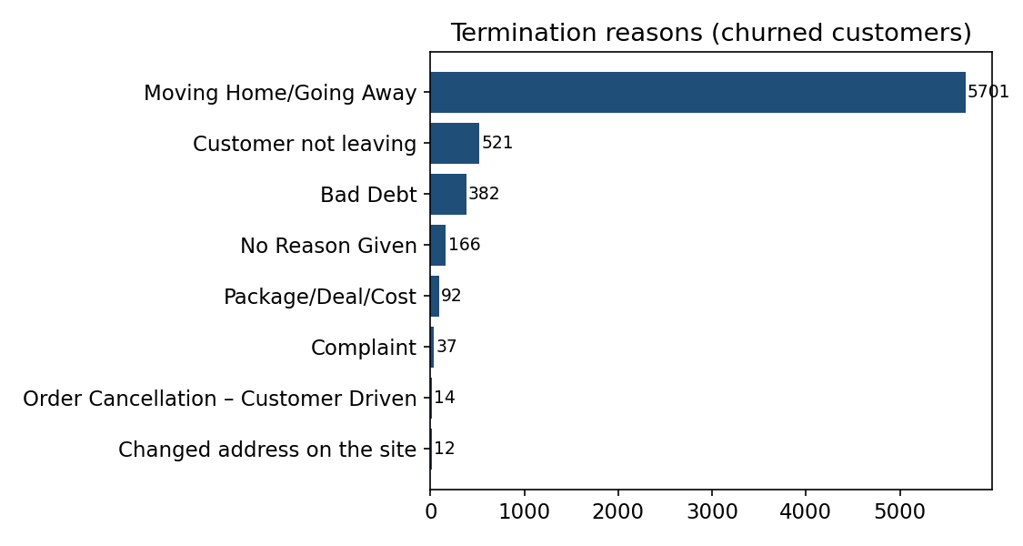
Why customers leave — reasons, contract & competition
Term | OR | sig.
24 Months (vs 12m) | 0.22 | ***
Monthly (vs 12m) | 1.28 | ***
1 competitor | 0.90 | n.s.
2 competitors | 0.87 | n.s.
• Moving Home/Going Away = 82% — 5,701 customers — structural churn, not dissatisfaction; 'Customer not leaving' (7.5%) is ambiguous but profile-matched to the base; Complaint + Package/Deal/Cost < 2%.
• Contract is the biggest lever — 24-month = 78% lower churn odds vs 12-month; monthly rolling +28%. Part of the gap is mechanical (still in-contract).
• Competitors don't move churn — 1 or 2 rivals present: no significant effect (p = 0.13 / 0.72).

Slide 4
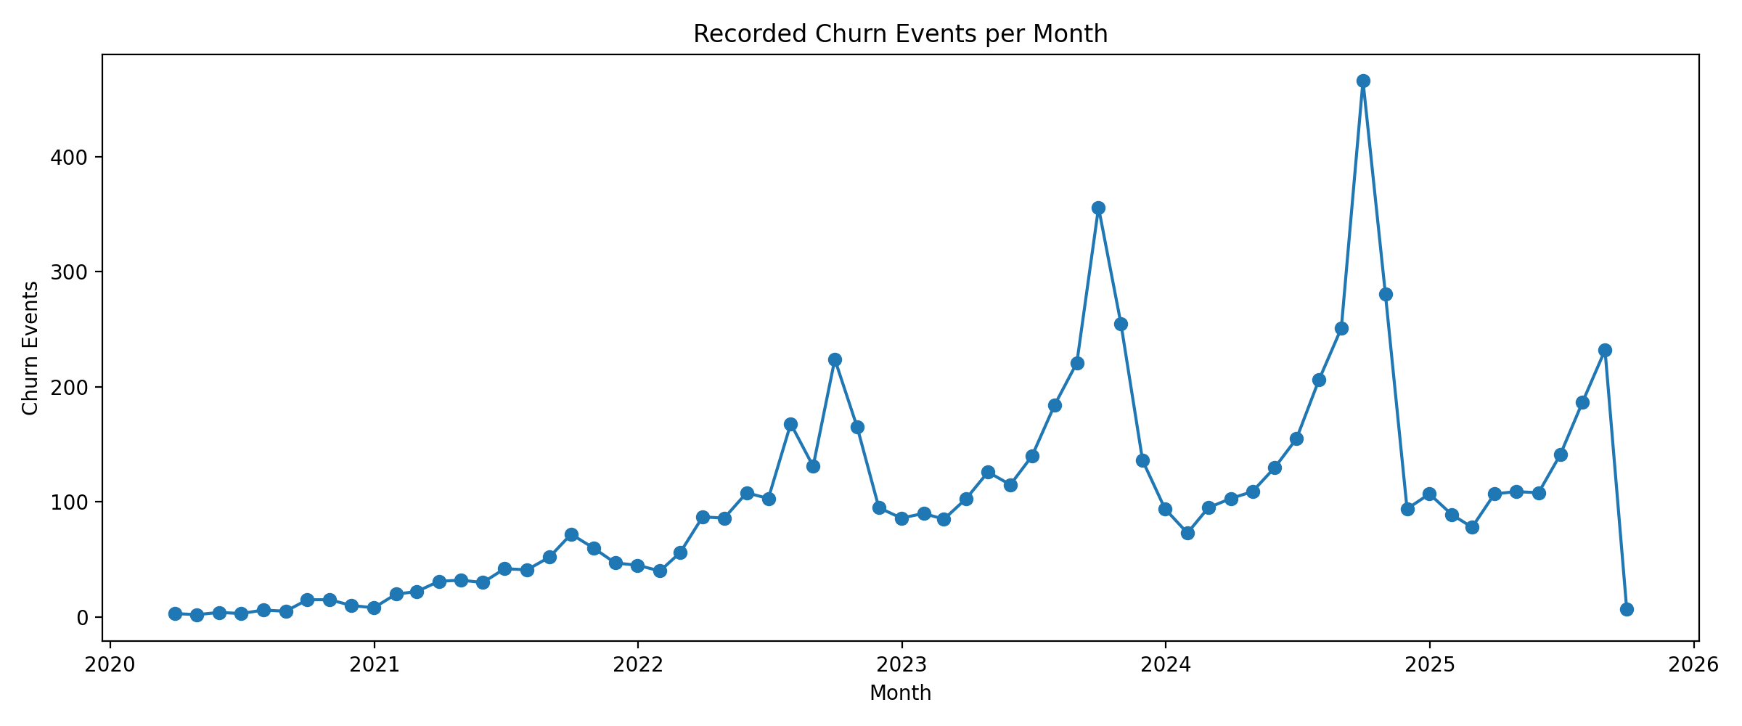
Where, what & when — geography, bundle, timing
• Where — Manchester churns ~51% more than Leeds after controls (OR 1.51); Nottingham ~64% less (OR 0.36). Leeds 82% / Manchester 77% vs London 63% / Nottingham 41%.
• What — 50Mb entry tier churns most — 82% (n=1,030; OR 1.39 vs 150Mb). Mid/high tiers lower: 500Mb 67%, 1Gb 66%.
• When — churn concentrates around contract end — median churned tenure ≈ 12 months. <6-month bands show 100% (observation artifact) but ~1,070 real early churners warrant onboarding review; 28 same-day terminations; 2024's 37% cohort rate is mostly less time to churn — report on a survival basis.

Slide 5
UK fibre market context & recommendations
• Altnet overbuild — UK altnets (incl. Hyperoptic) often overbuilt the same dense postcodes — when a mover's new address sits on another network, churn is automatic, not competitive loss. This matches our data: mover-dominated reasons + competitors not significant.
• Price pressure & consolidation — entry-level altnet FTTP prices fell from £22 to £19/month (2020–25) vs BT's £35 — price pressure is real; altnets are consolidating — retaining existing customers beats the market's rising acquisition costs.
• 1. Contract migration — move monthly/12-month customers to 24-month terms at renewal
(OR 0.22 — biggest controllable effect).
• 2. Mover's programme — seamless home-move transfers + landlord/developer
partnerships for the 82% who relocate.
• 3. Manchester & Leeds review — local service quality, install experience, overbuild pressure.
• 4. Entry-tier upgrade path — 50Mb churns most (82%) — nudge toward higher tiers;
deploy the model in CRM to score active customers; report churn on a survival basis.
Sources: Cartesian, 'The State of UK Fibre' (2025) — cartesian.com/state-of-uk-fibre · INCA & Point Topic, 'State of the Altnets' annual report — inca.coop · Ofcom, Telecoms Access Review / copper switchover proposals · Internal dataset: Case_Study_Data_1.xlsx (10,000 customers).

Slide 6
Recommended next steps
• 1. Survival-based churn reporting — replace cohort churn rates with Kaplan–Meier / survival curves so every cohort is compared at equal exposure; fixes the 2024 'low churn' artifact and the <6-month 100% bands.
• 2. Deploy the model in CRM — score active customers monthly; trigger retention offers when predicted churn crosses a threshold, prioritising monthly/12-month customers near renewal (24-month migration = 78% lower churn odds).
• 3. Split 'movers' by network coverage — join termination addresses to footprint data: off-network movers are structural loss; in-footprint movers are winnable and justify a home-move transfer programme for the 82%.
• 4. Manchester & Leeds deep-dive — pull install times, fault tickets and NPS for the two high-churn cities; test whether the gap is service quality or competitor overbuild density.
• 5. Entry-tier economics — analyse 50Mb cohort (82% churn): upgrade uptake, discount sensitivity, and whether an upgrade path to 150Mb+ cuts churn toward the 66–67% seen on higher tiers.
• 6. Enrich the model — add price paid, support tickets, outages, usage and rival-offer detail; competitor count alone was n.s., but offer quality may still matter.

