Slide 1
Churn Analysis — UK Full-Fibre Broadband
Case Study Data 1 · 10,000 customers · prepared with data through Sep 2025
Understanding who leaves, why they leave, and what we can do about it.

Slide 2
Data & Approach
Dataset: 10,000 customers across London, Manchester, Leeds and Nottingham
  Fields: city, postcode, bundle speed, contract duration, competitor presence, activation/termination dates and reason
Cleaning performed
  Excel serial dates converted; termination date '-' / blank treated as still active
  Churn flag: has a termination date and a real termination reason → 6,947 churned, 3,053 active
  Tenure measured to termination (churned) or to snapshot date Sep-2025 (active)
Overall churn rate in the base: 69.5% — unusually high, consistent with a churn-weighted sample
  All findings below compare churn rates between segments, not absolute volumes

Slide 3
Headline Findings
Moving home dominates: 82% of all terminations are 'Moving Home / Going Away' — largely uncontrollable churn
Contract length is the strongest retention lever: 24-month contracts churn at 42.5% vs ~75% for monthly/12-month
Geography matters: Leeds (82%) and Manchester (77%) churn far above London (63%) and Nottingham (41%)
Entry-level 50Mb bundles churn most (82%); churn declines as speed rises — 1Gb at 66%
Controllable churn is small: price/deal (1.3%), complaints (0.5%), bad debt (5.5%)
Churned customers leave after a median of ~12 months — the contract-end cliff

Slide 4
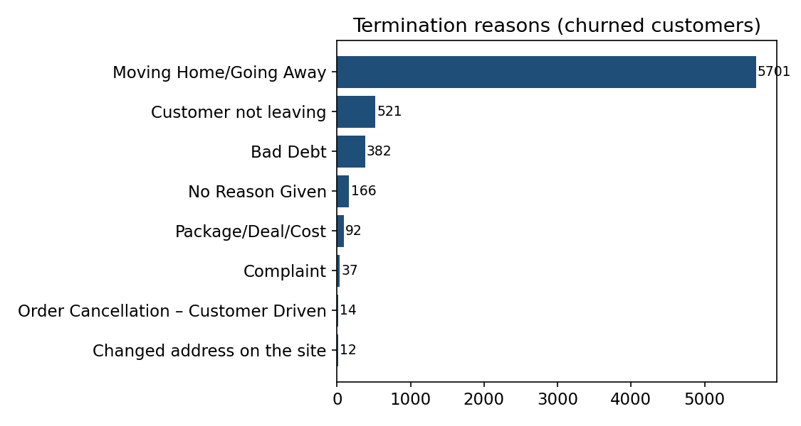
Why Customers Leave
Termination reason distribution (6,947 churned customers)
'Moving Home/Going Away' = 82% of churn
  Fibre is address-bound: movers churn when the new home isn't served (no offnet product)
'Customer not leaving' (521) likely admin/revoked terminations — data-quality fix
True controllable churn (price, complaints) is only ~2%

Slide 5
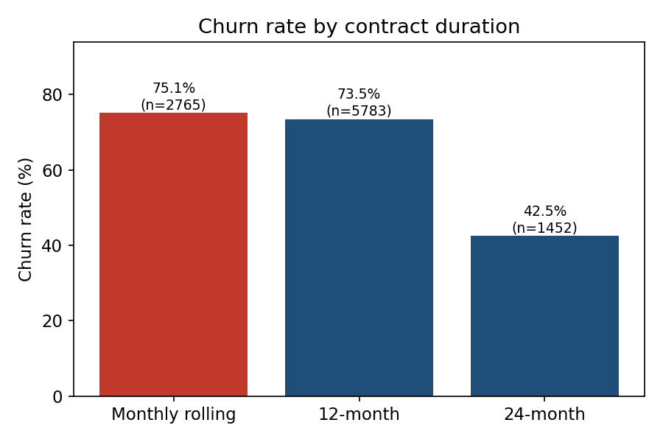
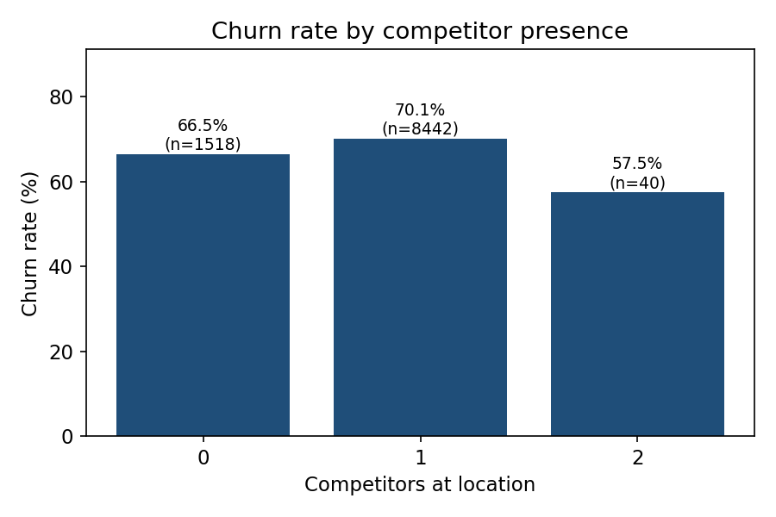
Contract Length & Competition
Longer contracts retain; competitor presence shows a mild effect
24-month contracts cut churn nearly in half vs monthly rolling
Areas with 1+ competitors churn ~4pts more than uncontested areas; 2-competitor sample is tiny (n=40)

Slide 6
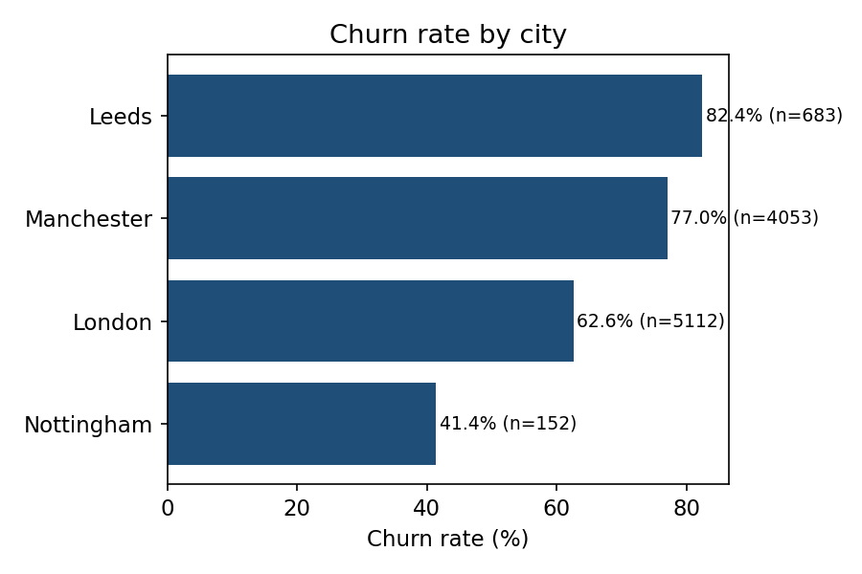
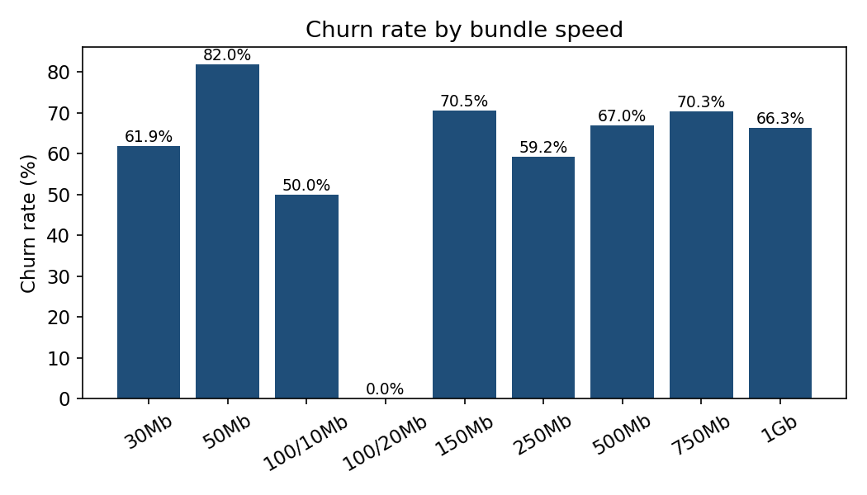
Where and What: Geography & Bundle
Leeds & Manchester churn ~15-20pts above London — likely higher overbuild/competition and housing churn
50Mb entry tier churns most — entry-tier customers are the most price-sensitive and mobile

Slide 7
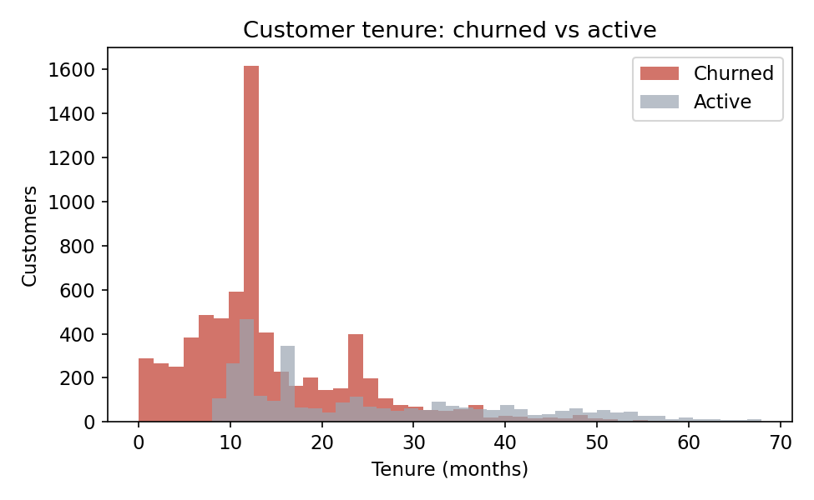
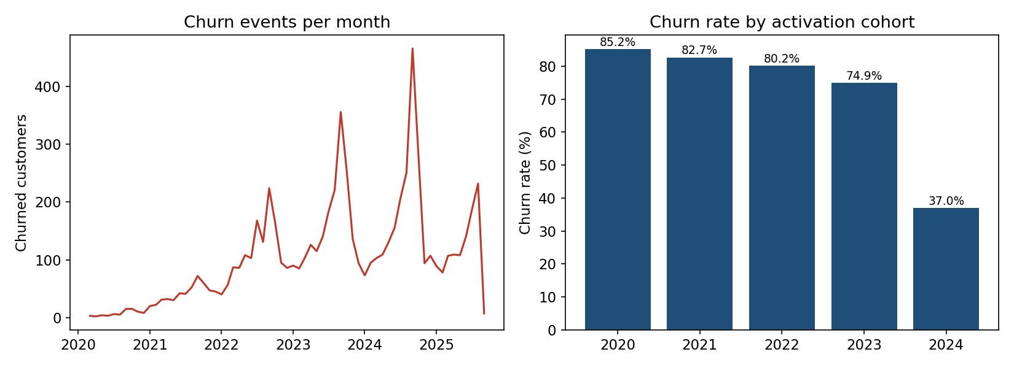
When Customers Leave
Median churned tenure ~12 months — churn concentrates at contract end
Churn spikes around the 12-month mark — contract expiry and intro-price rollover are the trigger
7.4% of churn happens within 3 months — early-life onboarding/installation issues

Slide 8
UK Fibre Market Context
External factors that amplify the findings
Altnet footprint nearly doubled: ~16m premises passed by late 2025 (~57% of UK FTTP) — overbuild keeps rising
FTTP prices fell ~41% in real terms over 3 years — switching is cheap and heavily promoted
House moves are the industry's largest 'uncontrollable' churn driver, worsened by Stamp-Duty-driven moves; most altnets don't sell offnet, so movers are lost at the address boundary
Consolidation is coming (CityFibre capital raise, Netomnia/nexfibre deal) — scale players will gain wholesale reach into the mover market
Altnets hold ~11% retail share; Hyperoptic ~1.7% — retention economics matter more than share grabs
  Sources: Intelligens Consulting (Dec 2025), 8Advisory FTTH take-up & churn (Jul 2025), Opensignal (Q2 2026), Enders Analysis Q2 2025

Slide 9
Recommendations
Attack the mover market (82% of churn)
  Launch a mover's program: proactive 'we're at your new address' outreach, address-portability check, partnered install at move-in
  Pursue wholesale/offnet partnerships (e.g. CityFibre, Openreach FTTP) so movers can stay customers at non-served addresses
Shift the base to longer contracts
  Incentivise 24-month terms (price locks, free speed upgrades) — they halve churn
Pre-empt the 12-month cliff
  Retention offers 60-90 days before contract end; re-contract before intro pricing rolls off
Fix early-life churn: onboarding quality checks and 90-day save-desk for new installs
Regional playbook for Leeds/Manchester: competitive win-back offers and service-quality audits where overbuild is densest
Data hygiene: reconcile 'Customer not leaving' records and add mover destination capture to measure recoverable churn

Slide 10
Caveats & Next Steps
The base is churn-weighted (69.5%) — segment rates are relative, not absolute business churn
No pricing, usage or satisfaction fields — recommended next data pull: ARPU, monthly spend, fault tickets, NPS
Suggested next analyses: survival/hazard modelling by cohort, mover-destination capture rate, competitor-density heatmap by postcode district

