Slide 1
Hyperoptic churn analysis — approach & headline findings
Data — 10,000 customers · activations 2020-01–2024-12 · terminations to 2025-09. Cleaning: Excel serial dates, '-' placeholders, no duplicates, no missing outside the two termination fields.
Churn definition — recorded termination = Termination Date present (6,947 churned, 3,053 active → 69.5% of this base).
Headline — 82% of terminations are 'Moving Home/Going Away' — largely structural (customer relocates off network), not dissatisfaction.
Strongest lever — 24-month contracts churn at 42.5% vs ~75% for monthly/12-month (odds 78% lower after controls).
Geography — Leeds 82.4% and Manchester 77.0% churn far above London 62.6% and Nottingham 41.4%.
Tools — pandas / scikit-learn / statsmodels / Chi-square & Cramér's V / logistic regression / Flask dashboard.

Slide 2
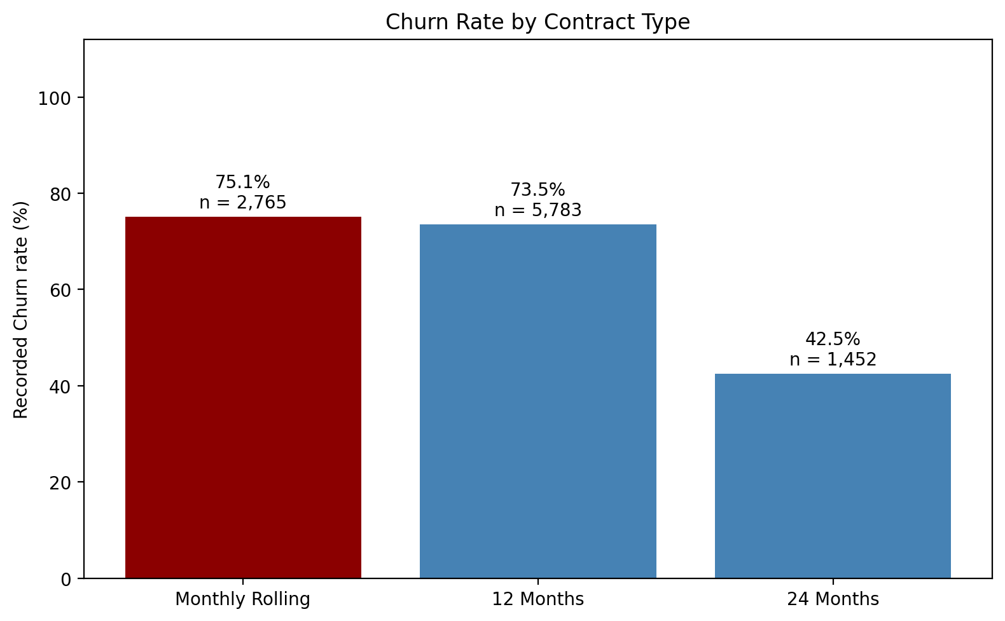
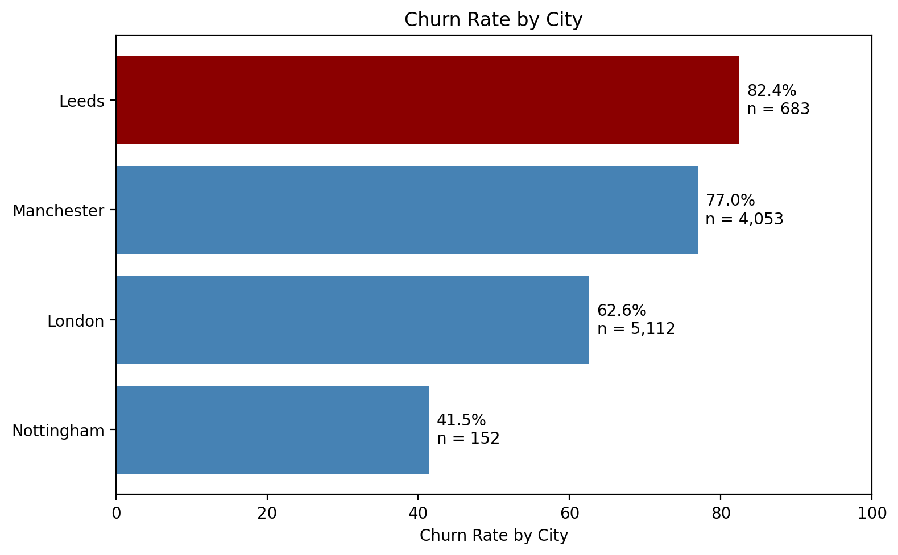
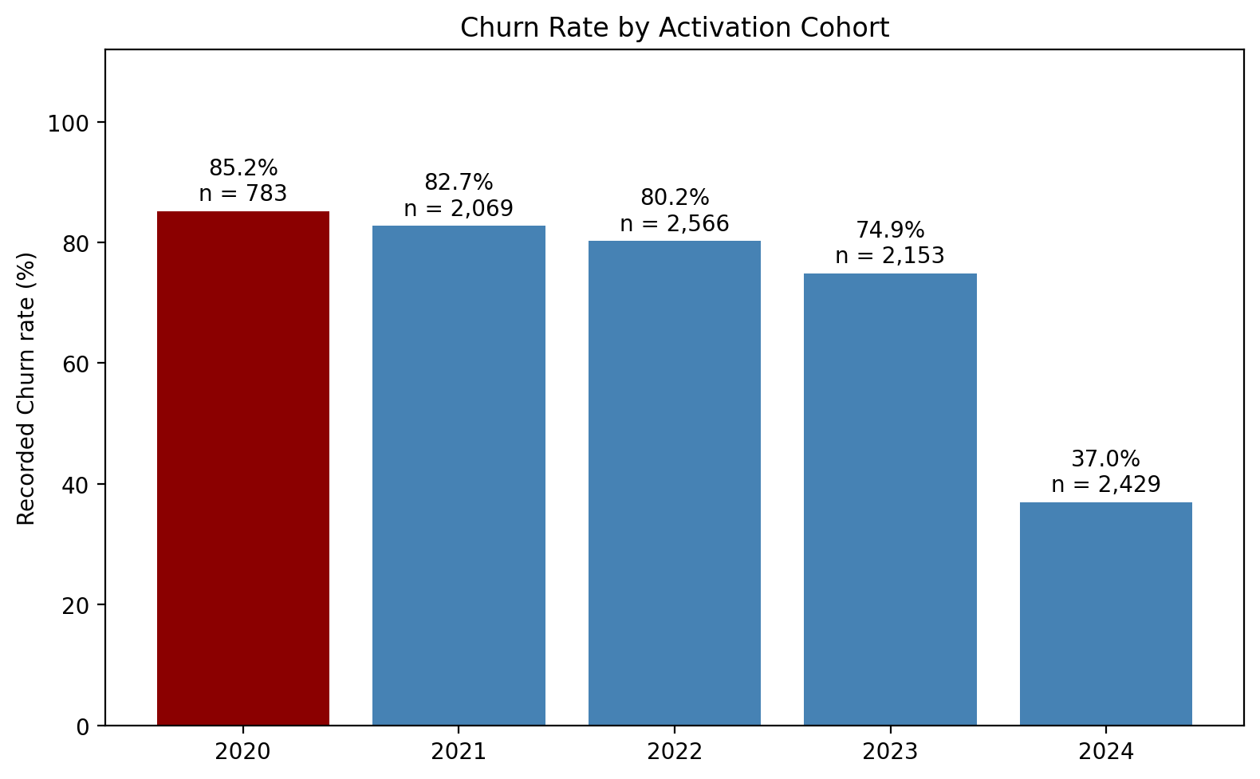
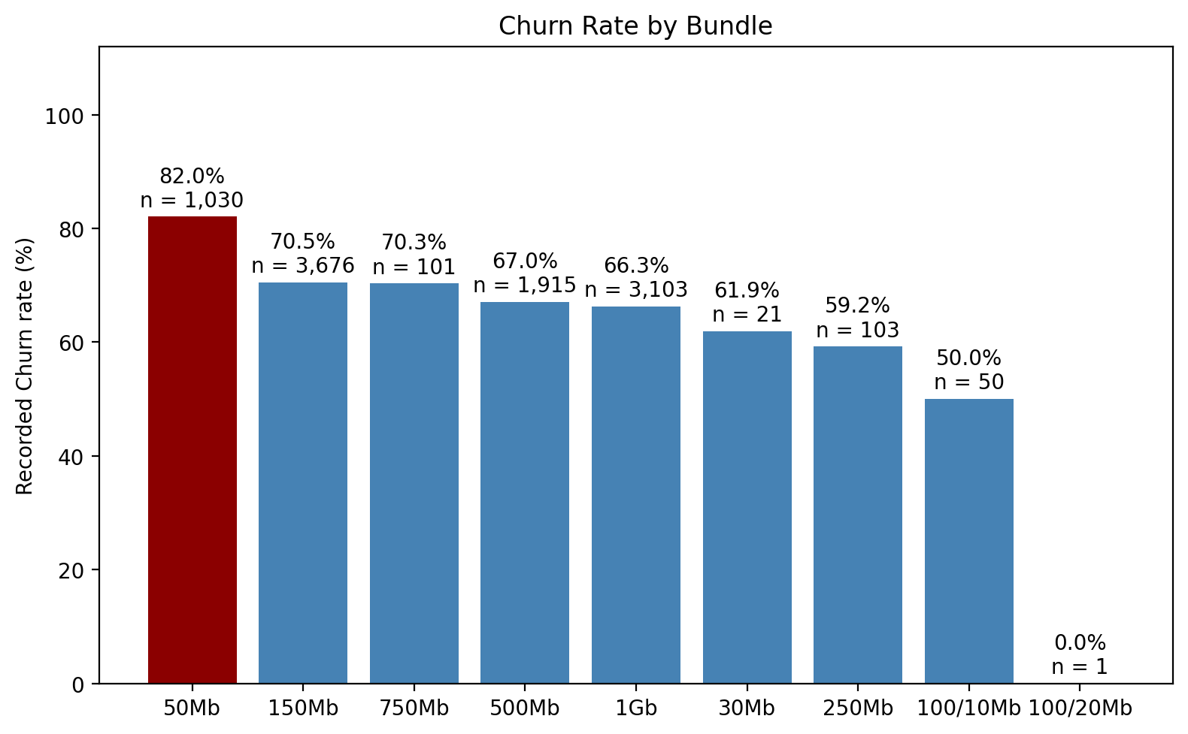
Descriptive analysis — where churn concentrates

Slide 3
Predictive layer — logistic regression results
Metric | Full model | Without activation year
Accuracy | 78.0% | 71.6%
Precision | 80.9% | 72.9%
Recall | 89.5% | 94.0%
ROC-AUC | 0.80 | 0.64
Term | Odds ratio | p
Contract Type_24 Months | 0.22 | 0.000
Contract Type_Monthly Rolling | 1.28 | 0.000
City_Manchester | 1.51 | 0.000
City_Nottingham | 0.36 | 0.000
Bundle Group_50Mb | 1.39 | 0.001
Bundle Group_Other | 0.51 | 0.000
Activation Year_2023 | 0.54 | 0.000
Activation Year_2024 | 0.09 | 0.000
Model — stratified 20% holdout, one-hot encoded factors; logistic regression chosen for interpretability (odds ratios).
Strongest signals — contract length (24m OR 0.22 vs 12m), cohort (2024 OR 0.09 — part exposure-window effect), Manchester vs Leeds (OR 1.51), 50Mb bundle (OR 1.39).
Not significant — number of competitors (p = 0.13 / 0.72) and London vs Leeds (p = 0.08) carry no signal once other factors are controlled.
Caveat — 2023–24 cohort coefficients partly reflect shorter observation windows, not better retention — flagged by the no-year robustness model (AUC 0.64).

Slide 4
Prescriptive analysis — what to do about it
1. Contract migration — move monthly/12-month customers toward 24-month terms near renewal — the single largest controllable effect (OR 0.22). Estimated addressable churn pool: ~60% of the base.
2. Mover's programme — 82% of churn is relocation. Offer seamless home-move transfers and partner with landlords/developers so 'Moving Home' doesn't mean leaving.
3. Manchester & Leeds focus — highest churn rates and sizeable populations — investigate local service quality, installation experience and altnet overbuild pressure.
4. 50Mb entry bundle — highest bundle churn (82%, n=1,030) — entry-tier customers may be price-sensitive or underserved; consider upgrade paths.
5. Early-tenure guardrail — the 0–6-month group shows 100% recorded churn — an observation-window artifact, but real early churn exists (~1,070 customers); tighten onboarding and install experience.

Slide 5
Insights, recommendations & caveats
Insight — churn in this dataset is dominated by structural movers and contract structure — price/competition play a minor recorded role (competitors V = 0.03).
Recommendation 1 — deploy the model into CRM: score active customers (the Flask app already exposes per-profile churn probability) and trigger retention offers above a threshold.
Recommendation 2 — report churn on a survival/exposure basis — raw cohort rates overstate recent-cohort improvement.
Recommendation 3 — clarify the 'Customer not leaving' category (521 records, 7.5% of churn) — it records a termination date but ambiguous churn meaning.
Caveat — the dataset is churn-weighted (69.5% observed churn is not the live-business rate); model AUC 0.80 is good for ranking, probabilities need recalibration on live volumes.

