Slide 1
Why our customers leave
Churn analysis — UK full-fibre broadband · customer base of 10,000 records
Prepared for business stakeholders · descriptive, predictive and prescriptive analytics

Slide 2
Executive summary — why customers leave
• The answer in one line — most churn is structural, not dissatisfaction: 82% of terminations are customers moving home or leaving the area — where our network may not reach.
• Recorded churn — 6,947 of 10,000 customers (69.5%) terminated; the base is churn-weighted, so treat rates as relative comparisons, not the live-business rate.
• The strongest lever is contract structure — 24-month contracts churn at 42.5% vs ~75% for monthly/12-month — 78% lower odds of churn after controls.
• Geography matters — Leeds (82%) and Manchester (77%) churn well above London (63%) and Nottingham (41%).
• Competition is NOT the driver — number of competitors present has no significant effect once other factors are controlled — retention spend should target contract terms and movers, not price matching.
• What to do — contract migration at renewal, a mover's programme, and Manchester/Leeds service-quality review — recommendations on the last slide.

Slide 3
Data & approach
• Data — 10,000 customers · activations Jan 2020 – Dec 2024 · terminations recorded to Sep 2025. Fields: city, postcode, bundle, contract duration, competitors, activation/termination dates and reason.
• Cleaning — Excel serial dates parsed, '-' placeholders → missing, no duplicates; only missing fields are termination-related — missing termination = still active, i.e. meaningful, not lost data.
• Churn definition — a record with a termination date counts as churned (6,947 churned / 3,053 active).
• Analytics flow — descriptive (where churn concentrates) → statistics (chi-square, Cramér's V, correlations) → predictive (logistic regression, odds ratios + holdout evaluation) → prescriptive (recommendations).
• Model — logistic regression on contract type, city, bundle group, competitors, activation year — chosen for interpretability: holdout accuracy 78%, AUC 0.80, recall 89%.

Slide 4
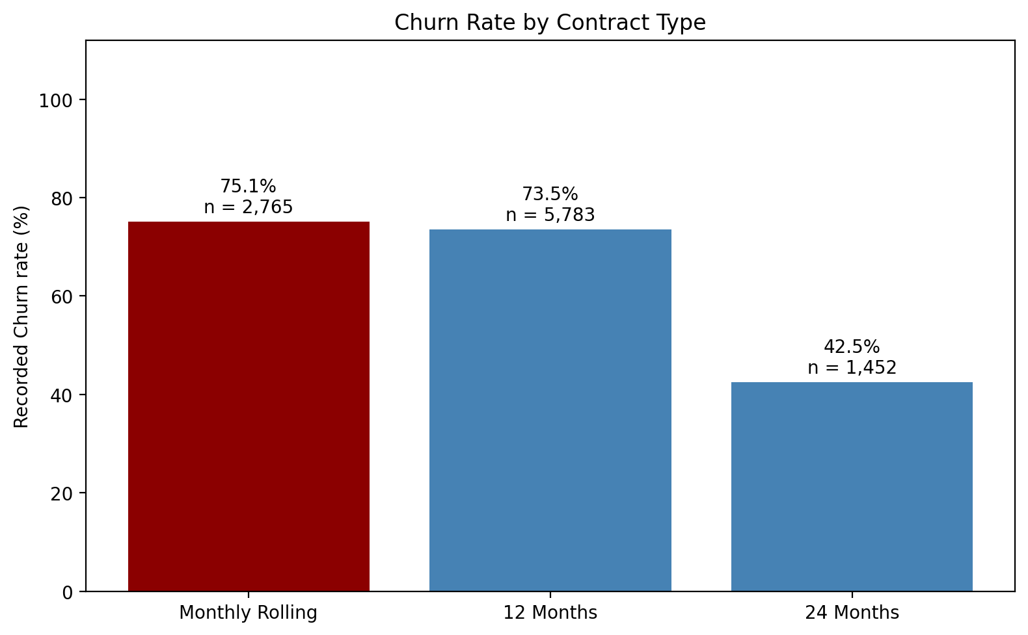
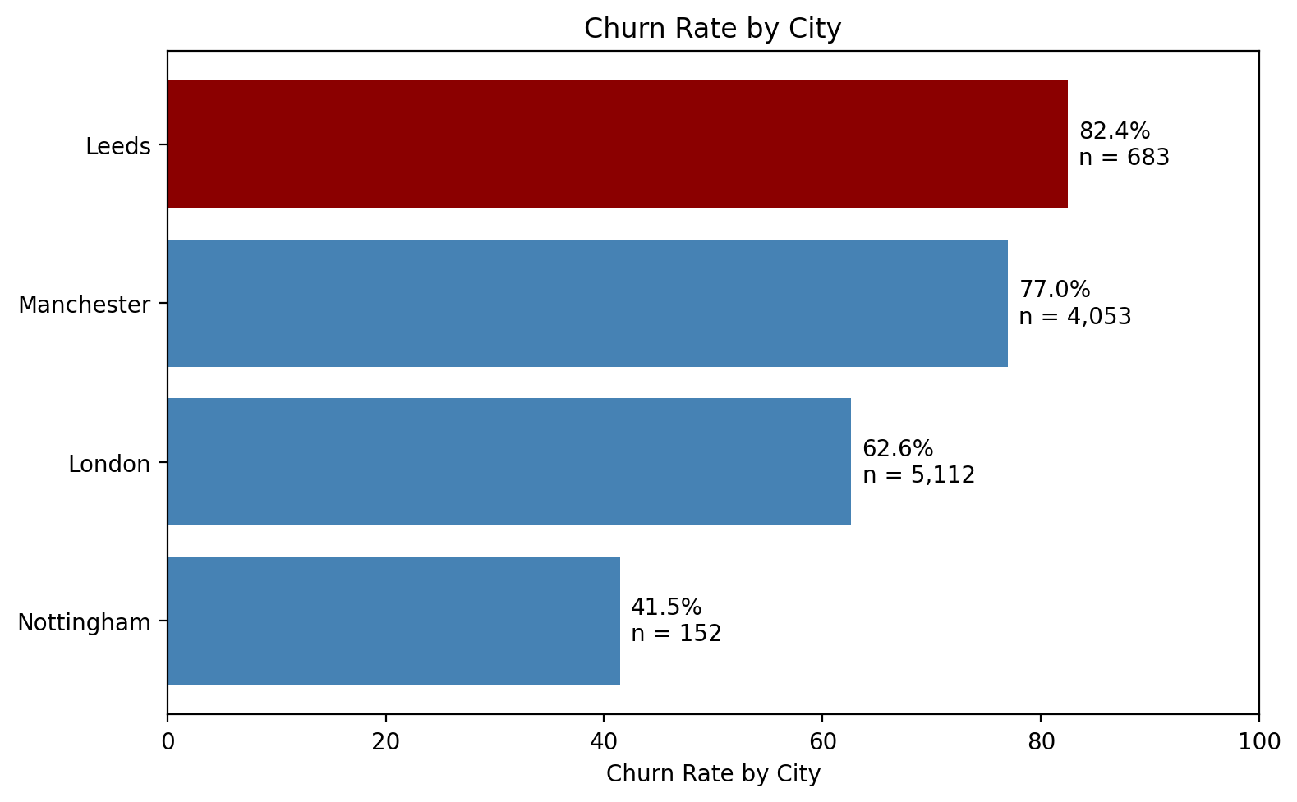
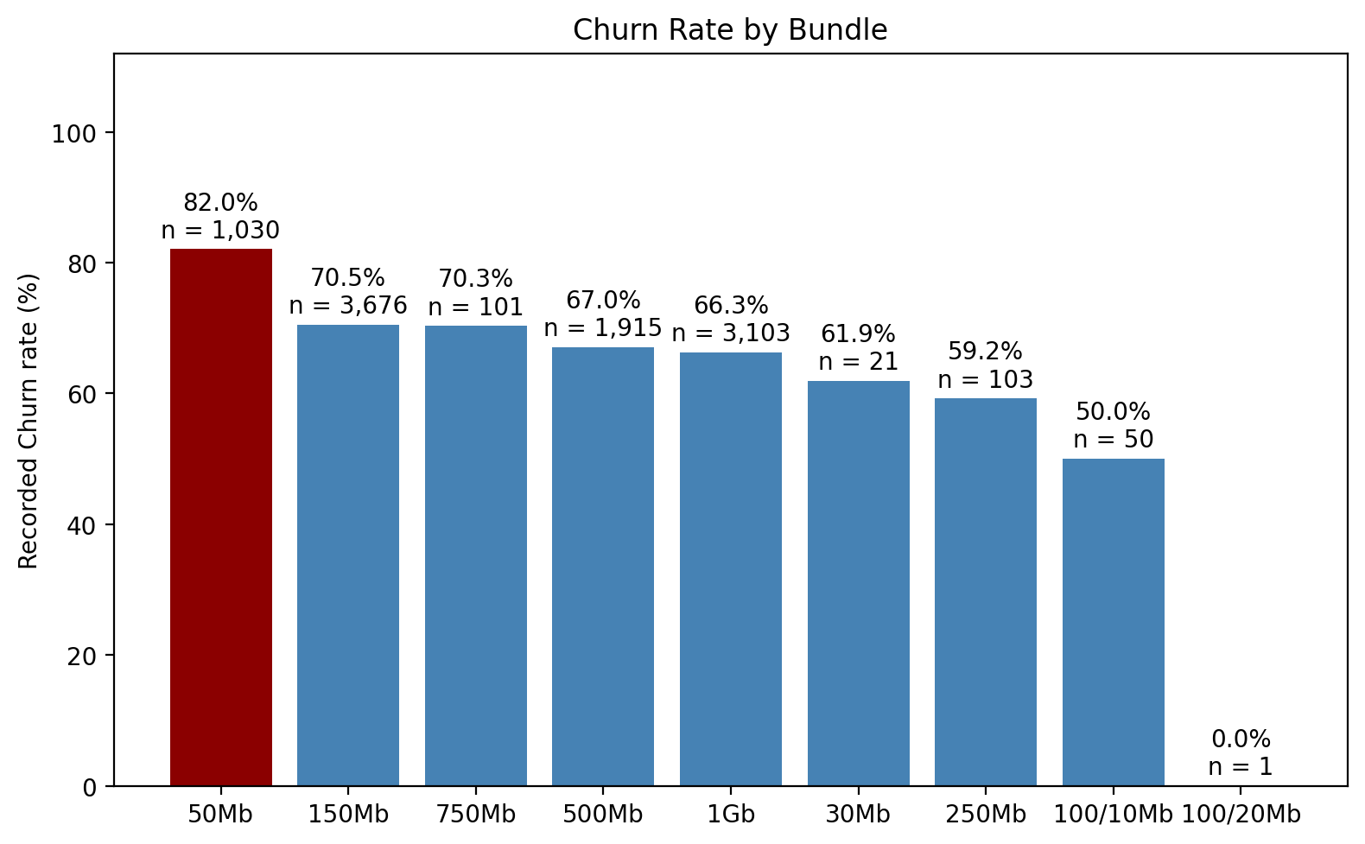
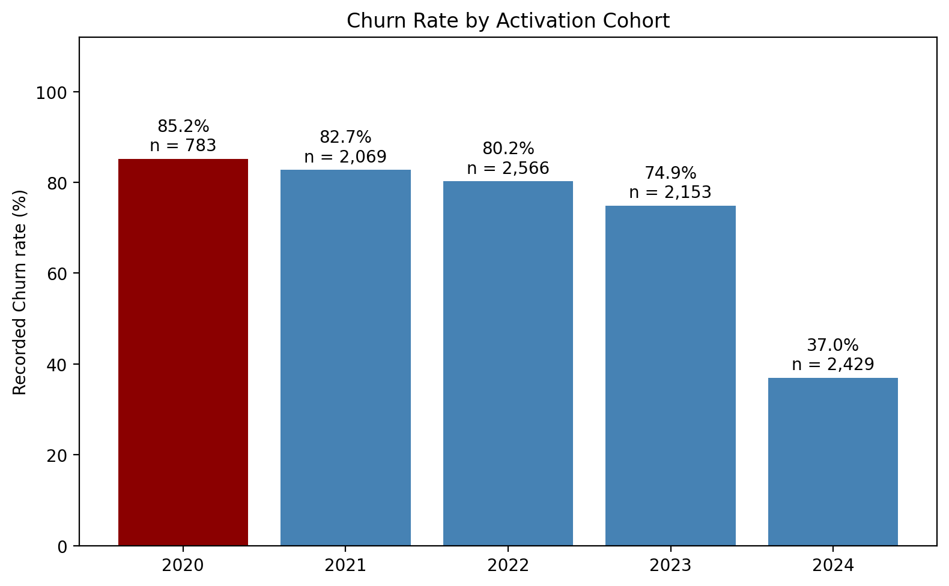
Headline findings — where churn concentrates

Slide 5
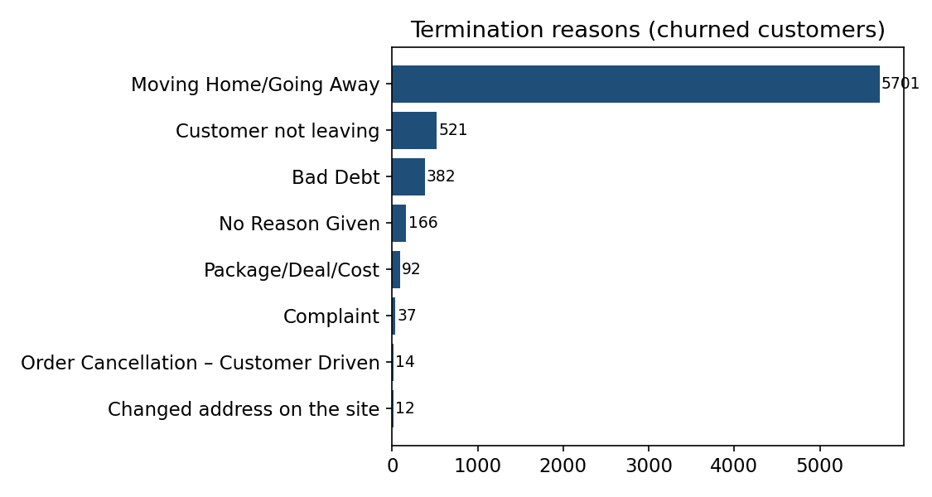
Why customers leave — termination reasons
• Moving Home/Going Away — 82.1% of all terminations (5,701 customers) — largely structural: the customer relocates, not necessarily dissatisfied.
• 'Customer not leaving' — 7.5% of churn records (521) — ambiguous category; its profile matches the overall base, kept but flagged.
• Bad Debt — 5.5% — a collections/pricing-design issue more than a service issue.
• Complaint + Package/Deal/Cost — under 2% combined — classic service/price churn is a small share.

Slide 6
Contract length & competition
Term | OR | sig.
24 Months (vs 12m) | 0.22 | ***
Monthly (vs 12m) | 1.28 | ***
1 competitor | 0.90 | n.s.
2 competitors | 0.87 | n.s.
• Contract is the biggest controllable lever — 24-month customers have ~78% lower odds of churning than 12-month; monthly-rolling churns more (+28%).
• Competition is not significant — having 1 or 2 competitors in the area does not move churn odds (p = 0.13 / 0.72) — presence of rivals alone doesn't drive exits.
• But — part of the 24-month gap is mechanical (still in-contract) — it's a lever, not pure satisfaction.

Slide 7
Where — geography
City (vs Leeds) | OR | sig.
London | 0.82 | p=.08
Manchester | 1.51 | ***
Nottingham | 0.36 | ***
• Manchester — churns ~51% more than Leeds after controls — the strongest geography signal.
• Nottingham — churns ~64% less — smallest base (n=152) but consistent.
• Action — review service quality, install experience and altnet overbuild pressure in Manchester and Leeds.

Slide 8
What — bundle
• 50Mb entry tier churns most — 82.0% (n=1,030; OR 1.39 vs 150Mb) — price-sensitive or underserved entry customers.
• Mid/high tiers churn less — 500Mb 67%, 1Gb 66%; 'Other' niche bundles show the lowest recorded churn (small n).
• Action — an upgrade path for the entry tier is cheaper than acquiring replacements.

Slide 9
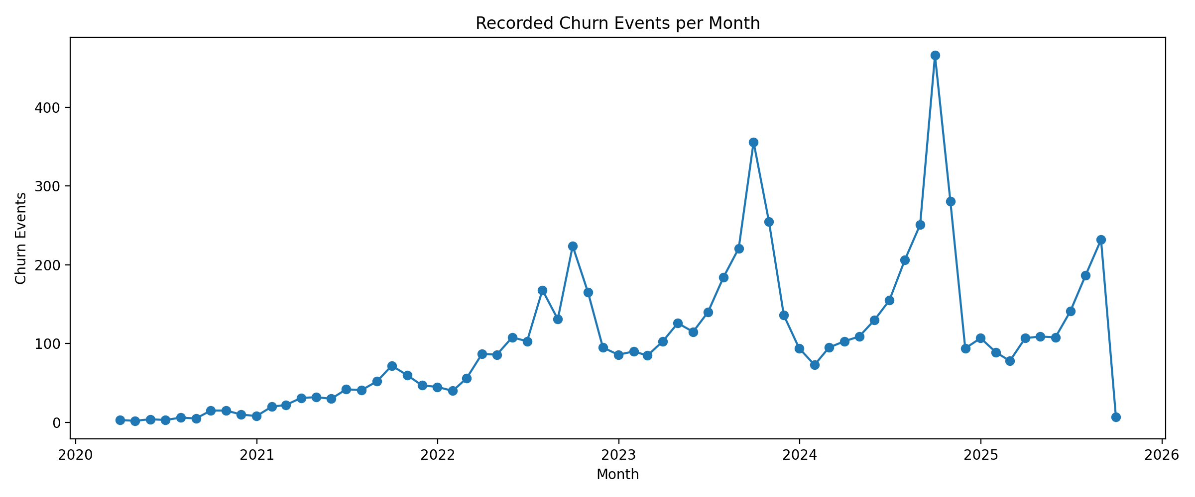
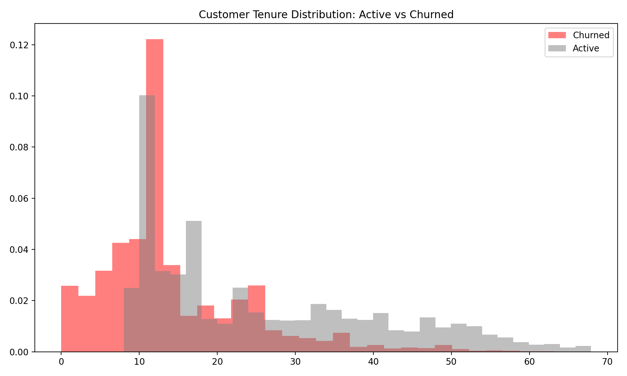
When customers leave — timing
• Churn concentrates around contract end — median churned tenure ≈ 12 months; the <6-month bands showing 100% are an observation artifact (active customers can't yet appear there) — though ~1,070 real early churners still warrant onboarding attention.
• Cohort rates reflect exposure — 2024's 37% is mostly less time to churn, not better retention — report on a survival basis.
• Same-day terminations — 28 customers left on activation day — worth an order-flow check.

Slide 10
UK fibre market context — why this matters
• Altnet overbuild — the UK altnet sector (incl. Hyperoptic) grew fast, often overbuilding the same dense postcodes — when a mover's new address sits on another network, churn is automatic, not competitive loss.
• Price pressure — wholesale FTTP prices fell ~40% in real terms over the build-out period — retention via contract length beats price wars.
• Consolidation wave — altnets are consolidating (debt-funded build-out + missed take-up targets); keeping existing customers is far cheaper than the market's rising acquisition costs.
• Read on our data — competitor count not being significant + mover-dominated reasons support the structural view: the fight is coverage and contracts, not head-to-head pricing.

Slide 11
Recommendations — prescriptive
• 1. Contract migration — move monthly/12-month customers to 24-month terms at renewal — biggest controllable effect (OR 0.22).
• 2. Mover's programme — 82% of churn is relocation: seamless home-move transfers + landlord/developer partnerships keep movers on-network.
• 3. Manchester & Leeds review — highest churn rates — local service quality, install experience, overbuild pressure.
• 4. Entry-tier upgrade path — 50Mb bundle churns most (82%) — nudge toward higher tiers.
• 5. Deploy the model — score active customers in CRM (dashboard calculator already live) and trigger offers above a risk threshold.
• 6. Better churn reporting — report survival/exposure-based churn; clarify the 'Customer not leaving' category.

