Slide 1
Fundamentals of Programming
Lecture 13
Introduction to Data Structures and Algorithms
BSc Business Information Systems

Slide 2
Agenda
Data Structures
Algorithms
Understand data types
Understand the role of classes
Understand objects
Learn C#.NET class Syntax
BSc Business Information Systems

Slide 3
Data structure
Data structure – method to store information
BSc Business Information Systems

Slide 4
Algorithms
Algorithm – method for solving a problem
Algorithm – a process or set of rules to be followed in calculations or other problem-solving operations
BSc Business Information Systems

Slide 5
Why study Algorithms?
If you know about available algorithms you can:
avoid re-inventing the wheel
select best algorithm based on information on complexity for different tasks
develop new algorithms more easily
BSc Business Information Systems

Slide 6
Algorithms
Web searching
Human genome project
Airline crew scheduling
GPS navigation
Financial prediction systems
Timetabling
BSc Business Information Systems

Slide 7
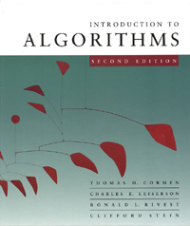
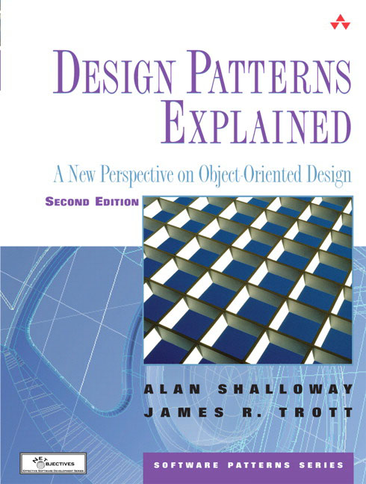
Books
BSc Business Information Systems

Slide 8
Data type
A definition of a set of data that specifies the possible range of values of the set, the operations that can be performed on the values, and the way in which the values are stored in memory.
BSc Business Information Systems

Slide 9
Data types
Integer
Operations: +, - , *, /
String
Operations: Substring(), Trim()
DateTime
Operations: AddDays(), AddYears()
BSc Business Information Systems

Slide 10
What is a Class?
Class is a user defined Data type
BSc Business Information Systems

Slide 11
What is an Object?
Object is an instance of a class
A variable of a particular class type
BSc Business Information Systems

Slide 12
Classes in C#.NET
public class Boat
{
private int _width;
private int _length;
//More stuff goes here
}
BSc Business Information Systems

Slide 13
Constructors
public Boat()
{
_width = 10;
_length = 110;
}
public Boat(int width, int length)
{
_width = width;
_length = length;
}
BSc Business Information Systems

Slide 14
Properties
private int _width;
public int Width
{
get
{
return _width;
}
set
{
_width = value;
}
}
BSc Business Information Systems

Slide 15
Auto properties
public int Width { get; set; }
BSc Business Information Systems

Slide 16
Methods
public void AddPerson(Person p)
{
//...
}
public int GetCurrentLoad()
{
return 0;
}
BSc Business Information Systems

Slide 17
The end
BSc Business Information Systems

