Slide 2
Fundamentals of Programming
Lecture 8
Relational database model, SQL

Slide 3
Agenda
Relational database model
SQL – Structured Query Language
Using VB to manipulate data in databases

Slide 4
What is a database
Database consists of one or more complex files that store data in a structured format.
Database Management System (DBMS, Database engine) manages the file or files and the data within those files.

Slide 5
What is DBMS?
Webopedia
DBMS is a collection of programs that enables you to store, modify, and extract information from a database.
http://www.webopedia.com/TERM/D/database_management_system_DBMS.html
Dictionary.com
DBMS: software that mediates access to, additions and deletions of, and changes in data contained in a database, so as to store and access data efficiently and control which data particular programs or individuals are allowed to use.
http://www.dictionary.com/browse/dbms
DBMS provides a means of accessing the data stored inside the database.
It manages important issues such as concurrent access (multiple accesses at one time) of the data, efficient access of the data, data backup and recovery.

Slide 6
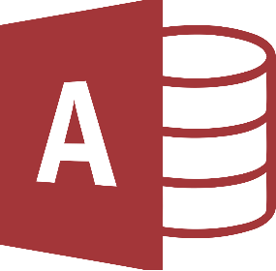





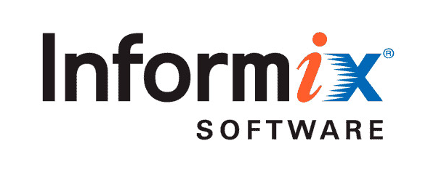


Examples of relational DBMS
Microsoft® Access
InterBase®

Slide 7
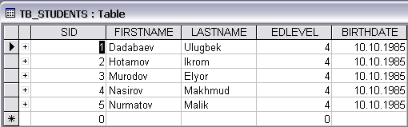
Tables
Table contains a collection of data, which is represented by one or more columns, and a number of rows of data.
Columns are referred as fields or attributes
Rows referred as records or tuples

Slide 8
Examples of relational DBMS
DBMS
Database
DBMS manages the database:
creating tables
inserting data
retrieving data
updating data
deleting data
etc.
Tables

Slide 9
Primary key
Primary key (PK) – a field that contains a unique value for each row in a table
The physical location of the row in a table is unimportant but a means of isolating a specific row in the table is necessary.
This is achieved by having a column on each row with a unique value, different from all other rows in that table.
PK enables user to retrieve just one row from among the others in the table.

Slide 10
Relationship
Relationship is a meaningful association between tables, e.g.:
a Person is located in a Country
a Sales Agent is responsible for a Client

Slide 11
Relationship types
One-to-One (Person – Student)
One-to-Many (Course – Student)
Many-to-Many (Student – Module)

Slide 12
SQL
Structured Query Language – special purpose language to retrieve and manipulate data of a relational database
Consists of 2 major components:
DDL – Data Definition Language
DML – Data Manipulation Language

Slide 13
DDL (Data Definition Language)
Used to manage database objects:
create tables or views
change columns
delete tables
etc.

Slide 14
DML (Data Manipulation Language)
Used for accessing and manipulating the data. Consists of 4 main operations (CRUD):
Create
Retrieve
Update
Delete

Slide 15
SQL SELECT – retrieve data
SELECT {* | column_name_list}
FROM table_list
[WHERE conditions]
More on this – next year
'select all columns from Teacher table
SELECT * FROM tbTeacher
'select first and last names from Teacher table
SELECT firstName, lastName FROM tbTeacher

Slide 16
SQL INSERT – create data
INSERT INTO table_name
[(column_list)]
VALUES (values_list)
'insert a row into Teacher table with the given values
INSERT INTO tbTeacher
(firstName, lastName, address, phone)
VALUES
('Anna', 'Kozlova', 'Tashkent', '111-11-11')

Slide 17
SQL UPDATE – edit data
UPDATE table_name
SET {column=value}
[WHERE conditions]
'change phone number for the teacher whose ID = 1
UPDATE tbTeacher
SET phone = '222-22-22'
WHERE id = 1

Slide 18
SQL DELETE – remove data
DELETE FROM table_name
[WHERE conditions]
'delete a row with ID = 1 from Teacher table
DELETE FROM tbTeacher
WHERE id = 1
'always include WHERE clause in your DELETE statements,
'unless you want to remove all data from table

Slide 19
ADO.NET
ADO.NET is a collection of classes (System.Data namespace) designed to provide connection to relational databases.
DB programming in .NET could be done via connected and disconnected architecture

Slide 20
Connected architecture
For every operation (CRUD) the application issues SQL statement against a database and shows the result to user
…DbConnection – connect to DB
…DbCommand – to send SQL to DB
…DataReader – to read database response

Slide 21
Connected architecture
var sql = "select * from tb_teacher";
var cmd = new OleDbCommand(sql, conn);
conn.Open();
OleDbDataReader rdr = cmd.ExecuteReader();
string result = "";
while (rdr.Read())
{
result += $"Id: {rdr.GetInt32(0)}; ";
result += $"Last name: {rdr.GetString(1)}; ";
result += $"First name: rdr.GetString(2); ";
result += $"Address: {rdr.GetString(3)}; ";
result += $"Phone: {rdr.GetString(4)}";
result += "\n";
}
MessageBox.Show(result);

Slide 22
Disconnected architecture
Application connects to the database to retrieve data and store it in memory
Disconnect from the database
Do updates to in-memory copy
Connect to database and do updates to the database

Slide 23
Disconnected architecture
…TableAdapter – performs read and update operations
DataSet, TypedTableBase – in-memory data store
BindingSource – position aware view of a DataTable

Slide 24
Disconnected architecture
Used for client with limited network connectivity (smart devices, distant areas)
If there is need for offline data storage
Potentially outdated data

Slide 25
The End

