Slide 1
Lecture 19
Sorting Algorithms

Slide 2
Outcomes
Understand bubble sort
Understand insertion sort
Understand selection sort
Understand quick sort
To be able to implement them in C#

Slide 3

Bubble Sort
Values “float like a bubble” from one end of the list to another

Slide 4
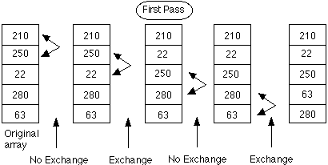
Bubble Sort

Slide 5
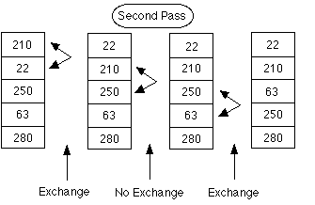
Bubble Sort

Slide 6
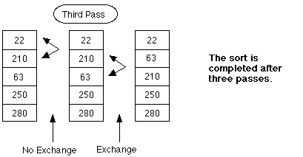
Bubble Sort

Slide 7
Selection Sort
Start at the beginning of the array, find the smallest element. Place it in position 0, start again from position 1

Slide 8
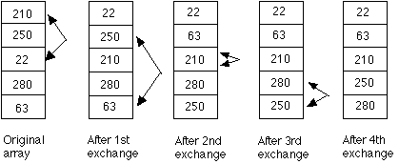
Selection Sort

Slide 9
Insertion Sort
Start from the first element. Place second before or after. Third in between before or after etc.

Slide 10
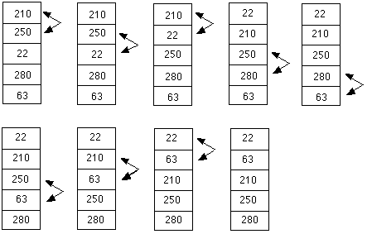
Insertion Sort

Slide 11
Quick Sort
Worst case – O(n²)
Average case – O(n lg n)
Based on the divide-and-conquer paradigm
Implementation requires knowledge of recursion

Slide 12
Quicksort - steps
The steps are:
Pick an element, called a pivot, from the list.
Reorder the list so that all elements with values less than the pivot come before the pivot, while all elements with values greater than the pivot come after it (equal values can go either way). This is called the partition operation. After this partitioning, the pivot is in its final position.
Recursively sort the sub-list of lesser elements and the sub-list of greater elements.
The base case of the recursion are lists of size zero or one, which never need to be sorted.

Slide 13
Choosing pivot
If leftmost (first) element is selected as pivot, worst case for already sorted array
Random index
Middle element
Last element

Slide 15
Quicksort
Pseudocode
function sort(array)
Dim less, greater as List
if array.Length ≤ 1
return array
select and remove a pivot value from array
for each x in array
if x ≤ pivot then append x to less
else append x to greater
return concat(sort(less), pivot, sort(greater))
C# implementation can be found here

Slide 16
Other sorting algorithms
Merge sort
Heapsort
https://visualgo.net/bn/sorting

Slide 17
The End

