Slide 1
Lecture 18
Big-O notation
Linked lists

Slide 2
Outcomes
Understand Big-O notation
Understand shortcomings of the Arrays
Understand nature and structure of Linked lists

Slide 3
Big-O notation
also known as
big Oh notation,
big Omicron notation,
Landau notation,
Bachmann–Landau notation,
asymptotic notation

Slide 4
Big-O notation
Big O notation is used in Computer Science to describe the performance or complexity of an algorithm.
Big O specifically describes the worst-case scenario, and can be used to describe the execution time required or the space used (e.g. in memory or on disk) by an algorithm.

Slide 5
O(1)
O(1) describes an algorithm that will always execute in the same time (or space) regardless of the size of the input data set.

Slide 6
O(1)
public bool IsFirstElementEmpty(string[] s)
{
if (s[0] == "")
return true;
else
return false;
}

Slide 7
O(N)
O(N) describes an algorithm whose performance will grow linearly and in direct proportion to the size of the input data set.

Slide 8
O(N)
public bool ContainsValue(string[] s, string v)
{
for (var i = 0; i <= s.Length - 1; i++)
{
if (s[i] == v)
return true;
}
return false;
}

Slide 9
O(N²)
O(N²) represents an algorithm whose performance is directly proportional to the square of the size of the input data set.
This is common with algorithms that involve nested iterations over the data set. Deeper nested iterations will result in O(N³), O(N⁴) etc.

Slide 10
O(N²)
private bool ContainsDuplicates(string[] s)
{
for (var i = 0; i <= s.Length - 1; i++)
{
for (var j = 0; j <= s.Length - 1; j++)
{
if (i == j)
continue;
if (s[i] == s[j])
return true;
}
}
return false;
}

Slide 11
Other possibilities
O(log N) – binary search
“Have a guess” exercise

Slide 12
Shortcomings of the Arrays
Insertion and Deletion requires shifting of all array elements
Need to know the size in advance

Slide 13
Linked List
A linked list is a collection of class objects called nodes.
Each node is linked to its successor node in the list using a reference to the successor node.
A node consists of a field for storing data and the field for the next node reference.
The reference to another node is called a link.

Slide 14
Anatomy of a linked list
A linked list consists of:
A sequence of nodes
myList
a
b
c
d
Each node contains a value
and a link (pointer or reference) to some other node
The last node contains a null link
The list may have a header

Slide 15
Linked List
Whereas the elements in an array are referenced by position (the index), the elements of a linked list are referenced by their relationship to the other elements of the list.

Slide 16
More terminology
A node’s successor is the next node in the sequence
The last node has no successor
A node’s predecessor is the previous node in the sequence
The first node has no predecessor
A list’s length is the number of elements in it
A list may be empty (contain no elements)

Slide 17
Advantages of Linked Lists
Insertion becomes a very efficient task when using a linked list – O(1).
Removing an item from a linked list is just as easy – O(1).
Index – O(N)

Slide 18
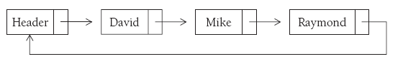
Circularly linked list
A circularly linked list is a list in which the last node points back to the first
node (which may be a header node).

Slide 19
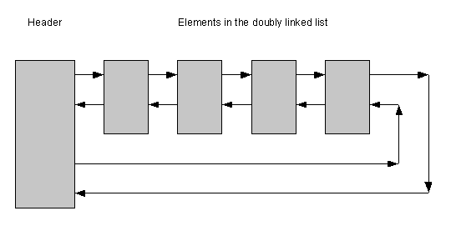
Doubly linked list

Slide 20
Implementation in C#
LinkedList<T> Class
LinkedListNode<T> Class
Doubly linked

Slide 21
The End

