Slide 1
Introduction to Data Structures and Algorithms
Lecture 14

Slide 2
Objectives
Data Structures
Algorithms
Understand data types
Understand the role of classes
Understand objects
Learn C#.NET class Syntax

Slide 3
Data structure
Data structure – method to store information

Slide 4
Algorithms
Algorithm – method for solving a problem
Algorithm – a process or set of rules to be followed in calculations or other problem-solving operations

Slide 5
Algorithms
Algorithms are at the heart of computing. Any system, be it software or hardware, will have algorithms (and data structures) as its basic building blocks.
Schneider F.B. Rodd M (Eds)
‘International Review of UK Research in Computer Science’, (2001)
http://www.iee.org/policy/csreport/cs_report.pdf

Slide 6
Why study Algorithms?
If you know about available algorithms you can:
avoid re-inventing the wheel.
select best algorithm based on information on complexity for different tasks.
develop new algorithms more easily.

Slide 7
Algorithms
Web searching
Human genome project
Airline crew scheduling
GPS navigation
Financial prediction systems
Timetabling

Slide 8
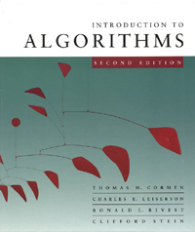
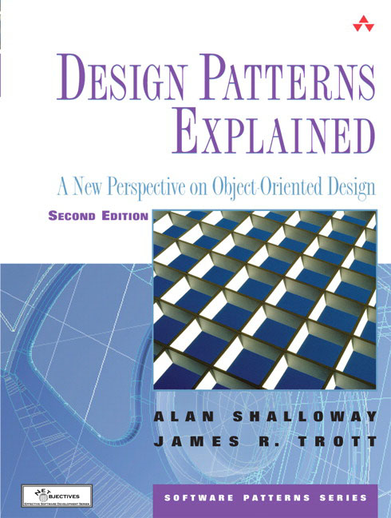
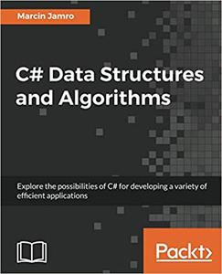
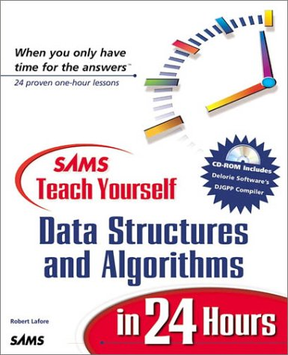
Books

Slide 9
Data type
A definition of a set of data that specifies the possible range of values of the set, the operations that can be performed on the values, and the way in which the values are stored in memory.

Slide 10
Data type
In programming languages a data type defines a set of values and the allowable operations on those values (http://en.wikipedia.org/wiki/Data_type)

Slide 11
Data types
Integer
Operations: +, - , *, /
String
Operations: Substring(), Trim()
DateTime
Operations: AddDays(), AddYears()

Slide 12
What is a class?
One of the primary uses of OOP is to develop user-defined data types.
Class is a user defined Data type.

Slide 13
What is an Object?
Object is an instance of a class
In other words you create an object by declaring a variable of a particular class type.

Slide 14
What is an Object?
A type is just a .NET class. (http://visualbasic.about.com/od/usingvbnet/a/datatypes.htm)

Slide 15
Classes in C#.NET
public class Boat
{
private int _width;
private int _length;
//More stuff goes here
}

Slide 16
Constructors
public Boat()
{
_width = 10;
_length = 110;
}
public Boat(int width, int length)
{
_width = width;
_length = length;
}

Slide 17
Properties
private int _width;
public int Width
{
get
{
return _width;
}
set
{
_width = value;
}
}

Slide 18
Auto properties
public int Width { get; set; }

Slide 19
Methods
public void AddPerson(Person p)
{
//...
}
public int GetCurrentLoad()
{
return 0;
}

Slide 20
The End

