Slide 1
Fundamentals of Programming
Lecture 18
Queues, Stacks, Trees, Maps
BSc Business Information Systems

Slide 2
Agenda
Queues
Stacks
Trees
Maps
BSc Business Information Systems

Slide 3
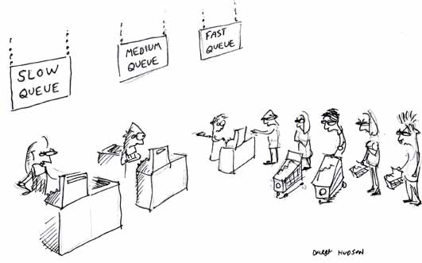
Queue
BSc Business Information Systems

Slide 4
Queue
A queue is a data structure in which data enter at the rear of a list and are removed from the front of the list
Queues are used to store items in the order in which they occur
Queues are an example of a First-In, First-Out data structure
BSc Business Information Systems

Slide 5
Queue operations
adding a new item is called Enqueue
removing an item from a queue is called Dequeue
BSc Business Information Systems

Slide 6
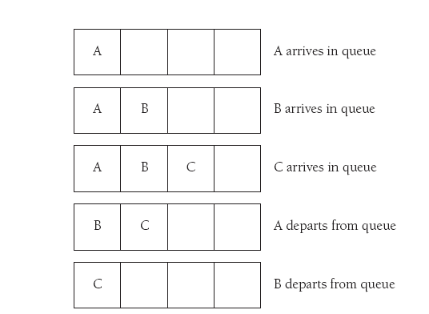
FIFO
BSc Business Information Systems

Slide 7
Queue applications
In operating systems, for controlling access to shared system resources such as printers, files, communication lines, disks and tapes
Batch-processing of large number of requests
SMS sending handling
BSc Business Information Systems

Slide 8
Queue applications
For simulation of real-world situations. For instance, a new bank may want to know how many tellers to install. The goal is to service each customer within a "reasonable" wait time, but not have too many tellers for the number of customers. To find out a good number of tellers, they can run a computer simulation of typical customer transactions using queues to represent the waiting customers.
BSc Business Information Systems

Slide 9
Priority Queue
Elements are pulled highest-priority-first
Operations:
insertWithPriority
pullHighestPriorityElement
Efficiency – implementation dependent
Enqueue O(log n)
Dequeue O(log n)
BSc Business Information Systems

Slide 10
Double-ended queue (Deque)
Pronounced “deck”
Operations
insert element at back
insert element at front
remove last element
remove first element
examine last element
examine first element
BSc Business Information Systems

Slide 11
Queue implementation in .Net
Queue<T>
Operations
Enqueue(T newElement)
Peek()
throws InvalidOperationException if empty
Dequeue()
throws InvalidOperationException if empty
Count
Efficiency – O(1)
BSc Business Information Systems

Slide 12
Stack
BSc Business Information Systems

Slide 13
Stack
Stacks is a special-purpose data structures which is only optimized for a limited number of predefined operations (namely Pop and Push)
Stack is an implementation of Last-in-First-out logic (LIFO)
BSc Business Information Systems

Slide 14
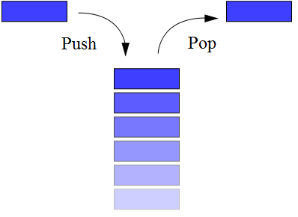
Stack
Classic implementation of Stack supports only two operations:
BSc Business Information Systems

Slide 15
Stack
Push adds new element to the top of the stack
Pop removes top element from the stack
Peek not a part of classical Stack, but many implementations provide Peek function to get the reference to the top element without removing it
BSc Business Information Systems

Slide 16
Stack
Performance:
All operations are O(1)
BSc Business Information Systems

Slide 17
Stack applications
Expression evaluation and syntax parsing
Postfix notation
Runtime memory management
BSc Business Information Systems

Slide 18
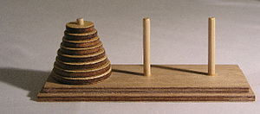
Stack applications
Hanoi tower
BSc Business Information Systems

Slide 19
Stack implementation in .Net
Stack<T>
Operations
Push(T newElement)
Pop()
throws InvalidOperationException
Peek()
throws InvalidOperationException
Count
BSc Business Information Systems

Slide 20
Tree
BSc Business Information Systems

Slide 21
Tree
Tree is a data structure that emulates a hierarchical tree structure with a set of linked nodes
BSc Business Information Systems

Slide 22
Tree terminology
A node is a structure which contains a value
Each node in a tree has zero or more child nodes
A node that has a child is called the child's parent node (or ancestor node)
A node has at most one parent
Data structure allowing more than one parent is called Graph
BSc Business Information Systems

Slide 23
Tree terminology
The height of a node is the length of the longest downward path to a leaf from that node. The height of the root is the height of the tree.
The depth of a node is the length of the path to its root
The topmost node in a tree is called the root node
A nodes with no children is called leaf node
BSc Business Information Systems

Slide 24
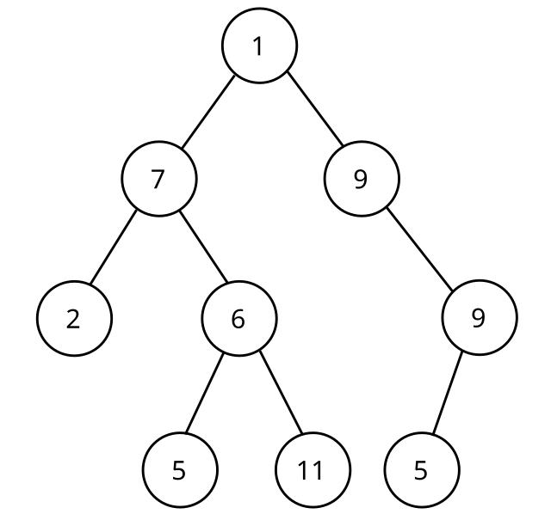
Tree
BSc Business Information Systems

Slide 25
Tree traversal
Tree nodes are not accessible by index. In order to access an element you should navigate from a root node in a node-by-node manner.
In order to access all nodes recursion should be used
BSc Business Information Systems

Slide 26
Recursion
Recursion is a method where the solution to a problem depends on solutions to smaller instances of the same problem
BSc Business Information Systems

Slide 27
Get all values
public void GetAll(List<string> result, Node node)
{
result.Add(node.Value);
foreach (var child in node.Children)
GetAll(result, child);
}
BSc Business Information Systems

Slide 28
Map
BSc Business Information Systems

Slide 29
Map
Map is a collection of key-value pairs
Map is optimized for retrieving values by key
Maps are sometimes referred to as associative arrays
BSc Business Information Systems

Slide 30
Map implementation in .Net
Dictionary<TKey, TValue>
Keys must be unique and cannot be null
Values can be null or duplicate
BSc Business Information Systems

Slide 31
Map implementation in .Net
Operations
Add(TKey key, TValue value)
ContainsKey(TKey key)
[] (indexer)
throws KeyNotFoundException
TryGetValue(TKey key, out TValue value)
Count
BSc Business Information Systems

Slide 32
Map implementation in .Net
Performance
Adding new elements
If count is less then capacity => approaches O(1)
If the capacity must be increased to accommodate the new element => O(n), where n is Count
Retrieving by key approaches O(1)
BSc Business Information Systems

Slide 33
Map implementation in .Net
Most collections have .ToDictionary() method
var d = myList.ToDictionary(t => t.Id, t => t);
BSc Business Information Systems

Slide 34
The end
BSc Business Information Systems

