Slide 1
Fundamentals of Programming
Lecture 19
Sorting Algorithms
Searching Algorithms
BSc Business Information Systems

Slide 2
Agenda
Bubble sort
Insertion sort
Selection sort
Quick sort
Sequential search
Searching for extremes
Binary search
BSc Business Information Systems

Slide 3
Bubble Sort
Values “float like a bubble” from one end of the list to another
BSc Business Information Systems

Slide 4
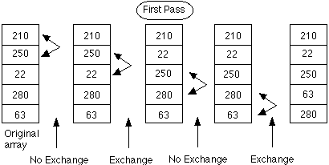
Bubble Sort
BSc Business Information Systems

Slide 5
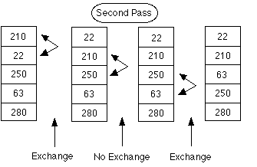
Bubble Sort
BSc Business Information Systems

Slide 6
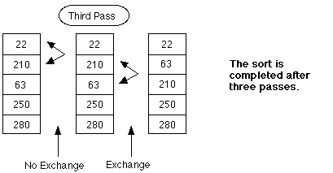
Bubble Sort
BSc Business Information Systems

Slide 7
Selection Sort
BSc Business Information Systems

Slide 8
Selection Sort
Find the smallest element and place it in position 0
Find the smallest element excluding the first one, and put it in the second position
Repeat
BSc Business Information Systems

Slide 9
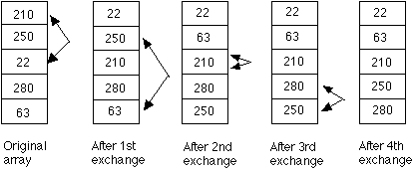
Selection Sort
BSc Business Information Systems

Slide 10
Insertion Sort
BSc Business Information Systems

Slide 11
Insertion Sort
First element is already at the right place
Examine the second element and put it before or after the first element, depending on the value
Examine the third element and move it up until you see a smaller element
Repeat
BSc Business Information Systems

Slide 12
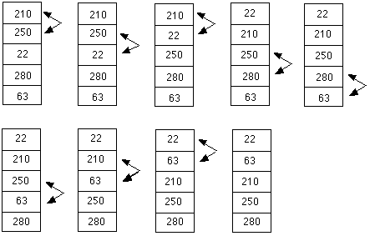
Insertion Sort
BSc Business Information Systems

Slide 13
Quicksort
BSc Business Information Systems

Slide 14
Quicksort
Worst case – O(n2)
Average case – O(n log2n)
Based on the divide-and-conquer paradigm
Implementation requires knowledge of recursion
BSc Business Information Systems

Slide 15
Quicksort steps
Pick an element from the list, it will be pivot
Reorder the list so that all elements with values less than the pivot come before the pivot, while all elements with values greater than the pivot come after it (equal values can go either way). This is called the partition operation. After this partitioning, the pivot is in its final position (between less-than and more-than subsets).
BSc Business Information Systems

Slide 16
Quicksort steps
Recursively sort the sub-list of lesser elements and the sub-list of greater elements
The base case of the recursion are lists of size zero or one, which never need to be sorted
BSc Business Information Systems

Slide 17
Choosing pivot
Leftmost (first) element
Results in worst case performance for already sorted sets
Random index
Middle element
Rightmost (last) element
BSc Business Information Systems

Slide 18
BSc Business Information Systems

Slide 19
Quicksort pseudocode
function sort(array)
var less, greater as List
if array.Length ≤ 1
return array
select and remove a pivot value from array
for each x in array
if x ≤ pivot then append x to less
else append x to greater
return concat(sort(less), pivot, sort(greater))
BSc Business Information Systems

Slide 20
Quicksort
C# implementation can be found here
BSc Business Information Systems

Slide 21
Other sorting algorithms
Merge sort
Heapsort
https://visualgo.net/bn/sorting
BSc Business Information Systems

Slide 22
Sequential Search
BSc Business Information Systems

Slide 23
Sequential Search
Also known as Linear Search
Start at the beginning of the array and compare each accessed array element to the value you’re searching for
BSc Business Information Systems

Slide 24
Sequential Search
private bool SeqSearch(int[] arr, int valueToFind)
{
foreach (var t in arr)
{
if (t == valueToFind)
return true; //found
}
return false; //not found
}
BSc Business Information Systems

Slide 25
Sequential Search
No prerequisites
Worst-case performance – O(n)
BSc Business Information Systems

Slide 26
Searching for extremes
BSc Business Information Systems

Slide 27
Searching for the minimum value
private int FindMin(int[] arr)
{
var min = arr[0];
for (var i = 1; i < arr.Length - 1; i++)
{
if (arr[i] < min)
min = arr[i];
}
return min;
}
BSc Business Information Systems

Slide 28
Searching for the maximum value
private int FindMax(int[] arr)
{
var max = arr[0];
for (var i = 1; i < arr.Length - 1; i++)
{
if (arr[i] > max)
max = arr[i];
}
return max;
}
BSc Business Information Systems

Slide 29
Binary Search
BSc Business Information Systems

Slide 30
Binary Search
50
25
75
12
38
62
88
6
19
32
44
56
69
82
94
BSc Business Information Systems

Slide 31
Binary Search
50
25
12
15
19
15
BSc Business Information Systems

Slide 32
Binary Search
Possible only over sorted array
Worst-case performance – O(log2n)
BSc Business Information Systems

Slide 33
Binary Search
private int BinSearch(int[] arr, int value)
{
var upperBound = arr.Length - 1;
var lowerBound = 0;
while (lowerBound <= upperBound)
{
var mid = (upperBound + lowerBound) / 2;
if (arr[mid] == value)
return mid;
else if (value < arr[mid])
upperBound = mid - 1;
else
lowerBound = mid + 1;
}
return -1;
}
BSc Business Information Systems

Slide 34
Recursive Binary Search
private int RbinSearch(int[] arr, int value, int lower, int upper)
{
if (lower > upper)
return -1;
var mid = (upper + lower) / 2;
if (value < arr[mid])
return RbinSearch(arr, value, lower, mid - 1);
else if (value == arr[mid])
return mid;
else
return RbinSearch(arr, value, mid + 1, upper);
}
BSc Business Information Systems

Slide 35
The end
BSc Business Information Systems

