Slide 1
Fundamentals of Programming
Lecture 1
Flow control
BSc Business Information Systems

Slide 2
Agenda
To be able to implement decisions using if statements
To learn how to compare integers, floating-point numbers, and strings
To recognize the correct ordering of decisions in multiple branches
To program conditions using Boolean operators and variables
BSc Business Information Systems

Slide 3
IF statement
amount ≤ balance?
false
true
balance =
balance – amount
BSc Business Information Systems

Slide 4
IF/ELSE statement
amount ≤ balance?
true
false
balance =
balance – amount
balance =
balance – amount – overdraftPenalty
BSc Business Information Systems

Slide 5
IF and IF/ELSE statements
if (condition) { statements } | if (condition) { statements } else { statements }
BSc Business Information Systems

Slide 6
Examples
if (amount <= balance)
{
balance = balance – amount
}
if (amount <= balance)
balance = balance – amount
else
balance = balance – amount – overdraftPenalty
BSc Business Information Systems

Slide 7
Relational Operators
OPERATOR | DESCRIPTION
> | Greater than
>= | Greater than or equal
< | Less than
<= | Less than or equal
== | Equal
!= | Not equal
BSc Business Information Systems

Slide 8
IF and IF/ELSE statements
if (condition1) statement1 else if (condition2) statement2 else if (condition3) statement3 else statement4 | The first matching condition is executed Order matters
BSc Business Information Systems

Slide 9
Multiple Alternatives
Order matters:
Do not omit “else”:
if (richter >= 0) //always passes
r = "Generally not felt by people“;
else if (richter >= 3.5) //not tested
r = "Felt by many people, no destruction“;
if (richter >= 8.0)
r = "Most structures fall";
if (richter >= 7.0) //omitted Else, ERROR is returned
r = "Many buildings destroyed";
BSc Business Information Systems

Slide 10
Nested Branches
Branch inside another branch:
if (condition1)
{
if (condition1a) statement1a else statement1b
} else statement2
BSc Business Information Systems

Slide 11
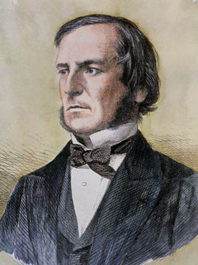
The Boolean Type
George Boole (1815-1864): pioneer in the study of logic
Value of expression amount < 1000 is true or false
Boolean type: one of these 2 truth values
BSc Business Information Systems

Slide 12
Boolean Variables
bool married
Set to truth value: married = true;
Use in conditions: if (married) if (!married)
Don't test Boolean variables against truth values - sign of cluelessness: if (married == true) // DON’T if (married = false) // DON’T if (married != false) // NO!!
BSc Business Information Systems

Slide 13
Boolean Operators
&& – and (conjunction)
|| – or (disjunction)
! – not (negation)
…
…
if (0 < amount && amount < 1000)
if (input == "S" || input == "M")
BSc Business Information Systems

Slide 14
AND, OR Operators
0 < amount
false
input = “S”
false
input = “M”
false
true
true
true
amount < 100
false
true
“AND” condition fulfilled
“OR” condition fulfilled
BSc Business Information Systems

Slide 15
Typical mistakes
Wrong:
Correct:
if (price > 10 && < 20) ...
if (value == "S" || "M") ...
if (price > 10 && price < 20) ...
if (value == "S" || value == "M") ...
BSc Business Information Systems

Slide 16
Truth Table – And (conjunction)
A | B | A and B
True | True | True
True | False | False
False | False | False
BSc Business Information Systems

Slide 17
Truth Table – Or (disjunction)
A | B | A or B
True | True | True
True | False | True
False | False | False
BSc Business Information Systems

Slide 18
Truth Table – Not (negation)
A | Not A
True | False
False | True
BSc Business Information Systems

Slide 19
String Comparison
Usual “==” operator can be used if exact match is required
Don't use “==“ for strings if comparison is case insensitive
Use Compare method:
if (input == "Y")
if (input == "Y")
//WRONG for input = "y"!
if (string.Compare(input, "Y", true) == 0)
BSc Business Information Systems

Slide 20
Comparing Strings
When comparing string the comparison starts from the left most character and the case matters
Place True or False in the 3rd column:
StrA | StrB | StrA < StrB
Apple | Basket | True
Geese | Geek | False
Hello | Hello World | True
BSc Business Information Systems

Slide 21
SWITCH statement
If the selection happens from the multiple number of choices then the if structure could be replaced with switch…case structure
It is easier to modify and more readable
BSc Business Information Systems

Slide 22
SWITCH statement
switch (expression)
{
case <case clause>:
<actions>
break;
case <case clause>:
<actions>
break;
…
default:
<actions>
break;
}
BSc Business Information Systems

Slide 23
SWITCH statement
switch (DeptNum)
{
case 11:
case 18:
case 19:
Building = "A";
break;
case int n when (n <= 6):
Building = "B";
break;
default:
Building = "C";
break;
}
The case clause may:
list individual values,
use conditions through the when keyword
must end with break keyword
BSc Business Information Systems

Slide 24
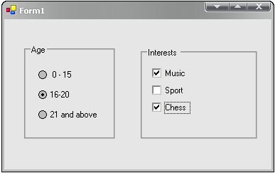
CheckBox and RadioButton
BSc Business Information Systems

Slide 25
CheckBox and RadioButton
To identify the state of the CheckBox or the RadioButton (checked or unchecked) use ‘Checked’ property of the component
If the value is true then the component is checked
If the value is false – the component is unchecked
BSc Business Information Systems

Slide 26
The end
BSc Business Information Systems

