Slide 1
Fundamentals of Programming
Lecture 17
Big-O notation
Linked lists
BSc Business Information Systems

Slide 2
Agenda
Understand Big-O notation
Understand shortcomings of the Arrays
Understand nature and structure of Linked lists
BSc Business Information Systems

Slide 3
Big-O notation
also known as
big Oh notation
big Omicron notation
Landau notation
Bachmann–Landau notation
asymptotic notation
BSc Business Information Systems

Slide 4
Big-O notation
Big O notation is used in Computer Science to describe the performance or complexity of an algorithm
Big O specifically describes the worst-case scenario, and can be used to describe the execution time required or the space used (e.g. in memory or on disk) by an algorithm
BSc Business Information Systems

Slide 5
O(1)
O(1) describes an algorithm that will always execute in the same time (or space) regardless of the size of the input dataset
BSc Business Information Systems

Slide 6
O(1)
public bool IsFirstElementEmpty(string[] s)
{
if (s[0] == "")
return true;
else
return false;
}
BSc Business Information Systems

Slide 7
O(N)
O(N) describes algorithms whose performance will grow linearly and in direct proportion to the size of the input dataset
BSc Business Information Systems

Slide 8
O(N)
public bool ContainsValue(string[] s, string v)
{
for (var i = 0; i <= s.Length - 1; i++)
{
if (s[i] == v)
return true;
}
return false;
}
BSc Business Information Systems

Slide 9
O(N²)
O(N²) represents algorithms whose performance is directly proportional to the square of the size of the input dataset
This is common with algorithms that involve nested iterations over the data set. Deeper nested iterations will result in O(N³), O(N⁴) etc.
BSc Business Information Systems

Slide 10
O(N²)
private bool ContainsDuplicates(string[] s)
{
for (var i = 0; i <= s.Length - 1; i++)
{
for (var j = 0; j <= s.Length - 1; j++)
{
if (i == j)
continue;
if (s[i] == s[j])
return true;
}
}
return false;
}
BSc Business Information Systems

Slide 11
Other cases
O(log N) – binary search
“Have a guess” exercise
BSc Business Information Systems

Slide 12
Linked Lists
BSc Business Information Systems

Slide 13
Shortcomings of the Arrays
Insertion and Deletion requires shifting of all array elements
Need to know the size in advance
BSc Business Information Systems

Slide 14
Linked List
A linked list is a collection of class objects called nodes
Each node is linked to its successor node in the list using a reference to the successor node
A node consists of a field for storing data and the field for the next node reference
The reference to another node is called a link
BSc Business Information Systems

Slide 15
Anatomy of a linked list
A linked list consists of a sequence of nodes
myList
a
b
c
d
Each node contains a value and a link (pointer or reference) to some other node
The last node contains a null link
The list may have a header
BSc Business Information Systems

Slide 16
Linked List
Whereas the elements in an array are referenced by position (the index), the elements of a linked list are referenced by their relationship to the other elements of the list.
BSc Business Information Systems

Slide 17
More terminology
A node’s successor is the next node in the sequence
The last node has no successor
A node’s predecessor is the previous node in the sequence
The first node has no predecessor
A list’s length is the number of elements in it
A list may be empty (contain no elements)
BSc Business Information Systems

Slide 18
Advantages of Linked Lists
Insertion becomes a very efficient task when using a linked list
O(1)
Removing an item from a linked list is just as easy
O(1)
Yet getting an element from particular position is slow
O(N)
BSc Business Information Systems

Slide 19
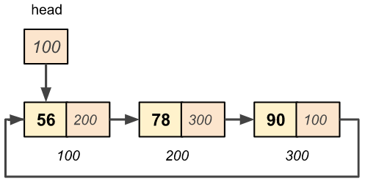
Circularly linked list
A circularly linked list is a list in which the last node points back to the first node (which may be a header node)
BSc Business Information Systems

Slide 20
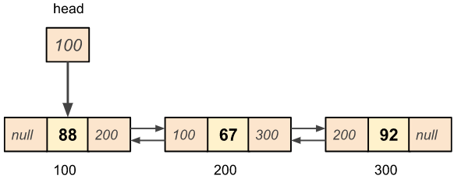
Doubly linked list
BSc Business Information Systems

Slide 21
Implementation in C#
LinkedList<T> Class
LinkedListNode<T> Class
Doubly linked
BSc Business Information Systems

Slide 22
The end
BSc Business Information Systems

