Slide 2
Fundamentals of Programming
Lecture 9. SQL

Slide 3
Agenda
SELECT statement
WHERE clause
BindingSource filtering

Slide 4
Writing SQL commands
SQL statement consists of reserved words and user-defined words.
Reserved words are a fixed part of SQL and must be spelt exactly as required and cannot be split across lines.
User-defined words are made up by user and represent names of various database objects such as relations, columns, views.
Most components of an SQL statement are case insensitive, except for literal character data.

Slide 5
SELECT statement
SELECT [DISTINCT | ALL]
{* | [columnExpression [AS newName]] [,...] }
FROM TableName [alias] [, ...]
[WHERE condition]
[GROUP BY columnList]
[HAVING condition]
[ORDER BY columnList]

Slide 6
SELECT statement
SELECT | Specifies which columns are to appear in output
FROM | Specifies table(s) to be used
WHERE | Filters rows
GROUP BY | Forms groups of rows with same column value
HAVING | Filters groups subject to some condition
ORDER BY | Specifies the order of the output
Order of the clauses cannot be changed
Only SELECT and FROM are mandatory

Slide 7
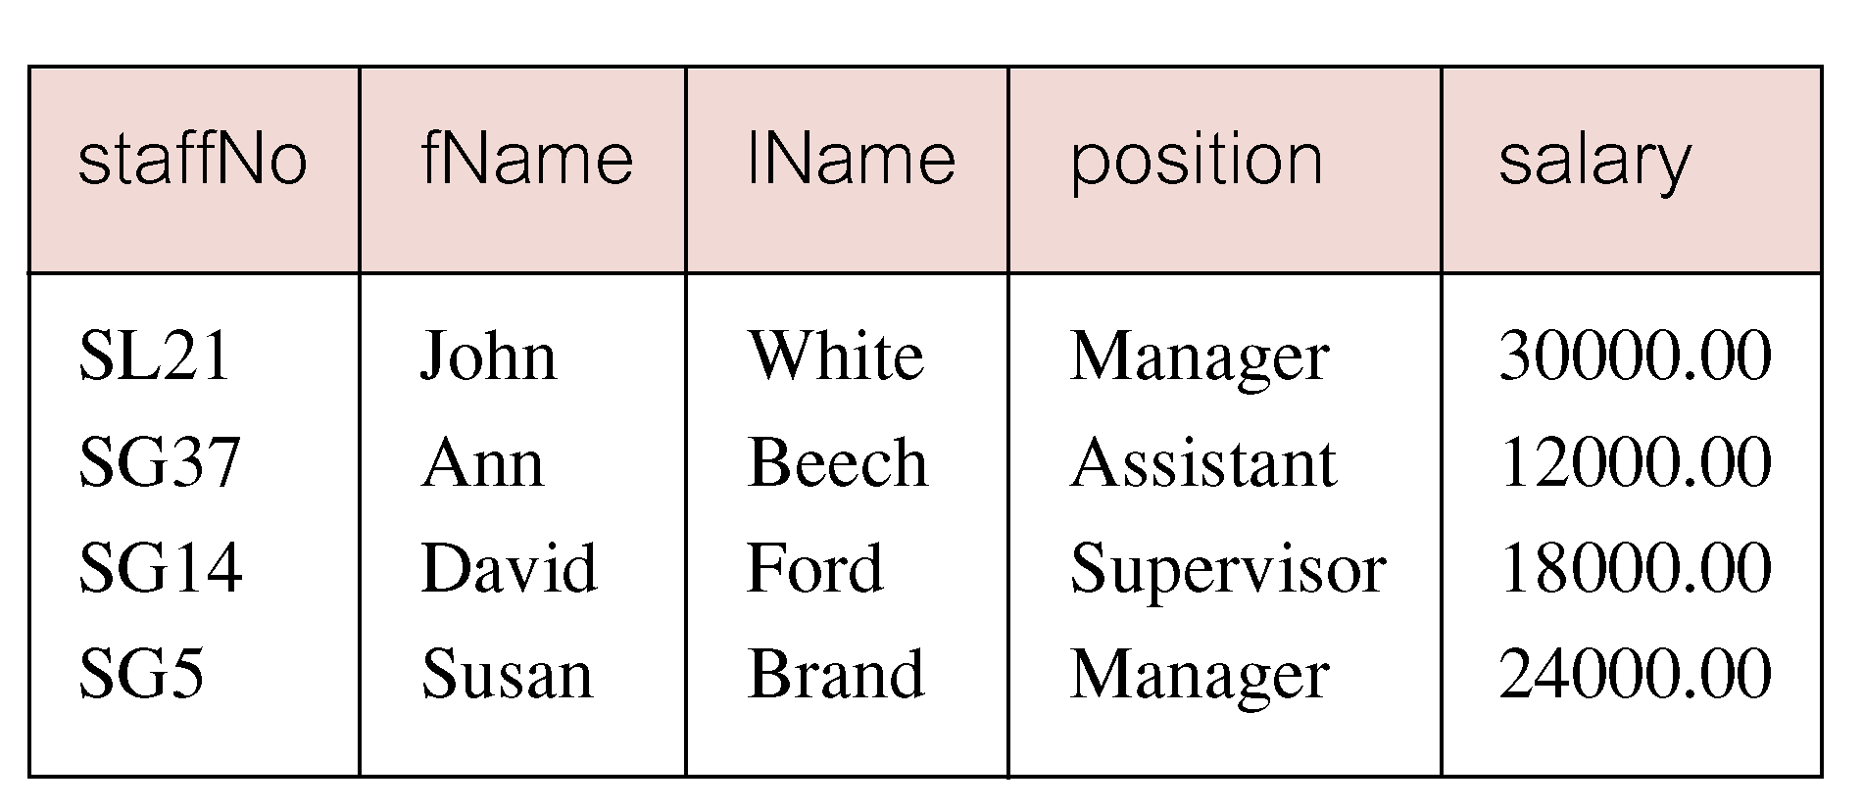
Comparison search
'List all staff with a salary greater than 10,000
SELECT staffNo, fName, lName, position, salary
FROM Staff
WHERE salary > 10000
WHERE salary > 10000

Slide 8
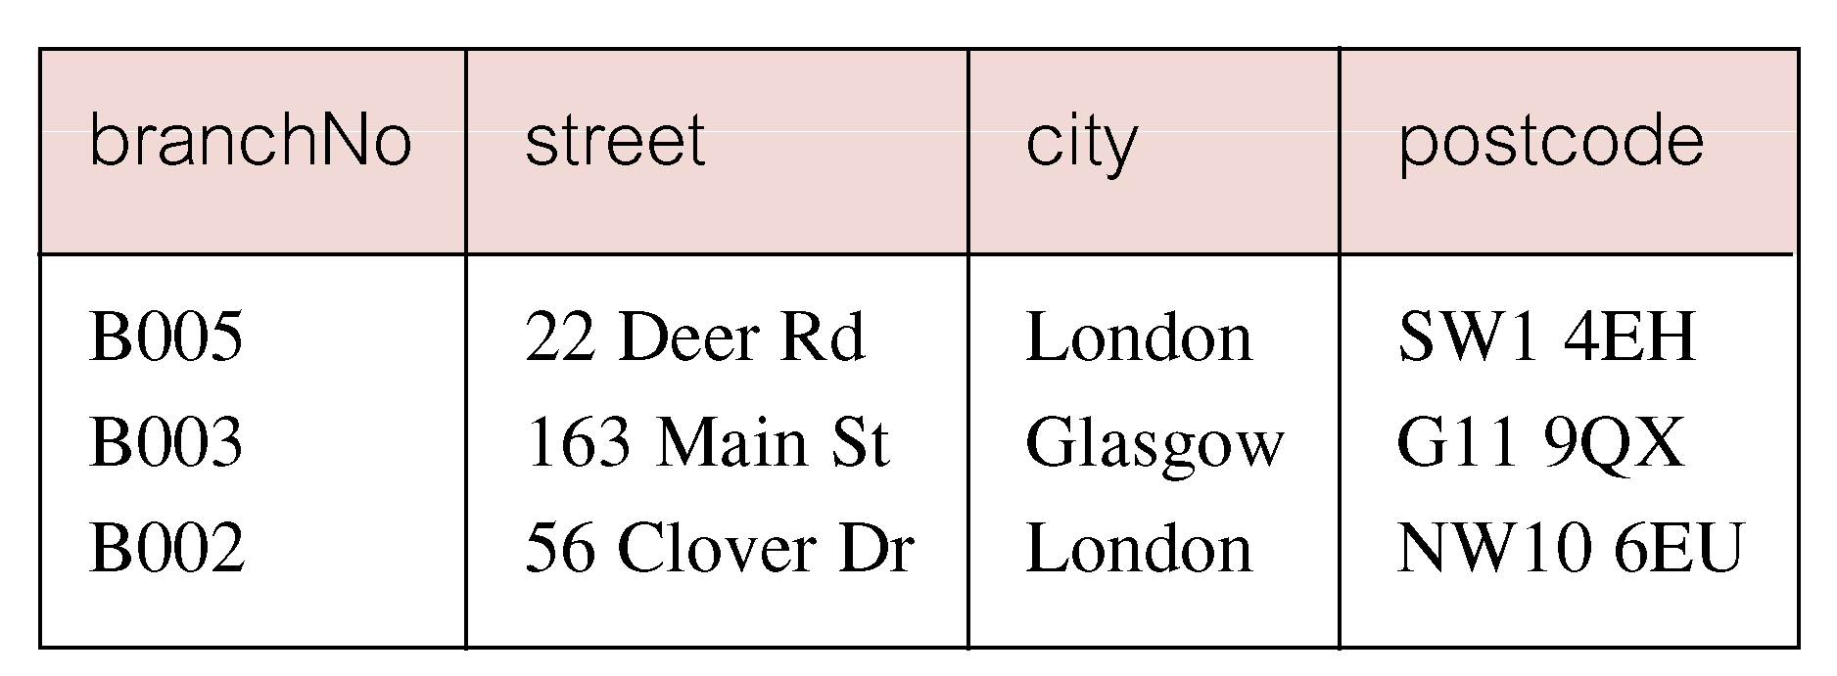
Compound comparison search
'List addresses of all branch offices in London or Glasgow
SELECT *
FROM Branch
WHERE city = 'London' OR city = 'Glasgow'
WHERE city = 'London' OR city = 'Glasgow'

Slide 9
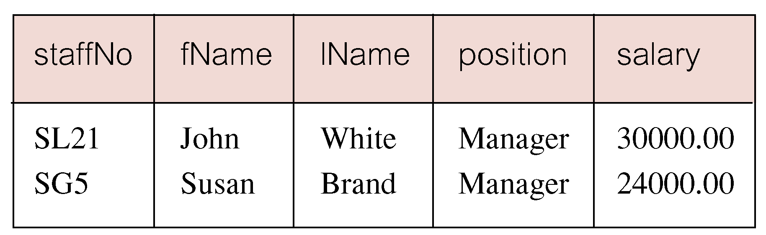
Range search (BETWEEN)
'List all staff with a salary between 20,000 and 30,000
SELECT staffNo, fName, lName, position, salary
FROM Staff
WHERE salary BETWEEN 20000 AND 30000 'inclusively
WHERE salary BETWEEN 20000 AND 30000

Slide 10
Range search (BETWEEN)
Can reverse the results using NOT BETWEEN clause
BETWEEN condition could be rewritten using comparison operators:
Useful, though, for a range of values
WHERE salary NOT BETWEEN 20000 AND 30000
'List all staff with a salary between 20,000 and 30,000
SELECT staffNo, fName, lName, position, salary
FROM Staff
WHERE salary >= 20000 AND salary <= 30000
WHERE salary >= 20000 AND salary <= 30000

Slide 11
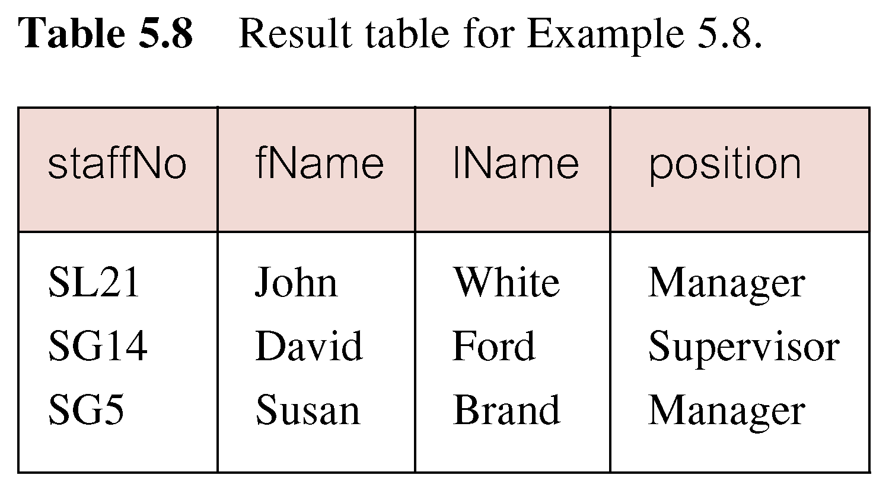
Membership condition (IN)
'List all managers and supervisors
SELECT staffNo, fName, lName, position
FROM Staff
WHERE position IN ('Manager', 'Supervisor')
WHERE position IN ('Manager', 'Supervisor')

Slide 12
Membership condition (IN)
Again, results can be reverses with NOT IN clause
IN condition could be also rewritten using comparison operators:
IN is more efficient when the list contains many values.
WHERE position NOT IN ('Manager', 'Supervisor')
'List all managers and supervisors
SELECT staffNo, fName, lName, position
FROM Staff
WHERE position = 'Manager' OR position = 'Supervisor'
WHERE position = 'Manager' OR position = 'Supervisor'

Slide 13
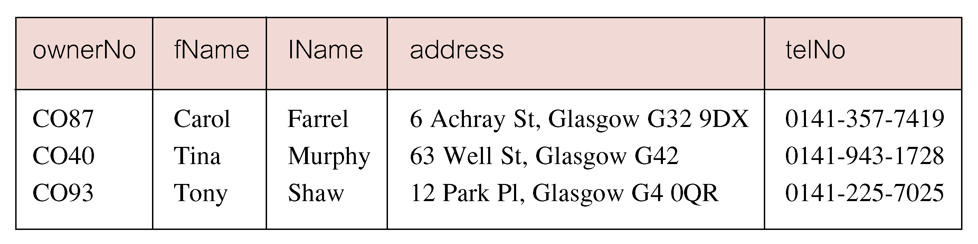
Pattern matching (LIKE)
'Find all owners with the string "Glasgow" in their address
SELECT clientNo, fName, lName, address, telNo
FROM PrivateOwner
WHERE address LIKE '%Glasgow%'
WHERE address LIKE '%Glasgow%'

Slide 14
Pattern matching (LIKE)
SQL has two special pattern matching symbols:
LIKE '%Glasgow%' means a sequence of characters of any length containing “Glasgow”
% | sequence of zero or more characters
_ (underscore) | any single character

Slide 15
BindingSource filtering
Applied to BindingSource only
Use Filter property
No need for WHERE keyword:
Set to “” to show all data:
TbTeacherBindingSource.Filter = "first_name = 'Anna'“;
TbTeacherBindingSource.Filter = "";

Slide 16
The End

