Slide 1
Fast and Simple Physics using Sequential Impulses
Erin Catto
Crystal Dynamics

Slide 2
Physics Engine Checklist
Collision and contact
Friction: static and dynamic
Stacking
Joints
Fast, simple, and robust

Slide 3
Box2D Demo
It’s got collision
It’s got friction
It’s got stacking
It’s got joints
Check the code, it’s simple!

Slide 4
Fast and Simple Physics
Penalty method?
  Nope
Linear complementarity (LCP)?
  Nope
Joint coordinates (Featherstone)?
  Nope
Particles (Jakobsen)?
  Nope
Impulses?
  Bingo!

Slide 5

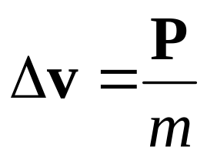

Why Impulses?
Most people don’t hate impulses
The math is almost understandable
Intuition often works
Impulses can be robust

Slide 6
Making Impulses not Suck
Impulses are good at making things bounce.
Many attempts to use impulses leads to bouncy simulations (aka jitter).
Forget static friction.
Forget stacking.

Slide 7
Impulses without the Bounce
Forget bounces for a moment.
Let’s concentrate on keeping things still.
It’s always easy to add back in the bounce.

Slide 8
The 5 Step Program
(for taking the jitter out of impulses)
Accept penetration
Remember the past
Apply impulses early and often
Pursue the true impulse
Update position last

Slide 9
Penetration
Performance
Simplicity
Coherence
Game logic
Fewer cracks

Slide 10
Algorithm Overview
Compute contact points
Apply forces (gravity)
Apply impulses
Update position
Loop

Slide 11
Contact Points
Position, normal, and penetration
Box-box using the SAT
Find the axis of minimum penetration
Find the incident face on the other box
Clip

Slide 12


Box-Box SAT
First find the separating axis with the minimum penetration.
In 2D the separating axis is a face normal.

Slide 13
Box-Box Clipping Setup
Identify reference face
Identify incident face
incident
reference

Slide 14
Box-Box Clipping
clipping planes
Clip incident face against reference face side planes (but not the reference face).
Consider clip points with positive penetration.

Slide 15


Feature Flip-Flop
Which normal is the separating axis?
Apply weightings to prefer one axis over another.
Improved coherence.

Slide 16
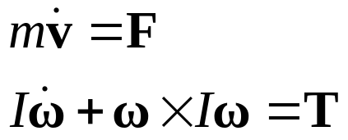
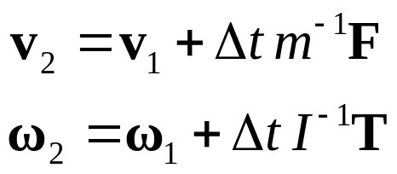
Apply Forces
Newton’s Law
Ignore gyroscopic term for improved stability
Use Euler’s rule

Slide 17
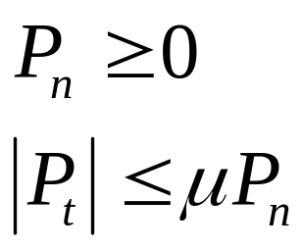


Impulses
Impulses are applied at each contact point.
Normal impulses to prevent penetration.
Tangent impulses to impose friction.

Slide 18





Computing the Impulse
2
1

Slide 19
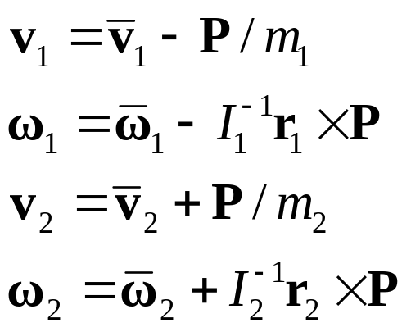

Linear Momentum
The normal impulse causes an instant change in velocity.
We know the direction of the normal impulse. We only need it’s magnitude.

Slide 20


Relative Velocity
2
Along Normal:
1

Slide 21


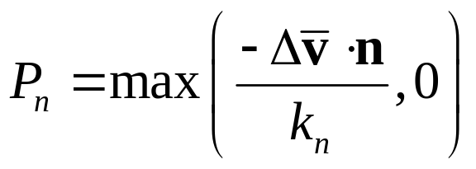

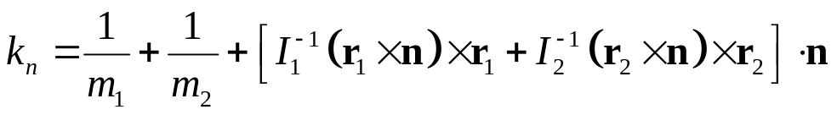
The Normal Impulse
Want:
Get:
Fine Print:

Slide 22
Bias Impulse
Give the normal impulse some extra oomph.
Proportional to the penetration.
Allow some slop.
Be gentle.

Slide 23
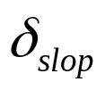
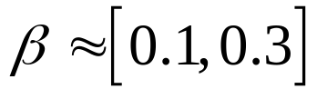
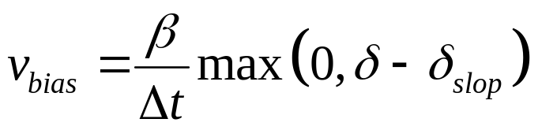
Bias Velocity
Slop:
Bias Factor:
Bias velocity:

Slide 24
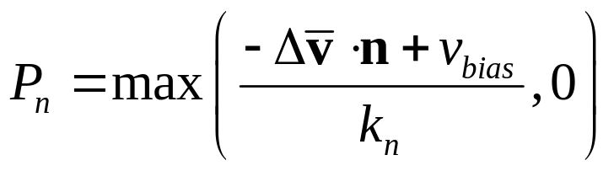
Bias Impulse
With bias velocity, this:
Becomes:

Slide 25



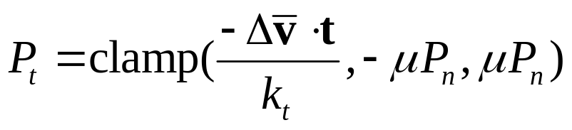
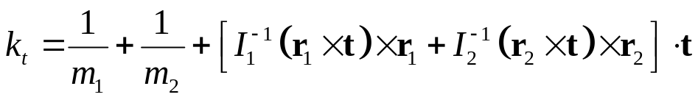
Friction Impulse
Tangent Velocity:
Want:
Get:
Fine Print:

Slide 26
Sequential Impulses
Apply an impulse at each contact point.
Continue applying impulses for several iterations.
Terminate after:
  - fixed number of iterations
  - impulses become small

Slide 27


Naïve Impulses
Each impulse is computed independently, leading to jitter.
velocity
velocity

Slide 28
Where Did We Go Wrong?
Each contact point forgets its impulse history.
Each contact point requires that every impulse be positive.
There is no way to recover from a bad impulse.

Slide 29


Accumulated Impulses
Each impulse adds to the total. Increments can be negative.
velocity

Slide 30
The True Impulse
Each impulse adds to an accumulated impulse for each contact point.
The accumulated impulse approaches the true impulse (hopefully).
True impulse: an exact global solution.

Slide 31
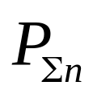
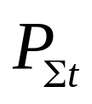
Accumulated Impulse
Clamp the accumulated impulse, not the incremental impulses.
Accumulated impulses:

Slide 32
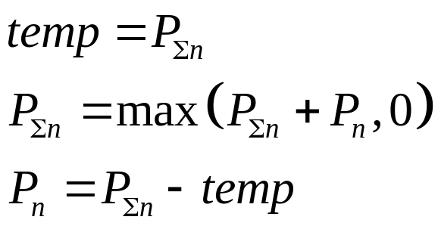
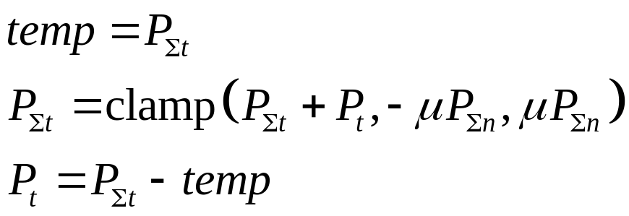
Correct Clamping
Normal Clamping:
Friction Clamping:

Slide 33
Position Update
Use the new velocities to integrate the positions.
The time step is complete.

Slide 34
Extras
Coherence
Feature-based contact points
Joints
Engine layout
Loose ends
3D Issues

Slide 35
Coherence
Apply old accumulated impulses at the beginning of the step.
Less iterations and greater stability.
We need a way to match old and new contacts.

Slide 36
Feature-Based Contact Points
Each contact point is the result of clipping.
It is the junction of two different edges.
An edge may come from either box.
Store the two edge numbers with each contact point – this is the Contact ID.

Slide 37






Contact Point IDs
box 1 edge 2
2
box 2 edge 3
box 2 edge 3
1
box 2 edge 4

Slide 38
Joints
Specify (constrain) part of the motion.
Compute the impulse necessary to achieve the constraint.
Use an accumulator to pursue the true impulse.
Bias impulse to prevent separation.

Slide 39
Revolute Joint
Two bodies share a common point.
They rotate freely about the point.

Slide 40
Revolute Joint
2
The joint knows the local anchor point for both bodies.
1
1

Slide 41

Relative Velocity
The relative velocity of the anchor points is zero.
An impulse is applied to the two bodies.

Slide 42

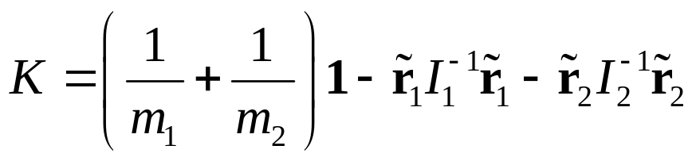
Linear Momentum
Apply linear momentum to the relative velocity to get:
Fine Print:
Tilde (~) for the cross-product matrix.

Slide 43
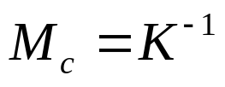
K Matrix
2-by-2 matrix in 2D, 3-by-3 in 3D.
Symmetric positive definite.
Think of K as the inverse mass matrix of the constraint.

Slide 44

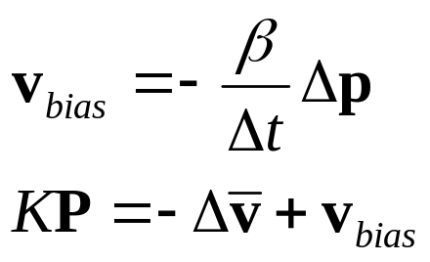
Bias Impulse
The error is the separation between the anchor points
Center of mass: x
Bias velocity and impulse:

Slide 45
Engine Layout
The World class contains all bodies, contacts, and joints.
Contacts are maintained by the Arbiter class.

Slide 46
Arbiter
An arbiter exists for every touching pair of boxes.
Provides coherence.
Matches new and old contact points using the Contact ID.
Persistence of accumulated impulses.

Slide 47
Arbiters
2
Arbiter
1

Slide 48
Collision Coherence
Use the arbiter to store the separating axis.
Improve performance at the cost of memory.
Use with broad-phase.

Slide 49
More on Arbiters
Arbiters are stored in a set according to the ordered body pointers.
Use time-stamping to remove stale arbiters.
Joints are permanent arbiters.
Arbiters can be used for game logic.

Slide 50
Loose Ends
Ground is represented with bodies whose inverse mass is zero.
Contact mass can be computed as a pre-step.
Bias impulses shouldn’t affect the velocity state (TODO).

Slide 51
3D Issues
Friction requires two axes.
Align the axes with velocity if it is non-zero.
Identify a contact patch (manifold) and apply friction at the center.
This requires a twist friction.
Big CPU savings.

Slide 52

Questions?
http://www.gphysics.com
erincatto at that domain
Download the code there.
Buy Tomb Raider Legend!

Slide 53
References
Physics-Based Animation by Kenny Erleben et al.
Real-Time Collision Detection by Christer Ericson.
Collision Detection in Interactive 3D Environments by Gino van den Bergen.
Fast Contact Reduction for Dynamics Simulation by Adam Moravanszky and Pierre Terdiman in Game Programming Gems 4.

