Slide 1

How to create a facebook application in 3 minutes
powered by:

Slide 2
Login to the facebook developers site
https://developers.facebook.com/

Slide 3
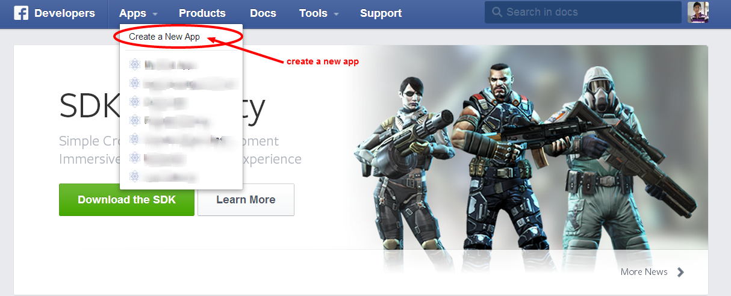
Create a new Application

Slide 4
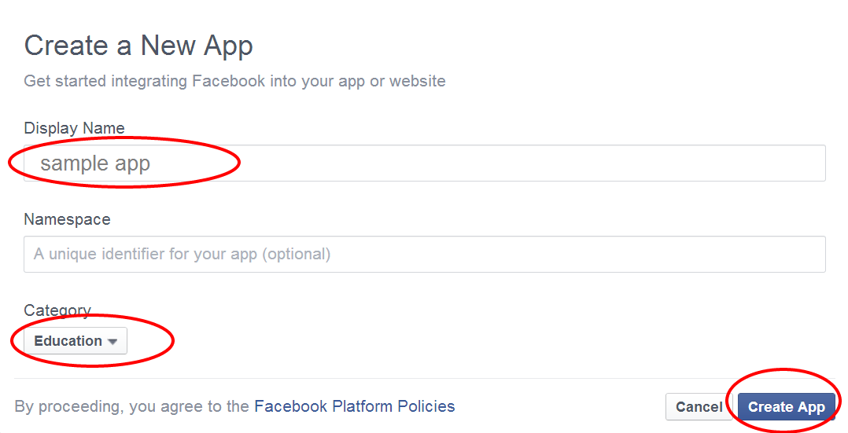
Enter app name, select category and hit Create App button

Slide 5
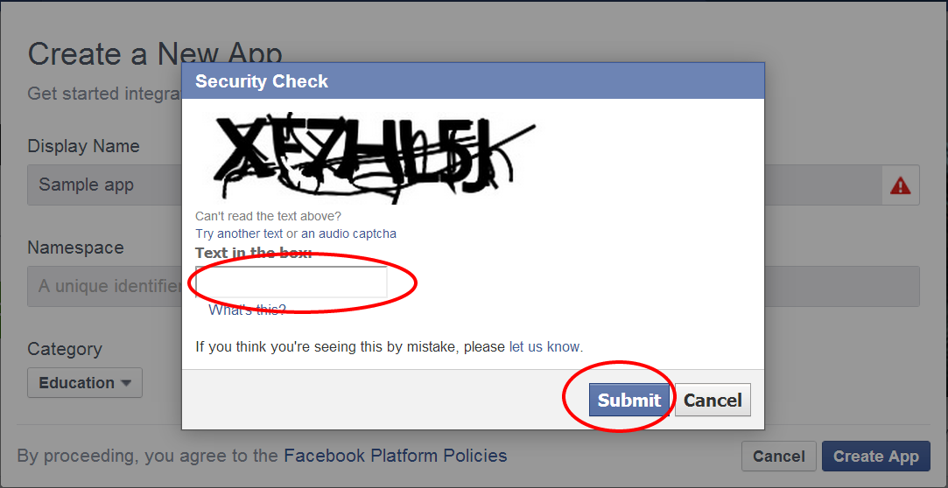
Fill up the captcha code and hit the submit button

Slide 6
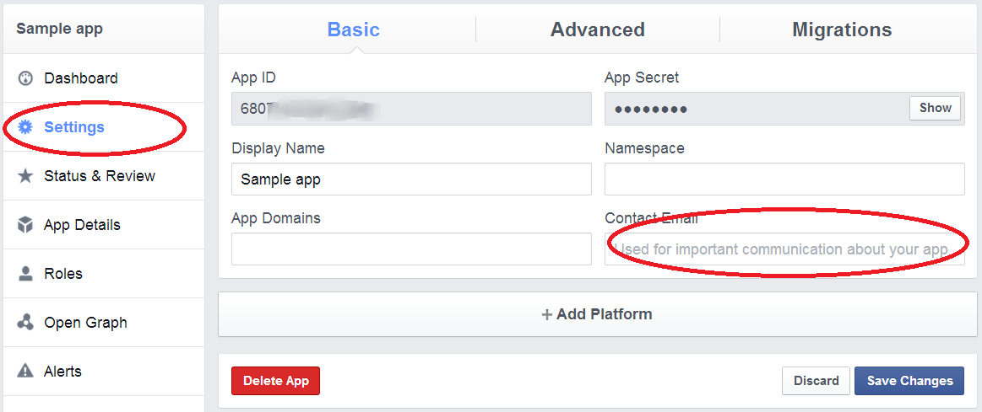
Open settings tab, and give your email address

Slide 7
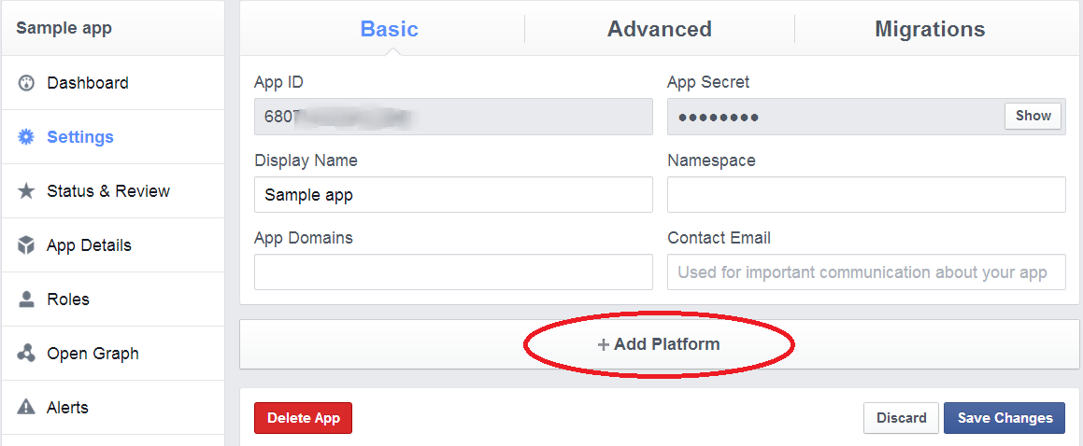
Click on Add platform tab below

Slide 8
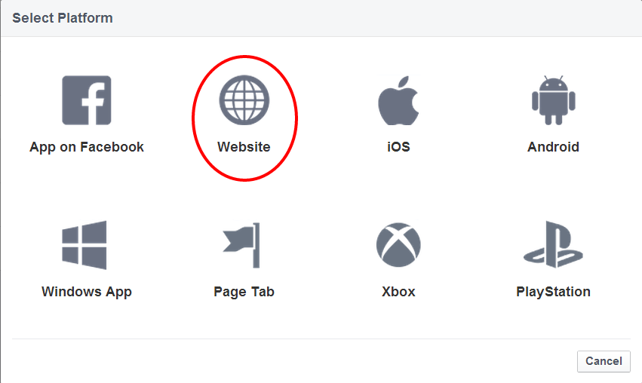
Select website

Slide 9
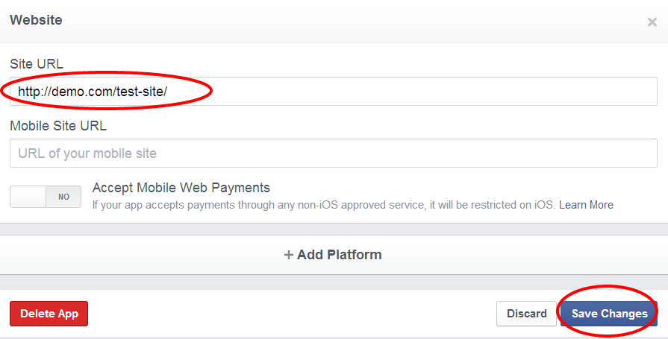
Enter your website address, and save it.

Slide 10
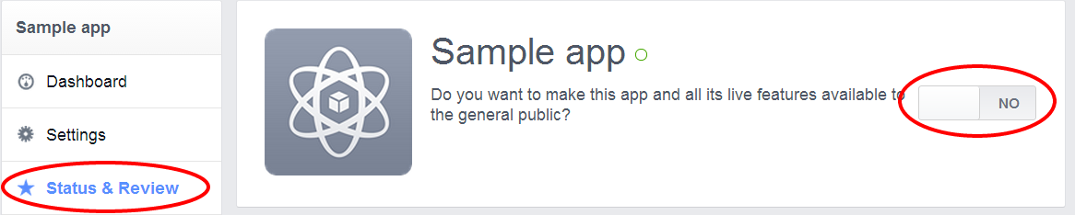
Just the final step to make your site live. Select Status & Review and uncheck no button to yes

Slide 11
Connect with us
website: www.thesoftwareguy.in
facebook: www.facebook.com/Thesoftwareguy7
twitter: www.twitter.com/thesoftwareguy7
google plus: www.plus.google.com/+ThesoftwareguyIn

