Slide 1




Addressing the Theory Crisis in Psychology
Stephan Lewandowsky
University of Bristol and University of Potsdam
@lewan.bsky.social w: www.lewan.uk e: stephan.lewandowsky@bristol.ac.uk
Potsdam, September 2024
Notes:
https://stephanlewandowsky.shinyapps.io/Amsterdam/

Slide 2
Replicability is Fundamental to Science
“A finding needs to be repeatable to count as a scientific discovery” (Zwaan et al., 2017)
Replicability is a line of demarcation that separates science from pseudoscience (Dunlap, 1926)
“Research findings that do not replicate are worse than fairy tales; with fairy tales the reader is at least aware that the work is fictional” (Wagenmakers et al., 2012)
Yes, but not really: Devezer et al. (2021)

Slide 3
The “Replication Crisis”
Replicability of psychological results (Open Science Collaboration, 2015)
25% in social psychology
50% in cognitive psychology
Concerns about replicability are widespread
psychology
linguistics
genetics
medicine and neuroscience
economics

Slide 4
Why is There a “Replication Crisis”?
Researcher degrees of freedom
Questionable research practices (QRPs)
underpowered studies (Button et al., 2013)
p-hacking (Jennison & Turnbull, 1990)
HARKing (Kerr, 1998)
publication bias (Ioannidis, 2005)
Reasons unrelated to quality of research(er) and methodology
heterogeneity of context (Bryan et al., 2021)
low replicability can be observed absent the existence of any false positives (Bak-Coleman et al., 2024)
Notes:
Low power problem: PPV (positive predictive value) depends on priors and power. PPV= power X prior odds / (power x prior odds + alpha)

Slide 5
How Do We Solve the Crisis?
Numerous recommendations to date
preregistration of method and analysis
large(r) samples
large collaborations
avoid publication bias
Bayesian statistics
All pertain to methods of data collection, analysis, and publication

Slide 6
Crisis Solved By Enhanced Rigor?
At first glance, avoiding QRPs and maximizing rigor enhances prospective replicability (86%) (Protzko et al., 2023)
But a single simple model can capture general literature (replicability 50%) and enhanced rigor (86%), pointing to replication sample size as the crucial factor (Bak-Coleman et al., 2024)

Slide 7
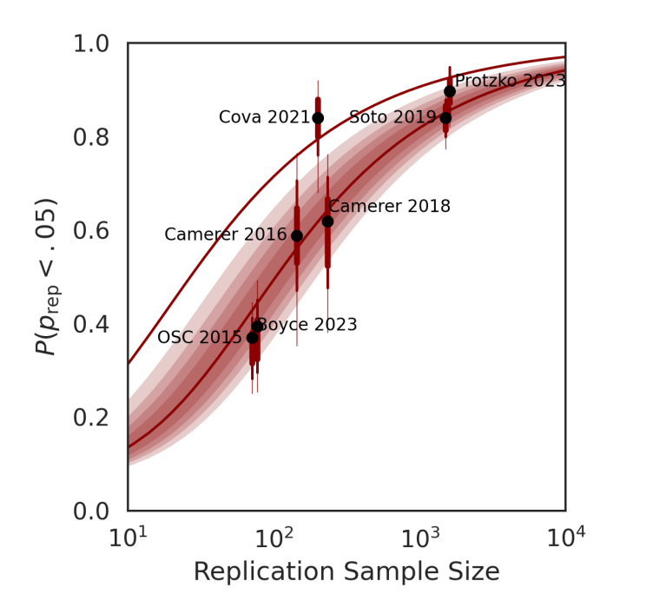
Crisis Solved By Enhanced Rigor?
At first glance, avoiding QRPs and maximizing rigor enhances prospective replicability (86%) (Protzko et al., 2023)
But the same simple model captures general literature (replicability 50%) and enhanced rigor (86%), identifying replication sample size as the crucial factor (Bak-Coleman et al., 2024)
!?
Replicability and rigor (or sample size)
The “replication crisis”

Slide 8
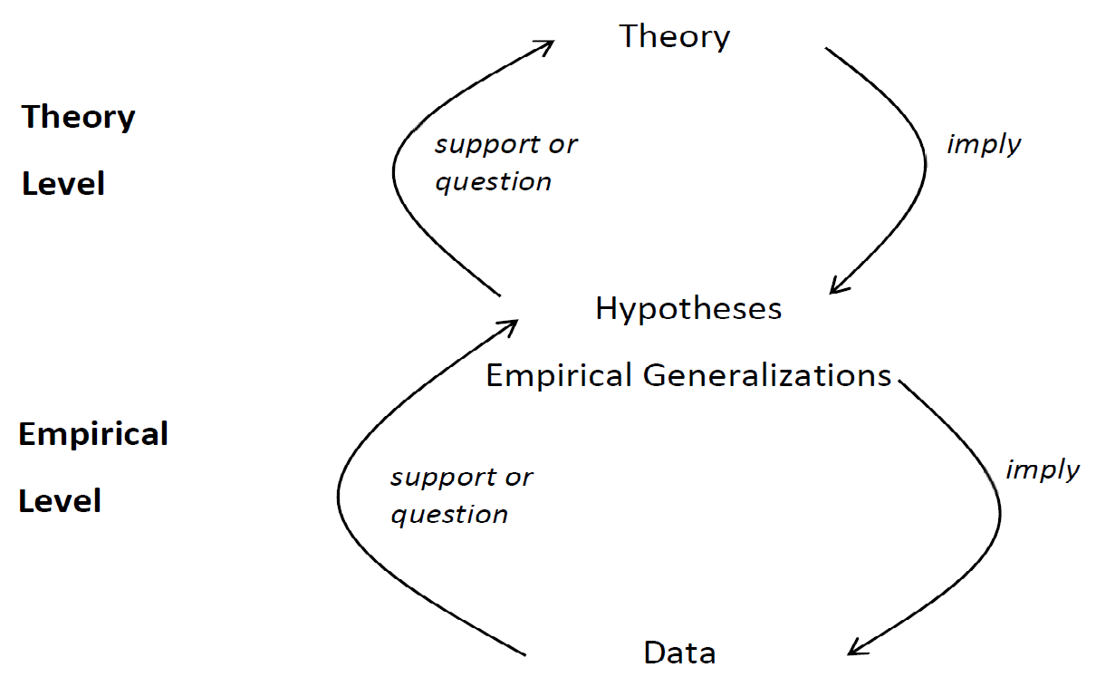
We Must Focus on Role of Theorizing (Oberauer & Lewandowsky, 2019)
What happens here …
… affects replicability

Slide 9
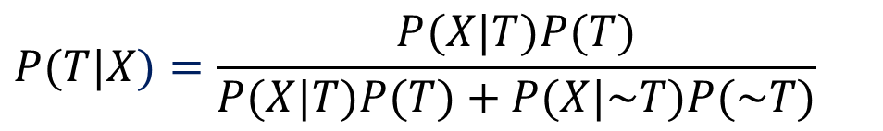
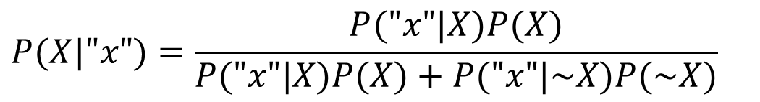
Theoretical Backbone: Bayes' Rule
T = Theory
X = Hypothesis (motivated or mandated by T)
"x" = Finding supporting X
$$P(T|X)=\frac{P(X|T)P(T)}{P(X|T)P(T)+P(X|\sim T)P(\sim T)}$$
Theory Level
Data Level
$$P(X|"x")=\frac{P("x"|X)P(X)}{P("x"|X)P(X)+P("x"|\sim X)P(\sim X)}$$
Notes:
Alternative slide for "Today's Talk"

Slide 10
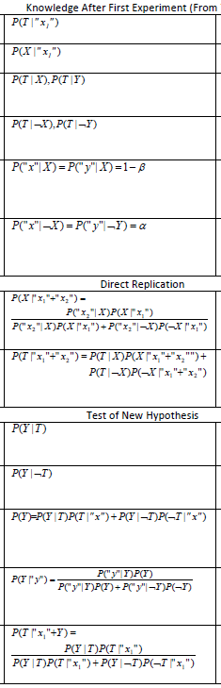
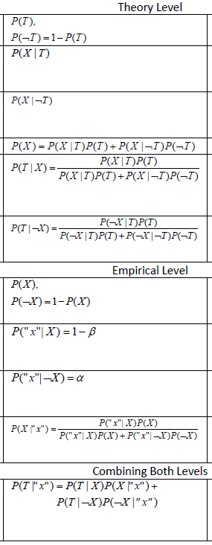
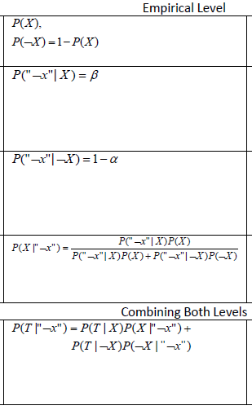
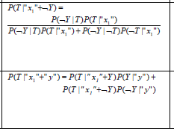
Today’s Talk (in its Entirety)
1. The tightness of coupling between theories and hypotheses affects replicability
2. Attempts to replicate may be inadvisable
3. Tests of novel predictions may be preferable

Slide 11
Discovery-Oriented Research
Theory implies existence of broad class of phenomena, Ω, but does not specify when a particular phenomenon, X, will or will not be observed
Embodiment Priming Theory
abstract concepts grounded in bodily states or actions
inducing a bodily state primes associated concept
this priming should have observable consequences
Ω
jumping over gap in floor (“leap of faith”) may enhance religiosity
turning crank clockwise may prime “future”, hence increase openness to experience
X

Slide 12
Discovery-Oriented Research Is Like Mushroom Hunting

Slide 13
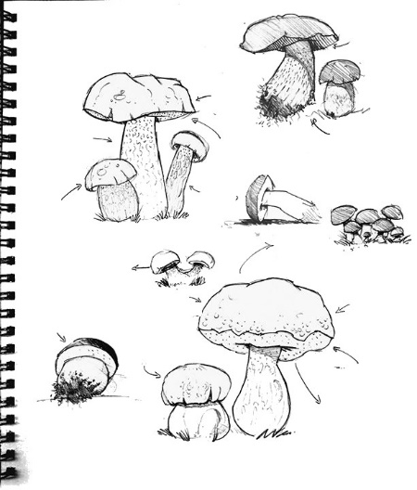
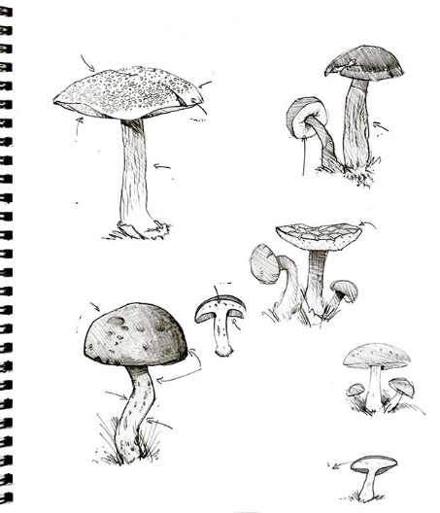
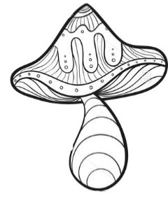
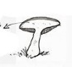
Inuitive Altruismucea
Overshadowia effectus
Large effect
found in italy
Egozia depletia
Dissonancia effectus
Facial feedbacksus
h/t Susa Fiedler

Slide 14
Is this Wrong?
Not necessarily
Exoplanets and new drugs are found this way
if the hypothesis is confirmed it is interpreted as evidence for the theory
If there is no evidence then you keep looking elsewhere
Notes:
Drugs: High Throughput Screening

Slide 15
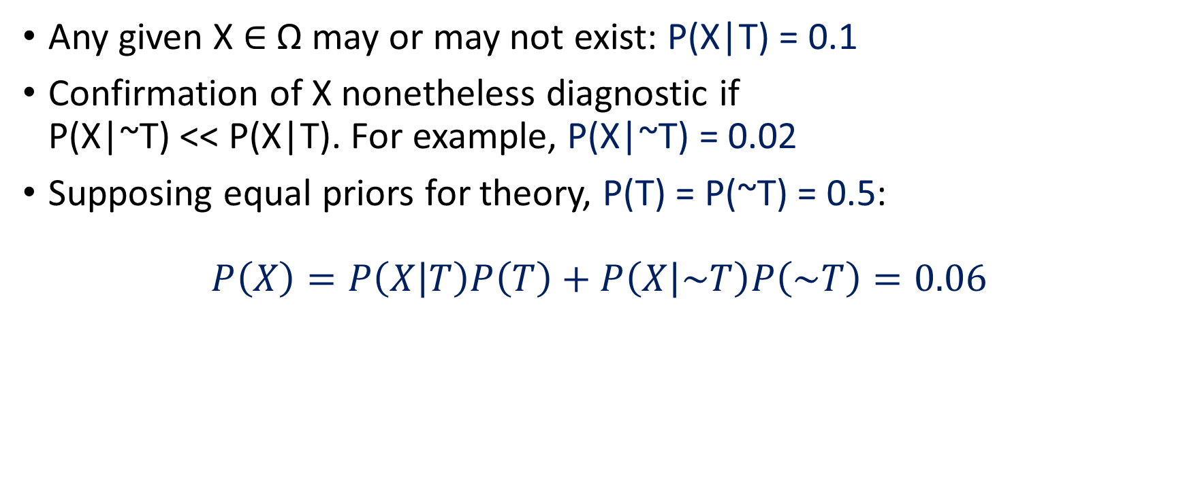
Disovery-Oriented Research and Replicability
Any given X $∈$ Ω may or may not exist: P(X|T) = 0.1
Confirmation of X nonetheless diagnostic if P(X|~T) << P(X|T). For example, P(X|~T) = 0.02
Supposing equal priors for theory, P(T) = P(~T) = 0.5:
$$P\left(X\right)=P\left(X | T\right)P\left(T\right)+P\left(X | \sim T\right)P\left(\sim T\right)=0.06$$

Slide 16

Discovery-Oriented Research and Replicability
Any given X $∈$ Ω may or may not exist: P(X|T) = 0.1
Confirmation of X nonetheless diagnostic if P(X|~T) << P(X|T). For example, P(X|~T) = 0.02
Supposing equal priors for theory, P(T) = P(~T) = 0.5:

Slide 17
Discovery-Oriented Research and Replicability
Any given X $∈$ Ω may or may not exist: P(X|T) = 0.1
Confirmation of X nonetheless diagnostic if P(X|~T) << P(X|T). For example, P(X|~T) = 0.02
Supposing equal priors for theory, P(T) = P(~T) = 0.5:
$$P\left(X\right)=P\left(X | T\right)P\left(T\right)+P\left(X | \sim T\right)P\left(\sim T\right)=0.06$$

Slide 18
Discovery-Oriented Research and Replicability
Any given X $∈$ Ω may or may not exist: P(X|T) = 0.1
Confirmation of X nonetheless diagnostic if P(X|~T) << P(X|T). For example, P(X|~T) = 0.02
Supposing equal priors for theory, P(T) = P(~T) = 0.5:
$$P\left(X\right)=P\left(X | T\right)P\left(T\right)+P\left(X | \sim T\right)P\left(\sim T\right)=0.06$$

Slide 19
Disovery-Oriented Research and Replicability
Some crucial terminology:
“x” – an outcome of an experiment
X – a hypothesis / state of the world
P(“x”|X) – power (1-β)
P(“x”|~X) – type I error rate (α)

Slide 20
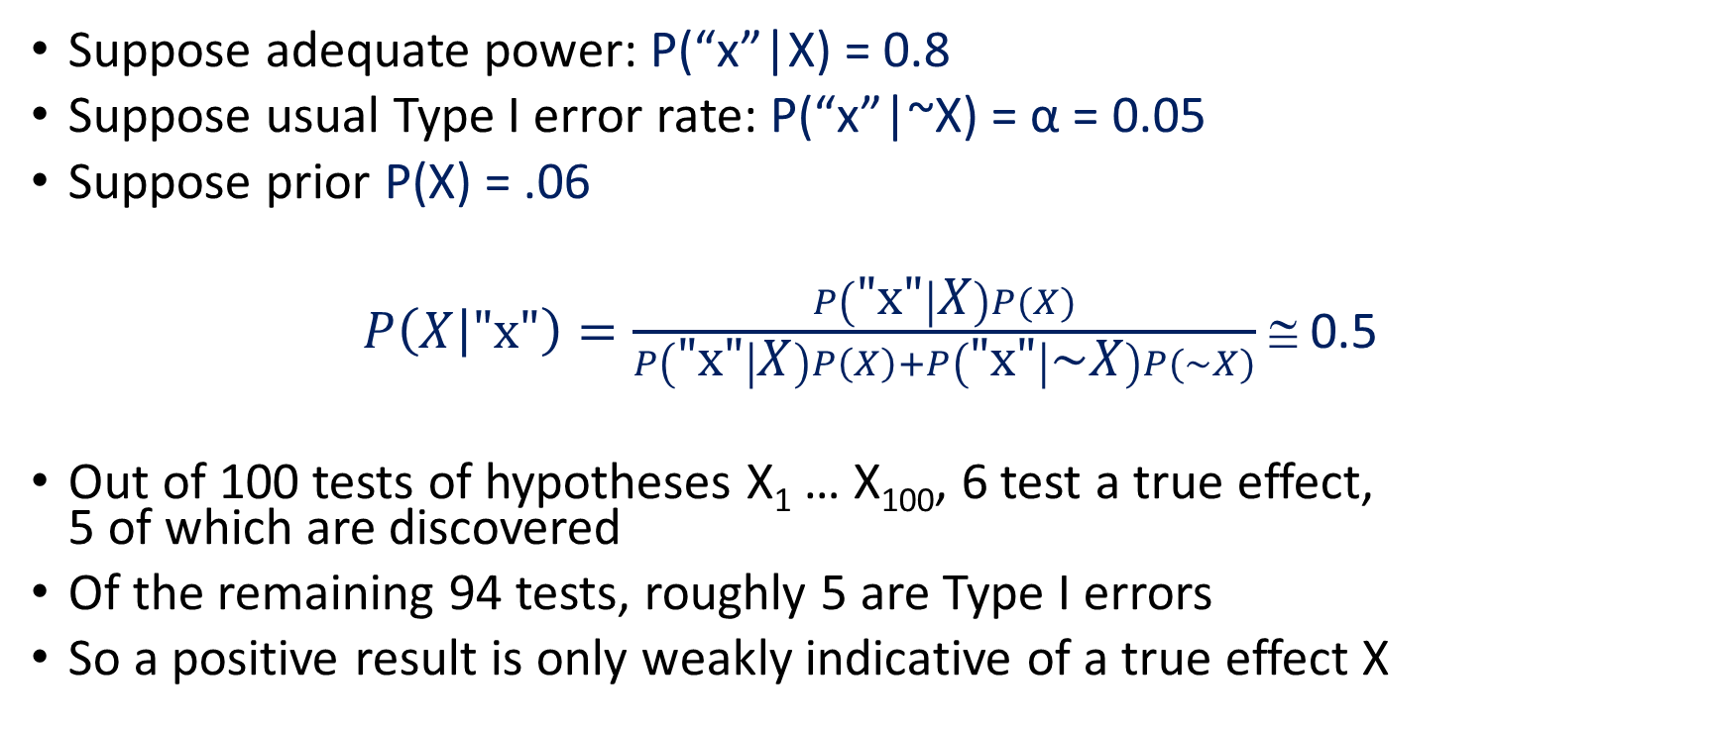
Disovery-Oriented Research and Replicability
Suppose adequate power: P(“x”|X) = 0.8
Suppose usual Type I error rate: P(“x”|~X) = α = 0.05
Suppose prior P(X) = .06
$P\left(X | \text{"}\text{x}\text{"}\right)=\frac{P\left(\text{"}\text{x}\text{"} | X\right)P(X)}{P\left(\text{"}\text{x}\text{"} | X\right)P\left(X\right)+P\left(\text{"}\text{x}\text{"} | \sim X\right)P(\sim X)}$ ≅ 0.5
Out of 100 tests of hypotheses X₁ … X₁₀₀, 6 test a true effect, 5 of which are discovered
Of the remaining 94 tests, roughly 5 are Type I errors
So a positive result is only weakly indicative of a true effect X

Slide 21
Disovery-Oriented Research and Replicability
Suppose adequate power: P(“x”|X) = 0.8
Suppose usual Type I error rate: P(“x”|~X) = α = 0.05
Suppose prior P(X) = .06
$P\left(X | \text{"}\text{x}\text{"}\right)=\frac{P\left(\text{"}\text{x}\text{"} | X\right)P(X)}{P\left(\text{"}\text{x}\text{"} | X\right)P\left(X\right)+P\left(\text{"}\text{x}\text{"} | \sim X\right)P(\sim X)}$ ≅ 0.5
Out of 100 tests of hypotheses X₁ … X₁₀₀, 6 test a true effect, 5 of which are discovered
Of the remaining 94 tests, roughly 5 are Type I errors
So a positive result is only weakly indicative of a true effect X

Slide 22
Theory-Testing Research and Replicability
Theory specifies that X must be the case under conditions specified by the theory
Temporal-distinctiveness theory of memory (e.g., SIMPLE) implies that extending retention interval must impair memory (all other factors being equal)
SIMPLE also predicts that increasing separation of list items must increase memory performance (all other factors being equal)

Slide 23

Temporal Distinctiveness (e.g., SIMPLE)
Poles are equally spaced
But appear closer in the distance
Items become more temporally crowded as time elapses

Slide 24
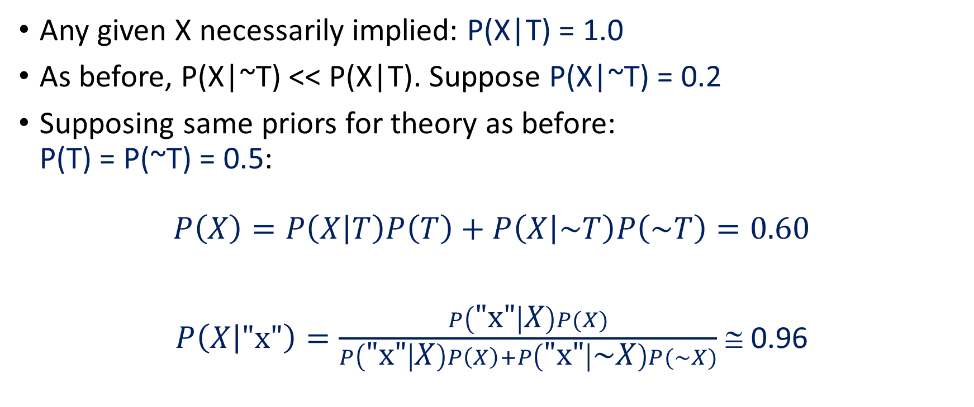
Theory-Testing Research and Replicability
Any given X necessarily implied: P(X|T) = 1.0
As before, P(X|~T) << P(X|T). Suppose P(X|~T) = 0.2
Supposing same priors for theory as before: P(T) = P(~T) = 0.5:
$$P\left(X\right)=P\left(X | T\right)P\left(T\right)+P\left(X | \sim T\right)P\left(\sim T\right)=0.60$$
$P\left(X | \text{"}\text{x}\text{"}\right)=\frac{P\left(\text{"}\text{x}\text{"} | X\right)P(X)}{P\left(\text{"}\text{x}\text{"} | X\right)P\left(X\right)+P\left(\text{"}\text{x}\text{"} | \sim X\right)P(\sim X)}$ ≅ 0.96

Slide 25
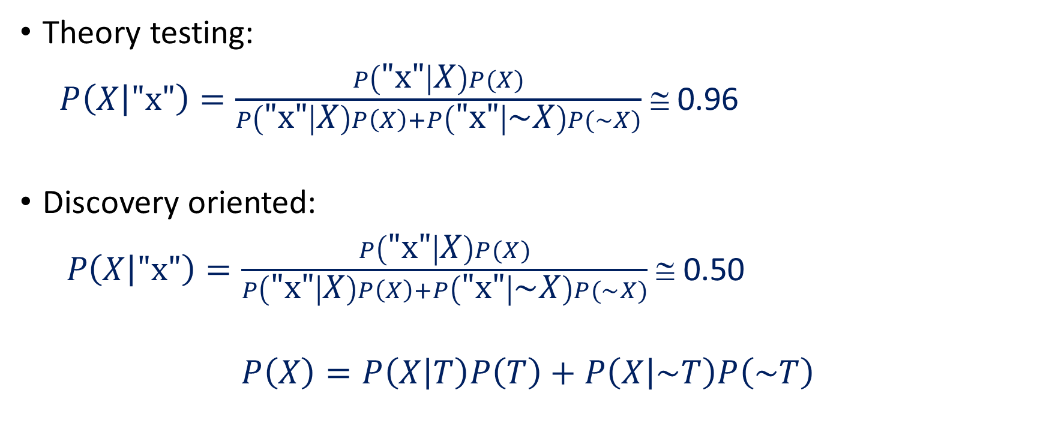
Discovery Oriented vs. Theory Testing
Theory testing:
$P\left(X | \text{"}\text{x}\text{"}\right)=\frac{P\left(\text{"}\text{x}\text{"} | X\right)P(X)}{P\left(\text{"}\text{x}\text{"} | X\right)P\left(X\right)+P\left(\text{"}\text{x}\text{"} | \sim X\right)P(\sim X)}$ ≅ 0.96
Discovery oriented:
$P\left(X | \text{"}\text{x}\text{"}\right)=\frac{P\left(\text{"}\text{x}\text{"} | X\right)P(X)}{P\left(\text{"}\text{x}\text{"} | X\right)P\left(X\right)+P\left(\text{"}\text{x}\text{"} | \sim X\right)P(\sim X)}$ ≅ 0.50
$$P\left(X\right)=P\left(X | T\right)P\left(T\right)+P\left(X | \sim T\right)P\left(\sim T\right)$$

Slide 26
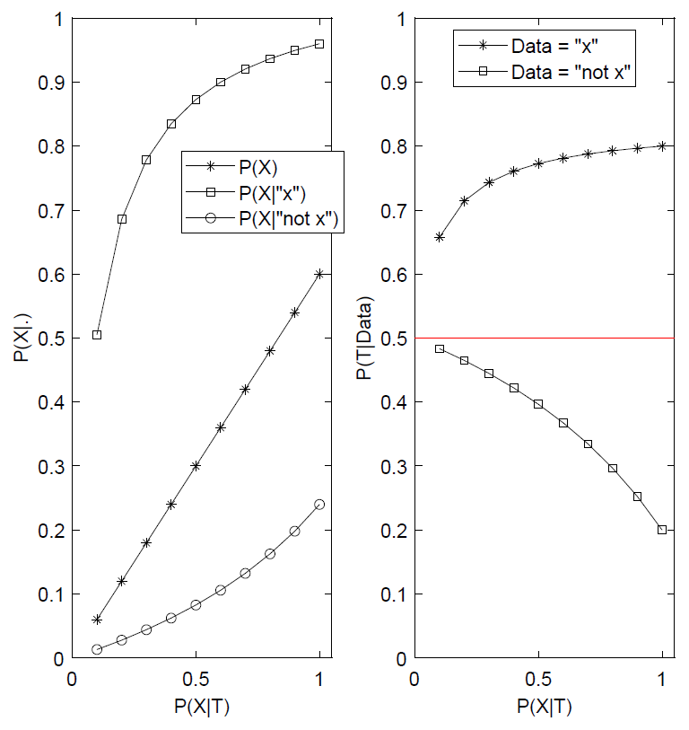
Discovery-Oriented vs. Theory-Testing Research
Theory-testing
Discovery-oriented

Slide 27
Discovery-Oriented vs. Theory-Testing Research
Confirmatory diagnosticity,
P(X|T)/P(X|~T),
equal
Evidence against hypothesis becomes increasingly informative as P(X|T) increases
Intolerable false positive rate in discovery-oriented research

Slide 28


Try the Shiny App
Notes:
https://stephanlewandowsky.shinyapps.io/Amsterdam/

Slide 29
Interim Summary
Low replicability can arise in methodologically flawless research without publication bias or questionable standards …
… by conducting discovery-oriented research without adequate safeguards

Slide 30
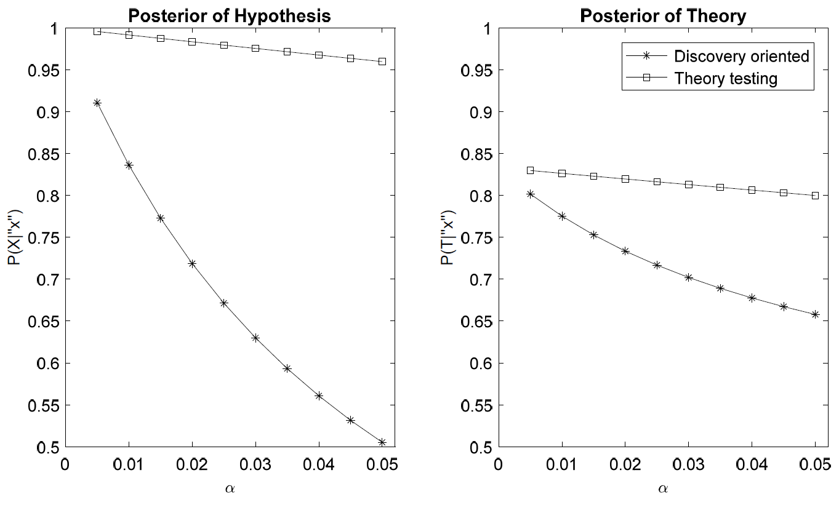
Incomplete Solutions: Lower p
Re‐define statistical significance as p < 0.005 (Benjamin et al., 2018)
Typical increase in required sample size is 70%
Worth 70% larger samples?
Massive gain for discovery-oriented
α
α

Slide 31
Incomplete Solutions: Replications

Slide 32
What Evidence Would You Prefer?
Replication
New prediction
Exp. 1 (N=25):
Observed "x"
Exp. 1R (N=50)
Exp. 2 (N=50)
"x"
"~x"
"y"
"~y"
Evidence: +++ on 1 prediction
Evidence: -
on 1 prediction
Evidence: +/++ on 2 predictions
Evidence: +/--
on 2 predictions

Slide 33
Incomplete Solutions: Replications
Discovery-oriented research benefits from replication: P(X|"x" ) = 0.51, P(X|”x₁”+”x₂”) = 0.94
Theory-testing research, not so much: P(X|"x" ) = 0.96, P(X|”x₁”+”x₂”) ≅ 1.00

Slide 34
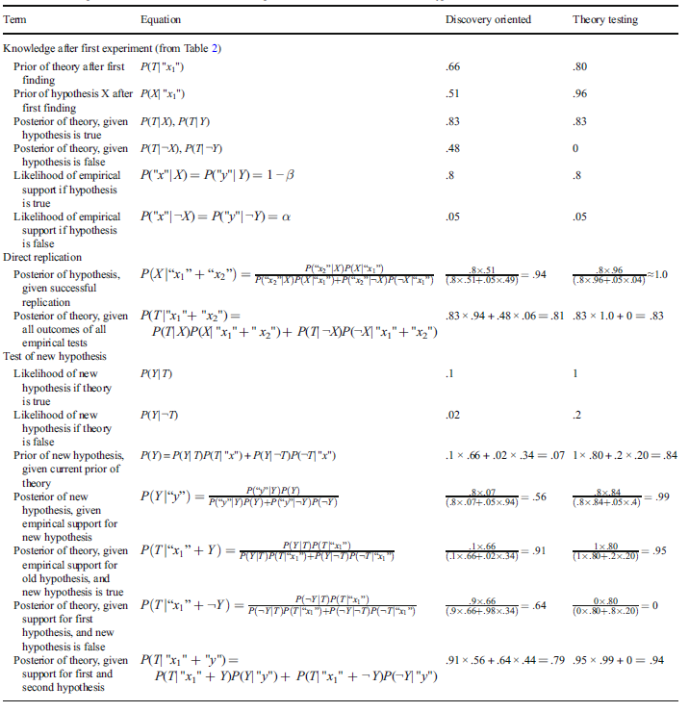
Why?

Slide 35
Incomplete Solutions: Replications
Test a new prediction, Y, instead?
 | Discovery-oriented | Theory-testing
Initial study | P(T|”x”) = 0.66 | P(T|”x”) = 0.80
After (successful) direct replication | P(T|”x+x”) = 0.81 | P(T|”x+x”) = 0.83
After (successful) test of new prediction | P(T|”x+y”) = 0.79 | P(T|”x+y”) = 0.94

Slide 36
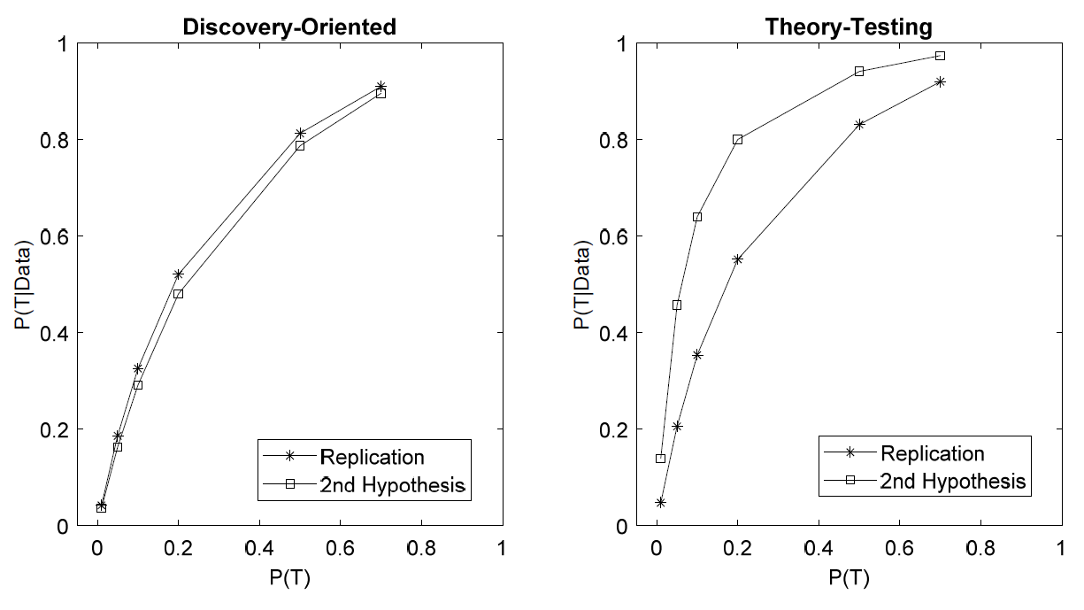
Replication (Dis-)advantage
Direct replications preferable to new hypothesis tests only for “counterintuitive” hypotheses motivated by discovery-oriented theories
Not every replication is a good thing

Slide 37
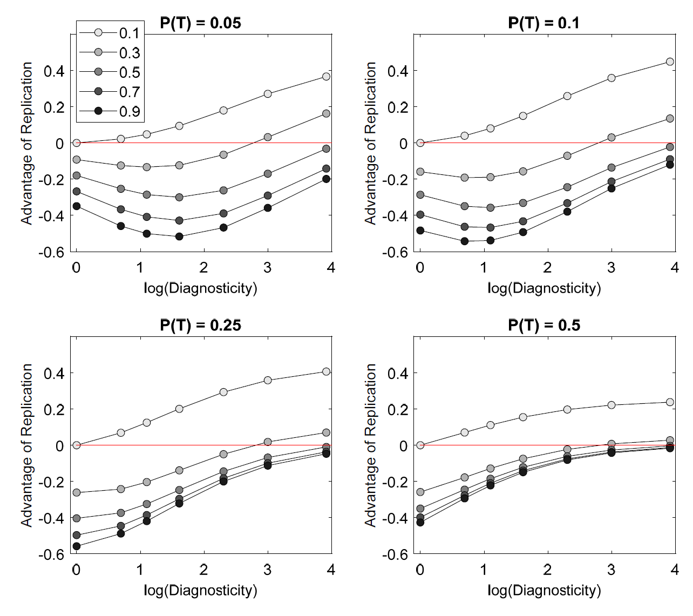
Replication vs. New Prediction
P(X|T)
Highly counterintuitive hypotheses (small P(X|~T)) benefit from replication
Confirmatory diagnosticity
P(X|T)/P(X|~T)

Slide 38
Conclusions
Methodological soundness alone cannot resolve replication crisis (to the extent there is a crisis)
Replication crisis can be ameliorated by developing strong theories
Tight link between theory and hypotheses
specify that X must follow from T
hence “~x” strongly disconfirms theory T
Conduct successive tests of different hypotheses in preference to direct replications
For discovery-oriented research, use large samples and replications

Slide 39
THE END
@lewan.bsky.social w: www.lewan.uk e: stephan.lewandowsky@bristol.ac.uk

