Slide 1
Basic CRUD Application using Spring-Boot

Slide 2
What is Spring-Boot and Why use Spring-Boot?
Spring Boot is an open source Java-based framework used to create a micro Service.
The following are the reasons why we use spring-boot:
Easy dependency Management.
Auto Configuration.
Embedded Servlet Container Support.

Slide 3
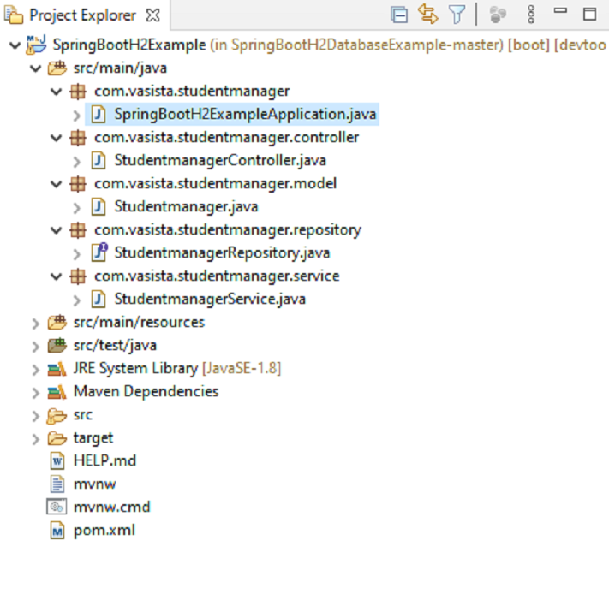
Structure of the Project

Slide 4
Creation Of the Spring-Boot project
The Spring Boot project is created in the start.spring.io and the following dependencies are added :
Spring web
H2 database
Spring data jpa
After the project is generated a pom.xml file will be created which can be used to import the spring boot project into the IDE.

Slide 5
H2 database configuration
As we already know Spring boot is opinionated framework and it will do lots of autoconfigurations based on dependencies available in class path.
We don’t have to configure anything in case if it is fine with the defaults. It uses schema name as testdb.
To override the defaults there is a property which can be implemented in the application.properties file.
spring.h2.console.enable=true

Slide 6
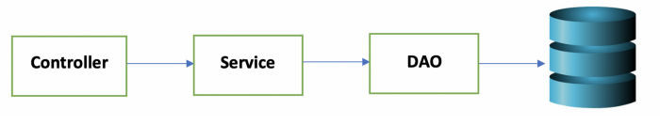
Configuration of the REST API
According to the structure the packages created are model, controller, service and the DAO.
The flow of control for a spring-boot application is depicted in the bellow image.

Slide 7
Contoller:
Contoller is the interface that interacts with the outside world. It handles incoming HTTP requests and send response back to the caller. Based on the incoming request URL and HTTP verb (GET/POST/PUT/PATCH/DELETE), API decides which controller and action method to execute.
Service:
Service is the utility that defines the business logic of the application.
DAO(DATA ACCESS OBJECT):
DAO or Data Access Object is used to interact with the database directly.

Slide 8
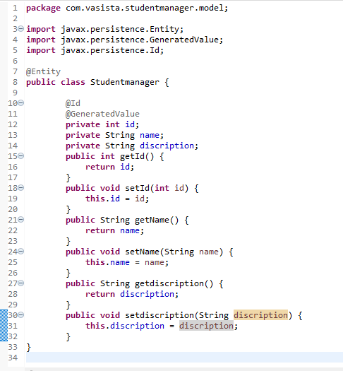
Creating DAO(Studentmanager.java)

Slide 9
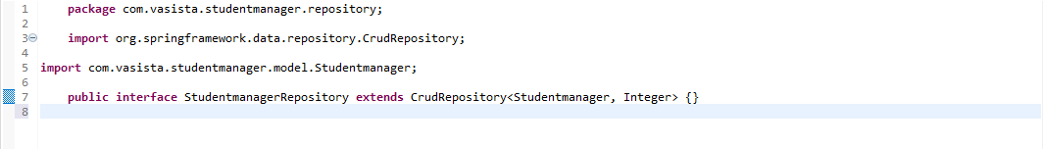
Creating a Repository

Slide 10
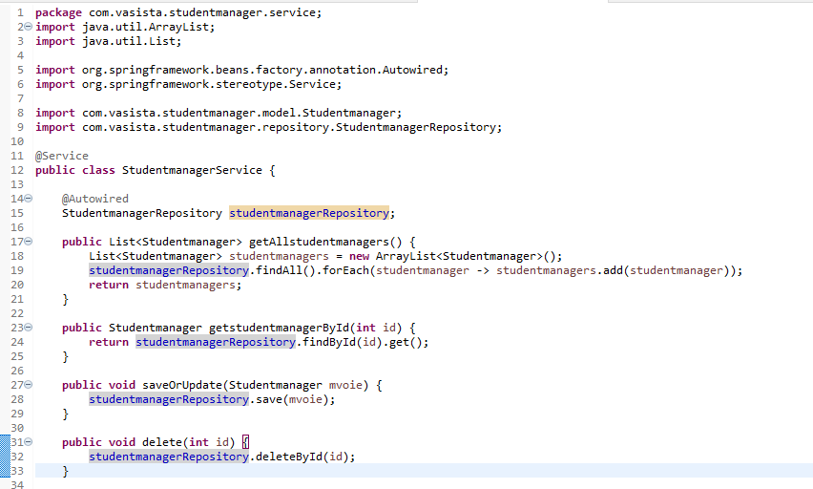
Creating a Service

Slide 11
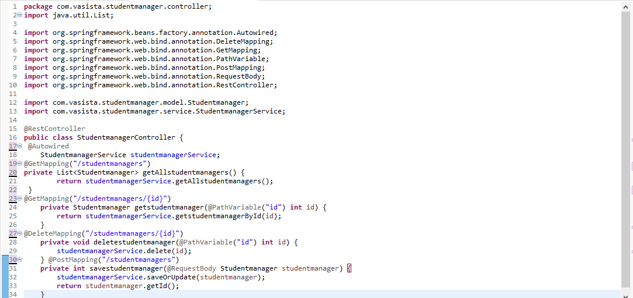
Creating a Controller

Slide 12
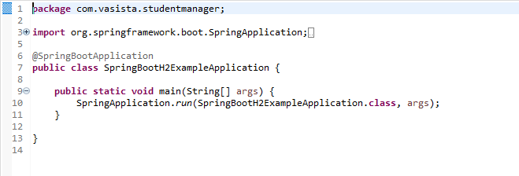
Spring-Boot Main File

Slide 13
@SpringBootApplication does the following work in the application
@Configuration makes the class as a source of bean definitions for the application context.
@EnableAutoConfiguration enables Spring boot to add beans present in classpath setting and various property setting.
Normally you would add @EnableWebMvc for a Spring MVC application, but Spring Boot adds it automatically when it sees spring-webmvc on the classpath. This flags the application as a web application and activates key behaviors such as setting up a DispatcherServlet.
@ComponentScan tells Spring to look for other components, configurations, and services in the default package, allowing it to find the controllers. If specific packages are not defined, scanning will occur from the package of the class that declares this annotation.

Slide 14
Running the Application
Starting the url: http://localhost/8080/h2-console in the web browser allows us to go to the local h2 server's console hosted by the application.
Here we connect to the database and we can find the table created by us in the model.java class.

Slide 15
Using Postman to send the requests
The application can be tested using postman , UI based client for testing restful web applications. It is chrome plugin. Launch postman.
A java based client, then you can also use how to send get or post request in java.

Slide 16
Post a request
Launch postman
Post is selected as the request type.
Set URL as http://localhost:8080/studentmanagers
In header content-type is given and application/json as key value.
In Body, select raw and paste
{ “name”: “Raju”, “discription”: “A student with good grades” }
6. Click on send

Slide 17
Get a request
Get is selected as the request type.
Set URL as http://localhost:8080/studentmanagers/{id}
In header content-type is given and application/json as key value.
In Body, select raw and paste
{
"id" : "1", "name": "Raju", "description": “A student with good grades” }
5. Click on send

Slide 18
Delete a request
Delete is selected as the request type.
Set URL as http://localhost:8080/studentmanagers/{id}
In header content-type is given and application/json as key value.
In Body, select raw and paste
{
"id" : "1", "name": "Raju", "description": “A student with good grades” }
5. Click on send

Slide 19
THANK YOU

