Slide 1
Comparative Study of different text classification methods for Hate Speech Detection
By
Eranki Vasistha
MSIM First Year
veranki2@illinois.edu

Slide 2
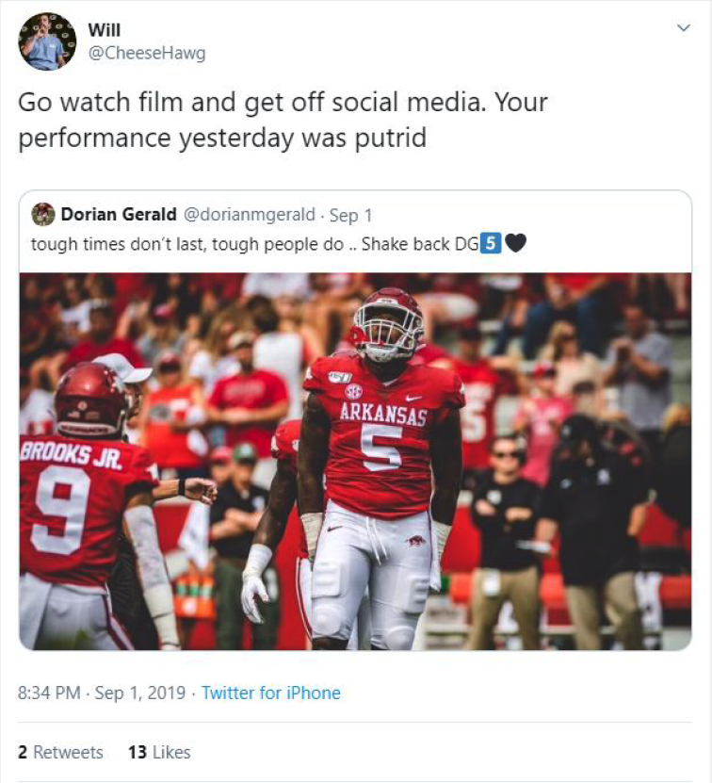
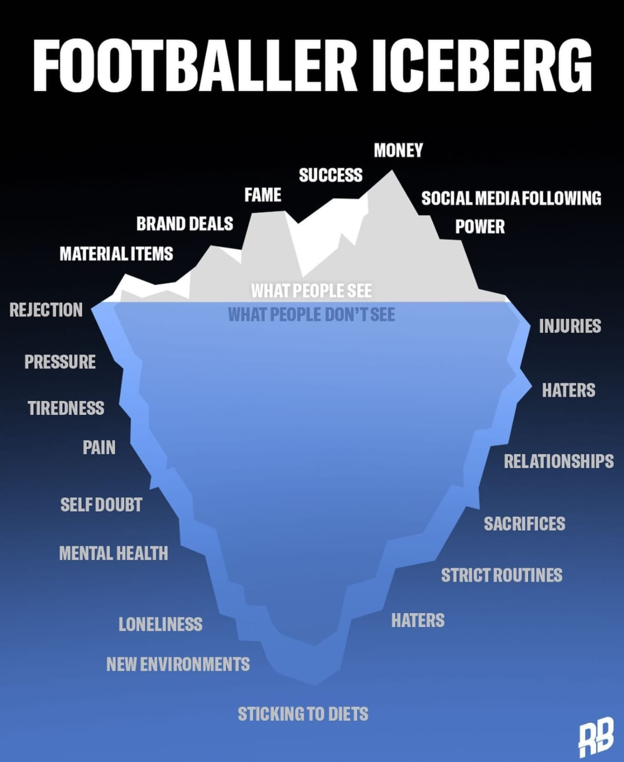
Motivation for the topic

Slide 3
Dataset
https://www.kaggle.com/datasets/mrmorj/hate-speech-and-offensive-language-dataset
This dataset has been taken from Kaggle website which contains of various tweets and retweets on X/twitter. The dataset is classified into three main types:
Offensive tweets,
Abusive tweets and
normal tweets
One major problem with the dataset is that it was highly skewed, i.e, the amount of tweets which were categorized were way more than that of the other two categories.
The graph in the next slide depicts the distribution of the dataset according to the labels :

Slide 4
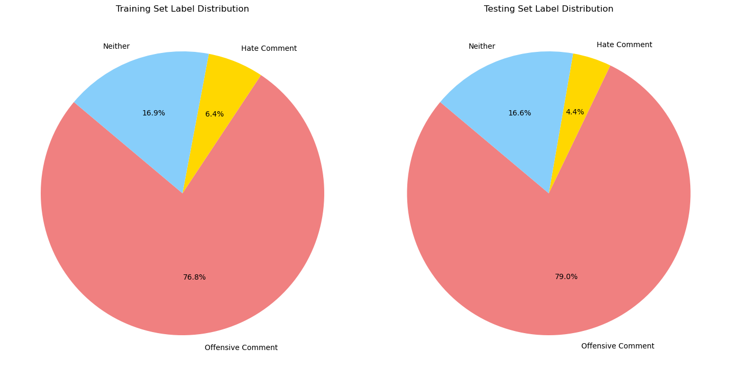
Dataset Distribution

Slide 5
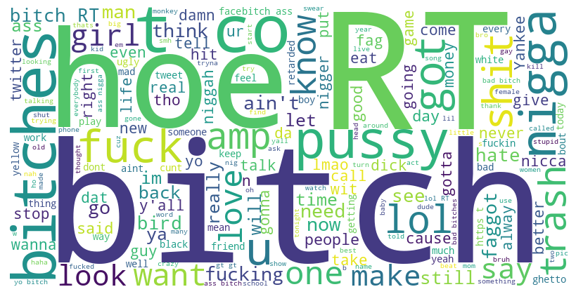


Word cloud generated from the dataset

Slide 6
Preprocessing techniques
The dataset underwent several preprocessing techniques to prepare it for modeling. URLs, special characters (@, !, &, etc.), and hashtags phrases were removed completely for simpler implementations model training like naïve bayes.
Implementing the decomposition hashtags phrases from the tweet as they provide more context to the topic being talked about. This will be helpful in implementing complex models like Neural networks and NER.
The text was also converted into lower cases ( this is not necessary for all columns and tweets)

Slide 7
Before and after processing tweet
Before : !!! RT @mayasolovely: As a woman you shouldn't complain about cleaning up your house. &amp; as a man you should always take the trash out...
After : rt as a woman you shouldn t complain about cleaning up your house amp as a man you should always take the trash out

Slide 8
Feature Selection
Unigram bag of words features space representation was used to extract the features from the cleaned tweets columns for naïve bayes model. This has statistically proven to work better when the task at hand is simple text classification.
There was a total of 15344 unigram features extracted from the entire training dataset.
Among these, best 2000 features were selected on the basis of value of information gain of each feature.
Information gain was used because it proved to be the most effective feature selection method when compared to frequency count, low variance etc.

Slide 9
Machine Learning algorithms used
Implemented naïve bayes model initially along with supervised machine learning algorithms like logistic regression and support vector machines.
Implemented the models with various feature selection sizes and methods so in order to understand which model with which feature selection and what size in order to get better results.

Slide 10
The Challenges ahead
As, hate speech and offensive speech is not just using abusive and in- appropriate language. People are clever and have a better understanding how language than machines, so they can produce a hate tweet without using abusive and hate words.
It becomes important that some context or semantics behind a given tweet has to be understood first.
This will ultimately yield better results and will work more effectively than most of the supervised learning models when it comes exclusively to detecting whether a new given tweet is offensive or abusive or a normal tweet.

Slide 11
Results and Evaluations so far
These are the results after training data and testing it on testing dataset. The main evaluation metrics used were precision, f1_score, recall and overall accuracy.
The graphs on the next slides show the label wise comparison of the f1 metric scores when compared to one another and the overall comparison of each evaluation metrics

Slide 12
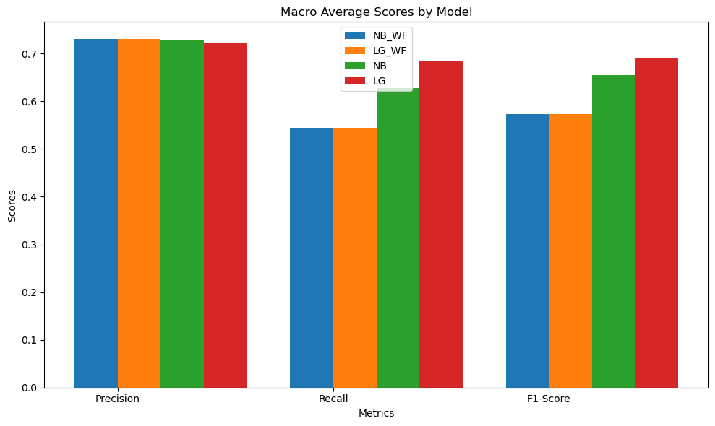
Overall Comparison

Slide 13
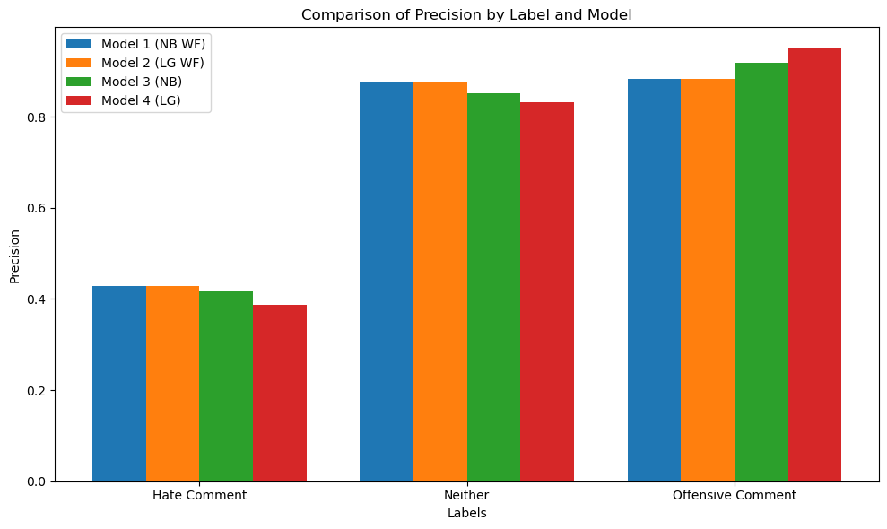
Label Wise Comparison- Precision

Slide 14
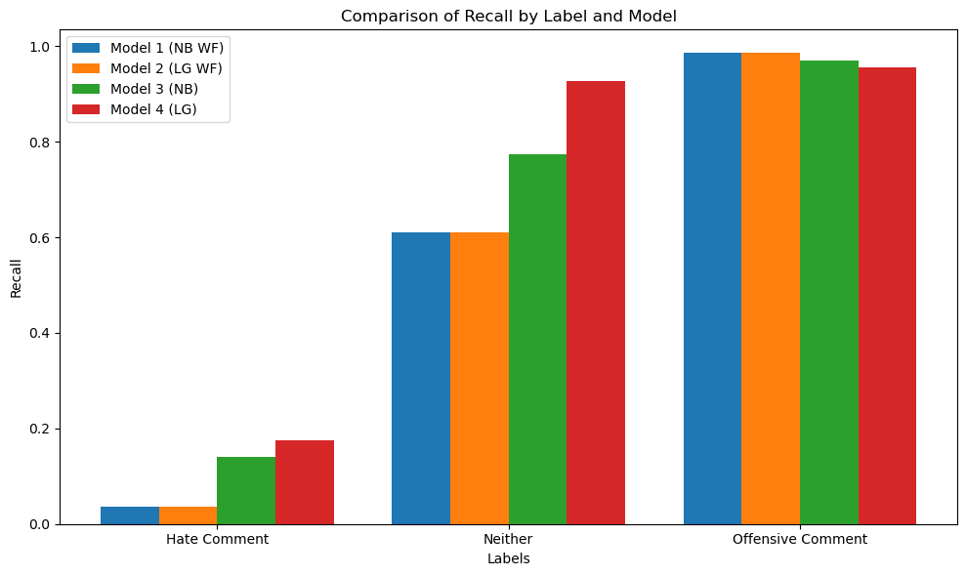
Label Wise Comparison – Recall

Slide 15
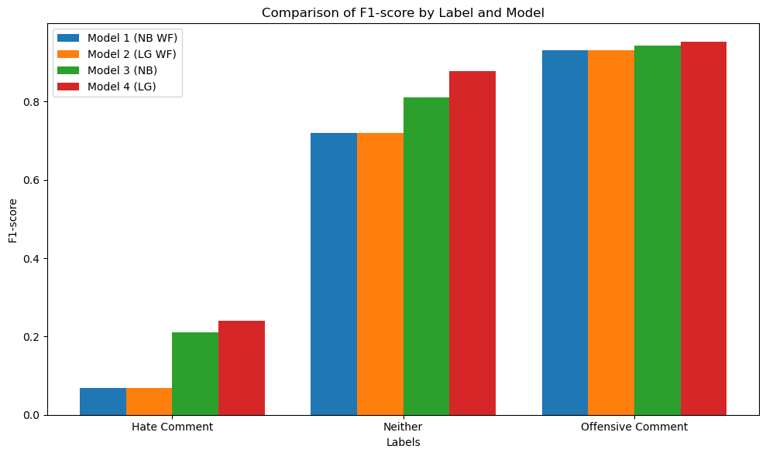
Label Wise Comparison – F1 score

Slide 16
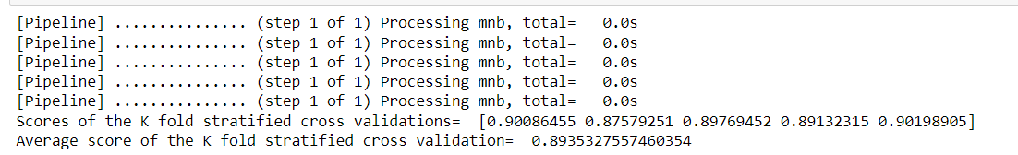
K-fold cross validation
Used k- fold cross validation for training the model. Used 5 folds in total for training the model.
Implemented this using naïve bayes and logistic regression having l1 norm of regularization in order to compare the performances between each of the two models. Again this was done with and without feature selection respectively.
The figure above is a sample output of the k-fold cross validation for naïve bayes using 2000 best features.

Slide 17
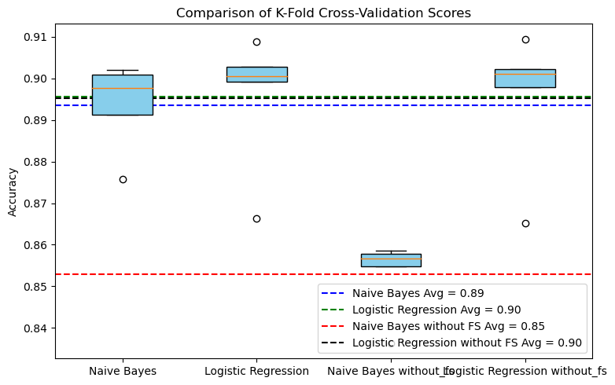
Graph showing performances of k-fold validation

Slide 18
An insight before I leave - Precision vs Fast
According to google, 350,000 tweets are generated every minute. In order to detect hate speech text in all of them is a big task.
If we use NER or Neural networks, we might be able to get a more precise or better hate speech detector. But it is computationally very expensive and time taking in this scenario.
Using supervised learning algorithms seems a good option but it would probably give a lesser precision.

Slide 19
Thank you

