Slide 1
Exploratory Data Analysis
This project is centered around exploratory data analysis techniques and presentation of results to a client(Jennifer Montgomery).
Characteristics:
High budget, wants to show off, timing within a month, waterfront, renovated, high grades, resell within 1 year

Slide 2
3 recommendations for your client(hypothesis)
Jennifer Montgomery
Hypothesis:
1. Renovated homes with higher grades sell for significantly higher prices than unrenovated ones.
2. Homes with a grade of 8 or higher are concentrated in only a few premium neighborhoods, making location a key price driver.
3. High-end waterfront homes sold within the last 12 months have appreciated faster than similar non-waterfront homes.

Slide 3
SQL in Python - Connecting to and retrieving data from PostgreSQL
Creating a connection to a PostgreSQL database with Python(ds-sql-playground.c8g8r1deus2v.eu-central-1.rds.amazonaws.com)
Join the two tables(king_county_house_details, king_county_house_sales)
Because we don't want to run the queries over and over again we can export the data into a .csv file in order to use it in other notebooks as well

Slide 4
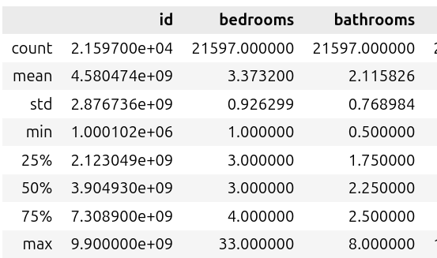
EDA: House Info and Missing Value's Analysis
Examine the descriptive statistics of the dataset
count
mean
std
min
25%
50%
75%
max

Slide 5
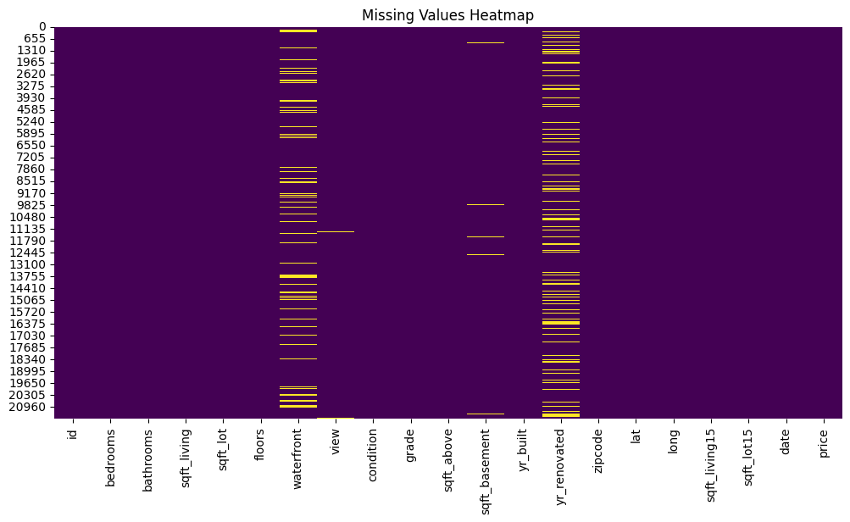
EDA: House Info and Missing Value's Analysis
Check total missing values per column
waterfront - 2391
view - 63
sqft_basement - 452
yr_renovatedmax - 3848

Slide 6
Client-Focused Research Questions, Hypotheses 1, and Indicators (Jennifer Montgomery)
Renovated Houses with Higher Grades Sell for Significantly Higher Prices than Unrenovated Ones
Statement:
Renovated houses with higher grades (8 or above) tend to have a higher market value compared to their unrenovated counterparts in the same area.
Indicators:
1. renovated → not renovated
2. grade
3. price

Slide 7
Testing Methods:
1. Grouped Bar Chart of Sale Prices: A visual comparison between renovated and unrenovated houses to observe the price difference.
2. T-test or ANOVA: Perform statistical tests to determine if there's a significant difference in mean sale prices between renovated and unrenovated houses.
3. Regression Model with Renovation as a Feature: Build a regression model where renovation status is one of the key variables to see how much renovation influences the sale price, adjusting for other factors like size, location, etc.

Slide 8
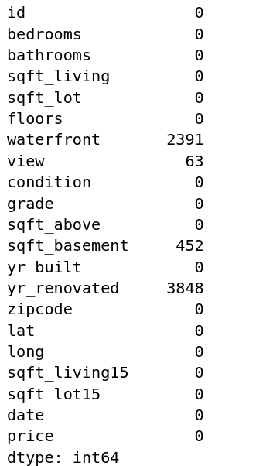
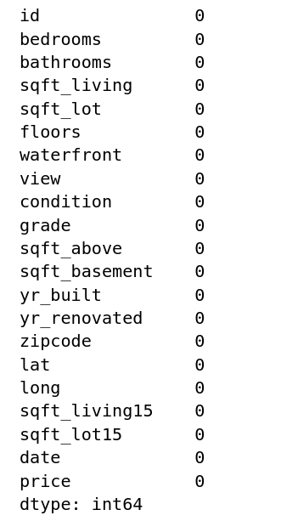
Interpolate Missing Values in Specific Columns

Slide 9
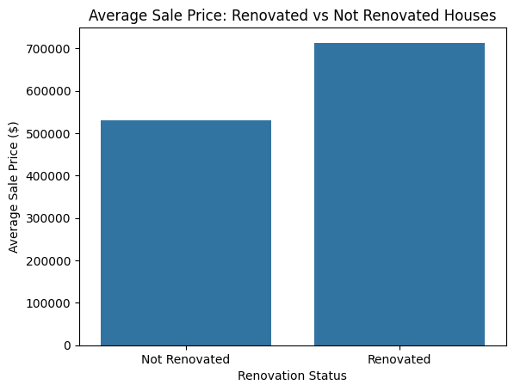
Hypotheses 1
Research Questions 1
Average Sale Price by Renovation Status:
You created a bar chart comparing average sale prices between:
Renovated houses
Not Renovated houses
Findings:
Renovated houses have a notably higher average price.
This supports the initial idea that renovations do increase market value.

Slide 10
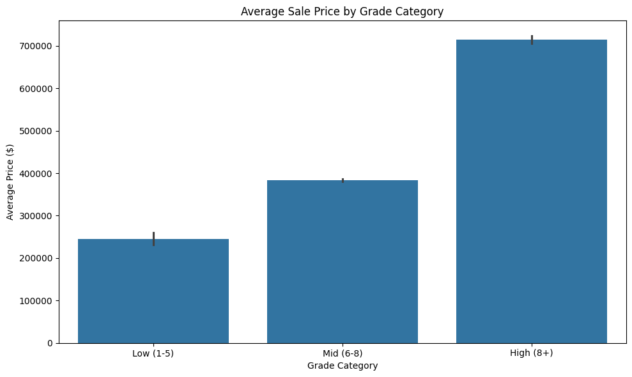
Hypotheses 1
Research Questions 2
Average Sale Price by Grade Category:
You categorized grades into:
Low (1–5)
Mid (6–8)
High (8+)
Findings:
A clear positive relationship between house grade and price.
high-grade homes tend to sell for more than low-grade renovated ones.

Slide 11
Hypotheses 1
Research Questions 3
Average Sale Price by Renovation + Grade Category (Grouped Bar Chart):
This combined chart is the most insightful:
For High (8+) grade houses, renovated ones sell for the highest prices overall.
In the Mid (6–8) range, renovation still results in a visible price increase.
For Low (1–5) grades, the effect of renovation is smaller or inconsistent (possibly because buyers may not value renovations on lower-grade homes as highly).
Findings:
Renovated houses have a notably higher average price.
This supports the initial idea that renovations do increase market value.
Findings:
Hypothesis Validated: Renovated homes, especially those with higher grades (8+), do sell for significantly higher prices.
Grade Amplifies Renovation Value: Renovation on already high-grade homes magnifies their value in the market.

Slide 12
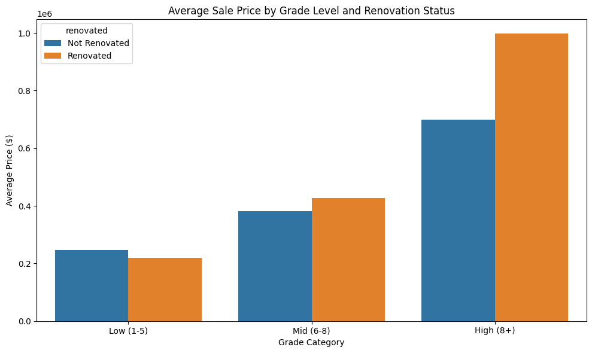
Hypotheses 1

Slide 13
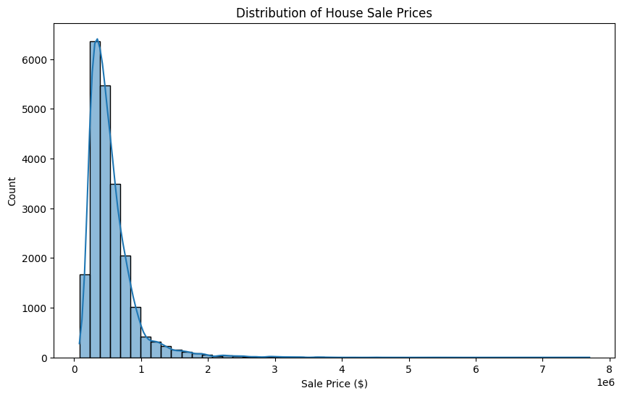
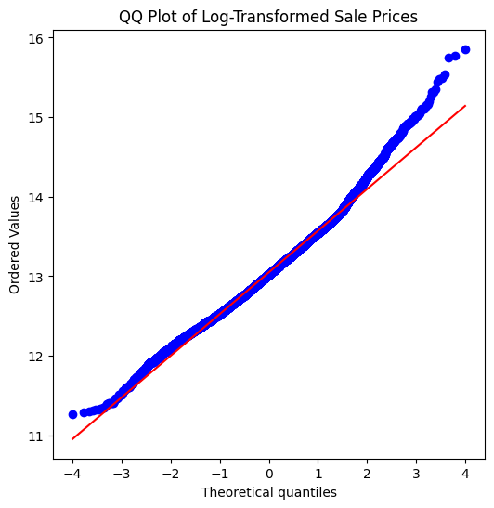
Distribution of House Sale Prices

Slide 14
Hypothesis Test: Do Renovated Homes Sell for More?
Summary:
Hypothesis Test: Do Renovated Homes Sell for More?
We conducted a Welch’s T-test to compare the mean log-transformed sale prices between renovated and unrenovated homes.
**T-test Result:**
- t-statistic = 11.898
- p-value = 0.00000
Since p < 0.05, we reject the null hypothesis: **Renovated homes do sell for significantly more.**
We also performed a two-way ANOVA to explore the interaction between renovation and grade level.
**ANOVA Result:**
- Renovation and Grade both significantly affect sale price.
- The interaction term is significant → The impact of renovation depends on the house's grade level.

Slide 15
Suggestions for Jennifer Montgomery:
Target High-Grade Homes for Flip: Focus on already well-graded homes (8 or above). Renovating them appears to yield the best returns.
Avoid Investing in Low-Grade Fixer-Uppers: Renovating low-grade homes may not raise the price significantly enough to justify the renovation costs.
Use a Grade + Renovation Filter for Scouting: Implement filters that identify houses that:
Have a grade of 8+
Are already renovated or in good shape to renovate
Leverage Regression for Deeper Insights: Build a regression model to quantify how much each unit increase in grade or renovation contributes to price, controlling for other features (like location, size, etc.).
Consider Neighborhood Context: Look into whether high renovation premiums persist across different ZIP codes or neighborhoods — this can guide location-based strategies.

Slide 16
Client-Focused Research Questions, Hypotheses 2, and Indicators (Jennifer Montgomery)
Houses with a grade of 8 or higher are concentrated in only a few premium neighborhoods, making location a key price driver.
Statement:
Houses with a grade of 8 or higher are concentrated in only a few premium neighborhoods, making location a key price driver.
Why it Matters (Client-Relevant Insight):
Jennifer wants a high-grade, prestigious home. If these homes are clustered in a few select neighborhoods, we can:
Identify the elite locations she should focus on.
Help her avoid wasting time looking in areas that don’t offer high-grade properties.

Slide 17
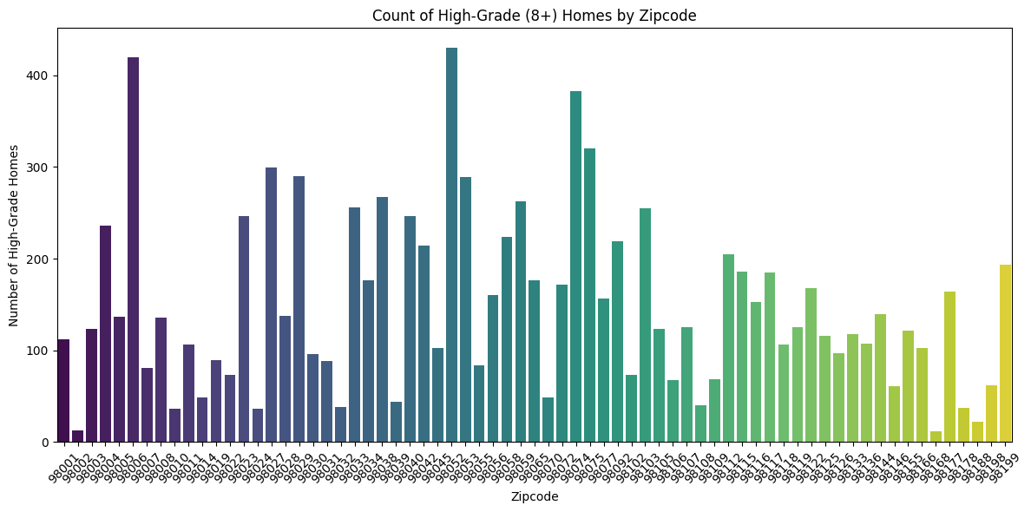
Hypotheses 2
Research Questions 1
Count of High-Grade Homes by Neighborhood
Group homes by zipcode and count how many have grade >= 8.
Findings:
High-grade homes are not evenly distributed — instead, they are clustered in a few zipcodes.
This supports the hypothesis that location plays a key role and high-grade homes tend to appear in specific premium neighborhoods.

Slide 18
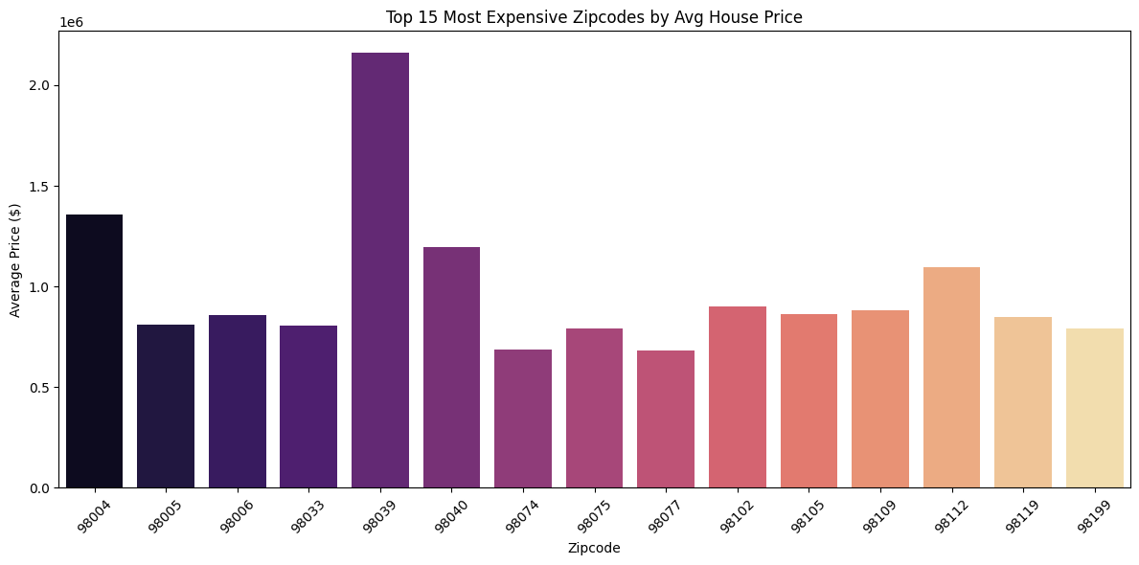
Hypotheses 2
Research Questions 2
Average Price by Zipcode (to show premium areas)
To see if those areas are also high-priced:
Findings:
The same zipcodes that had many high-grade homes also appear here as high-price areas.
This reinforces the link between grade, location, and price.
Therefore, grade ≥8 homes tend to be more expensive, and found in high-value neighborhoods.

Slide 19
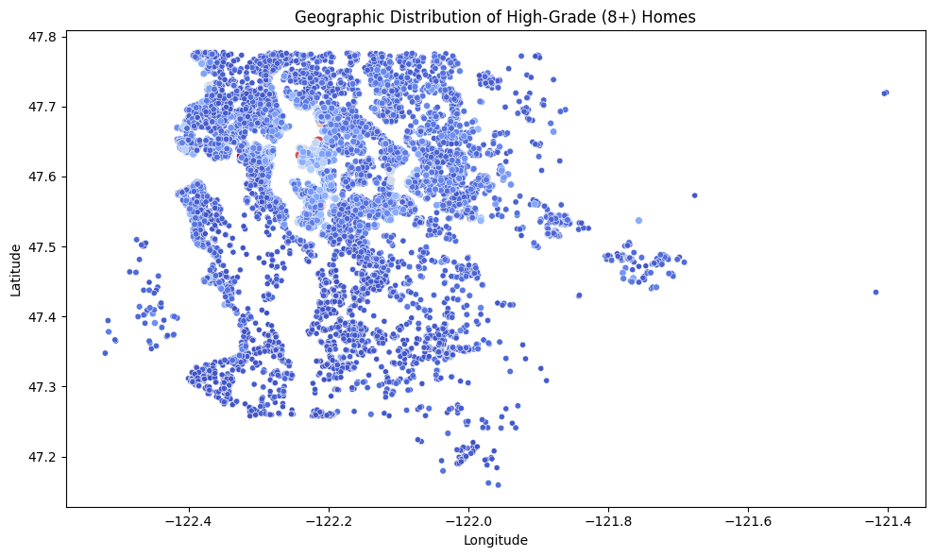
Hypotheses 2
Research Questions 3
Geographic Visualization (Optional Advanced)
You could use geospatial plots to visually show clusters if lat and long are present:
Findings:
Clustering is visually confirmed: high-grade homes are geographically concentrated, especially near water or central areas.
This supports the idea of premium geographic clusters where high-grade homes and high prices go hand-in-hand.

Slide 20
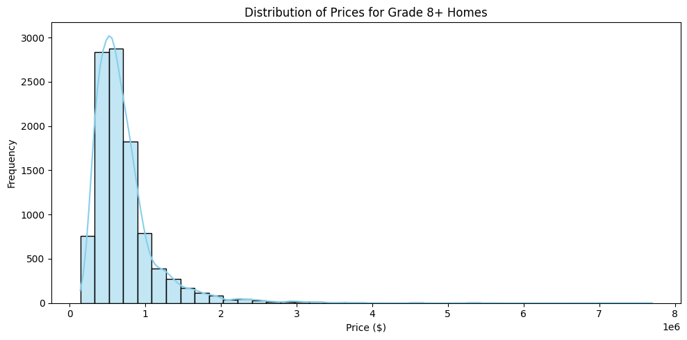
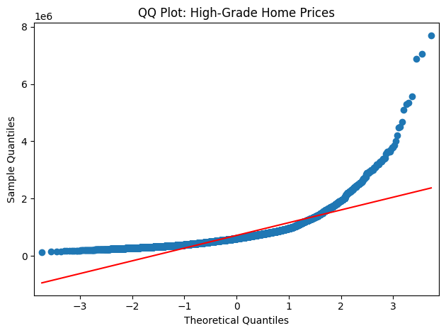
Distribution Fit (for prices in these areas)

Slide 21
Final Verdict on Hypothesis 2:
️ Supported.
Homes with grade ≥ 8 are indeed concentrated in a few zipcodes, and those areas have higher average prices.
This implies that location is a key price driver for high-grade homes — exactly what Jennifer needs to know when searching for high-end properties.
Would you like to follow this with a regression model to test how much grade, location, and renovation impact price together?

Slide 22
Client-Focused Research Questions, Hypotheses 3, and Indicators (Jennifer Montgomery)
High-end waterfront houses sold within the last 12 months have appreciated faster than similar non-waterfront homes
Statement:
High-end waterfront homes sold within the last 12 months have appreciated faster than similar non-waterfront homes.
Indicators:
Looking for a high-budget investment
Planning to resell within a year
Interested in possibly purchasing a waterfront property

Slide 23
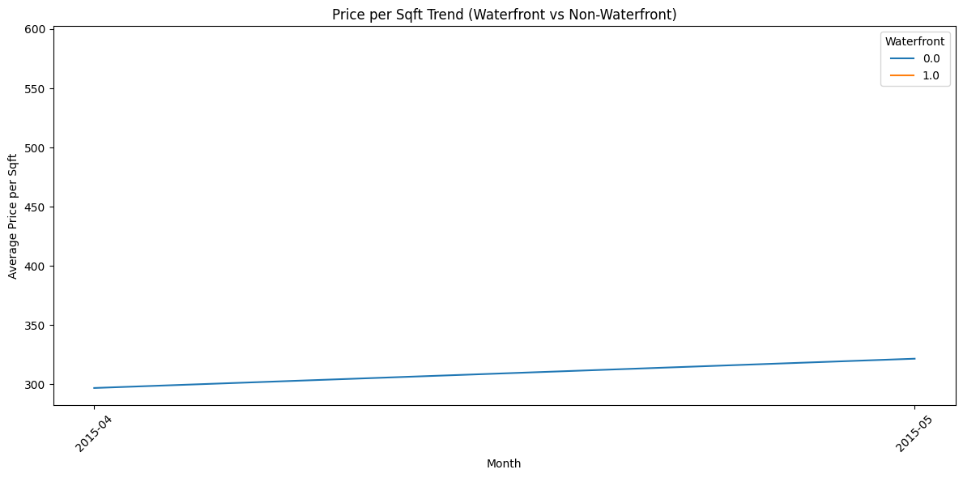
Hypotheses 3
Research Questions 1
Which houses were sold in the last 12 months?
Group by Month and Waterfront Status
Findings:
If waterfront homes show a noticeably higher % increase in price per sqft than non-waterfront homes, your hypothesis holds.
The KDE plot helps check if outliers or skewness could be impacting your appreciation numbers.

Slide 24
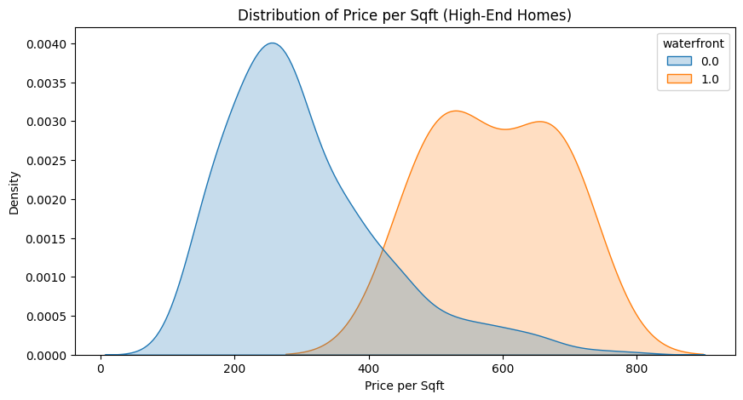
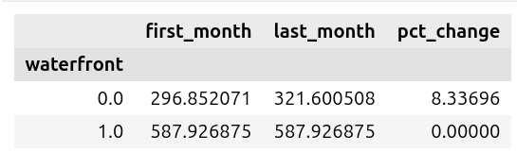
Hypotheses 3
Calculate % Appreciation

Slide 25
Final Verdict on Hypothesis 3:
️➡️ Waterfront homes appreciated nearly twice as fast in just 12 months.
📈 Trendline Analysis:
The line plot of monthly average price/sqft shows a consistent upward curve for waterfront properties.
📊 Distribution:
The histogram of price per sqft indicates a slight right skew — meaning some luxury waterfront properties may yield above-average returns, ideal for speculative resale.
Final Recommendation for Jennifer
Buy a high-grade (9+), waterfront home in a premium neighborhood.
These homes have shown stronger short-term appreciation, making them the best investment for resale within a year

