Slide 1

Alan Turing's Morphogenesis: on the wonders of nature
Vasilis Nicolaou

Slide 2

Visual Simulation

Slide 3
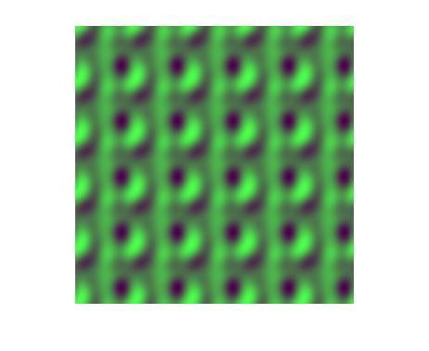
Mathematical Models
Reaction:
du/dt=U*V - U – 12
dv/dt=16-U(c)*V(c)[1]
Diffusion:
Interconnection Shape: Torus
U'=Cdu*(U(i-1, j) + U(i+1, j) + U(i, j-1)+U(i,j+1) – 4*U(i,j))
V'=Cdv*(V(i-1, j) + V(i+1, j) + V(i, j-1)+V(i,j+1) – 4*V(i,j))
Cdu is the constant diffusion coefficient of morphogen U
Figure taken from experiments
[1]Christopher G. Jennings, PhD (http://cgjennings.ca/toybox/lsystems/index.html), L-Systems

Slide 4
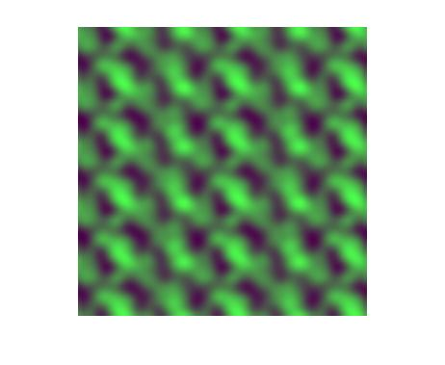
Color mapping
Algorithm scaleColors:
Input:
A vector V of a morphogen concentration values for every cell at a single point in time
Output:
A scale value to divide any morphogen concentration and retrieving a color value from 0-1
Begin
find the maximum max and the minimum min value of the morphogen in Vector V
return max – min
End

Slide 5
Matlab movies
Movies are considered an array of frames.
Each frame is an array representing the pixels of the picture in each frame.
The dimensions therefore are FxNxM, where N, M are the size of each frame and F is the Time the number of frames in that array
For outputing sound instead, scale sound with soundsc
To record frames in matlab use:
A=moviein(numframes,figure1,winsize);
Each time a call to imshow() or plot is done the figure1 is updated. By executing
A(:,i)=getframe(fig1,winsize);
after a figure update a new frame is captured at position i.
Finally you can play the movie using:
movie(fig1,A,1,5,winsize);
And save it:
movie2avi(A, 'movie.avi');

Slide 6
Documentation: matlab

Slide 7
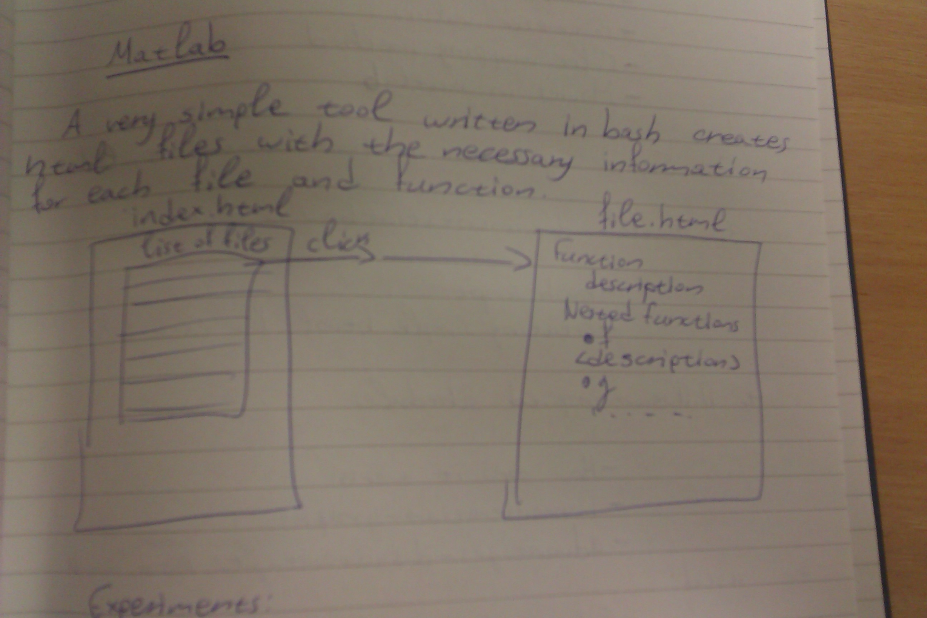
Bash script solution
Very simple to do it with bash and some html.
For each file with the '.m' extension take a pair of function and the comments above that function and output in an appropriate html format.
To prepare a matlab file and make the scripts work, put '%%' in front of a function description, above that function, instead of a single '%'.

Slide 8
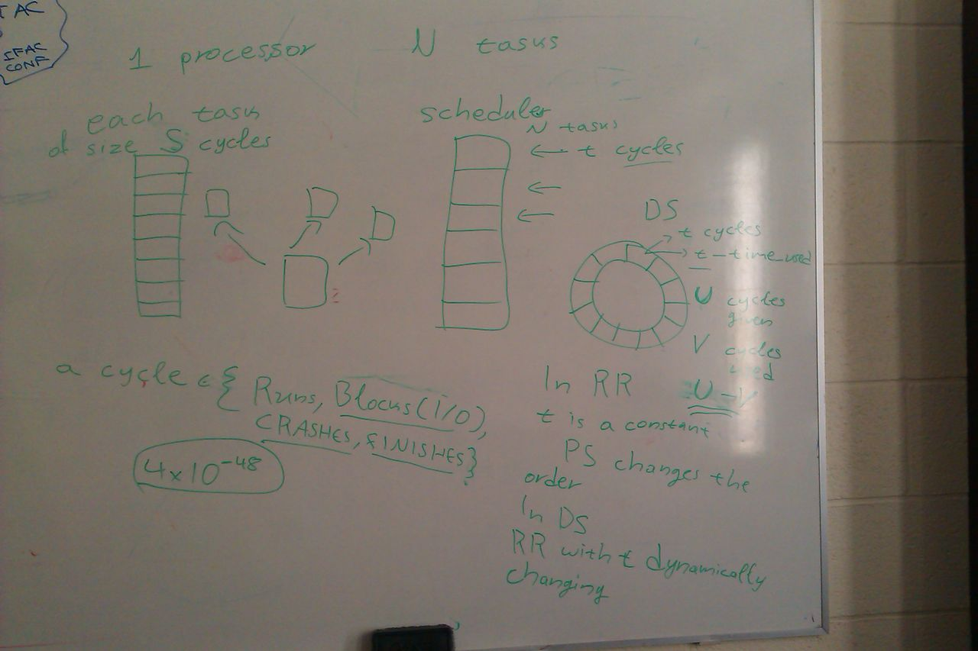
Diffusion-inspired Scheduling
Random Scheduler
Priority Scheduler
Round Robin Scheduler
Diffusion-inspired Scheduler
Figure: Designing and explaining the scheduling problem in terms of reaction-diffusion in a meeting.

