Slide 1


Book Management System

Slide 2
Prerequisite Software : 1.Python Interpreter, 2.VS Studio Code Editor, 3.MySQL Server, 4.MySQL Workbench 8.0 CE.

Slide 3
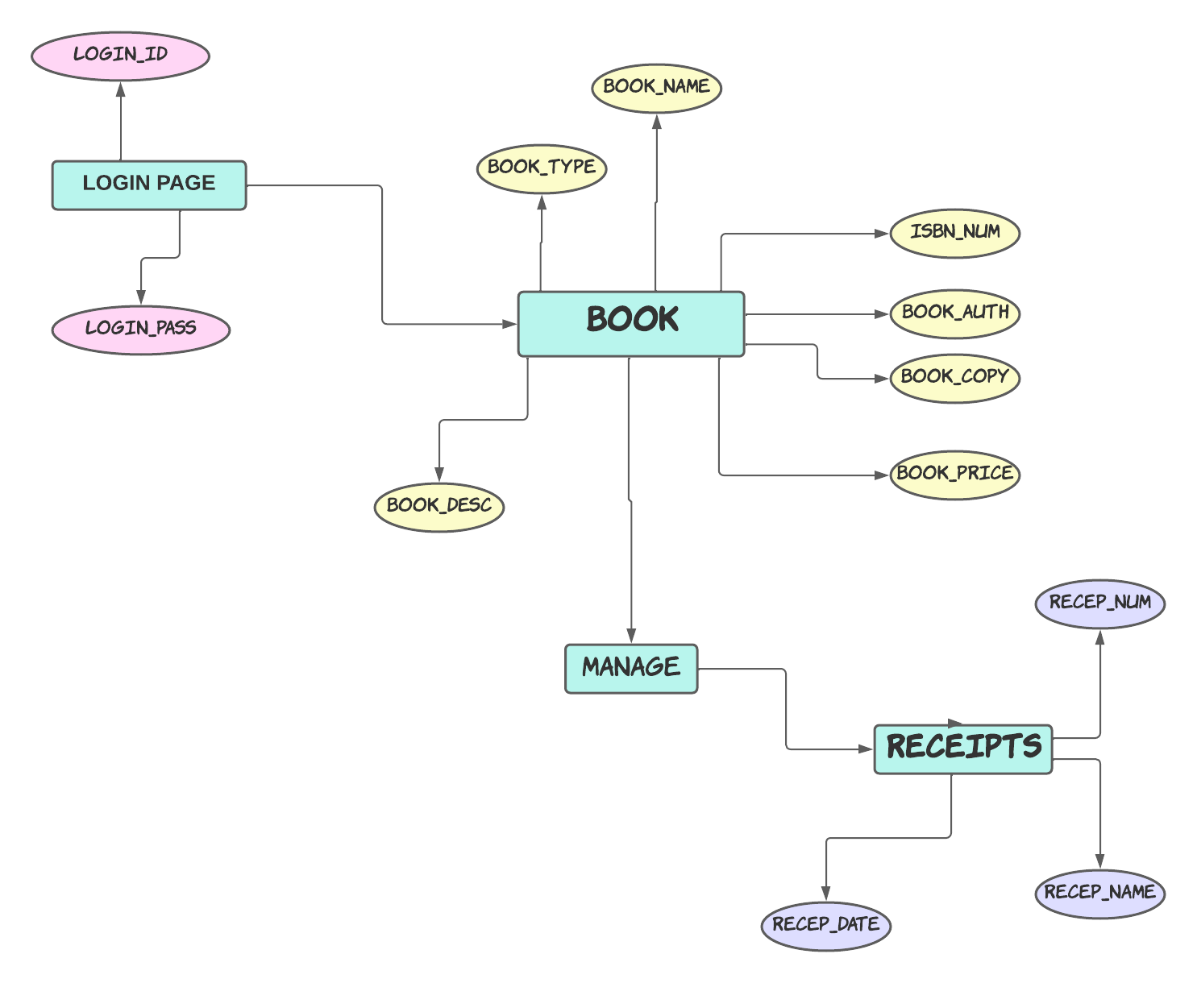
ER –DIAGRAM:

