Slide 1
Welcome All…..!!!

Slide 2

A Presentation On
“TRAFFIC - SIGN RECOGNITION”
Seminar-I/Seminar-II/DP-I/DP-II/DP-III/DP-IV/Final Presentation
Under the Guidance of
Ms. N. D. DEVAL
DEPARTMENT OF COMPUTER SCIENCE & ENGINEERING
SVERI’s College of Engineering, Pandharpur.

Slide 3
Group Members
Miss. Aparna Baliram Vasmale
Miss. Sakshi Vikas Shivsharan
Miss. Pallavi Aba Jadhav
Miss. Shruti Pandurang Adat
Miss. Anushka Santosh Chavan

Slide 4
OUTLINE
Introduction
Needs for Project Name
Problem Statement
Literature Review
Objective
Methodology
Experiment and data
Future work
Libraries
Proposed System Architecture
Implementation
Conclusion
References

Slide 5
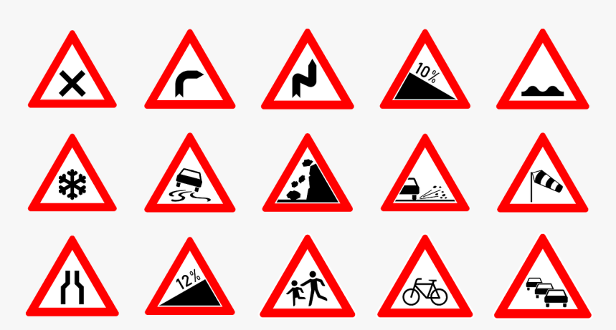
Introduction
Traffic Signs :
Traffic signs or road signs our signs erected at the side of or about roads to give instructions or provide information to road users.
Signs are treaty signed in 1968 which has been able to standardize traffic science across different a countries.
There are some examples of traffic signs.
Warning signs: Warning signs are two Warner of hazardous condition.

Slide 6
Problem Statement
To propose a method to extract the symbol of the traffic warning sign.
To propose a method to identify the symbol of the traffic warning sign.
To propose a method to extract the image frames from the video segment.

Slide 7
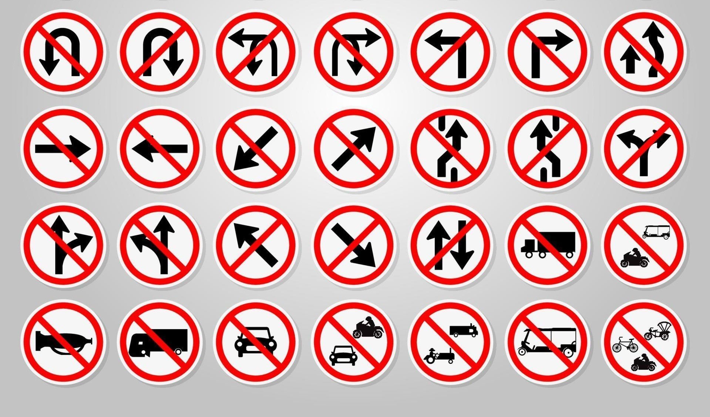
Prohibitory signs : Prohibition signs specified behavior or action file are not permitted.

Slide 8
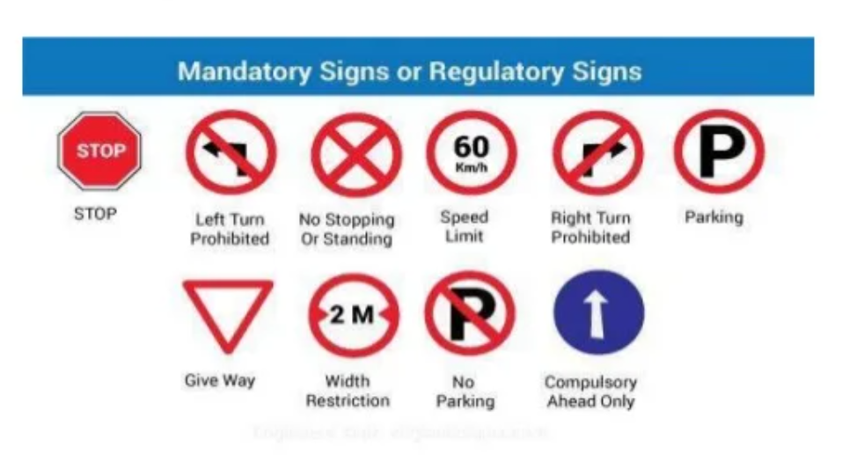
Mandatory sings: Mandatory sings are road signs which are used to set the obligations of all traffic which use a specific area of road.

Slide 9
TRAFFIC SIGN RECOGNITION
Traffic sign recognition is a technology by which a vehicle is able to recognize the traffic signs put on the road example speed limit or turn ahead.
The first TSR systems which recognized speed limits were developed in corporation by Mobileye and Continental.
In 2008 designer BMW 7 series and the Mercedes Benz'S.
Traffic Sign Recognition (TSR):
Detection
Classification

Slide 10
LITRATURE REVIEW
The existence of dirt on the faces of traffic signs has effects on signs readability issues with traffic sign readability can lead to an increase in unsafe driving behaviours . However cleaning traffic signs is very expensive and can potential due to safety issues for workers and traffic users does it is important to identify traffic signs.
The goal of this study was to revealed the effects of sign attributes and location observations on the number of dirty traffic signs.
According to study SURF technologies used for recognition of traffic signs but something stuck on blur images ,breakable images ,color images.

Slide 11
OBJECTIVE
The main objective of the traffic sign recognition project is to identify a traffic sign from a plate and digital photograph.
The sign maybe viewed from various angles and in many diverse background situations.
Traffic sign will then be highlighted after identification and classify signs with a high accuracy rate .All image processing algorithm will be done in MATLAB.

Slide 12
METHODOLOGY
Tracking
Input
Detection
Classification
Output

Slide 13
REQUARIMENT
Platform :
Operating system : Windows 10 Home Basic
Prerequisite :
VS Code
2. Python ID

Slide 14
FUTURE WORK
The traffic signs focus on reduction of the traffic load on existing road network through various travel demand management measures.
Traffic signs should remove the encroachments, congestion and improve the traffic signal, road condition and geometrics features at intersections.
Cameras fitted to the front of the car are able to recognise signposts and notify the driver of speed limits and more via alerts on the car's digital display.
The purpose of road signs is to promote road safety and efficiency by providing for the orderly movement of all road users on all roads in both urban and non-urban areas.

Slide 15
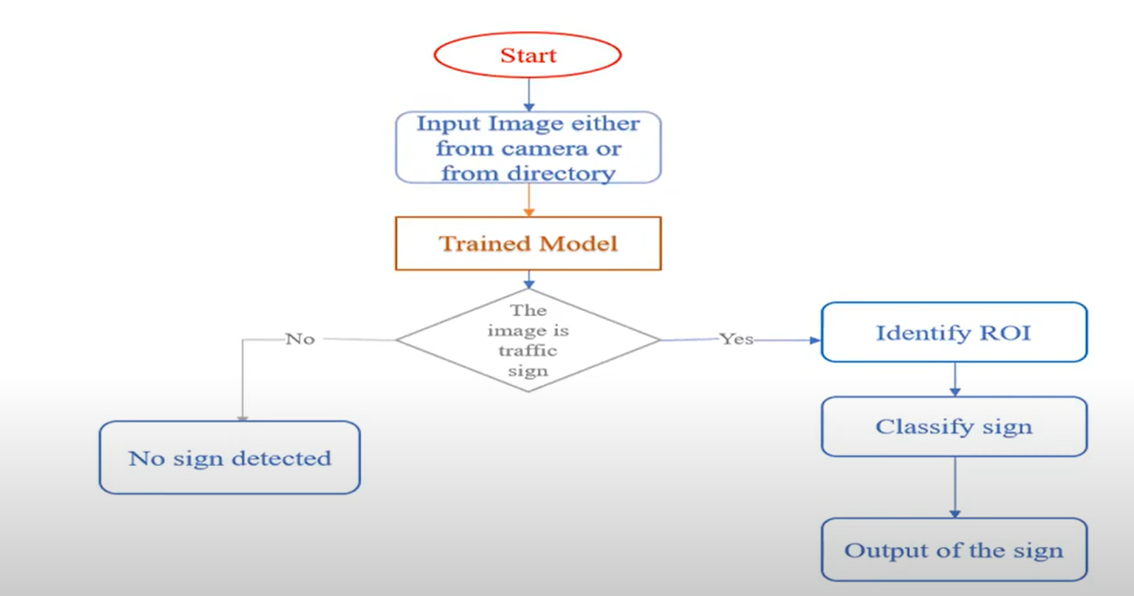
Proposed System Architecture

Slide 16
LIBRARIES
CNN
CV2
NumPy
SciPy

Slide 17

Implementation

Slide 18


Slide 19
Conclusion
This study proposed an automatic traffic sign detection, classification and recognition system. The detection of traffic signs, assumes a crucial role in any traffic sign recognition application. In fact, a sign that is not correctly detected cannot be classified and recognized to inform the driver. In detection step, the distinctive features of traffic signs shall be considered. Since, traffic signs are regulated to be in specific color and shape; it is convenient to use those features to decide the candidates.

Slide 20
References
mehmetbülenthavur, “traffic sign recognition for unmanned vehicle control”, recognition of traffic sign, pp.60-80. Nov 2006.
Sardar O. Ramadhan1, Burhan ERGEN 2, “Traffic Sign Detection and Recognition”, International Journal of Advanced Research in Electrical, Electronics and Instrumentation Engineering, recognition of traffic sign, Vol. 6, Issue 2, February 2017, pp.960.
S.K. Khanna, C.E.G.Justo and A.Veeraragavan, highway engineering, 10 Ed, classification of traffic sign, pp.242-248.
mehmetbülenthavur, “traffic sign recognition for unmanned vehicle control”, color analysis,pp.9-19, Nov 2006.
Carlos Filipe Moura Paulo, “Detection and Recognition of Traffic Signs” detection of traffic sign, pp. 4, sep.2007.

Slide 21
Thank You….!

