Slide 1
Implementation of a Wireless Sensor Network
Brian Kiaer
Vincent Tuason

Slide 2
Goal
Main Goal
Demonstrate our knowledge and understanding of how to create a low-power star topology network solution while not compromising on the distance that the transmission of data can cover.
Objective: Implement a Wireless Sensor Network
Use two CC1350 LaunchPads with one of them configured as a standalone transmitter while the other is configured as a co-processor module that is connected to the BeagleBone Black.
Install the SDK for Linux Gateway
Flash the BeagleBone Black with the am335x image file using an SD card
Configure the BeagleBone Black as the embedded host
Connect the MAC Processor to the host and run the network

Slide 3
Outcome - Accomplishments
Outcome – result of your project?
The outcome of our project is a successful implementation of a Wireless Sensor Network that is able to read and transmit the temperature and Lux value of the sensor’s environment and transmit that information to the Collector App that is accessible anywhere as long as you have the IP address and Internet connection. This was all done through the use of two CC1350 boards with one being configured as a transmitter(sensor) and the other being a MAC CoProcessor connected to the BBB. Setting up the network and obtaining the correct IP address was done through the terminal connected to the BBB.
Short Term usefulness: Be able to read the temperature and lux value of the environment that the sensor launchpad is currently in.
Long Term usefulness: Knowledge of how to implement a Wireless Sensor Network so the user can remotely track his/her sensors regardless of distance and add a wide variety of sensors to the Collector App that suit the user’s needs.

Slide 4
Components Used in Design
TSL2561 Light Sensor
CC1350 LaunchPad Temperature Sensor
TI 15.4 Collector App

Slide 5
Tools used in Design
Code Composer Studio 8.2.0
Win32 Disk Imager

Slide 6
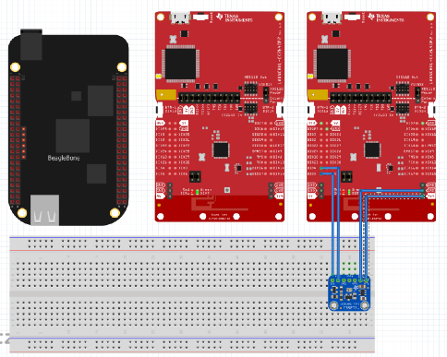
Schematics
Block diagram of the connections with components with pin specifications.
Lux Sensor CC1350
Vin -> 3.3V
GND -> GND
SCL -> DIO4
SDA -> DIO5

Slide 7
Pre-requisites used in Design
Software Prerequisites
AM335X SD Card Image
UniFlash
TI 15.4 Stack Linux Gateway SDK
Tera Term/PuTTy/Terminal
sensor_cc1350lp CCS Project
CC1350 SDK for Sensor and MAC CoProcessor
VirtualBox/Ubuntu
Hardware Prerequisites
2 x SimpleLink Dual-Band CC1350
1 x BeagleBone Black
1 x Mini USB Cable
2 x Micro USB Cable
Ethernet Cable

Slide 8
Links and Commands to install prerequisites
AM335X Image file: http://software-dl.ti.com/processor-sdk-linux/esd/AM335X/latest/index_FDS.html
UniFlash: http://www.ti.com/tool/UNIFLASH
TI 15.4 Stack Linux Gateway: http://www.ti.com/tool/ti-15.4-stack-gateway-linux-sdk
TeraTerm: https://ttssh2.osdn.jp/index.html.en
PuTTy: https://www.chiark.greenend.org.uk/~sgtatham/putty/latest.html
Sensor_cc1350lp Project: http://www.ti.com/tool/SIMPLELINK-CC13X0-SDK
VirtualBox/Ubuntu: https://www.virtualbox.org/wiki/Downloads
https://www.ubuntu.com/download/desktop

Slide 9
Implementation Details
Steps used in design:
Configure one of the CC1350 LaunchPads as a Sensor through UniFlash (sensor_default_cc1350lp.hex)
Configure one of the CC1350 LaunchPads as a MAC CoProcessor through UniFlash (coprocessor_cc1350lp.hex)
Install SDK for Linux Gateway: chmod +x ti15.4stack_linux_x64_x_xx_xx_xx.run and ./ti15.4stack_linux_x64_x_xx_xx_xx.run
Flash the BeagleBone Black with the SD Card Image then boot it up.
Once “Arago Project” is visible in the terminal, log in as a root user
Type ifconfig to find the assigned IP address
Look for the IP address under the eth0 section. It will be under “inet addr”
Open another terminal window and use the login root@192.168.1.133 (which is what our IP address was at the time)
Copy the tar.gz file from Ubuntu to the BeagleBone Black
Connect the MAC CoProcessor Launchpad to the Beagle Bone black

Slide 10
Implementation Details
11. Run “ls –l/dev.ttyACM*” to check if the MAC CoProcessor has been successfully connected to the BBB
12. Modify the paths in the script file and execute run_demo.sh
13. Copy the ID number and IP number given after running the script file and paste it into a web browser. (http://192.168.1.133:1310)

Slide 11
14. Add sensor to the collector app by resetting it the CC1350 launchpad that was configured to be a sensor and wait for 1-2 minutes
15. Add another sensor (TSL2561 Lux Sensor). Add to the sensor_cc1350lp project’s sensor.c file to be able to use the I2C interface. Libraries and Functions to initialize I2C communication. Lastly create a predefined symbol so that the sensor.c knows that the Lux Sensor has been activated.

Slide 12
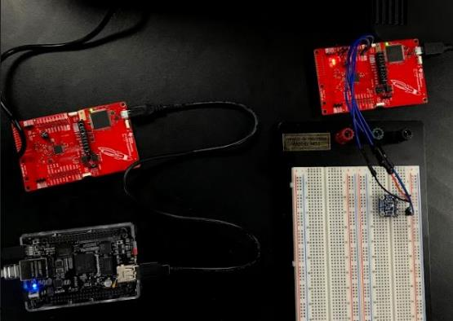
Actual project set-up
Screenshot of the project will all components
Notes:
xx

Slide 13
Demo
Video link: https://www.youtube.com/watch?v=bmGz9Q5drNA

Slide 14
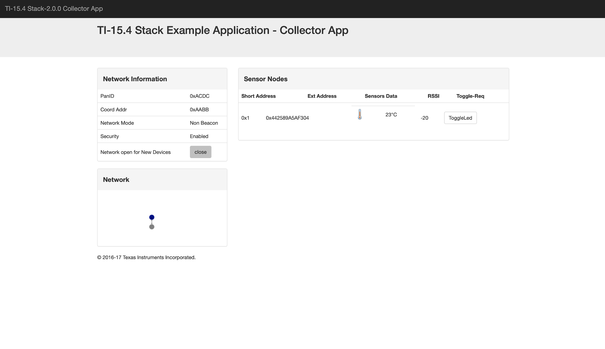
Results and Conclusions
The image on the right shows that the temperature reading has been successfully added to the collector app

Slide 15
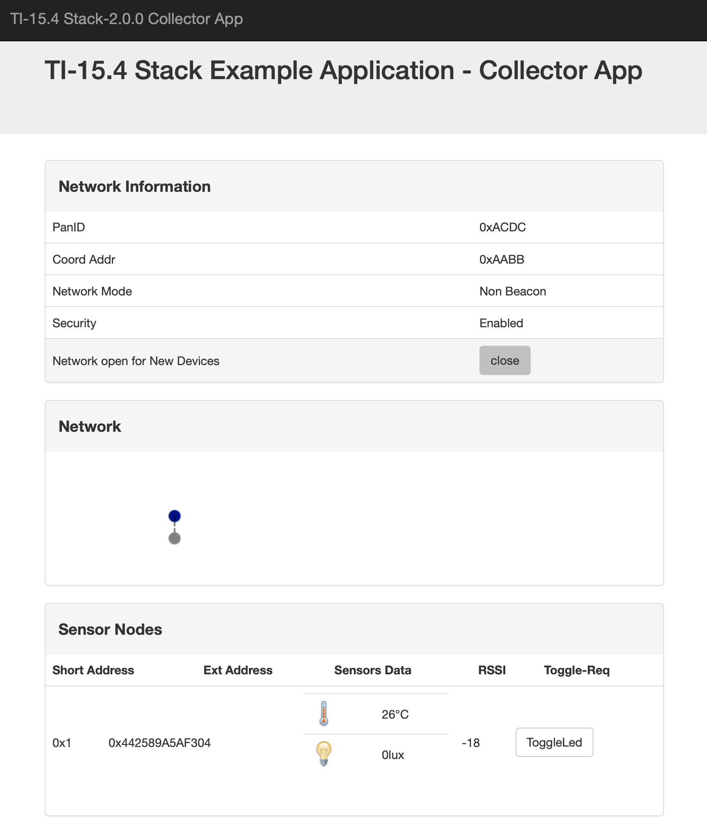
Results and Conclusions
The image on the right shows a functioning lux sensor that has been added to the Collector App

Slide 16
Results and Conclusions
By completing this project we were able to further our understanding of the implementation and function of a Wireless Sensor Network. It allowed us to learn how to configure the BeagleBone Black as a host to be able to communicate between two CC1350 Launchpads each configured as a sensor and a MAC CoProcessor respectively. Lastly it taught us how to setup an I2C connection so that we can add more sensors in the TI 15.4 Collector App.

Slide 17
Reference
“Adding New Sensor Support To Sub1GHz Sensor To Cloud Linux Gateway.” MSP430 LaunchPad Tutorials - Texas Instruments Wiki, processors.wiki.ti.com/index.php/Adding_New_Sensor_Support_To_Sub1GHz_Sensor_To_Cloud_Linux_Gateway.
三妹 . “Basic Example to Use OPT3001 on CC2650 LaunchPad.” Sun May Sky, 1 Jan. 1970, sunmaysky.blogspot.com/2016/03/basic-example-to-use-opt3001-on-cc2650.html.

