Slide 1

Notes:
Мое Скопје
Skopje's live city data, in one place.

Slide 2
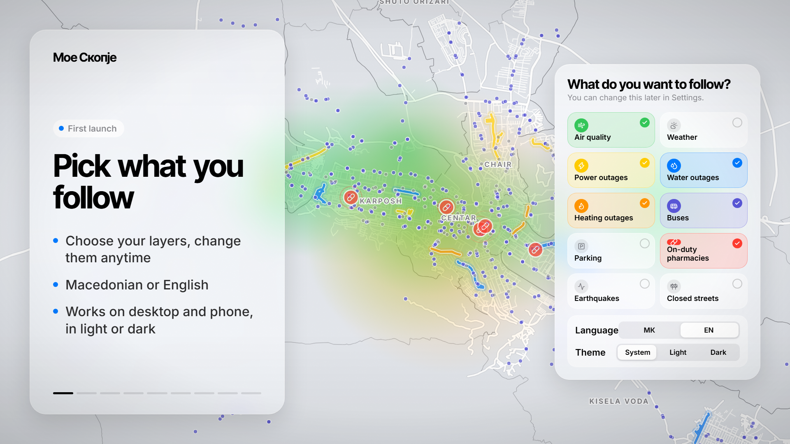
Notes:
Pick what you follow
Choose your layers, change them anytime
Macedonian or English
Works on desktop and phone, in light or dark

Slide 3
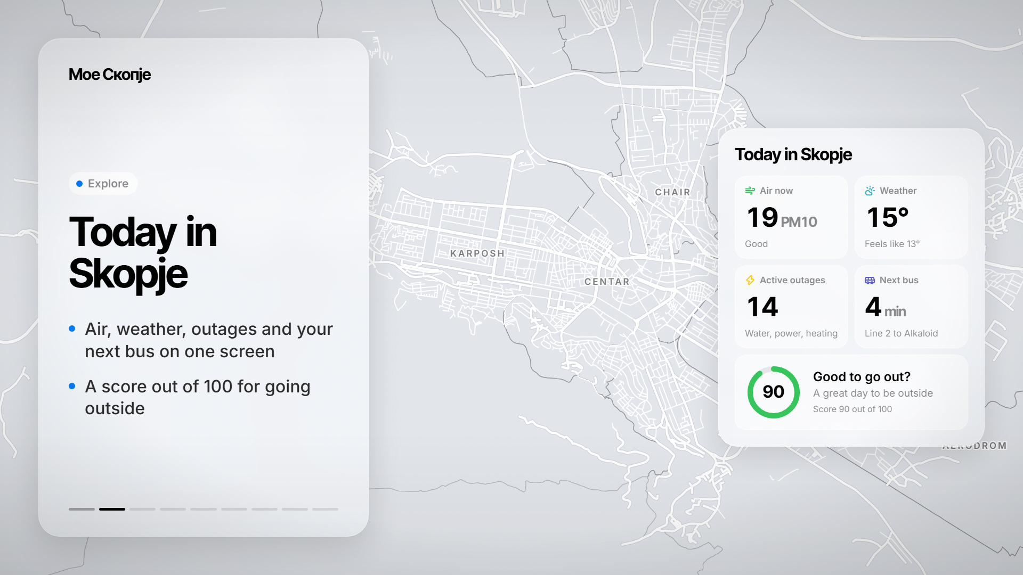
Notes:
Today in Skopje
Air, weather, outages and your next bus on one screen
A score out of 100 for going outside

Slide 4
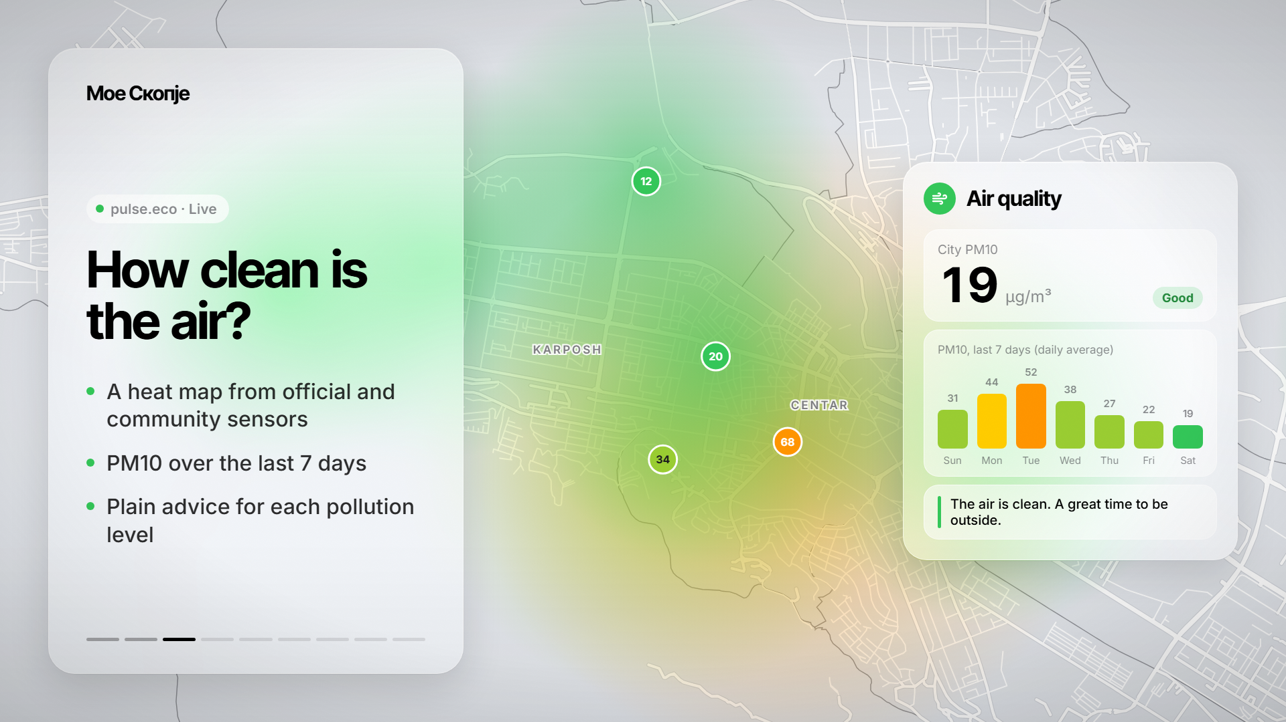
Notes:
How clean is the air?
A heat map from official and community sensors
PM10 over the last 7 days
Plain advice for each pollution level

Slide 5
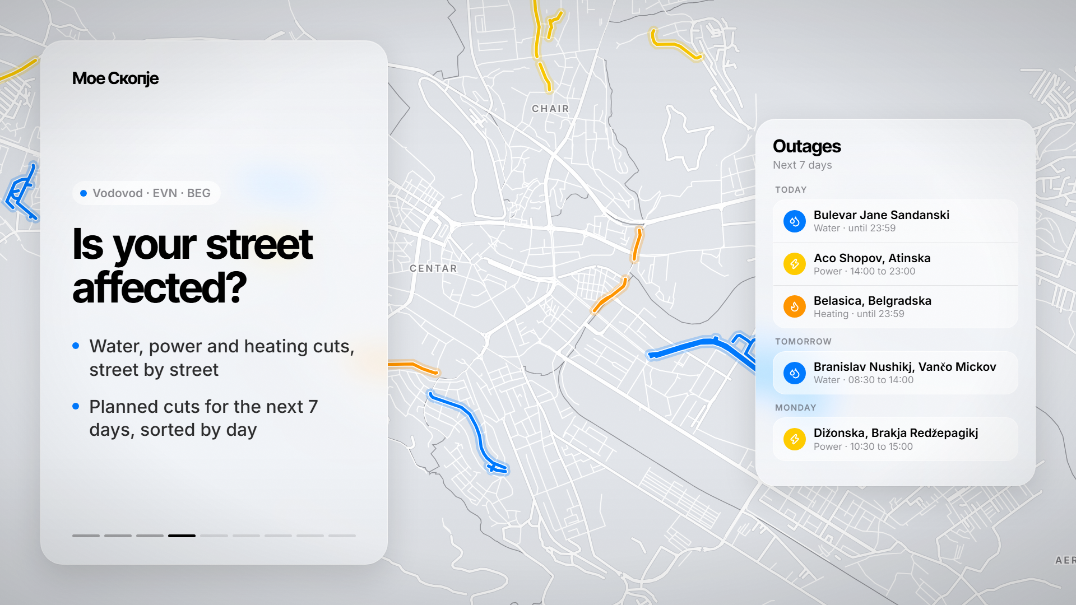
Notes:
Is your street affected?
Water, power and heating cuts, street by street
Planned cuts for the next 7 days, sorted by day

Slide 6
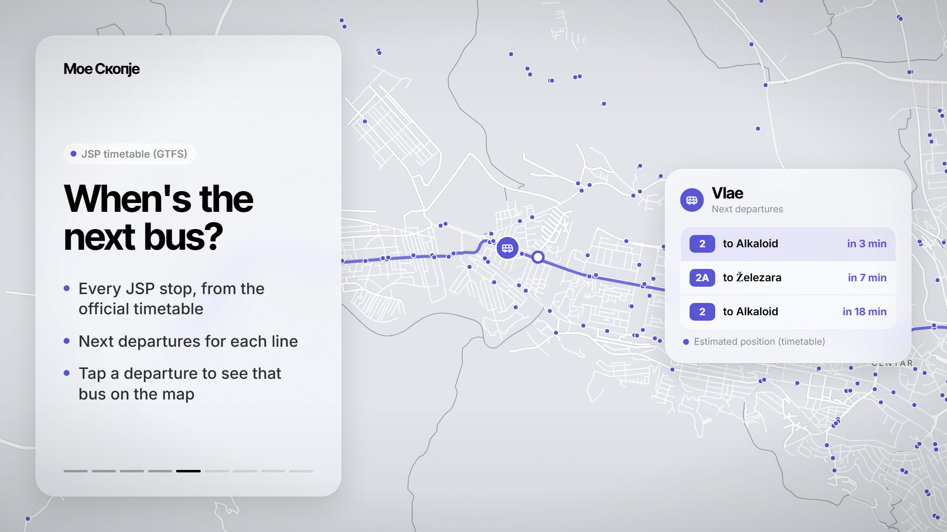
Notes:
When's the next bus?
Every JSP stop, from the official timetable
Next departures for each line
Tap a departure to see that bus on the map

Slide 7
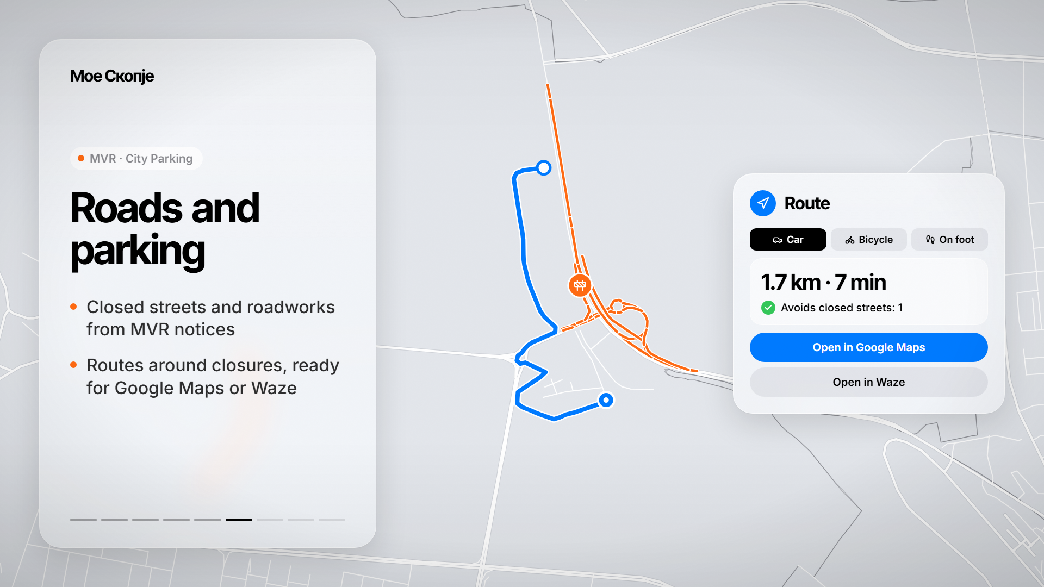
Notes:
Roads and parking
Closed streets and roadworks from MVR notices
Routes around closures, ready for Google Maps or Waze

Slide 8
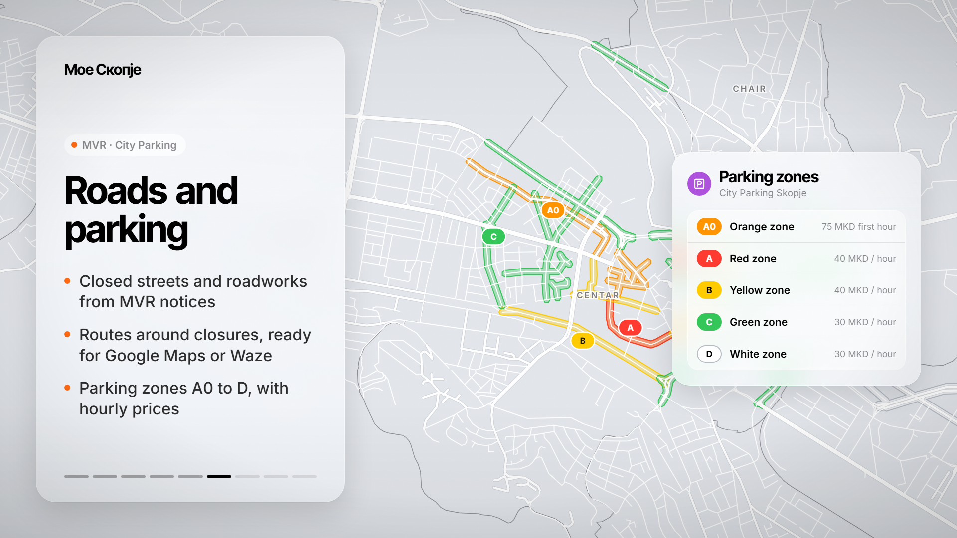
Notes:
Roads and parking
Closed streets and roadworks from MVR notices
Routes around closures, ready for Google Maps or Waze
Parking zones A0 to D, with hourly prices

Slide 9
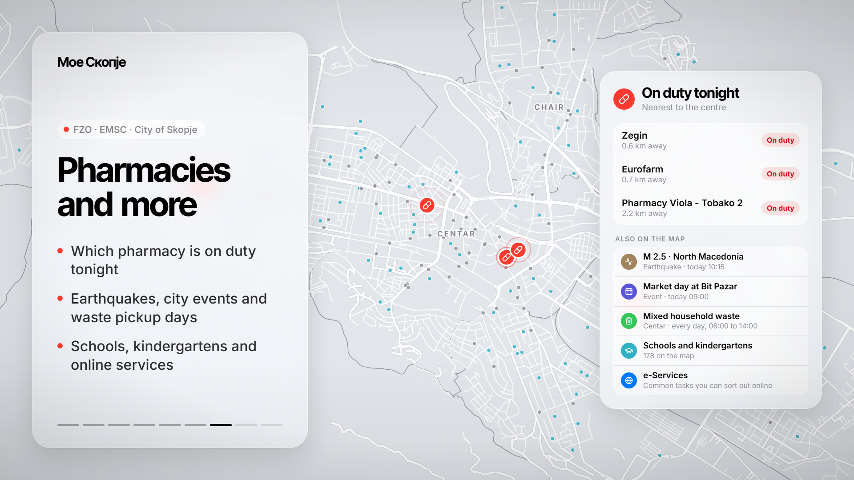
Notes:
Pharmacies and more
Which pharmacy is on duty tonight
Earthquakes, city events and waste pickup days
Schools, kindergartens and online services

Slide 10
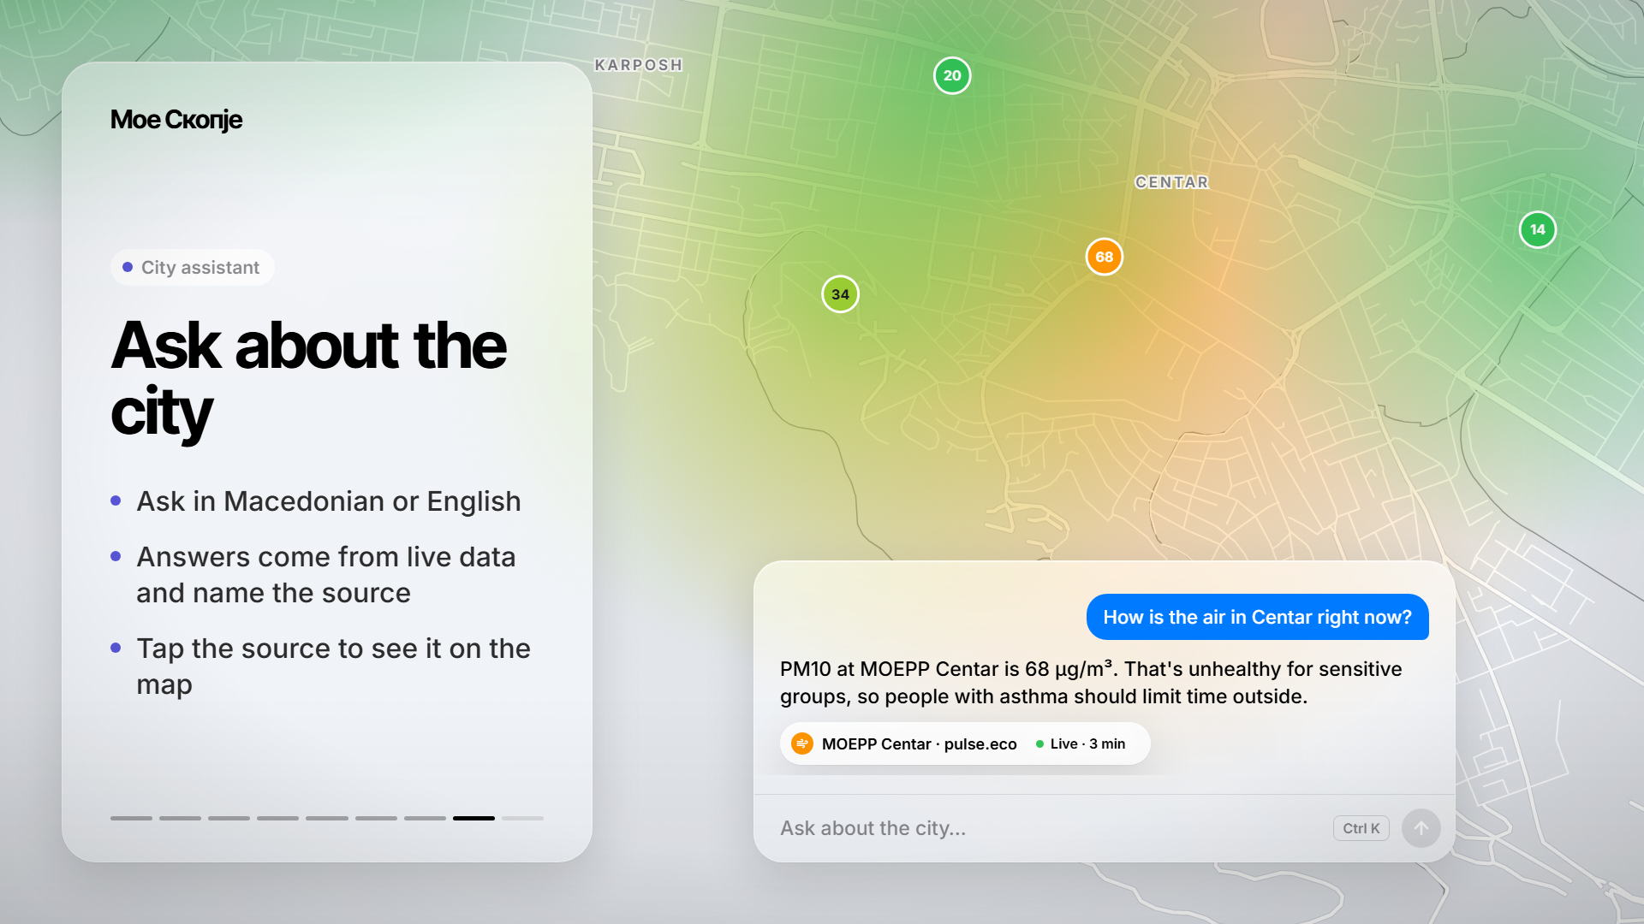
Notes:
Ask about the city
Ask in Macedonian or English
Answers come from live data and name the source
Tap the source to see it on the map

Slide 11
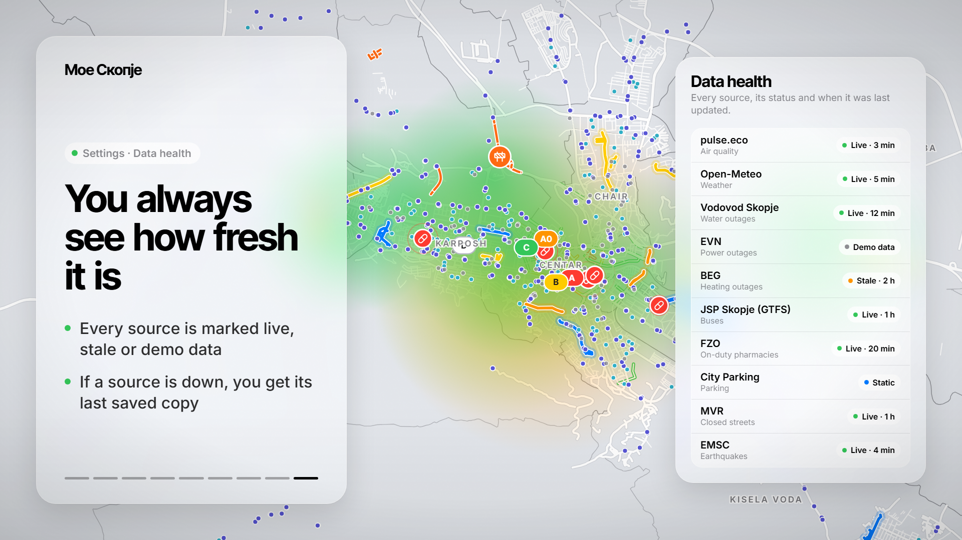
Notes:
You always see how fresh it is
Every source is marked live, stale or demo data
If a source is down, you get its last saved copy

Slide 12
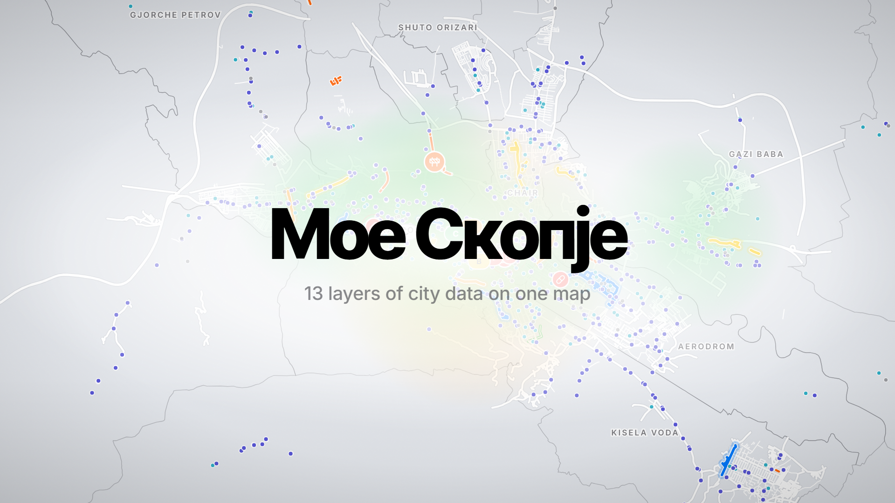
Notes:
Мое Скопје
13 layers of city data on one map

