Slide 1
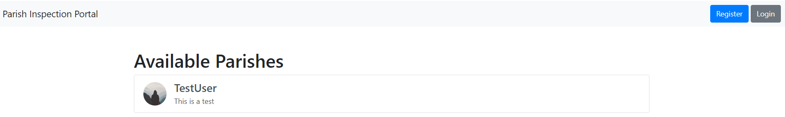
Total Number of parishes
Total Parish: 1
Description:
Location: Manchester
Lorem…
Phone : XYZZ
View
Contact: XYZZ
Inspection: 1|2|3|3
Shortcut to inspections
Button showing Parish data
High level labels
Notes>
Can we use Base template please?
Style all pages with a common theme – using HTML, css, js or Bootstrap etc

Slide 2
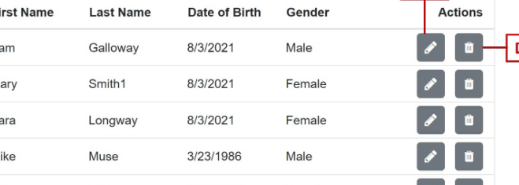
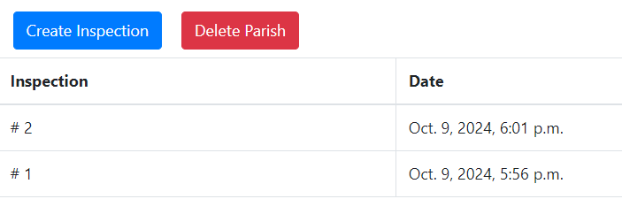
More icons etc

Slide 3
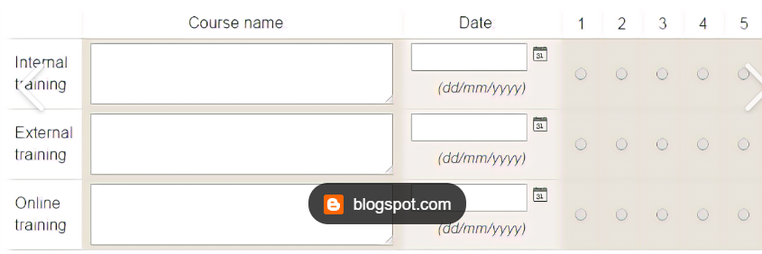
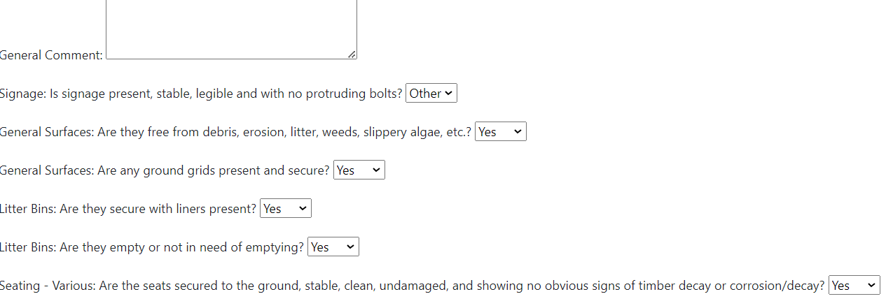
Similar style to this

