Slide 1





Million pixels
- 1 million pixels or boxes on canvas on a chart
Simulates a 1,000,000 pixels in a box
User selects a pixel, new form will appear
Must watch an intro youtube video (10 secs max)
Then answer a question
Finally buy the pixel for $2
Once pixel is purchased then colour is set for the bought pixels
Charity fundraiser
login
Fund
Hovering over pixel
*
Pixel x Owner: vas
Purchased: $2
TARGET
Screen 1
‘yellow’ canvas area
$ xxx
‘user selected pixel
‘user purchased pixel

Slide 2


1
2
Watch youtube video
Pixel selected
Pixel purchased by user
User Selects a Pixel
4
3
Answer a random question
Which is your favourite drink?
Coca-Cola
Pepsi
Fanta
Pixel updated with a colour
5

Slide 3
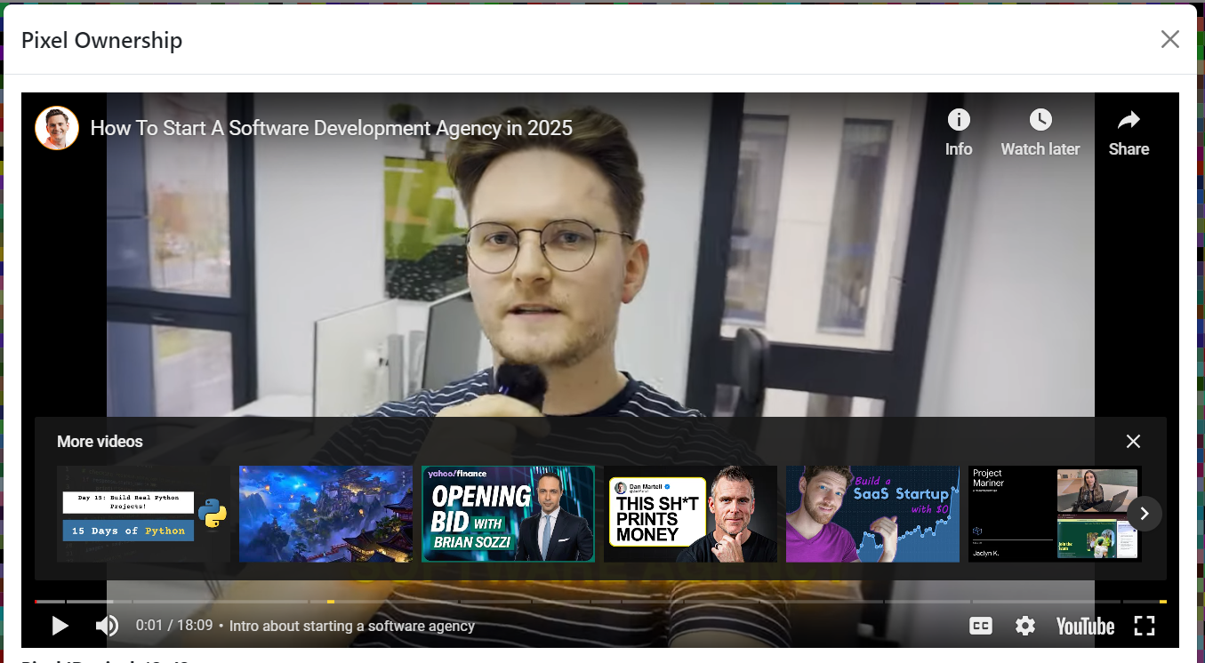
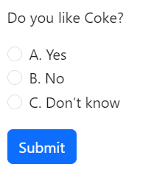


Slide 4
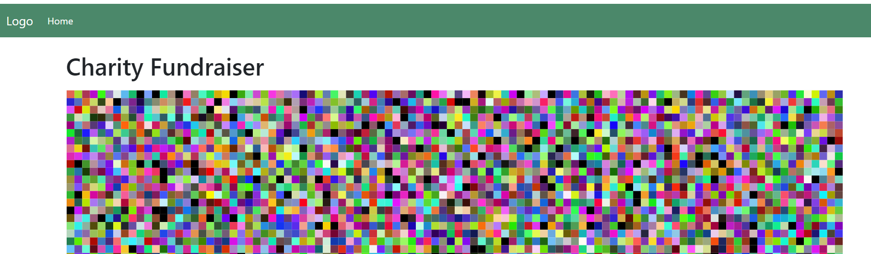
Zoom
300%
100%
250%
350%

