Slide 1
IBM Data Science Professional Certificate
Vasyl Razinkov

Slide 2
Introduction and Objectives
Algarve is a bustling tourist destination
Ripe for new business opportunities
Study distribution and concentration of existing businesses
Results influence the choice of new business construction

Slide 3
Data
Location data from Portuguese Post Office (ctt.pt)
Foursquare data for venue locations
Not 100% accuracy but enough for rough estimates

Slide 4
Methodology
From ctt.pt data, coordinates of all large enough locations in Algarve
10km radius centered around the locations for hotels
1km radius centered around hotels for nightlife and food venues
50 request limitation in each radius, per venue type

Slide 5
Methodology (cont.)
Heat maps of restaurants and nightlife venues
Hotels visible as black dots
Low density locations corresponds to potential expansion

Slide 6
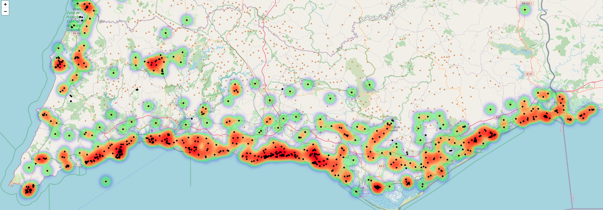
Heat-map of food venues

Slide 7
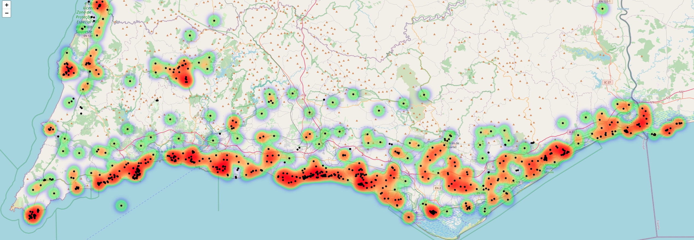
Heat-map of nightlife venues

