Slide 1
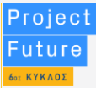



Fundraising Web App Group 7
Demo application demonstration for a fundraising application,
where users are able to request funds for their ideas or support other projects

Slide 2
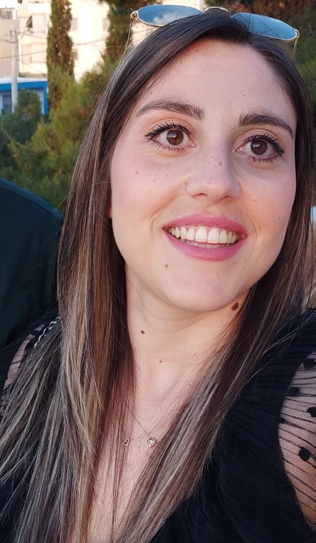
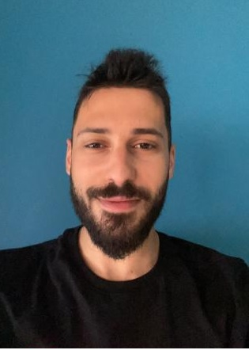
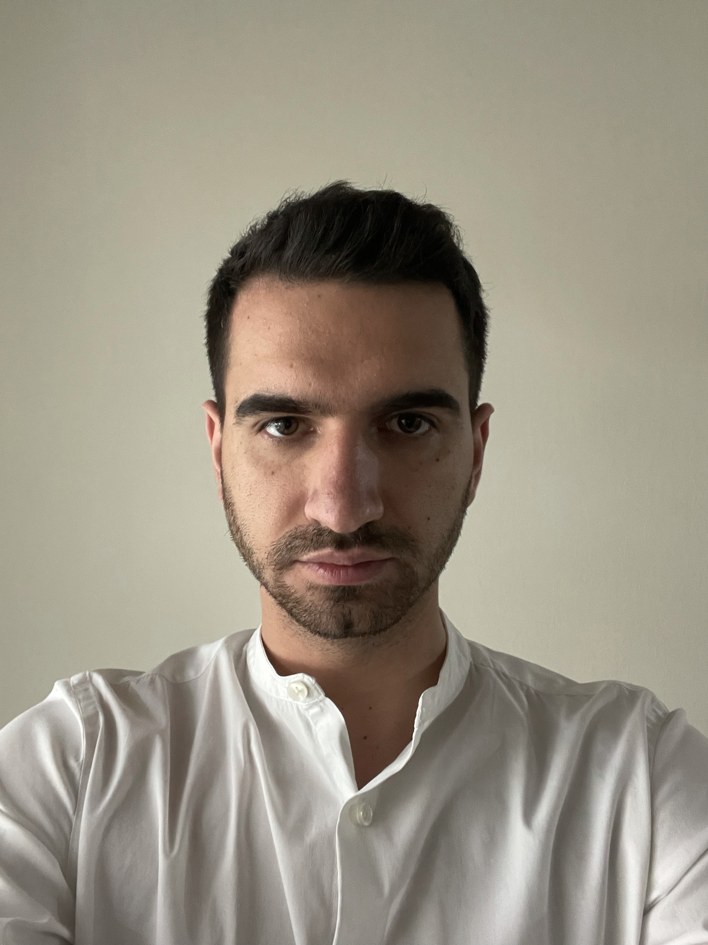
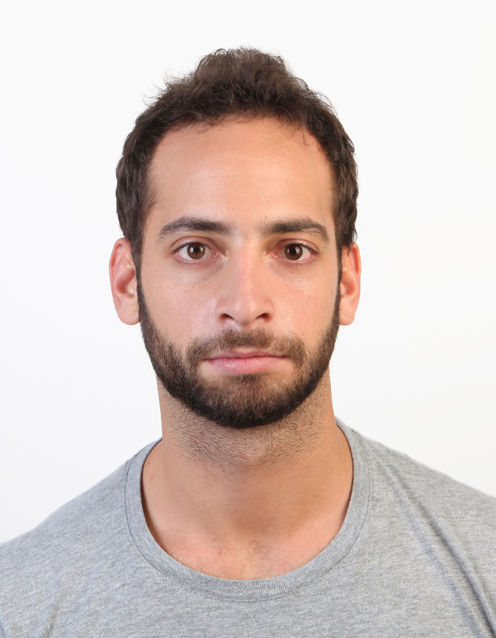
Who we are ?
Ioli Giannakopoulou
Christos Leventis-Rigas
Nikos Barollis
Konstantinos Vasilas

Slide 3
Summary of Project
Anyone can create a user account
Users are able to preview all projects
They may fund a project by buying a reward package
Users also are able to create their own projects and requests for funds
Members are provided with a Dashboard for their projects and the projects they fund
In Dashboard users are able to edit and/or delete their projects

Slide 4
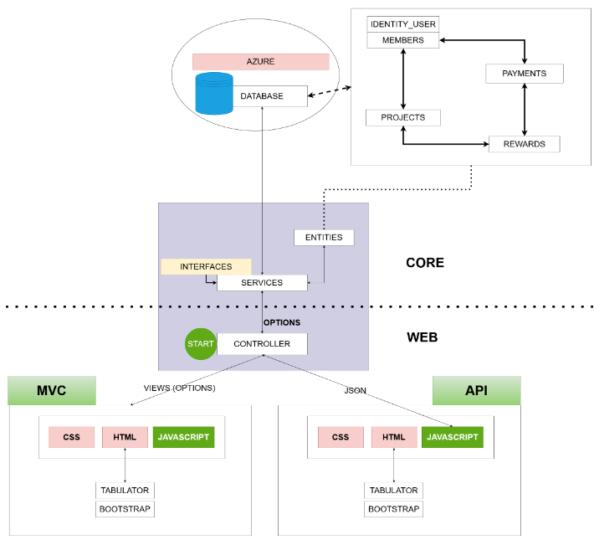
Project Architecture

Slide 5
Team Roles
Ioli Giannakopoulou
Database Model Design
Core Implementation
Front-end Implementation
Application Testing
Christos Leventis
Core Implementation
Azure Management – Application Deployment
MVC Implementation
Project structure Design
Nikos Barollis
Core Implementation
Front-end Implementation
Validations design and implementation
UI application Design
Konstantinos Vasilas
Core Implementation
API implementation
MVC implementation
Code Review

Slide 6
Live Demonstration

Slide 7
How we proceed with Development
Daily long meetings
Live coding
Implementation Design Diagrams
Proof of Concept test applications
Training sessions

Slide 8
Challenges
Difficulty in using Azure to create a Database.
Lack of theoretical knowledge of Async functionality in C#.
Not enough time to implement all the subjects we've learned.

Slide 9
Thank You !!!

