Slide 1
OOPS CONCEPTS
By: Ramya

Slide 2
Contents covered
Abstraction
Encapsulation
Polymorphism
Inheritance

Slide 3
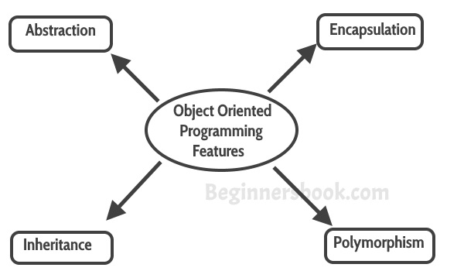

Slide 4
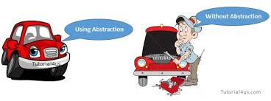

Slide 5
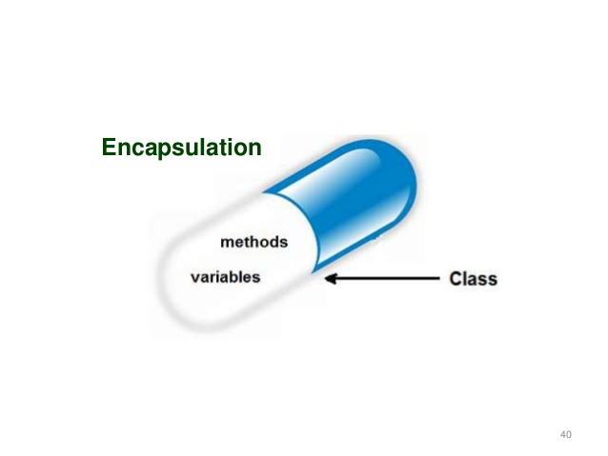

Slide 6
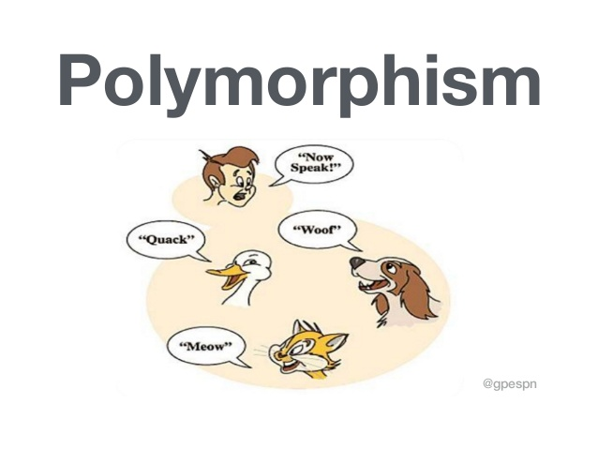

Slide 7
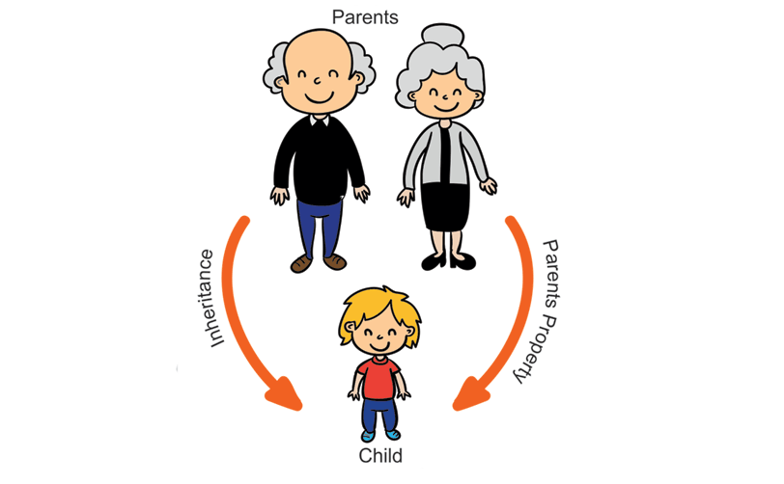
INHERITANCE

