Slide 1
Data Structures
Balanced Trees
CSCI 3110

Slide 2
Outline
Balanced Search Trees
  2-3 Trees
  2-3-4 Trees
  Red-Black Trees
CSCI 3110

Slide 3
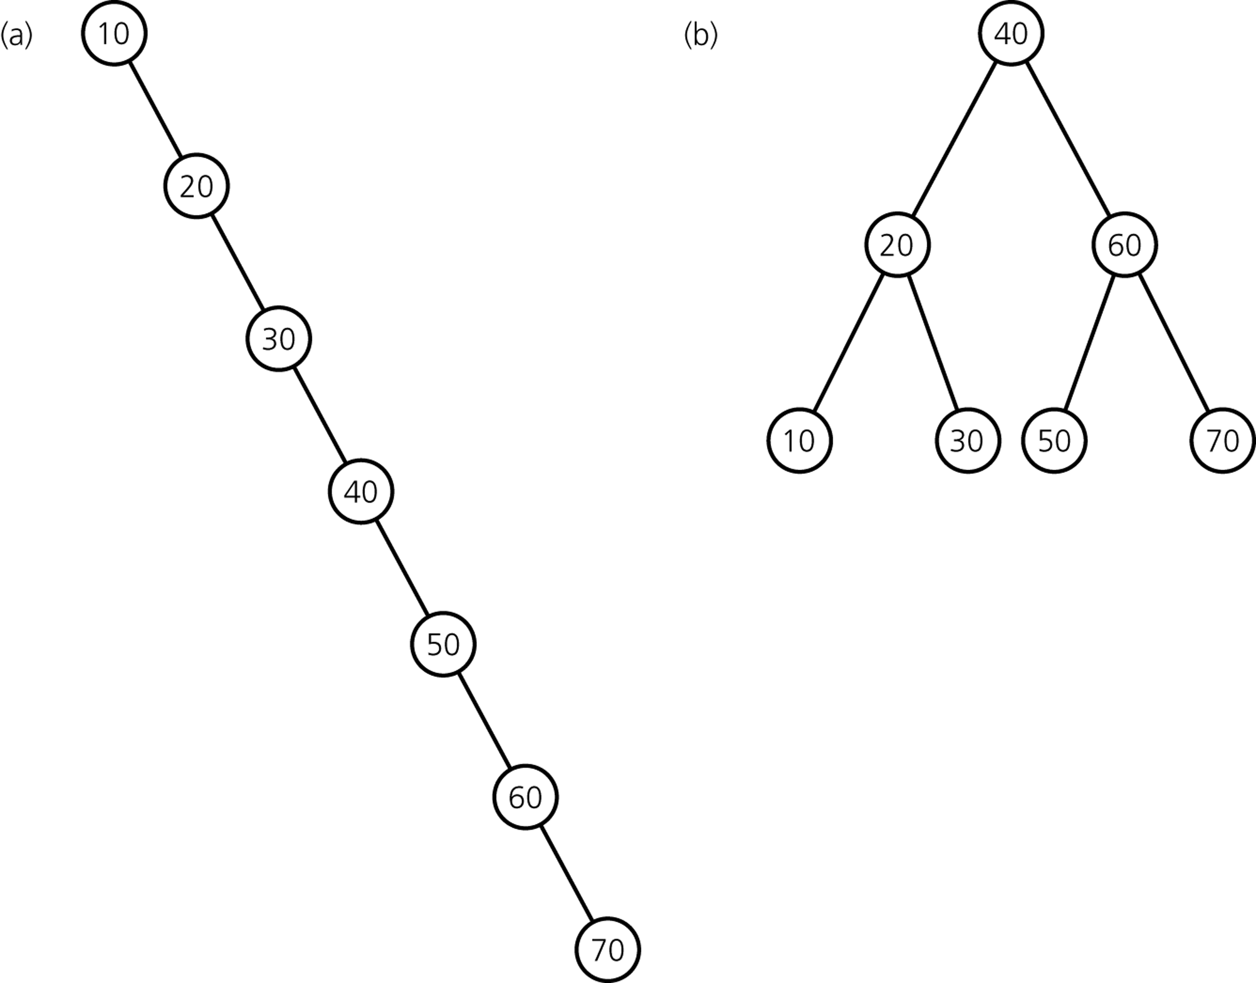
Why care about advanced implementations?
Same entries, different insertion sequence:
→ Not good! Would like to keep tree balanced.
CSCI 3110

Slide 4
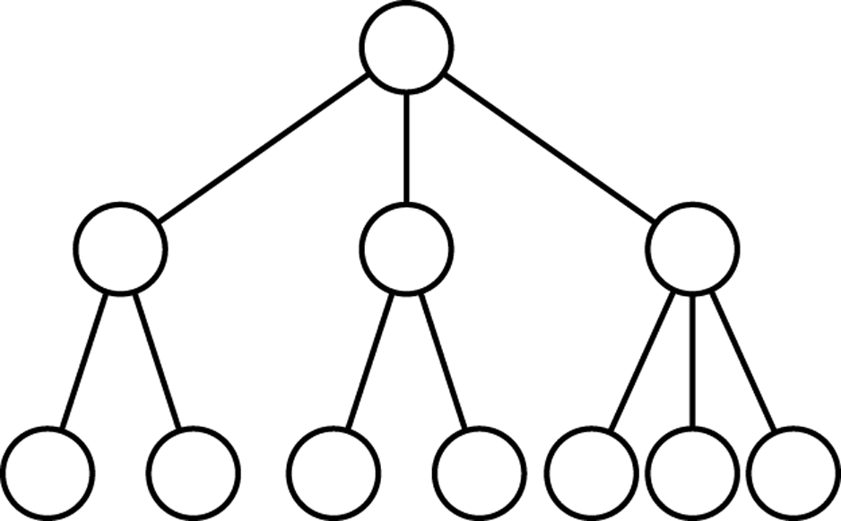
2-3 Trees
Features
each internal node has either 2 or 3 children
all leaves are at the same level
CSCI 3110

Slide 5
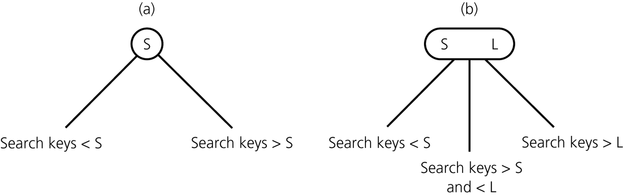
2-3 Trees with Ordered Nodes
2-node
3-node
leaf node can be either a 2-node or a 3-node
CSCI 3110

Slide 6
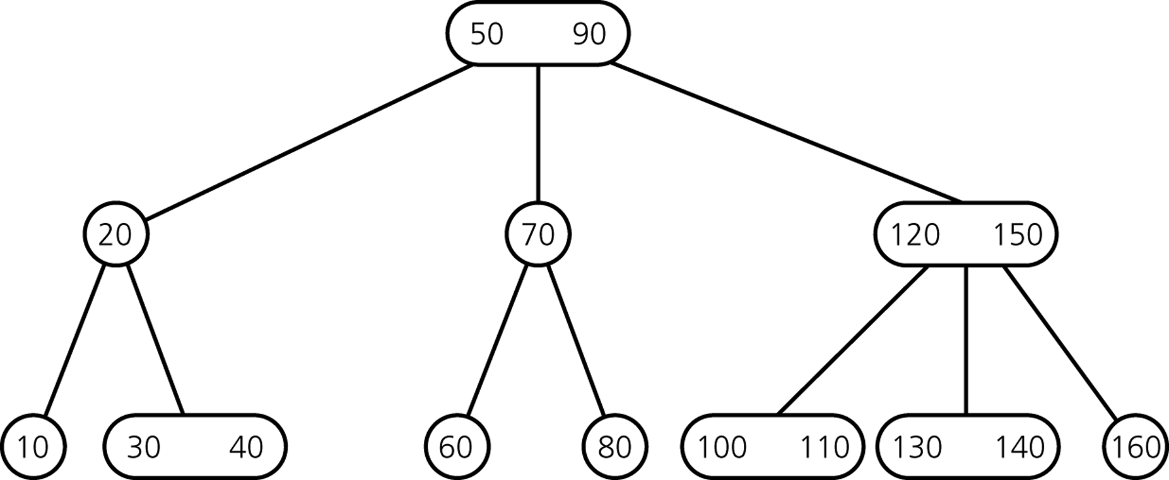
Example of 2-3 Tree
CSCI 3110

Slide 7
Traversing a 2-3 Tree
inorder(in ttTree: TwoThreeTree)
if(ttTree’s root node r is a leaf)
visit the data item(s)
else if(r has two data items)
{
inorder(left subtree of ttTree’s root)
visit the first data item
inorder(middle subtree of ttTree’s root)
visit the second data item
inorder(right subtree of ttTree’s root)
}
else
{
inorder(left subtree of ttTree’s root)
visit the data item
inorder(right subtree of ttTree’s root)
}
CSCI 3110

Slide 8
Searching a 2-3 Tree
retrieveItem(in ttTree: TwoThreeTree,
in searchKey:KeyType,
out treeItem:TreeItemType):boolean
if(searchKey is in ttTree’s root node r)
{
treeItem = the data portion of r
return true
}
else if(r is a leaf)
return false
else
{
return retrieveItem( appropriate subtree,
searchKey, treeItem)
}
CSCI 3110

Slide 9
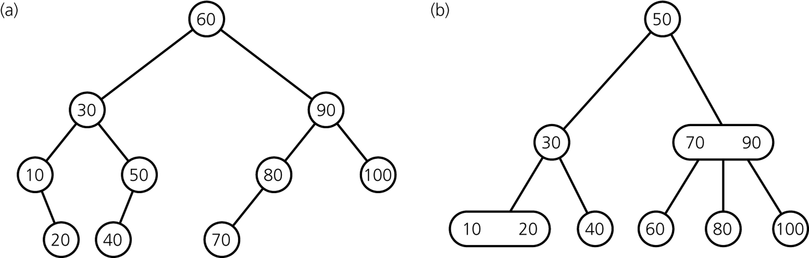
What did we gain?
What is the time efficiency of searching for an item?
CSCI 3110

Slide 10
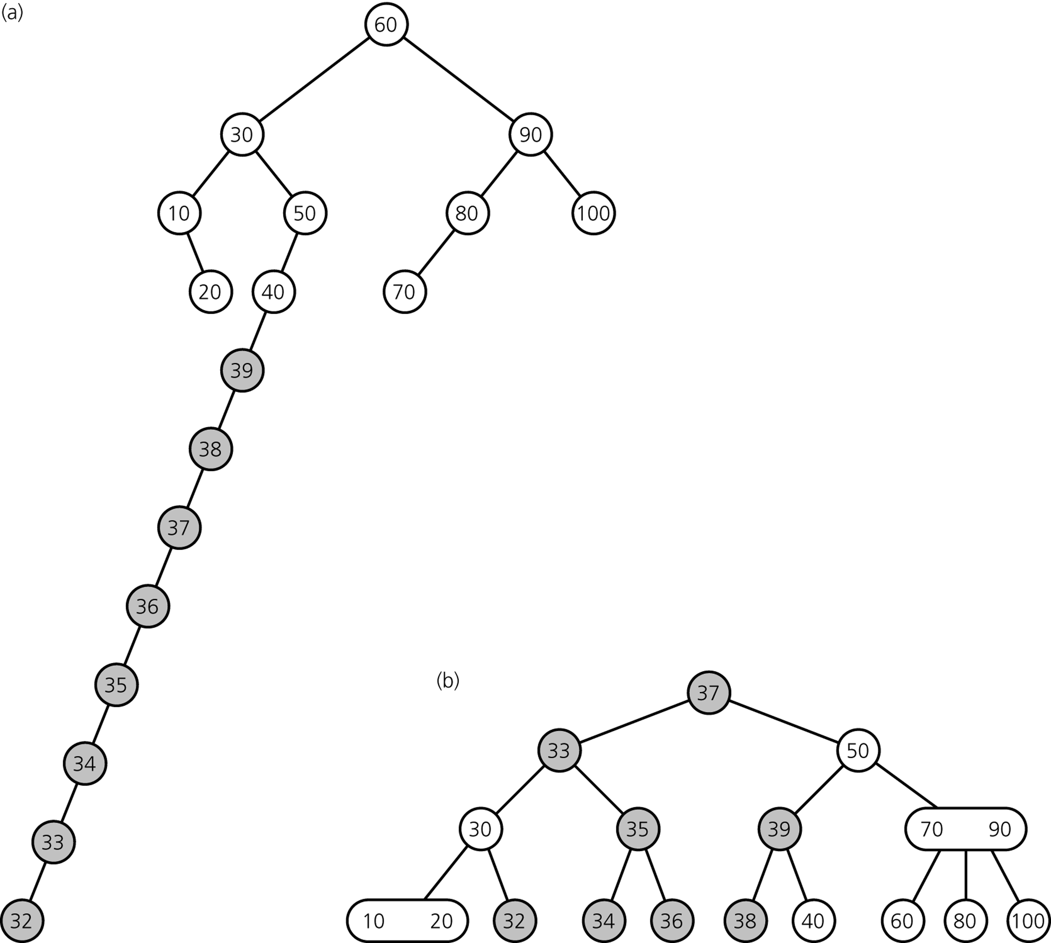
Gain: Ease of Keeping the Tree Balanced
Binary Search
Tree
both trees after
inserting items
39, 38, ... 32
2-3 Tree
CSCI 3110

Slide 11
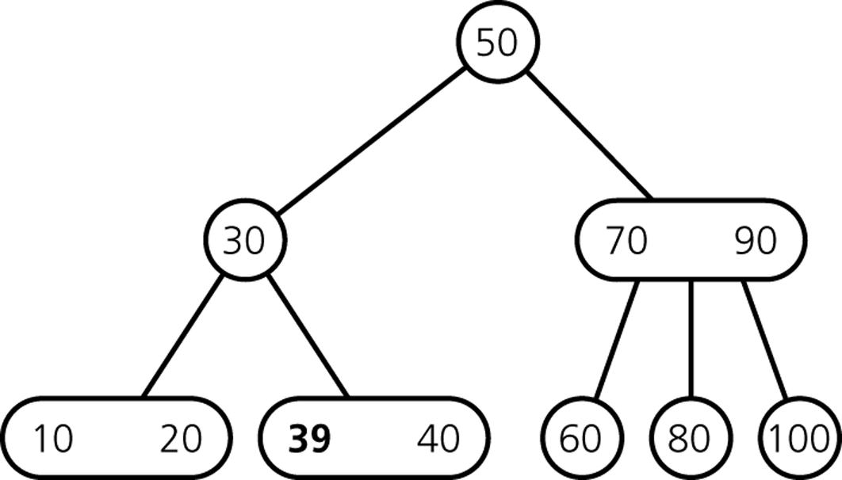
Inserting Items
Insert 39
CSCI 3110

Slide 12
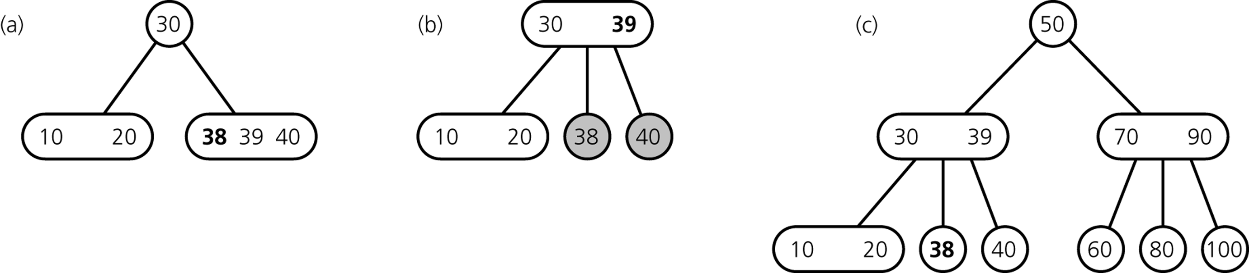
Inserting Items
Insert 38
divide leaf
and move middle
value up to parent
insert in leaf
result
CSCI 3110

Slide 13
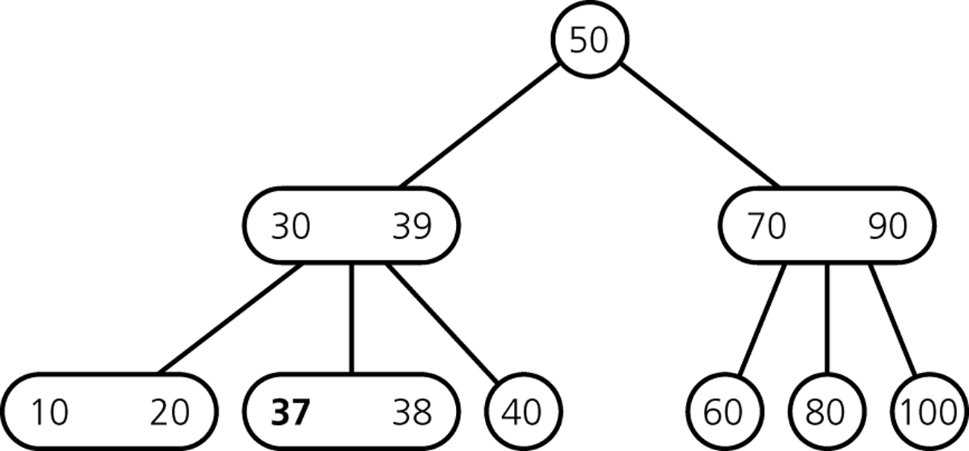
Inserting Items
Insert 37
CSCI 3110

Slide 14
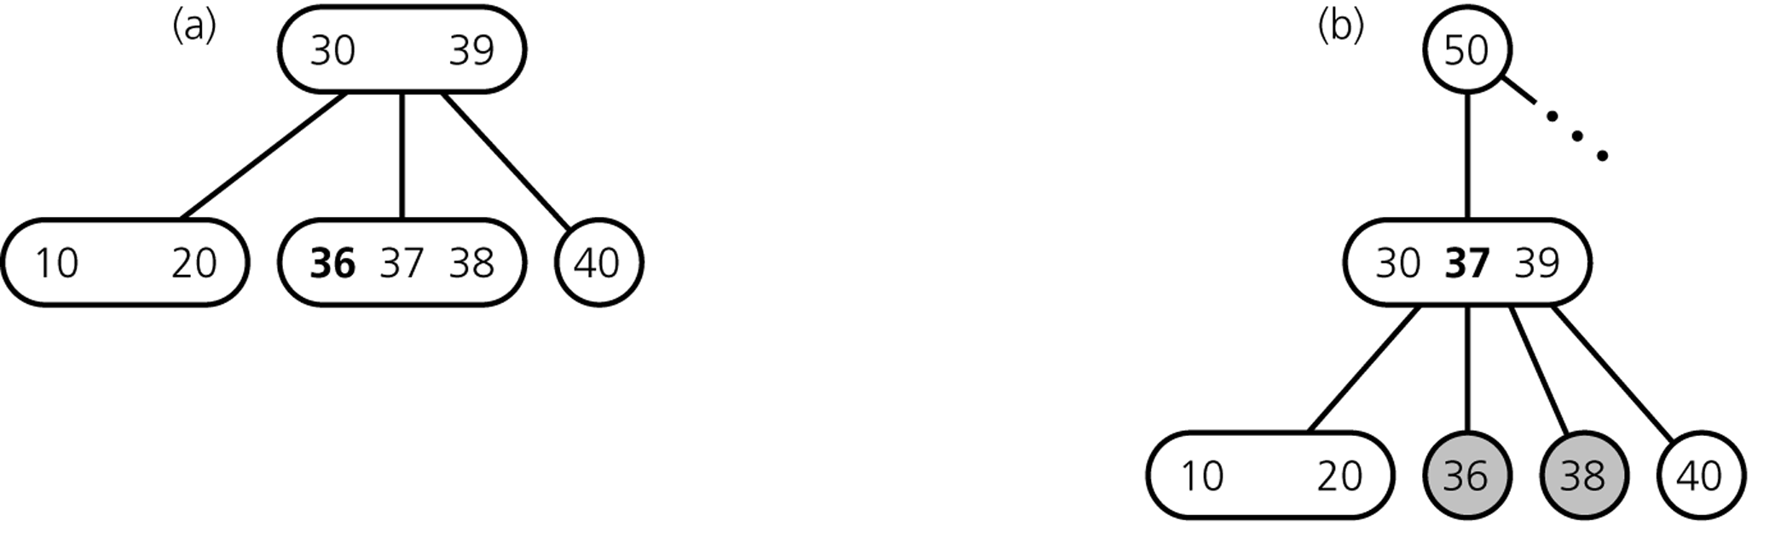
Inserting Items
Insert 36
divide leaf
and move middle
value up to parent
insert in leaf
overcrowded
node
CSCI 3110

Slide 15
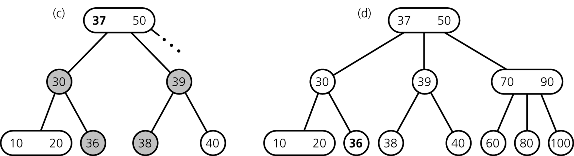
Inserting Items
... still inserting 36
divide overcrowded node,
move middle value up to parent,
attach children to smallest and largest
result
CSCI 3110

Slide 16
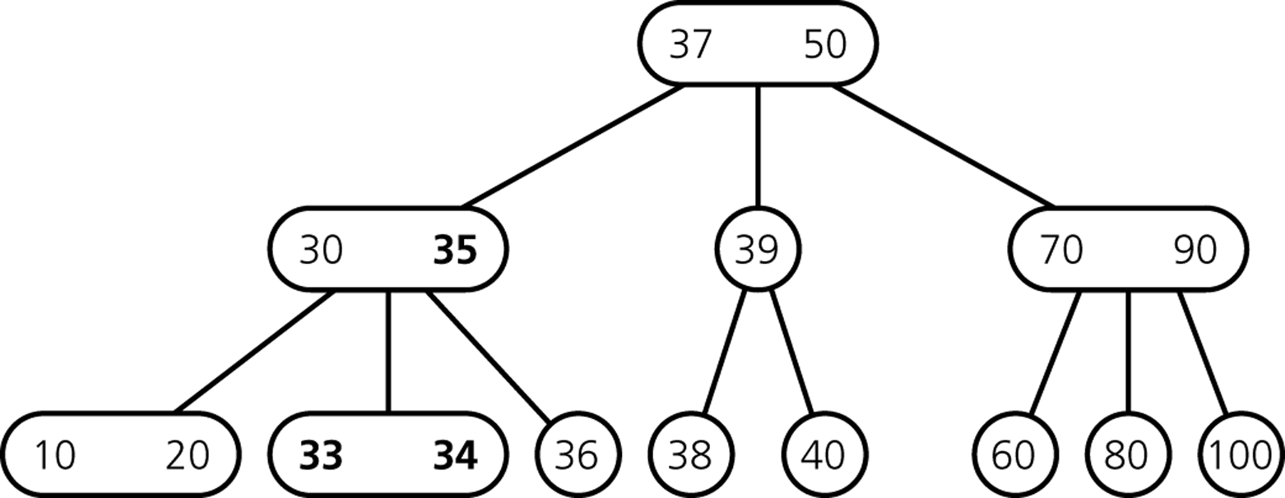
Inserting Items
After Insertion of 35, 34, 33
CSCI 3110

Slide 17
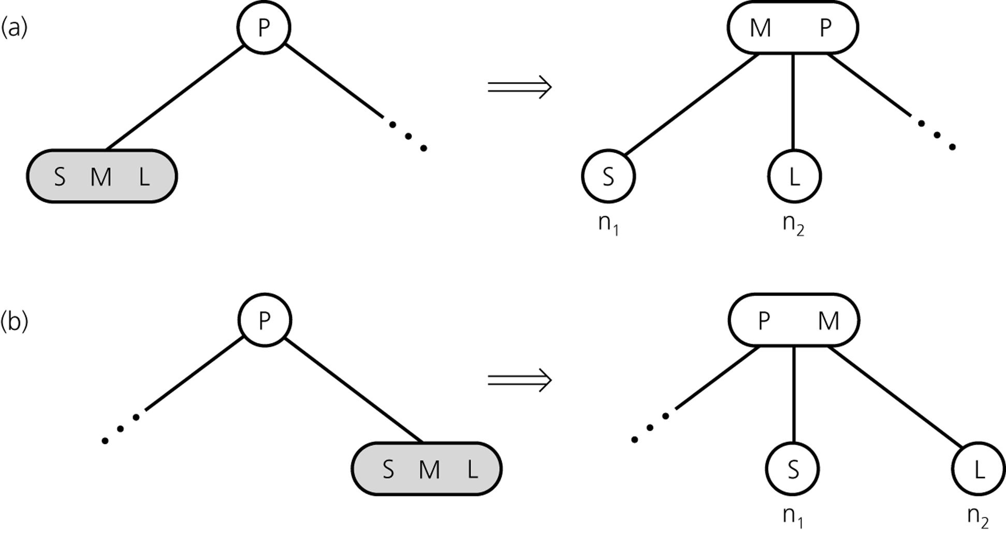
Inserting so far
CSCI 3110

Slide 18
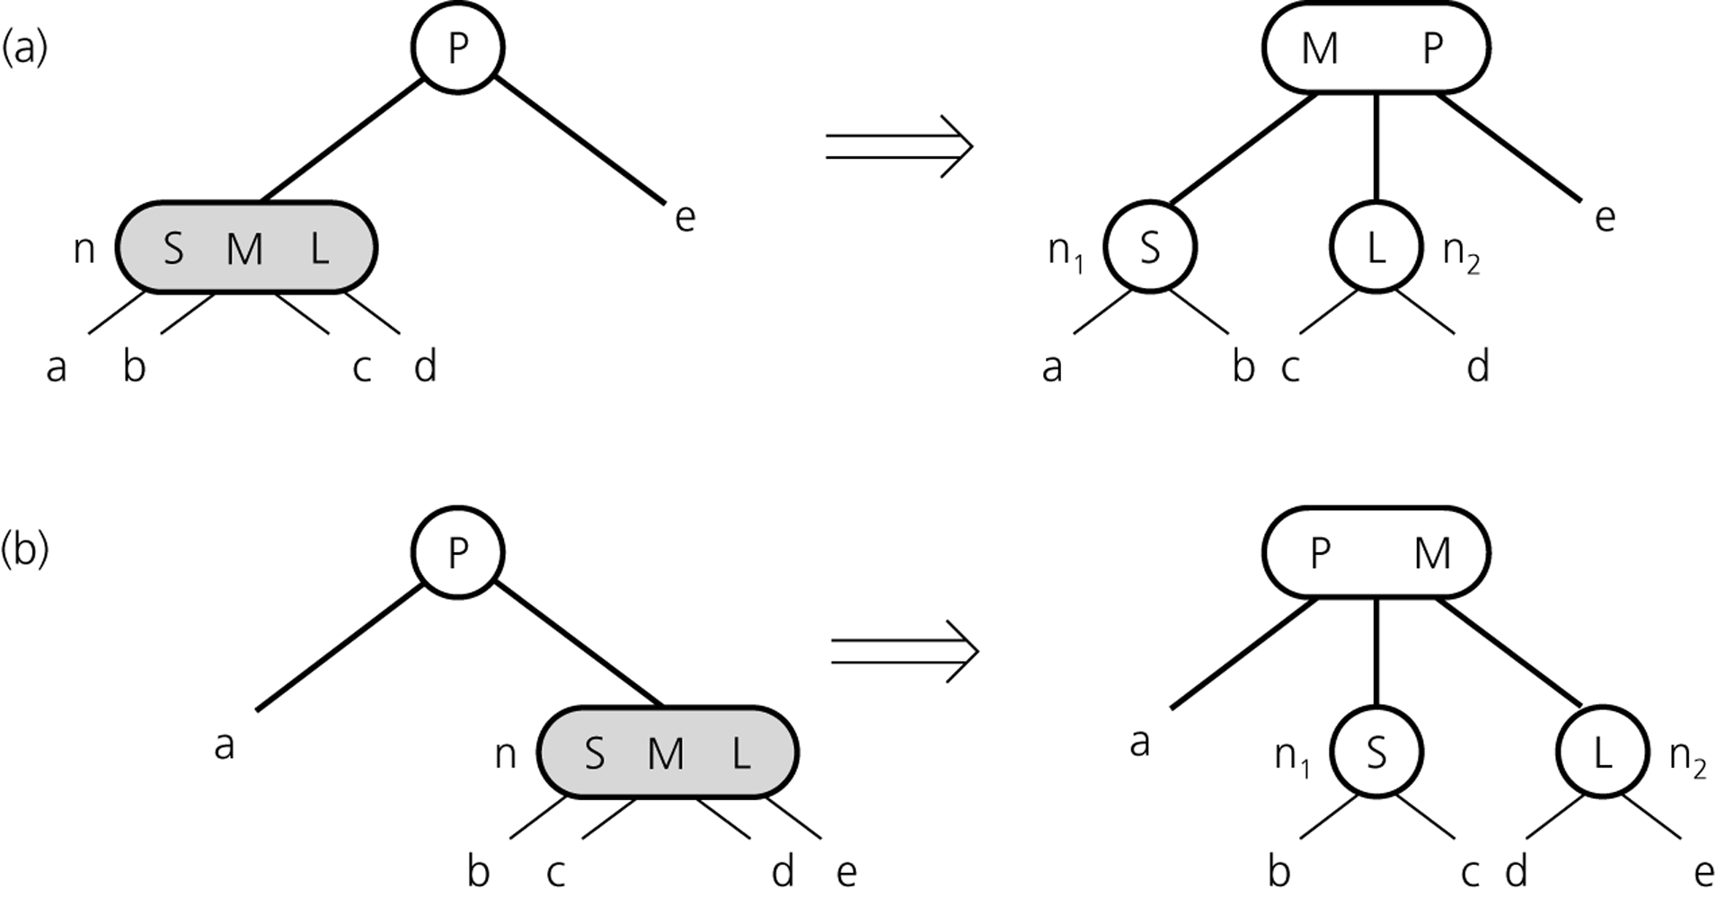
Inserting so far
CSCI 3110

Slide 19
Inserting Items
How do we insert 32?
CSCI 3110

Slide 20
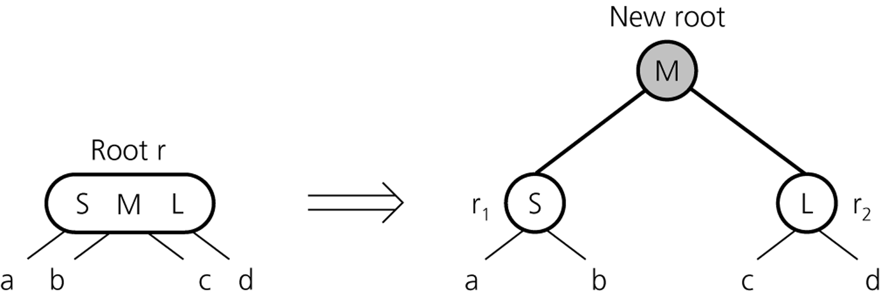
Inserting Items
creating a new root if necessary
tree grows at the root
CSCI 3110

Slide 21
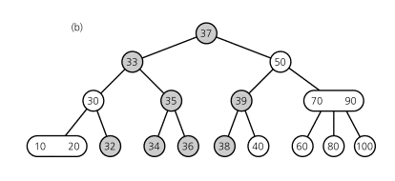
Inserting Items
Final Result
CSCI 3110

Slide 22
2-3 Trees Insertion
To insert an item, say key, into a 2-3 tree
  Locate the leaf at which the search for key would terminate
  If leaf is null (only happens when root is null), add new root to tree with item
  If leaf has one item insert the new item key into the leaf
  If the leaf contains 2 items, split the leaf into 2 nodes n₁ and n₂
CSCI 3110

Slide 23
2-3 Trees Insertion
When an internal node would contain 3 items
  Split the node into two nodes
  Accommodate the node’s children
When the root contains three items
  Split the root into 2 nodes
  Create a new root node
  The tree grows in height
CSCI 3110

Slide 24
insertItem(in ttTree:TwoThreeTree, in newItem:TreeItemType)
Let sKey be the search key of newItem
Locate the leaf leafNode in which sKey belongs
If (leafNode is null) add new root to tree with newItem
Else if (# data items in leaf = 1)
Add newItem to leafNode
Else //leaf has 2 items
split(leafNode, item)
CSCI 3110

Slide 25
Split (inout n:Treenode, in newItem:TreeItemType)
If (n is the root) Create a new node p
Else let p be the parent of n
Replace node n with two nodes, n1 and n2, so that p is their parent
Give n1 the item from n’s keys and newItem with the smallest search-key value
Give n2 the item from n’s keys and newItem with the largest search-key value
If (n is not a leaf)
{ n1 becomes the parent of n’s two leftmost children
n2 becomes the parent of n’s two rightmost children
}
X = the item from n’s keys and newItem that has the middle search-key value
If (adding x to p would cause p to have 3 items) split (p, x)
Else add x to p
CSCI 3110

Slide 26
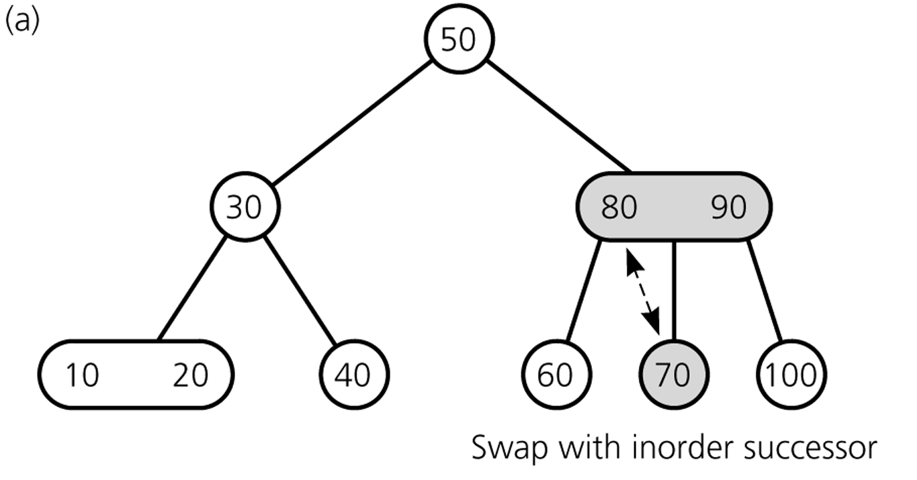
Deleting Items
Delete 70
70
80
CSCI 3110

Slide 27
Deleting Items
Deleting 70: swap 70 with inorder successor (80)
CSCI 3110

Slide 28
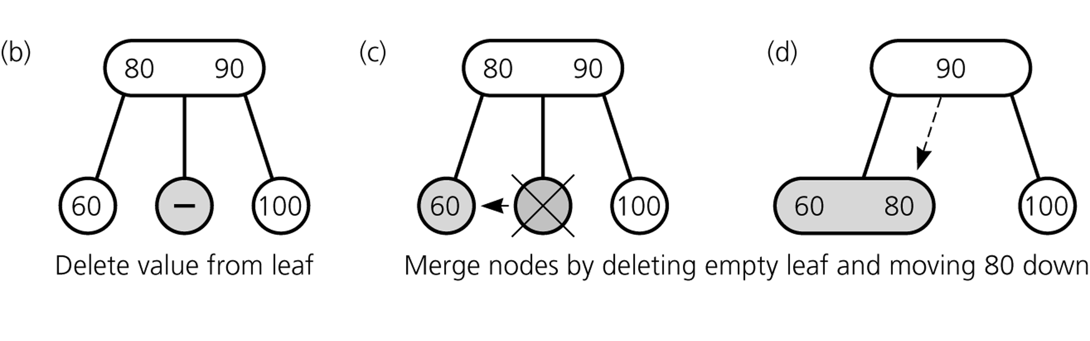
Deleting Items
Deleting 70: ... get rid of 70
CSCI 3110

Slide 29
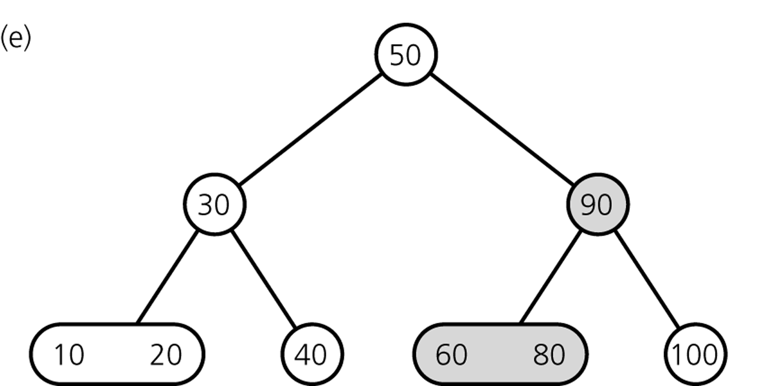
Deleting Items
Result
CSCI 3110

Slide 30
Deleting Items
Delete 100
CSCI 3110

Slide 31
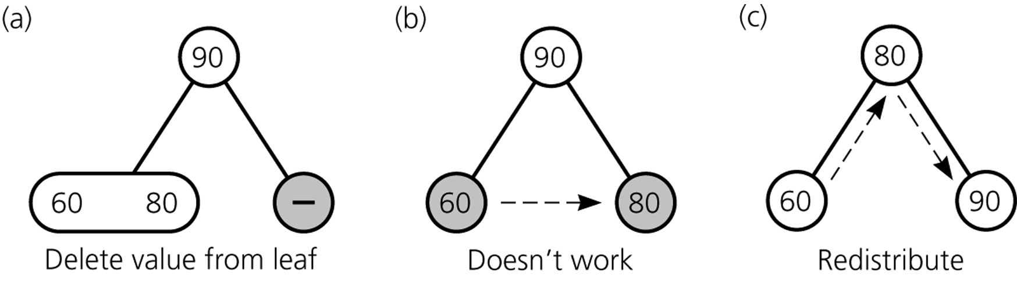
Deleting Items
Deleting 100
CSCI 3110

Slide 32
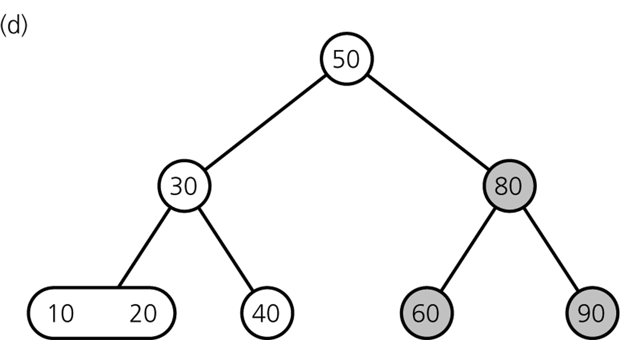
Deleting Items
Result
CSCI 3110

Slide 33
Deleting Items
Delete 80
CSCI 3110

Slide 34
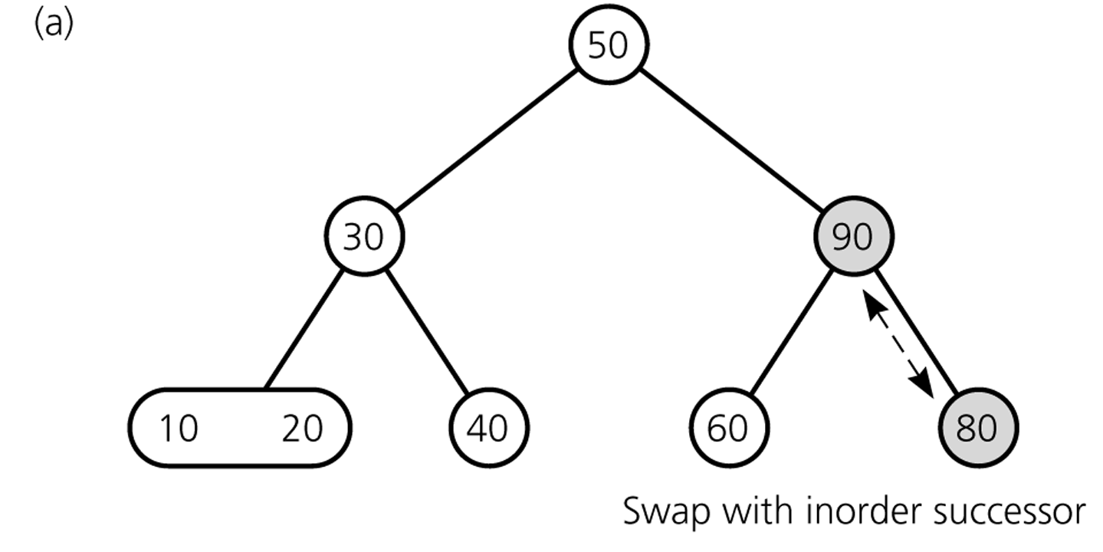
Deleting Items
Deleting 80 ...
CSCI 3110

Slide 35
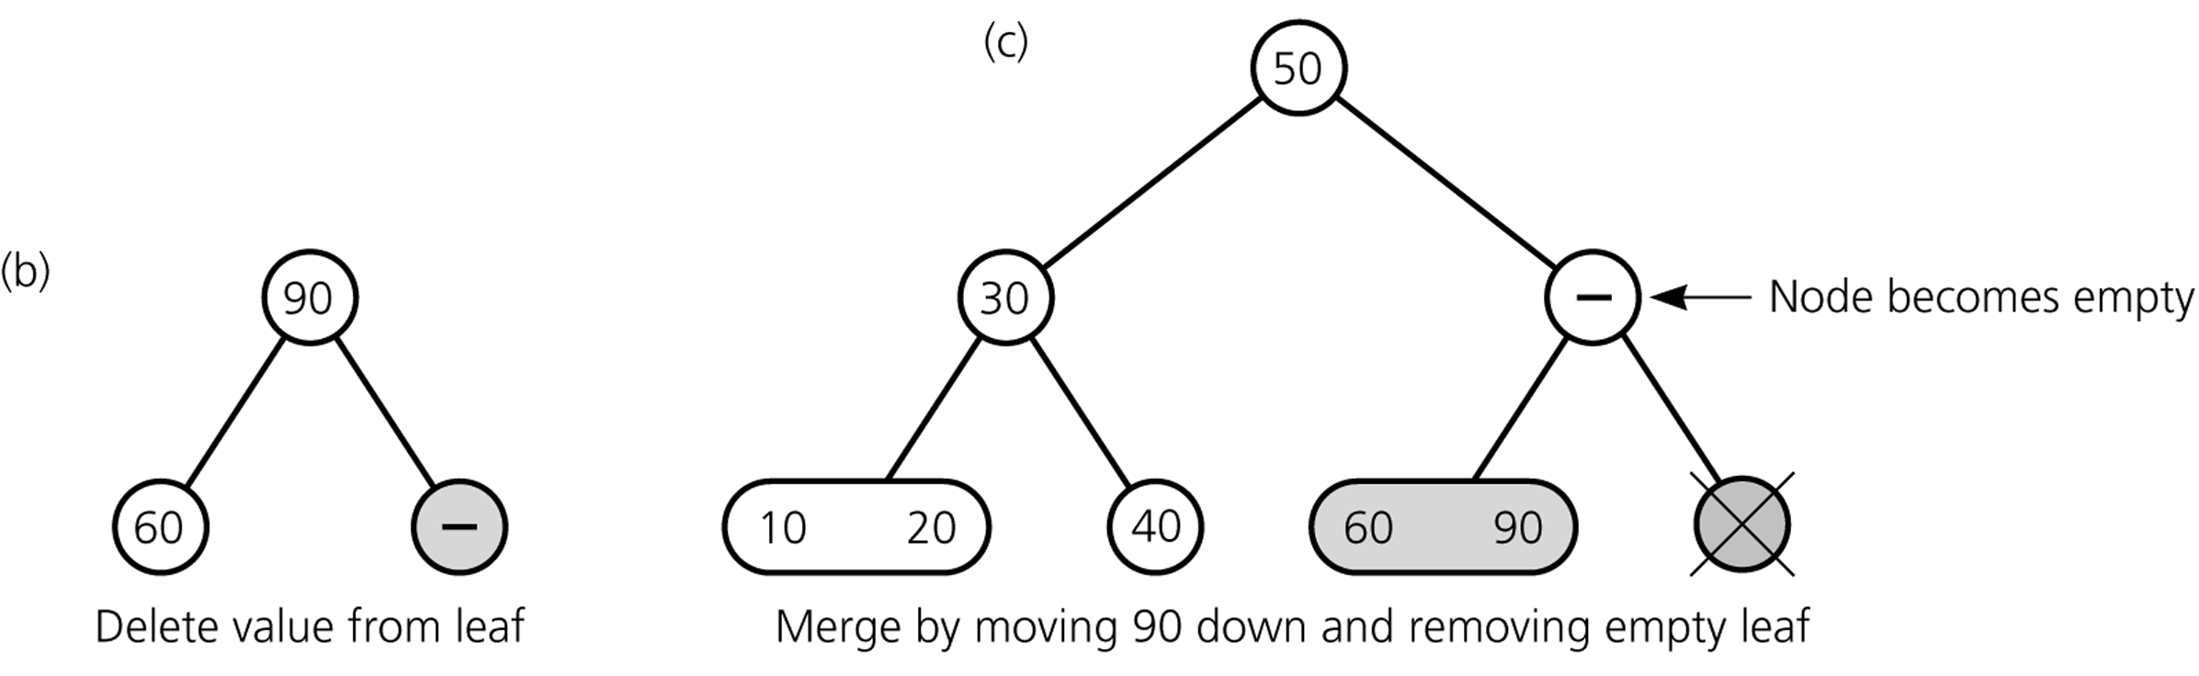
Deleting Items
Deleting 80 ...
CSCI 3110

Slide 36
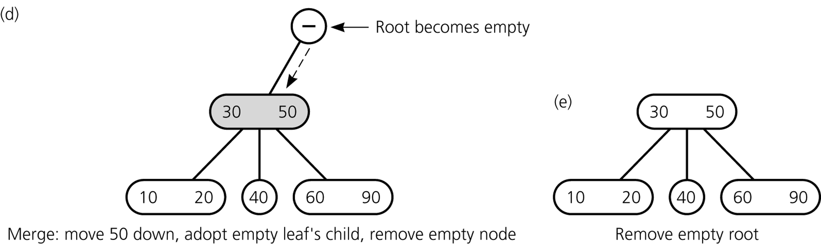
Deleting Items
Deleting 80 ...
CSCI 3110

Slide 37
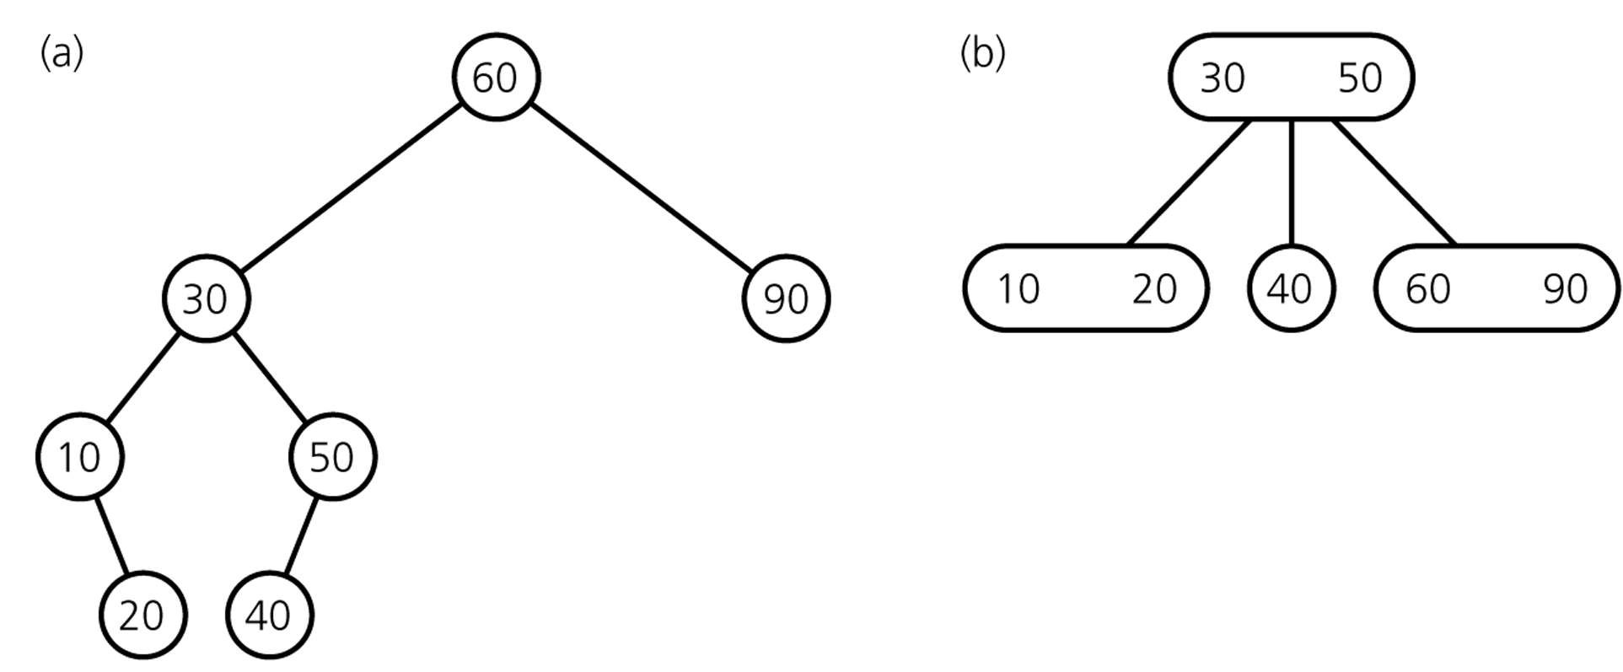
Deleting Items
Final Result
comparison with
binary search tree
CSCI 3110

Slide 38
Deletion Algorithm I
Deleting item I:
Locate node n, which contains item I (may be null if no item)
If node n is not a leaf → swap I with inorder successor
deletion always begins at a leaf
If leaf node n contains another item, just delete item I
else
try to redistribute nodes from siblings (see next slide)
if not possible, merge node (see next slide)
CSCI 3110

Slide 39
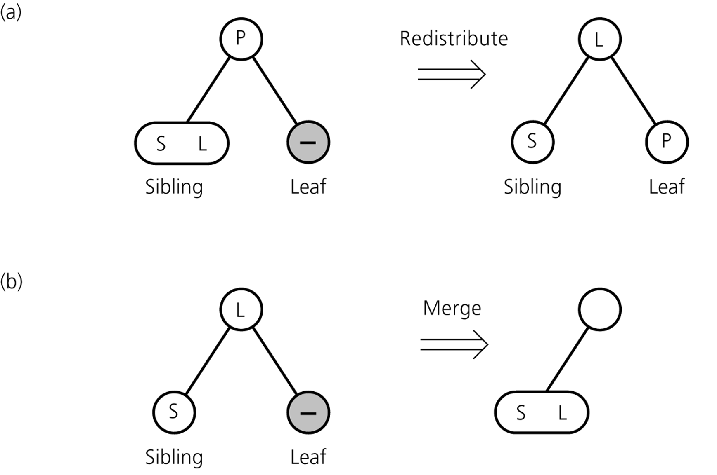
Deletion Algorithm II
Redistribution
A sibling has 2 items:
redistribute item
between siblings and
parent
Merging
No sibling has 2 items:
merge node
move item from parent
to sibling
CSCI 3110

Slide 40
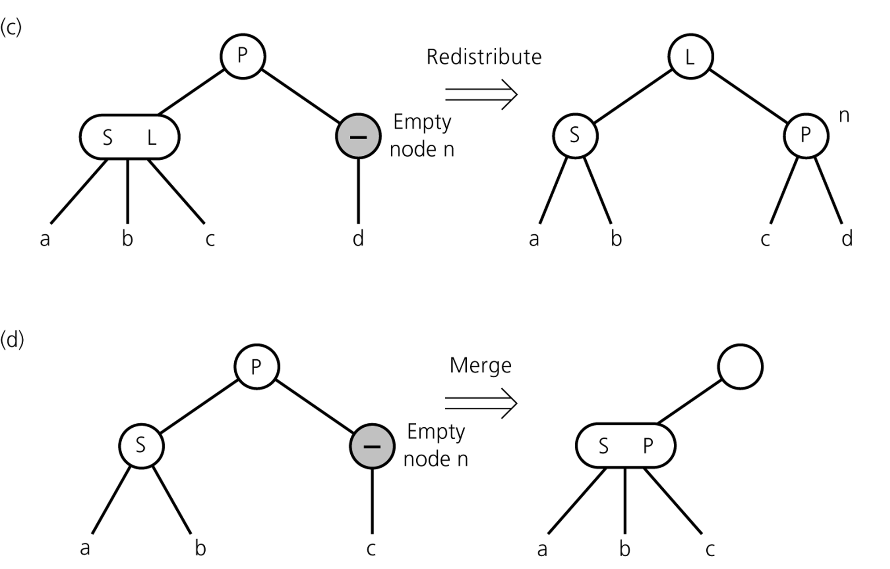
Deletion Algorithm III
Redistribution
Internal node n has no item left
redistribute
Merging
Redistribution not possible:
merge node
move item from parent
to sibling
adopt child of n
If n's parent ends up without item, apply process recursively
CSCI 3110

Slide 41
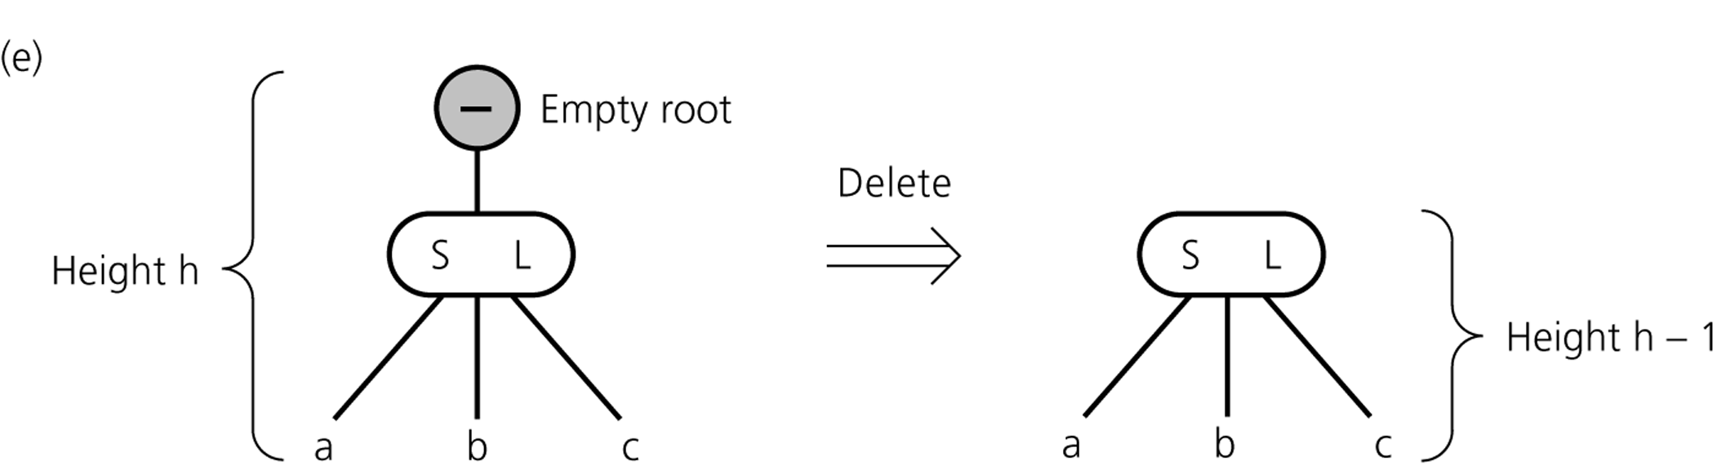
Deletion Algorithm IV
If merging process reaches the root and root is without item
→ delete root
CSCI 3110

Slide 42
deleteItem (in item:itemType)
node = node where item exists (may be null if no item)
If (node)
if (item is not in a leaf)
swap item with inorder successor (always leaf)
leafNode = new location of item to delete
else
leafNode = node
delete item from leafNode
if (leafNode now contains no items)
fix (leafNode)
CSCI 3110

Slide 43
//completes the deletion when node n is empty by
//either removing the root, redistributing values,
//or merging nodes. Note: if n is internal
//it has only one child
fix (Node*n, ...)//may need more parameters
{
if (n is the root)
{ remove the root
set new root pointer
}else {
Let p be the parent of n
if (some sibling of n has 2 items){
distribute items appropriately among n,
the sibling and the parent (take from right
first)
if (n is internal){
Move the appropriate child from
sibling n (May have to move many children
if distributing across multiple siblings)
}

Slide 44
Delete continued:
Else{ //merge nodes
Choose an adjacent sibling s of n (merge left first)
Bring the appropriate item down from p into s
if (n is internal)
move n’s child to s
remove node n
if (p is now empty)
fix (p)
}//endif
}//endif

Slide 45
Operations of 2-3 Trees
all operations have time complexity of log n
CSCI 3110

Slide 46
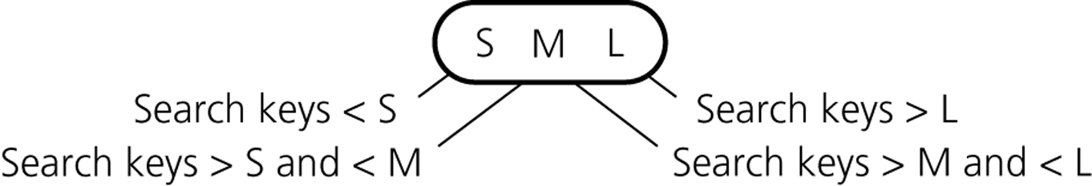
2-3-4 Trees
similar to 2-3 trees
4-nodes can have 3 items and 4 children
4-node
CSCI 3110

Slide 47
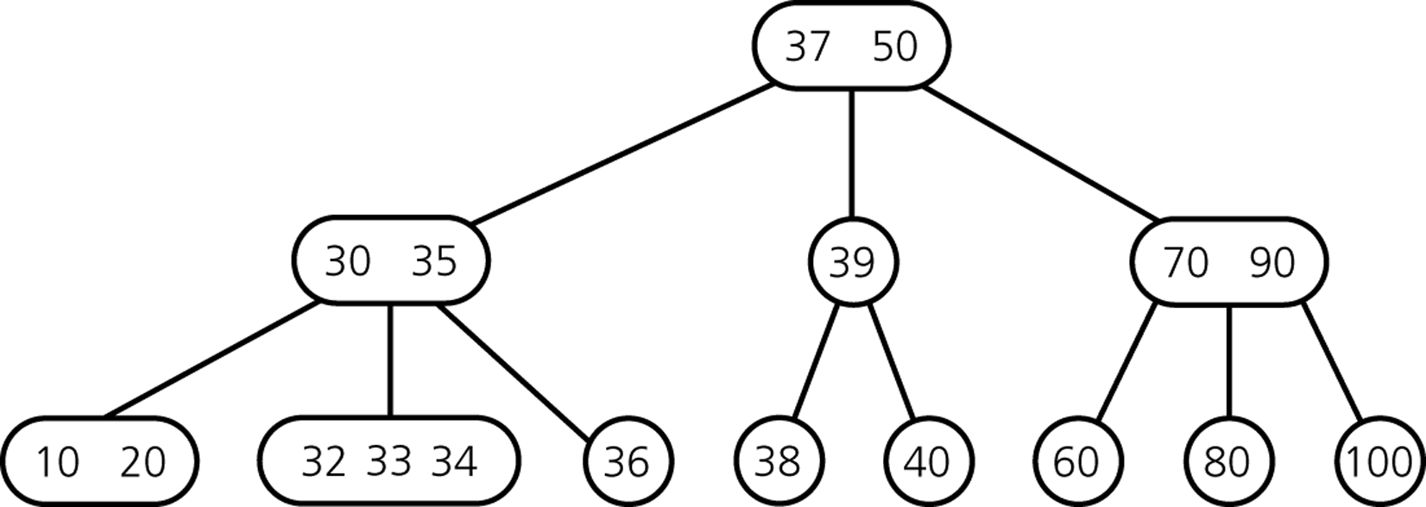
2-3-4 Tree Example
CSCI 3110

Slide 48
2-3-4 Tree: Insertion
Insertion procedure:
  similar to insertion in 2-3 trees
  items are inserted at the leafs
  since a 4-node cannot take another item,
  4-nodes are split up during insertion process
Strategy
  on the way from the root down to the leaf:
  split up all 4-nodes "on the way"
  → insertion can be done in one pass
  (remember: in 2-3 trees, a reverse pass might be necessary)
CSCI 3110

Slide 49
2-3-4 Tree: Insertion
Inserting 60, 30, 10, 20, 50, 40, 70, 80, 15, 90, 100
CSCI 3110

Slide 50
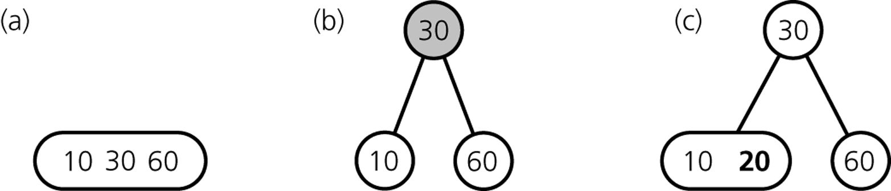
2-3-4 Tree: Insertion
Inserting 60, 30, 10, 20 ...
... 50, 40 ...
CSCI 3110

Slide 51
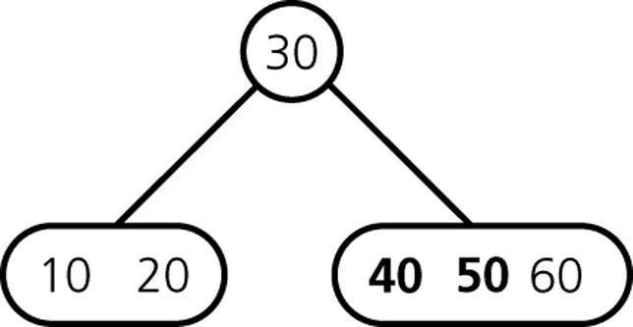
2-3-4 Tree: Insertion
Inserting 50, 40 ...
... 70, ...
CSCI 3110

Slide 52
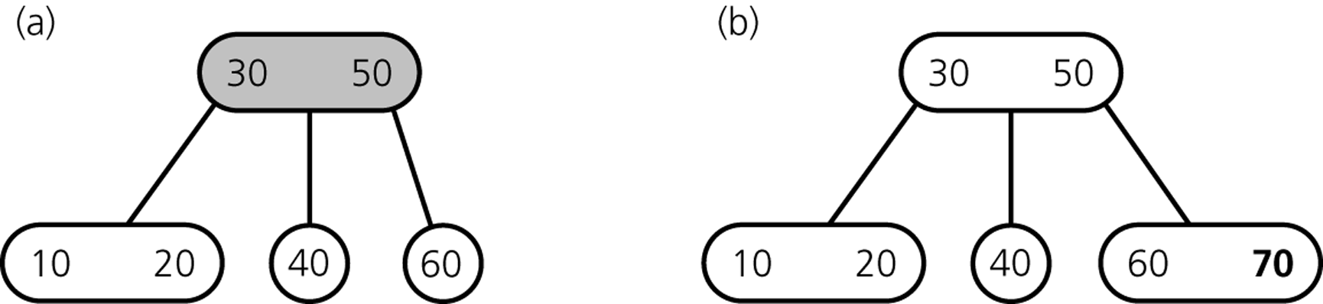
2-3-4 Tree: Insertion
Inserting 70 ...
... 80, 15 ...
CSCI 3110

Slide 53
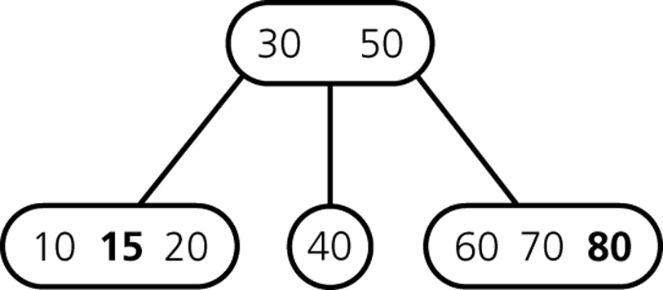
2-3-4 Tree: Insertion
Inserting 80, 15 ...
... 90 ...
CSCI 3110

Slide 54
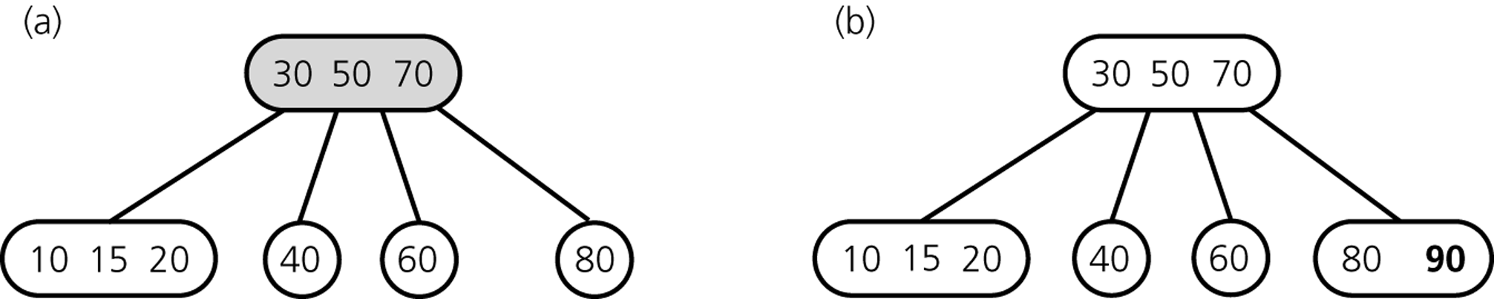
2-3-4 Tree: Insertion
Inserting 90 ...
... 100 ...
CSCI 3110

Slide 55
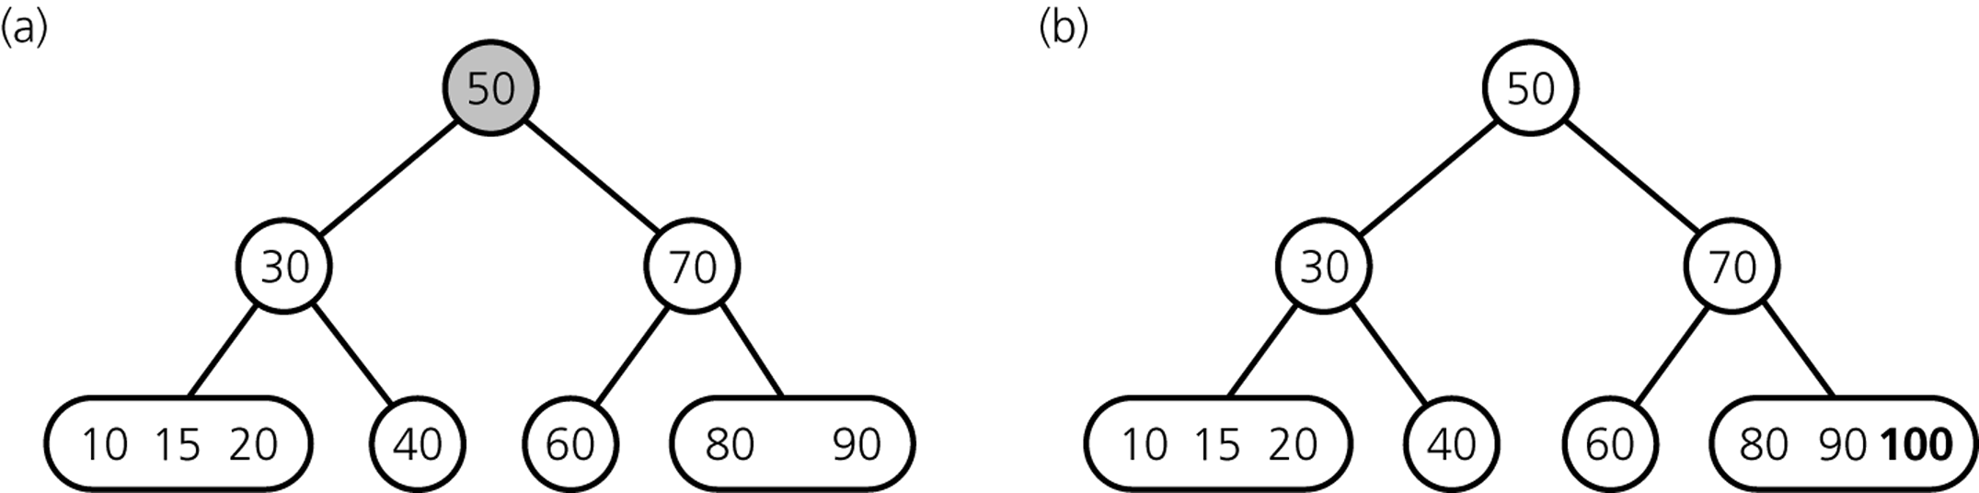
2-3-4 Tree: Insertion
Inserting 100 ...
CSCI 3110

Slide 56
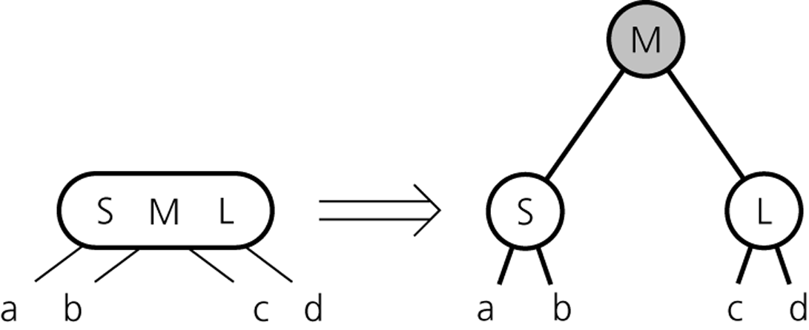
2-3-4 Tree: Insertion Procedure
Splitting 4-nodes during Insertion
CSCI 3110

Slide 57
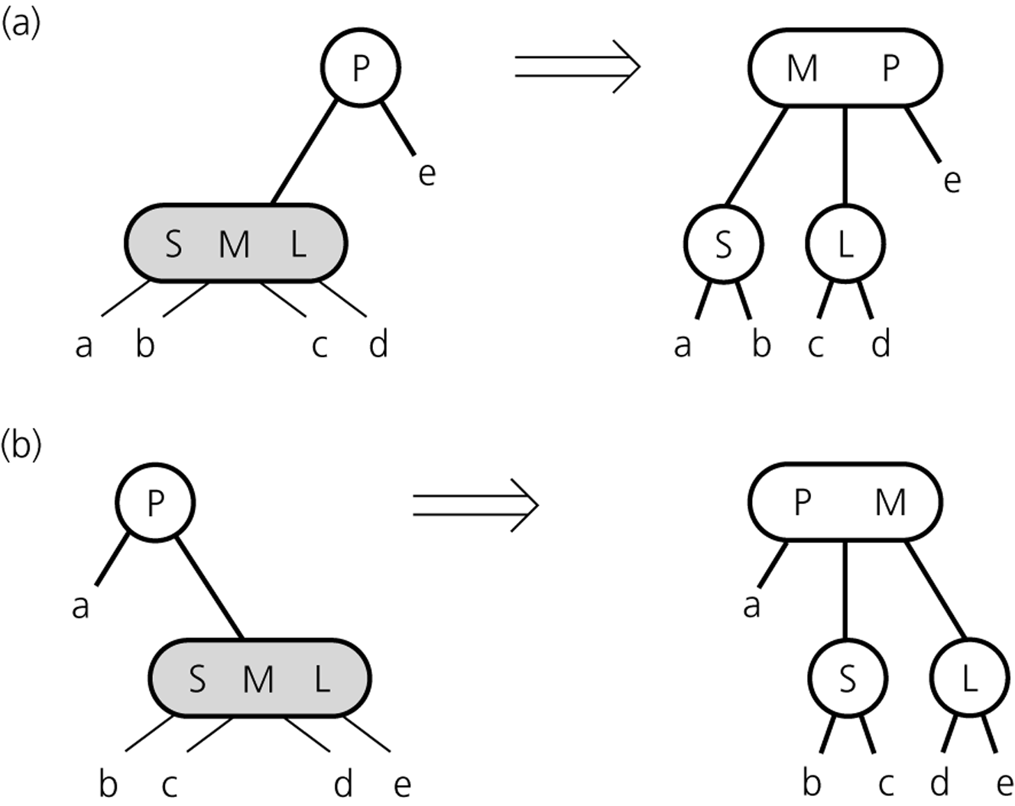
2-3-4 Tree: Insertion Procedure
Splitting a 4-node whose parent is a 2-node during insertion
CSCI 3110

Slide 58
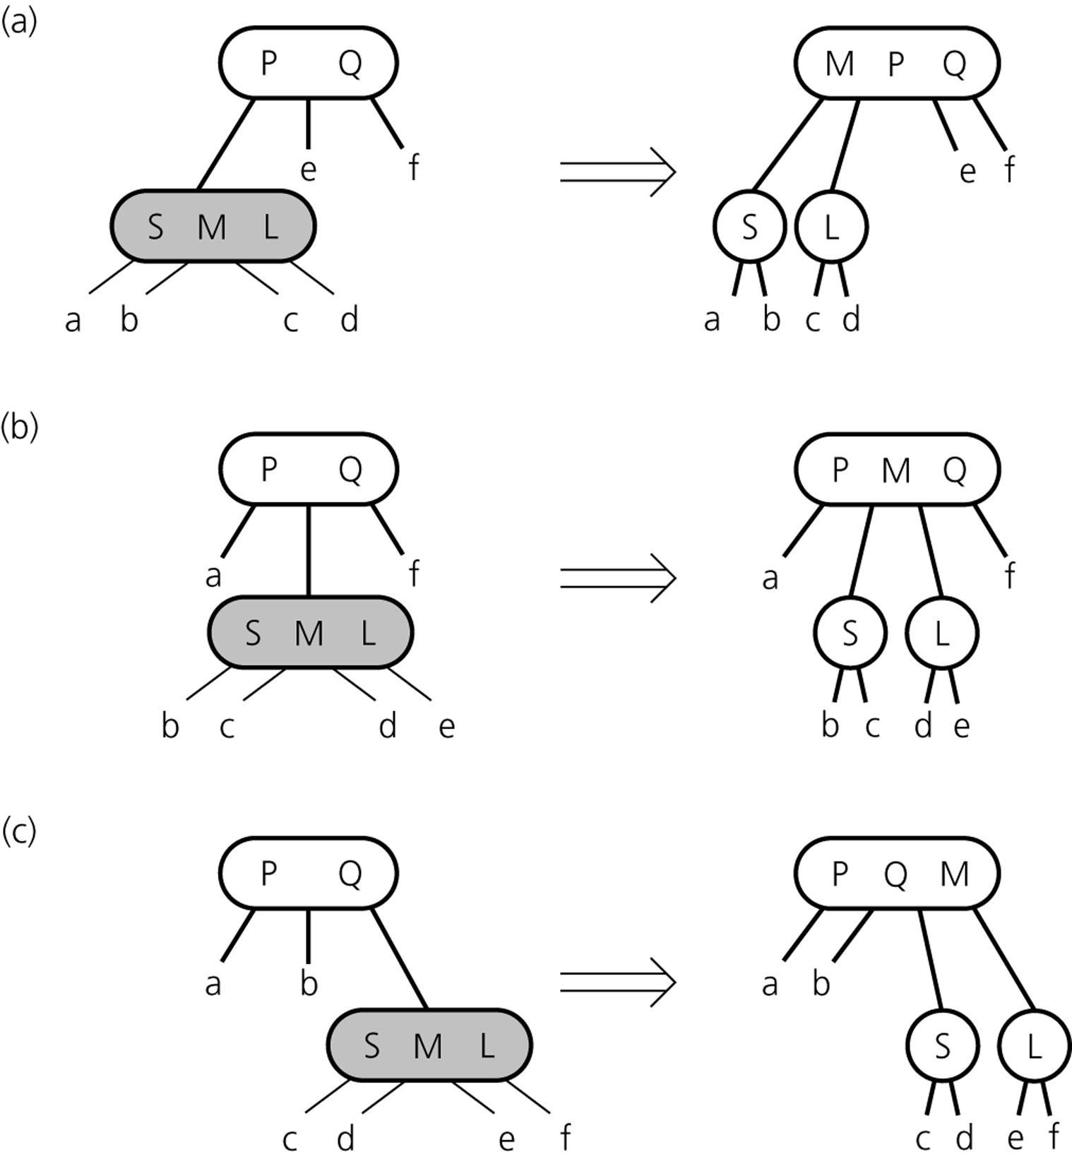
2-3-4 Tree: Insertion Procedure
Splitting a 4-node whose parent is a 3-node during insertion
CSCI 3110

Slide 59
2-3-4 Tree: Insertion Procedure
loop traverse down the tree by doing comparison until leaf is reached:
if the node encountered is a 4-node
split the node
perform comparison and traverse down the proper path
else
perform comparison and traverse down the proper path
end loop
if leaf is not a 4-node
add data into the leaf node
else
split leaf node
add new data into the proper leaf node
Note: splitting a 4-node requires 3 cases (the parent is a 2-node; a 3-node; or the 4-node is the root of the tree)
CSCI 3110

Slide 60
2-3-4 Tree: Deletion
Deletion procedure:
  similar to deletion in 2-3 trees
  items are deleted at the leafs
  → swap item of internal node with inorder successor
  note: a 2-node leaf creates a problem
Strategy (different strategies possible)
  on the way from the root down to the leaf:
  turn 2-nodes (except root) into 3-nodes
  → deletion can be done in one pass
  (remember: in 2-3 trees, a reverse pass might be necessary)
CSCI 3110

Slide 61
2-3-4 Tree: Deletion
Turning a 2-node into a 3-node ...
Case 1: an adjacent sibling has 2 or 3 items
  → "steal" item from sibling by rotating items and moving subtree
30 50
20 50
10 20
40
10
30 40
"rotation"
25
25
CSCI 3110

Slide 62
2-3-4 Tree: Deletion
Turning a 2-node into a 3-node ...
Case 2: each adjacent sibling has only one item
  → "steal" item from parent and merge node with sibling
  (note: parent has at least two items, unless it is the root)
30 50
50
10
40
10 30 40
merging
25
35
25
35
CSCI 3110

Slide 63
2-3-4 Tree: Deletion Practice
Delete 32, 35, 40, 38, 39, 37, 60
CSCI 3110

Slide 64
Red-Black Tree
binary-search-tree representation of 2-3-4 tree
3- and 4-nodes are represented by equivalent binary trees
red and black child pointers are used to distinguish between
original 2-nodes and 2-nodes that represent 3- and 4-nodes
CSCI 3110

Slide 65
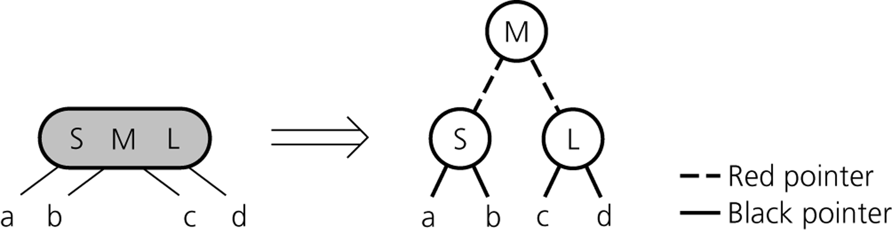
Red-Black Representation of 4-node
CSCI 3110

Slide 66
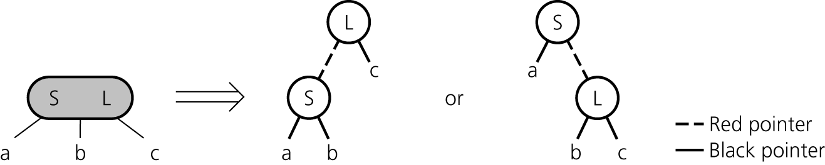
Red-Black Representation of 3-node
CSCI 3110

Slide 67
Red-Black Tree Example
CSCI 3110

Slide 68
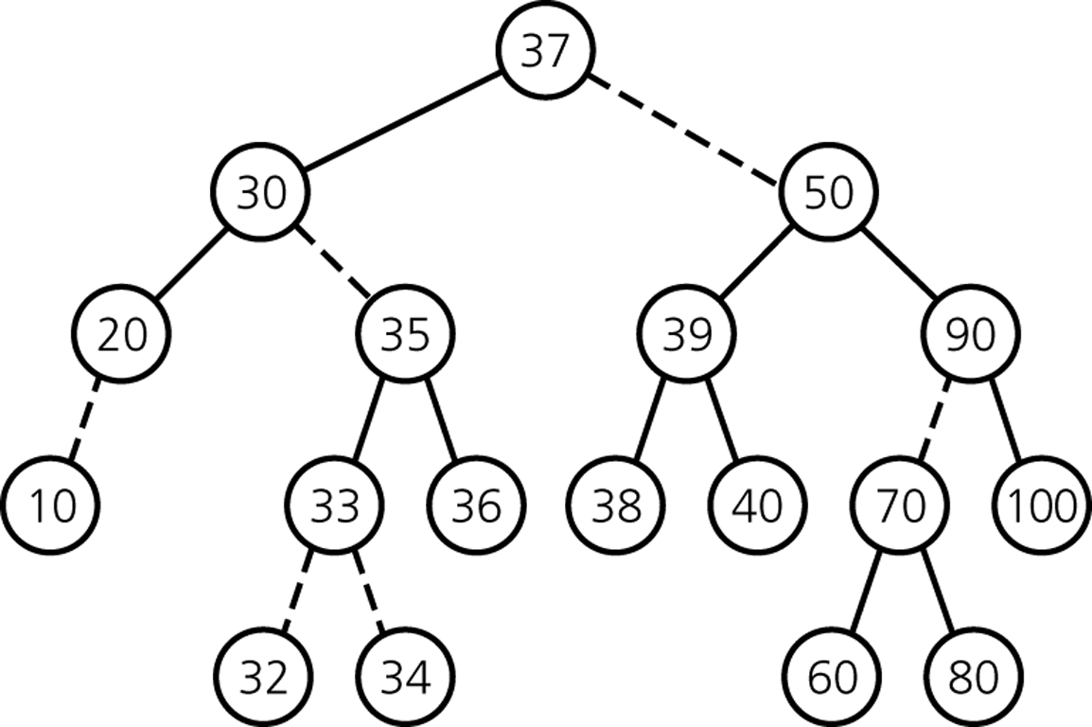
Red-Black Tree Example
CSCI 3110

Slide 69
Red-Black Tree Operations
Traversals
  same as in binary search trees
Insertion and Deletion
  analog to 2-3-4 tree
  need to split 4-nodes
  need to merge 2-nodes
CSCI 3110

Slide 70
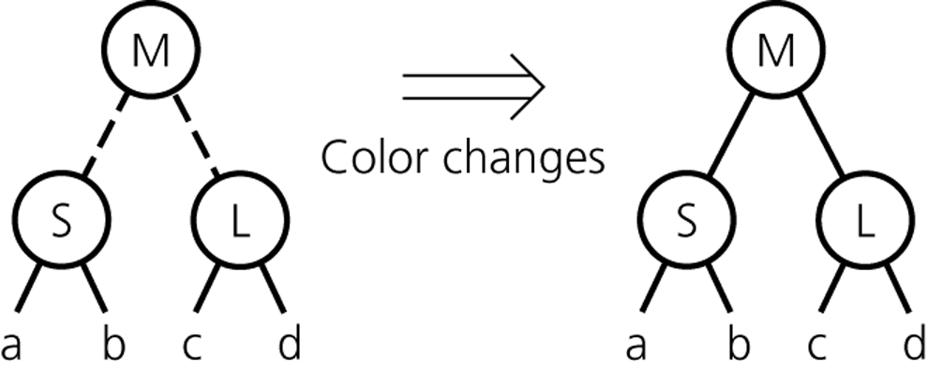
Splitting a 4-node that is a root
CSCI 3110

Slide 71
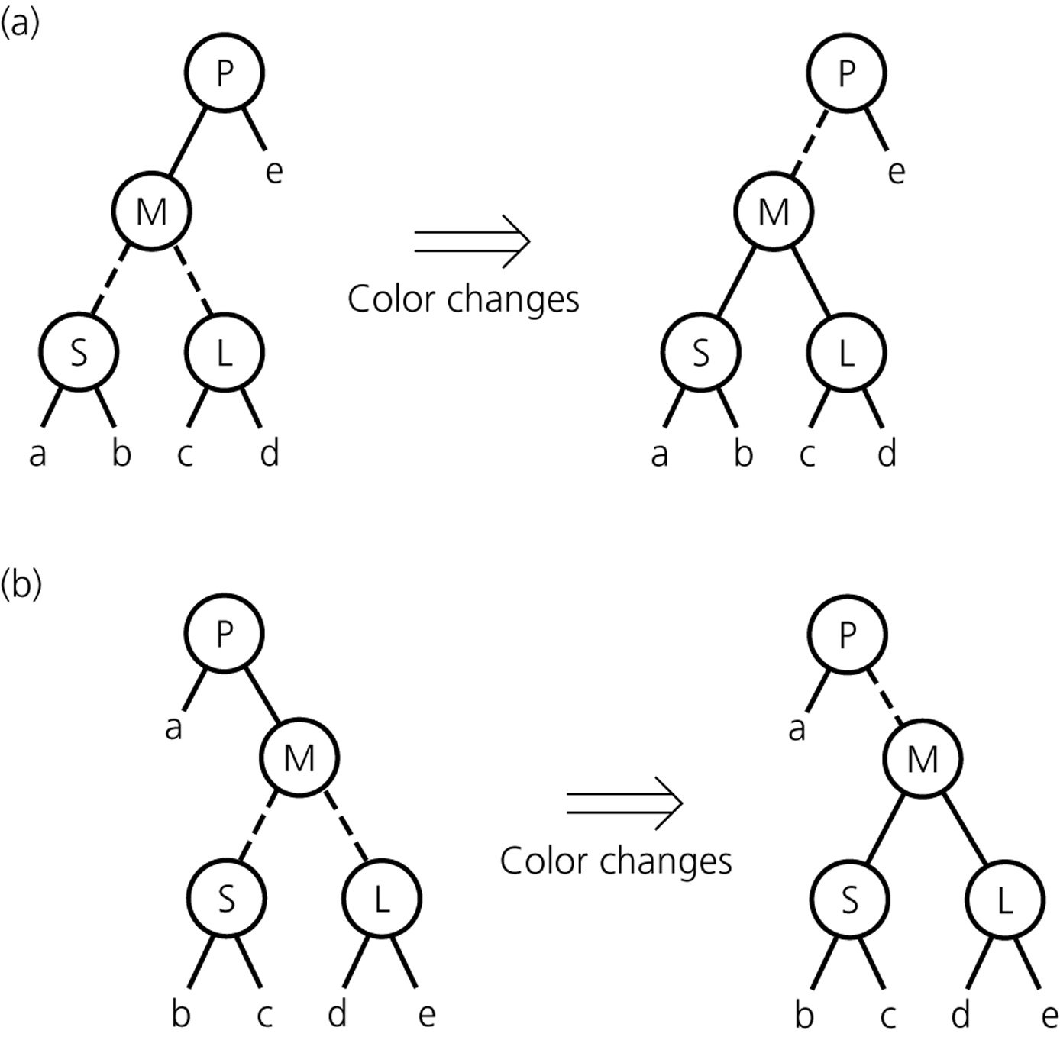
Splitting a 4-node whose parent is a 2-node
CSCI 3110

Slide 72
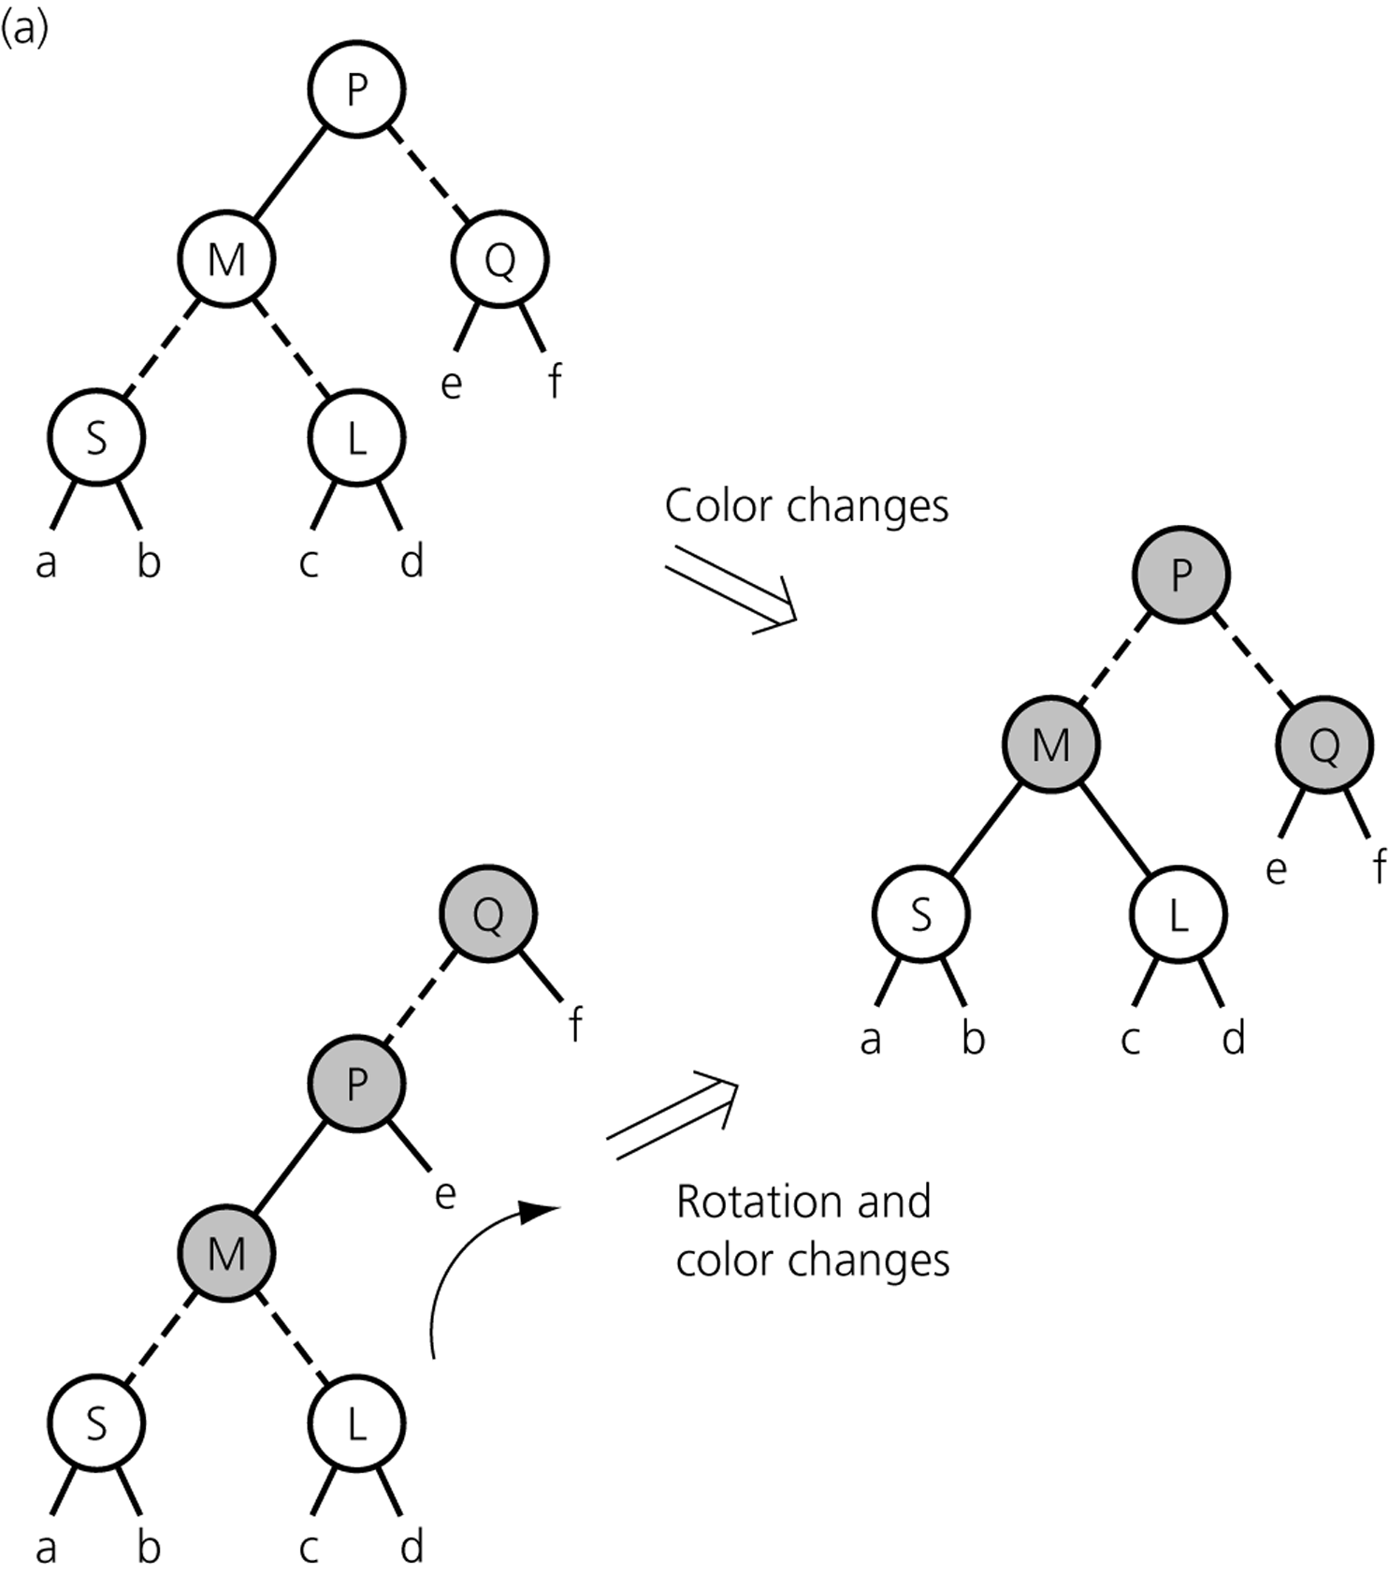
Splitting a 4-node whose parent is a 3-node
CSCI 3110

Slide 73
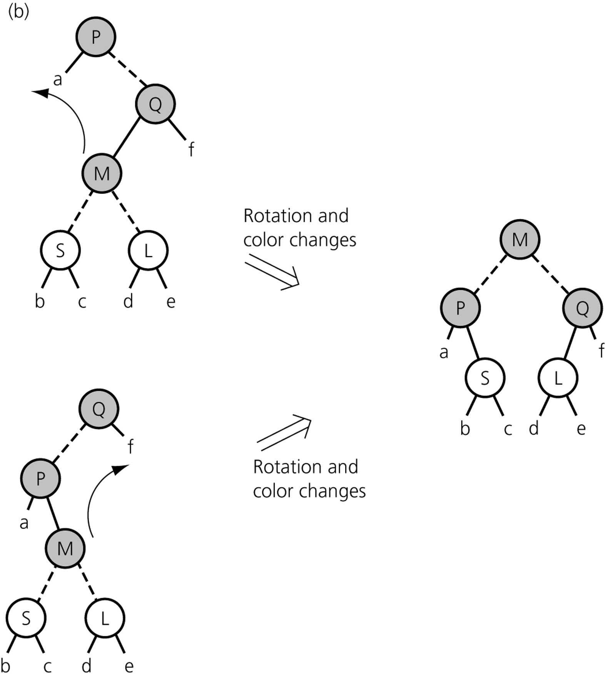
Splitting a 4-node whose parent is a 3-node
CSCI 3110

Slide 74
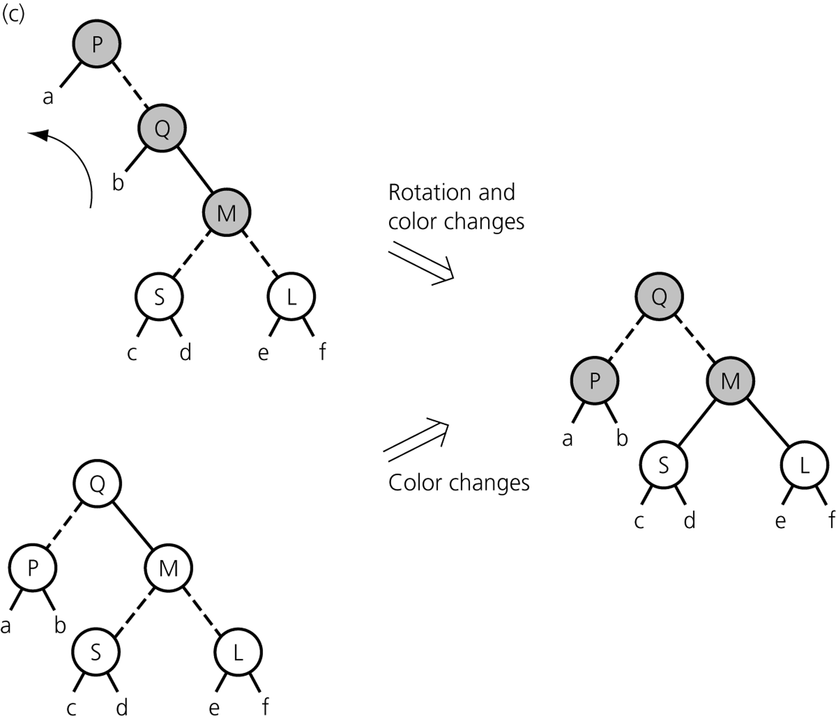
Splitting a 4-node whose parent is a 3-node
CSCI 3110

Slide 75
Insertion
Maintaining a red-black tree as new nodes are added primarily involves recoloring and rotation, as follows:
Create a new node n to hold the value to be inserted
If the tree is empty, make n the root.
Otherwise, go left or right, as with normal insertion in a binary search tree, except that if you pass through a node m with red links to both its children,
  Color those links black, and
  If m is not the root, color m’s parent link red.
At the appropriate leaf, add n as a child with a red link from its parent.
If either of the steps that adds red links creates 2 red links in a row, rotate the associated nodes to create a node with 2 red links to its children.
CSCI 3110

Slide 76
Insertion tips
To help you implement this insertion, keep the most recent 4 nodes in the path from root to leaf, i.e., a node, its parent, its grandparent, and its great-grandparent. These are easy to maintain while going down the tree.

