Slide 1
Midterm Thursday
Topics:
First Midterm
Instructions Set Architecture
Machine Language Programming
Assembly Language Programming
Traps, Subroutines, & Interrupts
Simulating / Debugging
LC-3 Instruction sheet & ASCII table will be provided

Slide 2
C Programming
Chapters 11, . . .
C – Compiler
Secure File Transfer / Terminal Tools
- SSH Tectia File Transfer
- SSH Tectia Client
Testing C Programs
- Compiling C programs
- Tracing C programs
- Tracing C program stacks

Slide 3
Getting the Compiler
Necessary if you don’t want to compile your programs on insttech or if you want to get C programs in the lcc-1.3/test folder
Go to our home page:
  http://faculty.washington.edu/lcrum/
Go to the Author’s web site:
  http://www.mhhe.com/patt2
Get the compiler:
  C to LC-3 Compiler
Some files to play with are in:
  lcc-1.3/test (you might want to copy his file to your H: drive )

Slide 4
Getting Secure File Transfer tools
Institute Lab Resources: http://css.insttech.washington.edu/~lab/
You can access C Compiler from:
  Lab: Cherry Parks 206D
  Use your H: file for storing your C programs and compilations
  Home: see Institute Lab Resources:
  how to access some resources of the labs from your home computer.
  Click on: TeraTermPro with SSH Support (or get from UWICK Disk)
  Search by title for: SSH Tectia Client
  Download it from the serve and install it.
  Open SSH Tectia Client and Click Profiles and Add Profile
  the Hostname is repos.insttech.washington.edu
  the Username is your UW login name
  To begin a session, Open SSH Tectia Client, Click Profiles, Click repos.insttech.washington.edu . Under window you can select either or both
  New Terminal or New File Transfer .

Slide 5
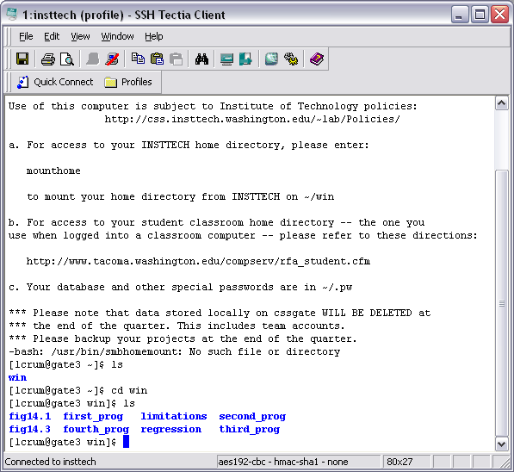
Using SSH Tectia Client

Slide 6
Using SSH Tectia Client
You are logged into a Linux machine. Some usefull commands are:
ls list files in the directory you are pointed toward
cd change directory (.. Up one level)
To run the compiler, type:
lcc filename.c
It will produce the following files:
  ASM LC-3 Assembly Program
  SYM LC-3 Symbol Table
  OBJ LC-3 Simulator Load Module

Slide 7
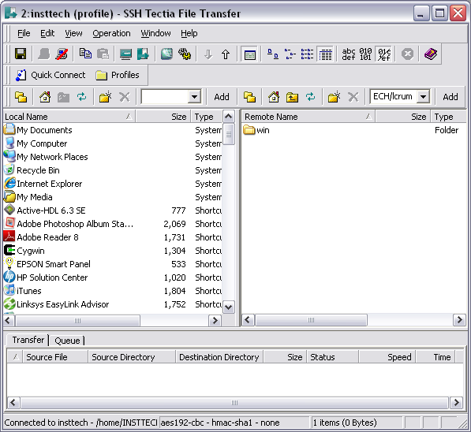
Using Tectia File Transfer

Slide 8
Using Tectia File Transfer
The left screen is you home computer files
The right screen is your H: drive
  Win is a folder in it for your files
You can moves up/down the folder hierarchy on either side
You can transfer files either way by dragging them

Slide 9
Compiling and Testing a C program
Using your Tectia File Transfer, place your C program in your win folder.
Navigate in your SSH Tectia Client, to see your C program file.
Execute the C Compiler: lcc programname.c
Transfer the resultant files back to your home machine, where you have your LC-3 simulator.
Load your OBJ file into the simulator and run it.

Slide 10
What is in the Compiler ASM file
The ASM file is organized as follows:
The raw uncommented LC-3 assembly equivalent of
your C program
- with your functions and the library functions
scanf (input)
printf (output)
The Global Data Table
- includes the literals and labels

Slide 11
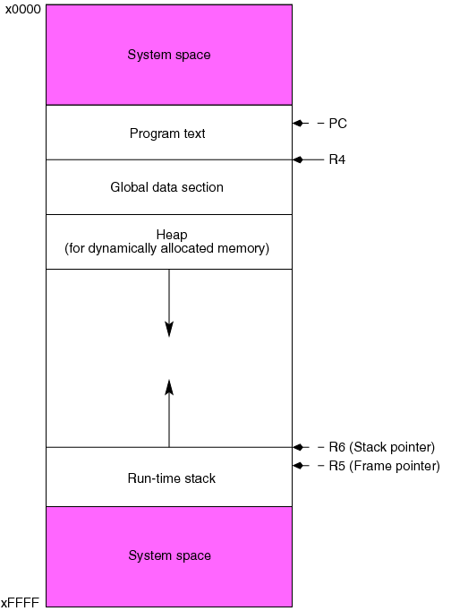
Memory map
(Global Data pointer)
I/O Devices

Slide 12
C Program
; Program to add A + B
#include <stdio.h> ; I/O Library Functions included
int main() ; C programs always begin with main
{
int A = 3; ; Declare your variables
int B = 5;
int C;
C = A + B; ; computations
; can end with a return “n”
}
Brackets specify the scope of main

Slide 13
C Program Compilation
Compile the program
Look at the files
Load them into the LC-3 simulator
Execute the program and observe its stack

