Slide 1
CS 4740/6740 Network Security
Lecture 8: Host-based Defenses
(Canaries, DEP, ASLR, CFI)

Slide 2
Stack-Based Defenses
Canaries
Data Execution Prevention (DEP)

Slide 3
Stack Overflow Defenses
Don't write vulnerable code (realistic?)
Don't use languages that aren't memory-safe, e.g. Rust (if you can)
Safer APIs – e.g., strlcpy, std::string
Shadow stacks
Stack canaries
DEP (later)

Slide 4
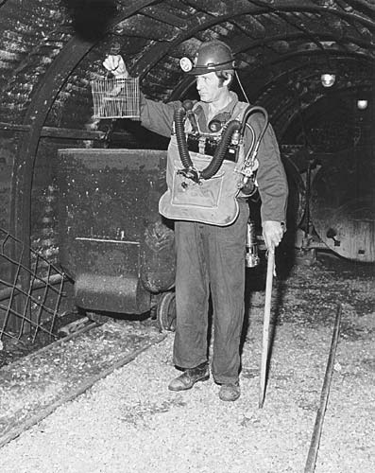
The Canary in the Coal Mine
Miners used to take canaries down into mines
The birds are very sensitive to poisonous gases
If the bird dies, it means something is very wrong!
The bird is an early warning system

Slide 5
Stack Canaries
A stack canary is an early warning system that alerts you to stack overflows
Stack
Malicious shellcode
Automatically added by the compiler
Stuff from
previous frame
Overflow destroys the canary, assert fails, program safely exits
int canary = secret_canary;
char buf[8];
for (x = 1; x < argc; ++x) {
strcpy(buf, argv[x]);
num = atoi(buf);
check_for_secret(num);
}
...
assert(canary==secret_canary);
return 0;
NOP sled
ESP - 24
return address
ESP - 20
Pointer to sled
canary value
ESP - 16
Garbage
int num
ESP - 12
int x
ESP - 8
char buf[8]
ESP

Slide 6
Canary Implementation
Canary code and data are inserted by the compiler
gcc supports canaries
Disable using the –fno-stack-protector argument
Canary secret must be random
Otherwise the attacker could guess it
Canary secret is stored on its own page at semi-random location in virtual memory
Makes it difficult to locate and read from memory

Slide 7
Canaries in Action
[cbw@finalfight game] ./guessinggame AAAAAAAAAAAAAAAAAAAAAAA
*** stack smashing detected ***: ./guessinggame terminated
Segmentation fault (core dumped)
Note: canaries do not prevent the buffer overflow
The canary prevents the overflow from being exploited

Slide 8
Stack Canaries
main:
push rbx
sub rsp, 0x110
mov rax, qword fs:0x28 ; load secret at fs:0x28
mov qword [rsp+0x108], rax ; store secret on stack
; [...]
mov rax, qword fs:0x28 ; load secret
cmp rax, qword [rsp+0x108] ; compare to stack copy
jne .bad ; if not equal, bail
xor eax, eax
add rsp, 0x110
pop rbx
ret ; everything is good?
.bad:
call __stack_chk_fail ; print a scary message

Slide 9
Stack Canaries
How to make canaries hard to guess?
Random from large domain, generated at runtime
Example of a great success story for security
One simple compiler flag
Downsides
Introduces bloat, results in worse cache behavior
Incomplete coverage in popular implementations
Can be defeated by information leaks
Notes:
-fstack-protector vs. -fstack-protector-all vs. -fstack-protector-strong
-fstack-protector: alloca, char array > size 8
-fstack-protector-all: all functions
-fstack-protector-strong: addr of local variable taken, any array, any object enclosing an array, register local variables; idea is to cover more uses of pointers to stack

Slide 10
When Canaries Fail
Stack
Canary is left intact
ESP - 1036
return address
void my_func() { ... }
int canary = secret_canary;
void (*fptr)(void);
char buf[1024];
fptr = &my_func;
strcpy(buf, argv[1]);
fptr();
assert(canary==secret_canary);
return 0;
ESP - 1032
canary value
ESP - 1028
Function pointer
fptr
Pointer to sled
ESP - 1024
char buf[1024]
Malicious shellcode
NOP sled
Calling fptr triggers the exploit
ESP

Slide 11
ProPolice Compiler
Stack
ESP - 1036
Security oriented compiler technique
Attempts to place arrays above other local variables on the stack
Integrated into gcc
return address
ESP - 1032
canary value
ESP - 1028
char buf[1024]
ESP - 4
ESP
fptr

Slide 12
When ProPolice Fails
void my_func() { ... }
struct my_stuff {
void (*fptr)(void);
char buf[1024];
};
int canary = secret_canary;
struct my_stuff stuff;
stuff.fptr = &my_func;
strcpy(stuff.buf, argv[1]);
stuff.fptr();
assert(canary==secret_canary);
return 0;
The C specification states that the fields of a struct cannot be reordered by the compiler

Slide 13
Data Execution Prevention (DEP)
Problem: compiler techniques cannot prevent all stack-based exploits
Key insight: many exploits require placing code in the stack and executing it
Code doesn’t typically go on stack pages
Solution: make stack pages non-executable
Originally implemented by PaX on Linux
Closely followed by W^X on OpenBSD
Modern implementations rely on hardware support
e.g., NX bit on page table entries
Or, fine-grain memory tags

Slide 14
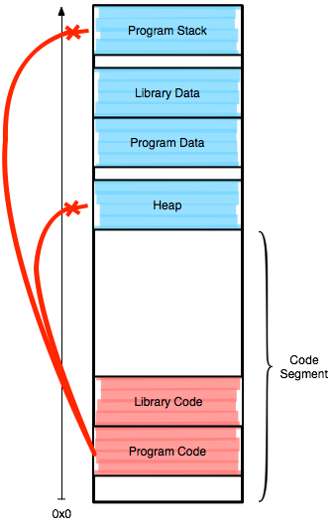
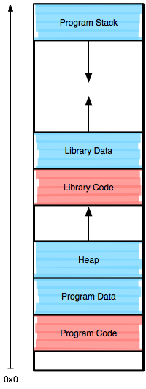
W^X (Segmentation)
Original W^X implementation used segmentation to prevent data execution
Code, data segments clustered together
Code segment limit set below base offset of data segments
Effective, at mitigating some exploits, but there is a price
Reduces available memory
Notes:
Any downsides to this approach?
It's slow, reduces available memory

Slide 15
x86 Page Table Entry
On x86, page table entries (PTE) are 4 bytes
31 - 12 | 11 - 9 | 8 | 7 | 6 | 5 | 4 | 3 | 2 | 1 | 0
Page Frame Number (PFN) | Unused | G | PAT | D | A | PCD | PWT | U/S | W | P
W bit determines writeable status
… but there is no bit for executable/non-executable
On x86-64, the most significant bit of each PTE (bit 63) determines if a page is executable
AMD calls it the NX bit: No-eXecute
Intel calls it the XD bit: eXecute Disable

Slide 16
When NX bits Fail
NX prevents shellcode from being placed on the stack
NX must be enabled by the process
NX must be supported by the OS
Can exploit writers get around NX?
Of course ;)
Return-to-libc
Return-oriented programming (ROP)

Slide 17
Data Exploits and Countermeasures
Return-to-libc
Return Oriented Programing (ROP)
Address Space Layout Randomization (ASLR)
Control Flow Integrity (CFI)

Slide 18
Return to libc
“/bin/sh”
char ** argv
0
Parameters for a call to execvp()
char * file
Ptr to string
Fake return addr
return address
0x007F0A82
Current stack
frame
Example exploits thus far have leveraged code injection
Why not use code that is already available in the process?
execvp(char * file, char ** argv);
ESP
libc Library
execvp()
0x007F0A82
EIP
0x007F0000

Slide 19
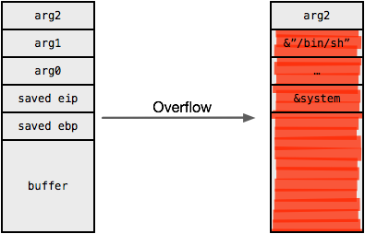
Return-into-libc

Slide 20
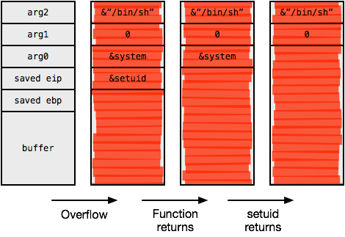
Return-into-libc
Notes:
Can also chain function invocations

Slide 21
Stack Control = Program Control
Return to libc works by crafting special stack frames and using existing library code
No need to inject code, just data onto the stack
Return-oriented programming (ROP) is a generalization of return to libc
Why only jump to existing functions?
You can jump to code anywhere in the program
Gadgets are snippets of assembly that form a Turing complete language
Gadgets + control of the stack = arbitrary code execution power

Slide 22
ROP
Return-oriented programming (ROP) extends return-into-libc by changing the granularity of code reuse
Introduced by Shacham in 2007
Shown to be Turing complete
Instead of returning to functions, ROP uses gadgets
Gadgets: small sequences of instructions ending in a control transfer – e.g., a return
Each gadget performs a small update to the program state
Execution becomes a chain of returns to gadgets

Slide 23
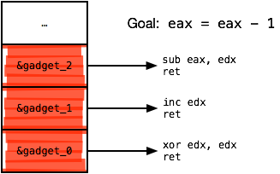
ROP Gadgets
Stack

Slide 24
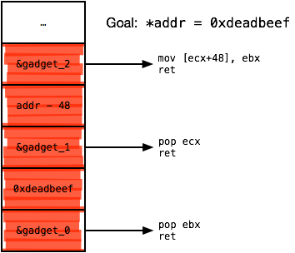
ROP Gadgets

Slide 25
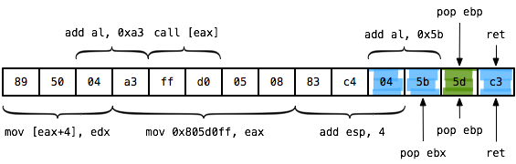
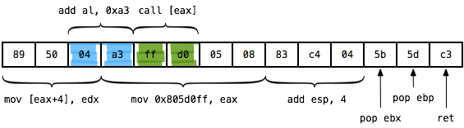
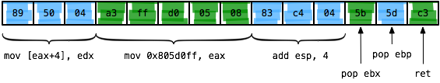
Finding Gadgets
Gadgets are found by scanning memory for desirable instruction sequences
Because x86(-64) has variable-length instructions, unintended instruction sequences are also possible

Slide 26
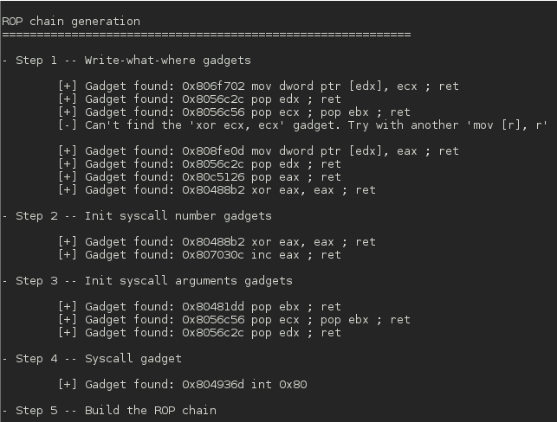
ROP Compilers
There are several automated tools that will:
Locate gadgets in a target binary
Use them to construct a desired exploit payload
Example: ROPgadget from Jonathan Salwan (Shell-Storm)

Slide 27
ROP
Works against virtually any architecture, not just x86
Useful in many situations
Non-executable memory, signed code enforcement
When combined with memory disclosures, ROP is very difficult to defend against
Extremely active area of research

Slide 28
Defending Against ROP
Virtual Memory
Return-to-libc and ROP work by repeatedly returning to known pieces of code
This assumes the attacker knows the addresses of the code in memory
Key idea: place code and data at random places in memory
Address Space Layout Randomization (ASLR)
Supported by all modern OSes
2⁶⁴-1
Stack Region
Stack
Stack
Stack
Heap Region
Heap
Heap
Heap
Code Region
Code
Code
Code
0

Slide 29
Randomizing Code Placement
Virtual Memory
2⁶⁴-1
It’s okay for stack and heap to be placed randomly
Example: stack is accessed relative to RSP
Problem: code is typically compiled assuming a fixed load address
Process 2
Addr of foo(): 0x0DEB49A3
Process 1
Addr of foo(): 0x000FE4D8
0

Slide 30
Position Independent Code Example
Modern compilers can produce Position Independent Code (PIC)
Also called Position Independent Executable (PIE)
e8 is the opcode for a relative function call
Address is calculated as EIP + given value
Example: 0x4004cc + 0xffffffe8 = 0x4004b4
004004b4 <func>:
004004bf <main>:
4004bf: 55 push ebp
4004c0: 48 89 e5 mov ebp, esp
4004c3: 48 83 ec 10 sub esp, 0x10
4004c7: e8 e8 ff ff ff call 4004b4 <func>
4004cc: 89 45 fc mov [ebp-0x4], eax
4004cf: c7 05 3f 0b 20 00 10 mov [eip+0x200b3f], 0x10
4004d6: 00 00 00
4004d9: b8 00 00 00 00 mov eax, 0x0
4004de: c9 leave
4004df: c3 ret
int global_var = 20;
int func() { return 30; }
int main() {
int x = func();
global_var = 10;
return 0;
}
Global data is accessed relative to EIP

Slide 31
Tradeoffs with PIC/PIE
Pro
Enables the OS to place the code and data segments at a random place in memory (ASLR)
Con
Code is slightly less efficient
Some addresses must be calculated
In general, the security benefits of ASLR far outweigh the cost

Slide 32
ASLR
Lightweight and effective defense
No program recompilation required (in most cases)
Transparent to benign applications
Little overhead
When to randomize?
At process creation?
Or, periodically – e.g., after every process fork?

Slide 33
Security of ALSR
Let's call an attempted attack with randomization guess x a probe
If x is correct, the attack succeeds; if not, it fails
Assume a 32 bit architecture and uniform probe distribution
Scenarios
Address spaces are randomized once
Address spaces are randomized after each probe
What is the expected number of trials required to perform a successful attack in each scenario?

Slide 34

No Re-Randomization
Flashback to intro to probability
Imagine that each probe is a ball in a bin; in total, there are 2¹⁶ balls
Without re-randomization, a probe is equivalent to drawing a ball without replacement
With re-randomization, a probe is equivalent to drawing a ball with replacement

Slide 35
No Re-Randomization
Probability of success on the n^{th} trial
Success
Failures

Slide 36
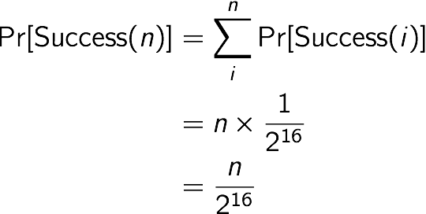
No-Rerandomization
Probability of success by the n^{th} trial

Slide 37
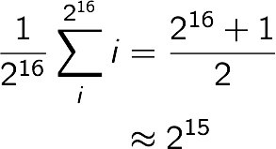
No Re-Randomization
What is the expected number of trials until a successful probe?

Slide 38
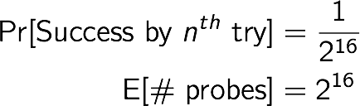
Re-Randomization
How about with re-randomization?
Re-randomization only gives 1 more bit of security

Slide 39
ASLR Circumvention
Lots of guesses (but this is inefficient)
Memory disclosures
Typically the target executable and libraries are known
If an address of known code or data is leaked, it's simple to recover the image base
Spraying (heap, JIT)
Exploit any remaining fixed structures – e.g., the PLT

Slide 40
More Randomization
How about another artificial diversity defense?
What if the attacker is allowed to:
Hijack control flow
Inject a payload
Locate and jump to the payload
...but, cannot reliably execute the payload?
The attacker also assumes the target uses a particular instruction set architecture
e.g., injecting an ARM payload won't work on x86_64

Slide 41
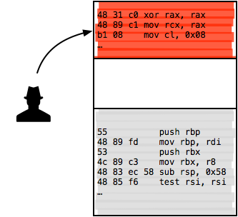
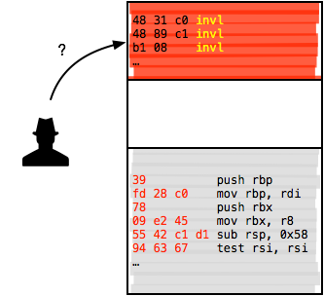
Instruction Set Randomization
Attacker injects a payload and hijacks control flow
ISR "periodically" changes the bit representation of instructions
With sufficient entropy, attacks become very difficult
Another example of introducing a work factor

Slide 42
ISR Discussion
Fine-grain approach to artificial diversity
Requires a large degree of support from underlying software and hardware
How to efficiently execute randomized code?
Implementation approaches
Virtual machines (e.g., JVM)
Or, hardware support
Deemed not worth the cost to implement and deploy so far

Slide 43
Control Flow Integrity (CFI)
Let's move on from randomization to fine-grained policy enforcement
Control-flow integrity (CFI)
Extract all possible control flow transfers from a program
Enforce that only those transfers can occur during execution
Notes:
One example of long line of work on preventing control-flow hijacking: Program shepherding, PCC, TAL

Slide 44
CFG
A program's control-flow graph (CFG) is an abstraction of all possible control-flow transfers that can be made when executing a program
Directed graph where nodes represent basic blocks and edges represent jumps/calls/returns
Basic blocks are contiguous sets of instructions that must execute sequentially
No jumps out of a basic block except at the end
No jumps into the middle of a basic block

Slide 45
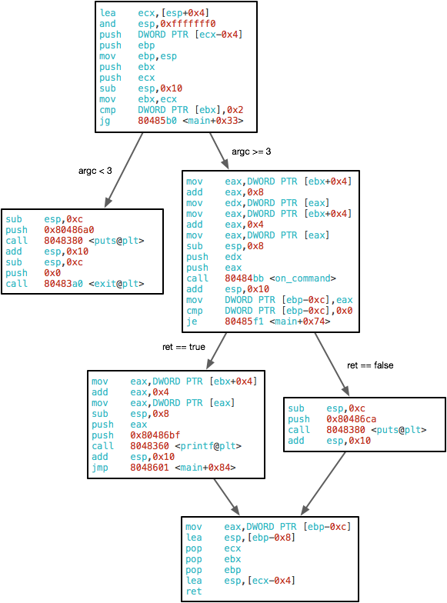
Example CFG
int main(int argc, char** argv) {
if (argc < 3) {
exit(0);
}
int ret = on_cmd(argv[1], argv[2]);
if (ret) {
printf("ERROR: %s\n", argv[1]);
} else {
printf("OK\n");
}
return ret;
}
Notes:
Intraprocedural CFG
Do calls end basic blocks?
Why is there no out-edge from the left child of the entry block?

Slide 46
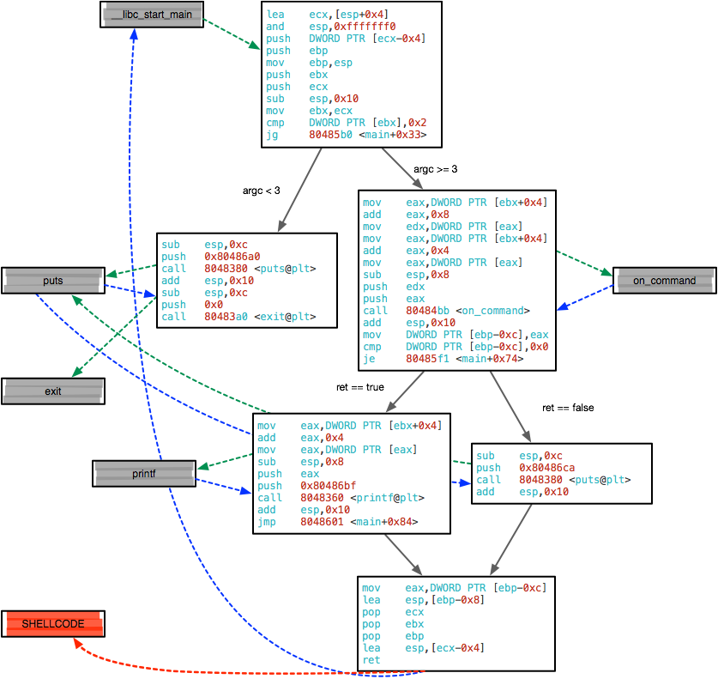
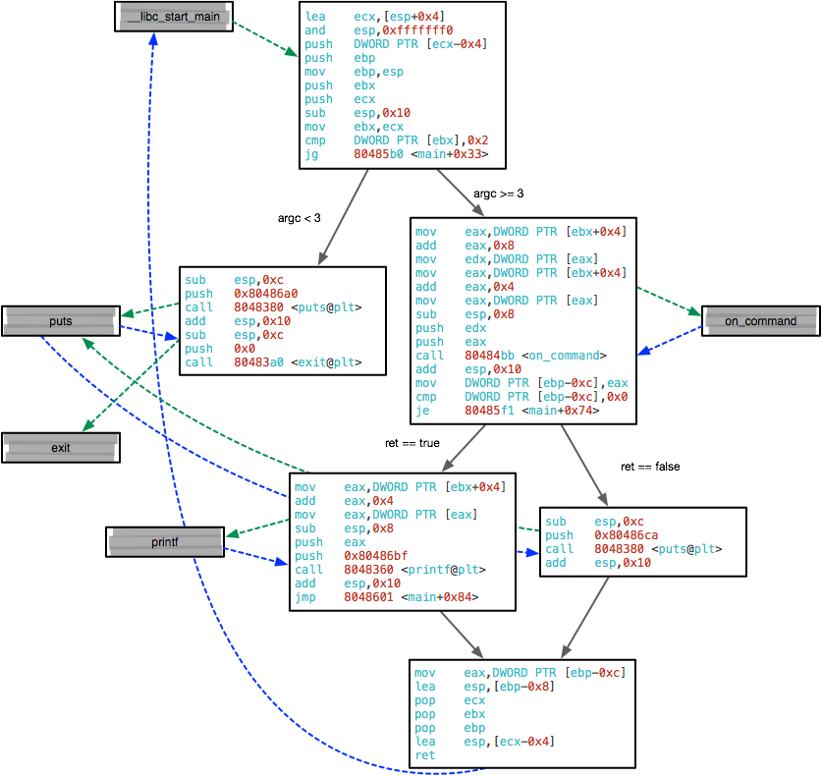
sCFG
Notes:
Super control-flow graph superimposes inter-procedural call graph on intra-procedural control-flow graphs for each function

Slide 47
CFI Implementation
Many ways to implement CFI
Original idea: static binary analysis and rewriting
Extract a CFG from a binary program
Add runtime checks on destinations of control-flow transfers
Program terminated if a check fails

Slide 48
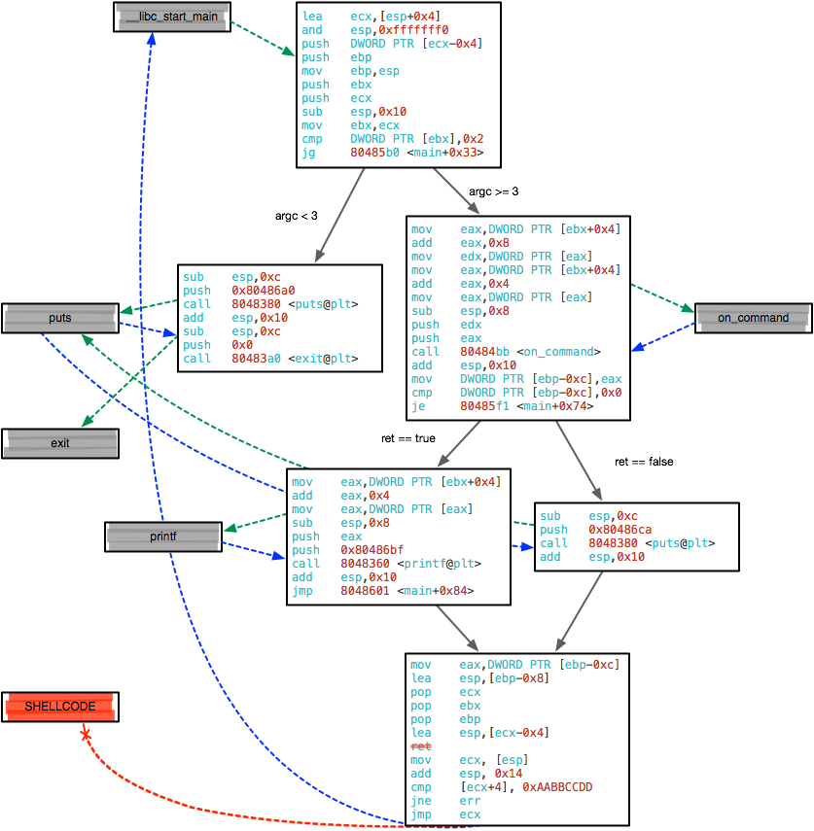
CFI Enforcement
Return label
check
Notes:
Check to see if the return address is correct
Works in this case because main() is only called by __libc_start_main(), thus there is only one correct return address
This simple check doesn’t work for foo() if foo() is called by bar() and bar2()

Slide 49
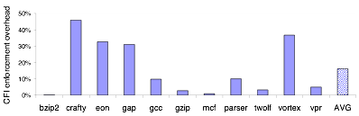
CFI Overhead
CFI labeled transition enforcement overhead on SPEC2000

Slide 50
CFI Discussion
Why is this better than, e.g., DEP or ASLR?
Overhead is significant
Much work on more efficient, but weaker, implementations
Can you always extract an accurate CFG?
Is it sound?
Is it a tight approximation?
Still vulnerable to mimicry attacks
What if adversary can implement an attack within the enforced CFG?
Notes:
Sound in the sense that all possible transfers are represented? Indirect jumps pose a problem here.
Is your analysis imprecise in that too many invalid transfers are allowed?

Slide 51
CFI Mimicry Attack
int exec_prog(char* path) {
char buf[1024];
strcpy(buf, path);
return system(buf);
}
Assuming CFI is enforced, can the attacker perform a stack-smashing attack?
What can the attacker do instead?
Overflow buf, perform a return-to-libc attack that directs to system()
The CFI enforcer expects exec_prog() to call system()
Thus, the attack succeeds ;)

Slide 52
Sources
Many slides courtesy of Wil Robertson: https://wkr.io
ROPgadget.py: http://shell-storm.org/project/ROPgadget/

