Slide 1
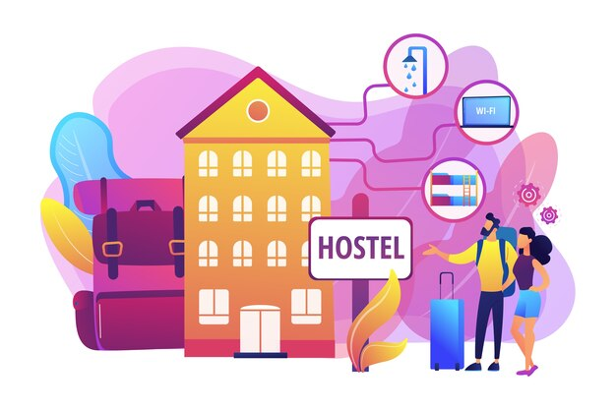
Stay-Easy | Stay safe and comfortable
EarthLogicware Technologies

Slide 2

01
Introduction

Slide 3
Introduction
A Stay-Easy is a comprehensive software solution designed to streamline and automate the administrative and operational tasks associated with managing a hostel. This system enables hostel administrators to efficiently handle various functions such as student registration, room allocation, fee collection, and guest management. It also facilitates the tracking of student movements through gate pass issuance, ensuring enhanced security. The system maintains detailed records of students, rooms, transactions, and other relevant data, allowing for easy retrieval and reporting. By integrating these diverse functionalities into a single platform, the Stay-Easy reduces manual effort, minimizes errors, and enhances overall efficiency, thereby providing a better living and learning environment for students.

Slide 4
02
Data Flow Diagram

Slide 5
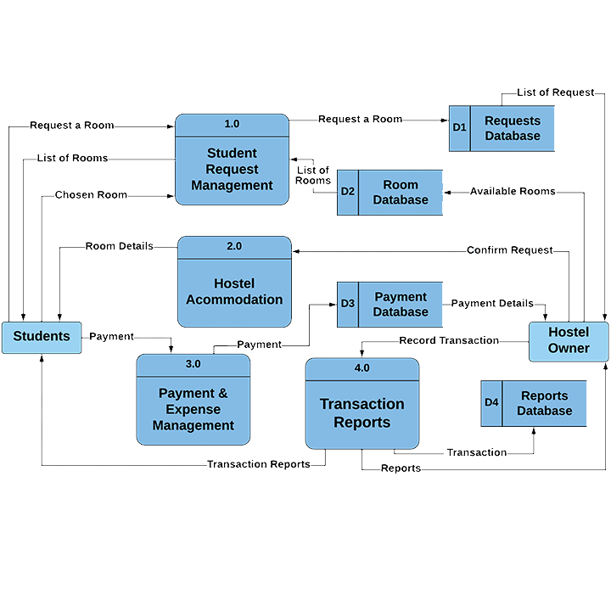


Slide 6
03
Benifits

Slide 7
Centralized Management: Consolidates all hostel operations into a single platform, making it easier to manage various functions from one place.
Real-time Updates: Provides instant updates on room availability, maintenance requests, and other critical information, enabling timely decision-making.
Automated Processes: Streamlines tasks like room allocation, check-ins/check-outs, and payment processing, reducing manual effort and errors.
Self-service Portal: Enables residents to request services, lodge complaints, and track their status online.
Automated Billing: Generates invoices and receipts automatically, reducing manual work and ensuring accuracy.
Financial Reporting: Provides detailed financial reports and analytics, helping in budget planning and financial management.

Slide 8
Efficient Room Allocation: Optimizes room allocation based on availability, gender, and other criteria, ensuring maximum occupancy.
Access Control: Implements robust access control mechanisms, ensuring only authorized individuals can enter the hostel premises.
Visitor Management: Tracks and manages visitor information, enhancing security and accountability.
Compliance and Reporting: Helps in maintaining compliance with regulatory requirements and generating necessary reports.
Customizable Features: Offers customizable features to meet the specific needs of different hostels, providing flexibility and adaptability.
Feedback Mechanism: Allows students to provide feedback, helping in improving services and addressing issues promptly.

Slide 9
Educational Institutions: Enhances student satisfaction and retention by providing a comfortable and well-managed living environment.
Parents and Guardians: Provides peace of mind by ensuring the safety and well-being of students through robust security measures and efficient management.

Slide 10
04
Security

Slide 11
Visitor Management: Keeping a digital log of visitors, including their identification and purpose of visit, ensuring that only authorized guests are allowed entry.
Secure Network Configuration: Ensuring the hostel’s network is configured securely, with strong passwords, encryption, and segmentation of networks to limit access to critical systems.
Remote Access: Using Virtual Private Networks for secure remote access by administrators or staff, ensuring data privacy and security.
Hostel Operators: Reduces the risk of theft, unauthorized access, and data breaches, thereby protecting the reputation and operational integrity of the hostel.
Parents and Guardians: Provides assurance that their wards are in a secure environment with robust measures in place to protect their safety and privacy.

Slide 12
Thanks!

